Slide 1
Pistol DDS
Peer-to-peer development framework
Notes:
Introducing Pistol DDS peer-to-peer development framework. Pistol makes building p2p apps simple.

Slide 2
Client/service side only
Security
Redundancy
Flexibility
Censorship resistance
1
2
3
4
5

Slide 3
Client-Side
Development
1
No Server/DB code
Html/CSS/Javascript
NodeJS services
React/NextJS/Vue...

Slide 4
Client-Side
Development
1
Faster dev time
Easier E2E testing
Less troubleshooting
Easier deploy
Lower cost

Slide 5

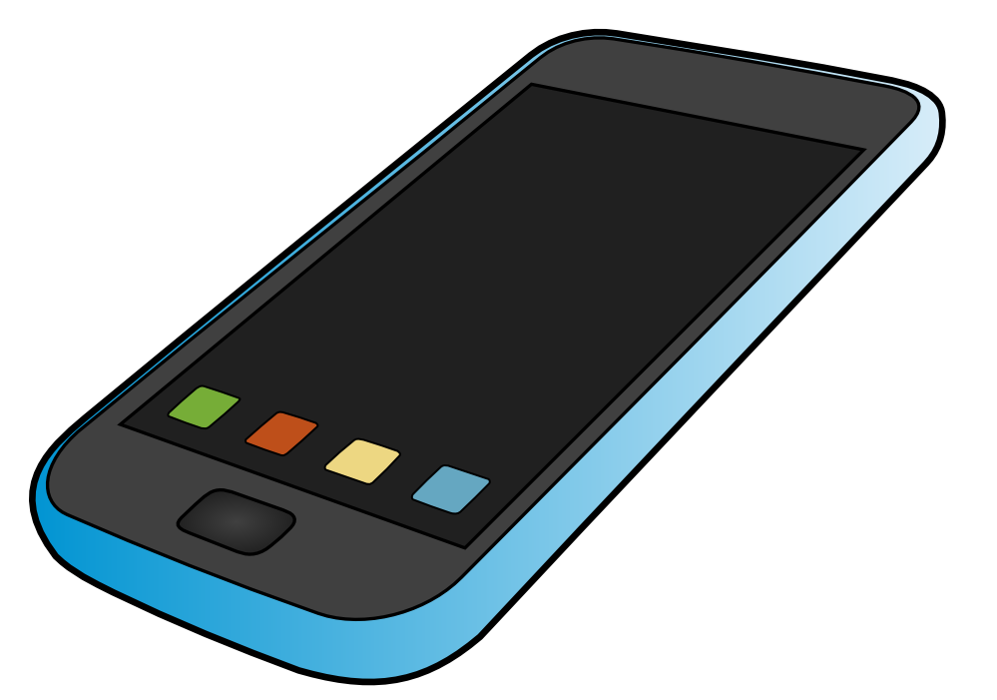
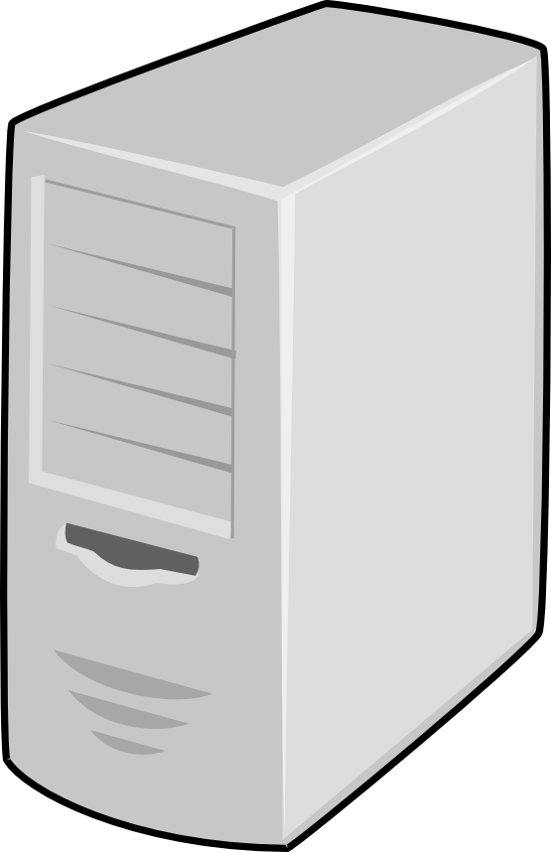
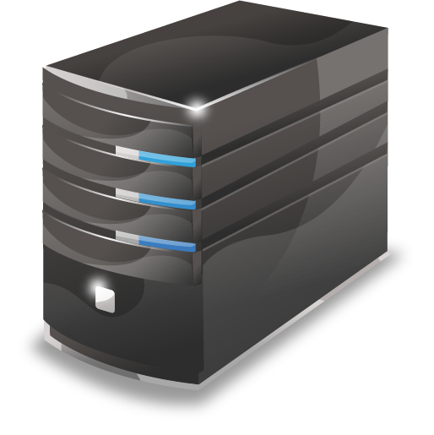
Everything is a peer

Slide 6
Security
If everything is a peer, how do you keep data secure?
2

Slide 7


Owner write
Public read
Only owner read/write
Public
Write-only
Cryptographic signature verification
Encryption
&
Signature
No verification
Hash verify

Slide 8
Redundancy
2

Slide 9
User 1
User 1
Who has
User 1
I do
User 1

Slide 10
User 1
User 1
I do
I do
Node1
Who has
User 1
User 1
User 1
c

Slide 11
Flexibility
3

Slide 12

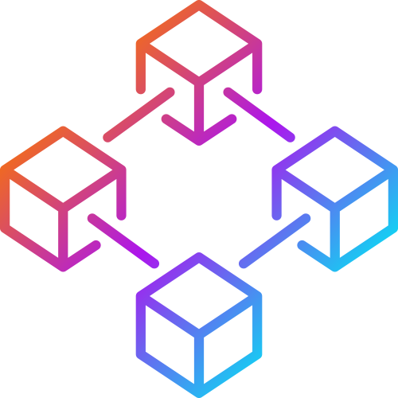
Dual Service
Gateway
Blockchain Gateway
Traditional REST/RPC
And many others...

Slide 13
Censorship resistance
c
c
c

Slide 14
Ease of development
Create apps faster/cheaper
You control
Supports many different configurations to fit your needs and amount of control that you need
Censorship resistance
Nobody controls the data in your app but you
Built in redundancy
Data is stored in multiple locations automatically

Slide 15
Thank you
To get started follow the instructions in the “Getting Started” menu to install the Pistol DDS starter kit.

