Slide 1
The Technology Value Stream
Scott Cacal . 1/12/2025 . CSD 380 . Module 1.2

Slide 2
Table of Contents
Introduction
Technology Value Stream
Lead Times
Setup for Success
Example
Conclusion
References

Slide 3
Introduction What does “The Technology Value Stream” relate to?
We can relate it to DevOps (Development Operations), a methodology comprised of trusted development and management principles originally from the world of manufacturing and has been applied to IT.

Slide 4

The Technology Value Stream
It was mentioned previously that DevOps inspired by the successes of manufacturing such as the Lean Movement. Courtesy of the Toyota production system. A respect for manufacturing lead time to finished consumer goods of the best quality, providing both customer and employee satisfaction. The best way to then achieve shorter (better) lead times was by ensuring what produced was smaller and “manageable”.

Slide 5
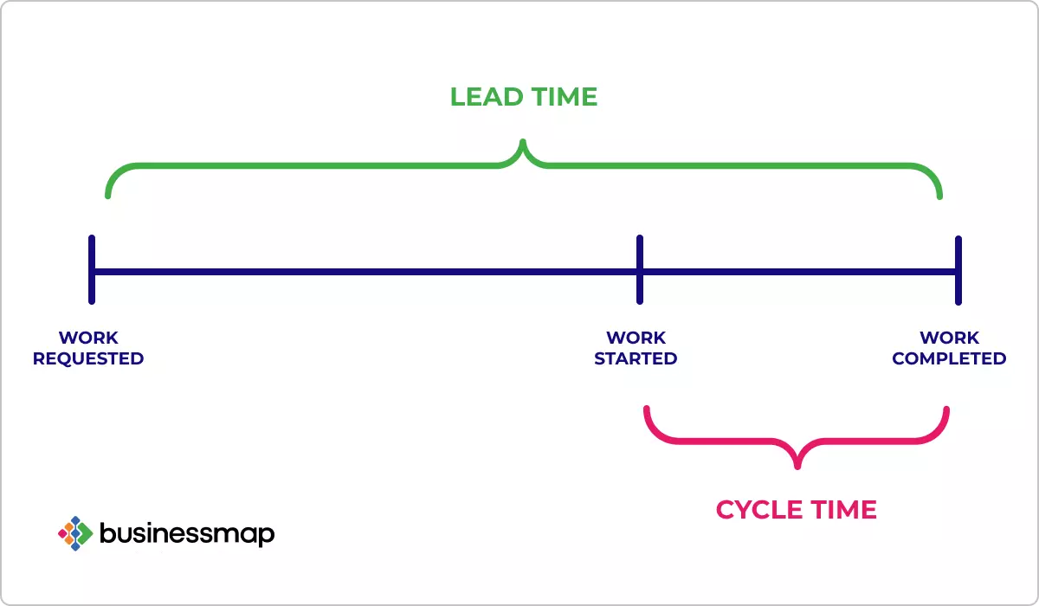
Lead Times
We have thrown around the term “Lead Time” a bit, it’s important we understand it as it is what the customer (i.e. anyobody with business expectation deliverables) experiences with respect to time therefore it garners the most attention when a need for improvement arises.
Fig. 1 . Linear explanation of lead time from:
Naydenov Pavel . “Cycle Time vs. Lead Time: Differences You Need to Know” https://businessmap.io/kanban-resources/kanban-software/kanban-lead-cycle-time . Accessed 11 Jan. 2025 . Businessmap
Above is an image very similar to that from, The DevOps Handbook, that demonstrates that the lead time is measured by the start of when work is requested to when it is completed and in between is a cycle time (process time) which is generally what us a individual contributors may experience.

Slide 6
Set up for Success
There are two areas of discussion from, The DevOps Handbooks, that address the least ideal to most ideal situations that we can derive how we can setup for success
(Not-Ideal) Deployment Lead Times Requiring Months – We’ve noticed some gaps between customer request, work started, and work completion. Addressing these gaps such as managing the request and what we’ll discuss in the next point can be a contributors to successful deployments and shorter lead times
(Ideal) Deployment Lead Times of Minutes – Cycle times are short and iterative, this is ideal for individual contributors and is represented in a lot of current processes such as Agile. This needs to be managed by establishing “smaller” achievable tasks.

Slide 7
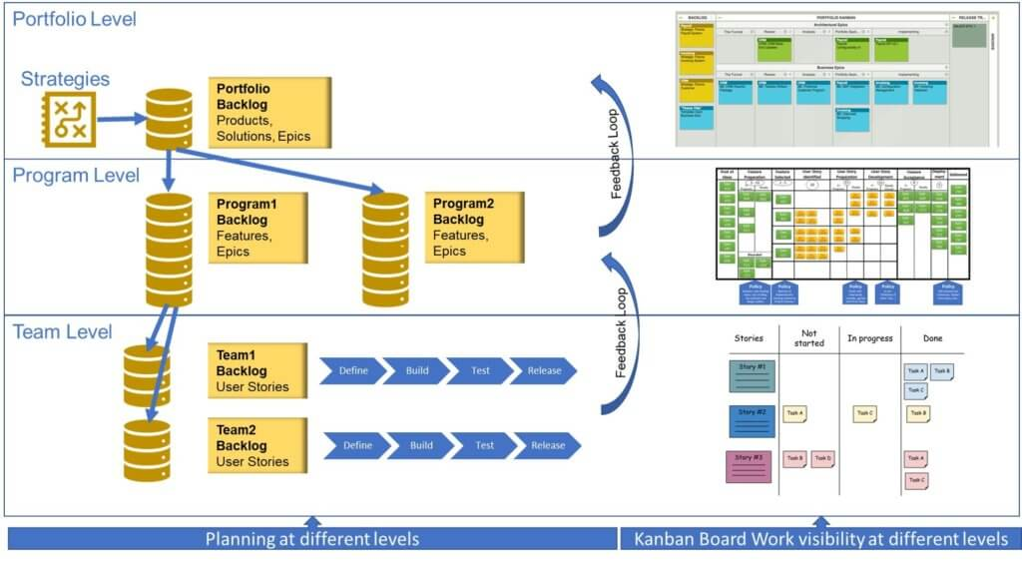
Example
To the right is a nice graphical example of how successful value stream can be established. We can see how a backlog of programs are distributed and how the work is executed at the team level. Most importantly reevaluation.
Fig. 2 . Lean methodology
Prakash, Satyan . “DevOps Institute” https://www.devopsinstitute.com/value-stream-management-explained-in-plain-english/ . Accessed 11 Jan. 2025 . DevOps Institute

Slide 8

Conclusion
Organizational success can be obtained but it takes respect from all business units, from those allocating the work to those who are hands on striving to produce a quality product, in order to achieve that.

Slide 9
References
Kim, Gene; Humble, Jez; Debois, Patrick; Willis, John; Forsgren, Nicole . The DevOps Handbook . IT Revolution Press, LLC . 2021 . e-book
Naydenov Pavel . “Cycle Time vs. Lead Time: Differences You Need to Know” https://businessmap.io/kanban-resources/kanban-software/kanban-lead-cycle-time . Accessed 11 Jan. 2025 . Businessmap
Prakash, Satyan . “DevOps Institute” https://www.devopsinstitute.com/value-stream-management-explained-in-plain-english/ . Accessed 11 Jan. 2025 . DevOps Institute

