Slide 1
Pager Rotation Duties – How It Relates to DevOps
Scott Cacal
2.16.2025
CSD 380
Module 7.2

Slide 2
Agenda
Introduction
Benefits
Who Offer Support
Schedule
Final Takeaways

Slide 3
Introduction
The resource below suggest that on-call doctors are a necessity to support medical emergencies around the clock, similarly although an extreme comparison is that the need for around the clock software support is needed as well.
The goal of DevOps is to implements a continuous feed-back loop of support to improve development and operations.
Pager rotation duties align with this methodology as support is continuous and the metrics uncovered by the on-call engineers can be beneficial to developers and better operations and most importantly, improve user experience.

Slide 4
What are the Benefits?
Increase accountability in handling issues
Issues are handled as they come - immediately
Elimination of the time it may typically take to find support
The timely handling of issues improves other areas
A decrease in downtime
Improved User Experiences
Data from 2022, it was estimated that downtimes can cost business up to $700 billion (a loss). Hence, the need for continuous operation and therefore support is imperative.

Slide 5

Who offers the support?
In the past operation and maintenance was handed over to engineers – not the developers which caused a delay in offering or providing the appropriate support to issues. On-call engineers is derived from developers wanting and needing to provide quality support to their products. In addition, some of these roles may be engineers who design and maintain tools intended to improve the operation of applications.

Slide 6
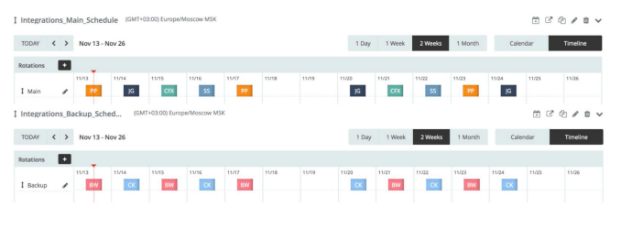
On-call Schedule
An on-call schedule can be used to help scale a company’s growth. An initial schedule may require adjustment, understanding of failures and what time zones need to be heavily support needs to be established, and by doing so placing the appropriate specialist followed by their support (if they are busy or off) can be thoughtfully structured. Below is an example of a primary responder's schedule and back of up if an expert is not readily available.
“Scaling On-Call in a DevOps Organization” https://pages.eml.atlassian.com/rs/594-ATC-127/images/Whitepaper-Scaling-On-Call-Dev-Ops-Organization.pdf . Accessed 16 Feb. 2025 . Opsgenie

Slide 7
Final takeaways
Seek feedback
Reflect on performance
Explore new techniques
Set personal goals
Iterate and adapt
As pager rotation duties are intended to ensure continuous operation and continuous feedback to DevOps. The structure of a pager rotation requires the same level of attention in order to offer the best quality support to software and users.

Slide 8
References
Nizami, Myra . “Best Practices for Creating On-Call Rotations and Schedules” https://www.blameless.com/blog/on-call-rotation#:~:text=Most%20on%2Dcall%20rotations%20are,impact%20the%20business%20and%20users. . Accessed 16 Feb. 2025 . Blameless
“On-Call Rotations and Schedules” https://www.pagerduty.com/resources/learn/call-rotations-schedules/#toc-1 . Access 16 Feb. 2025 . PagerDuty
“Scaling On-Call in a DevOps Organization” https://pages.eml.atlassian.com/rs/594-ATC-127/images/Whitepaper-Scaling-On-Call-Dev-Ops-Organization.pdf . Accessed 16 Feb. 2025 . Opsgenie

