Slide 1
Databases
Terms, Relational DB and ERD

Slide 2
Data vs. Information
Data
Information
Raw facts
Raw data - Not yet been processed to reveal the meaning
Building blocks of information
Data management
Generation, storage, and retrieval of data
Produced by processing data
Reveals the meaning of data
Enables knowledge creation
Should be accurate, relevant, and timely to enable good decision making

Slide 3
Database
Shared, integrated computer structure that stores a collection of:
End-user data - Raw facts of interest to end user
Metadata: Data about data, which the end-user data are integrated and managed
Describe data characteristics and relationships
Database management system (DBMS)
Collection of programs
Manages the database structure
Controls access to data stored in the database

Slide 4
Role of the DBMS
Intermediary between the user and the database
Enables data to be shared
Presents the end user with an integrated view of the data
Receives and translates application requests into operations required to fulfill the requests
Hides database’s internal complexity from the application programs and users

Slide 5
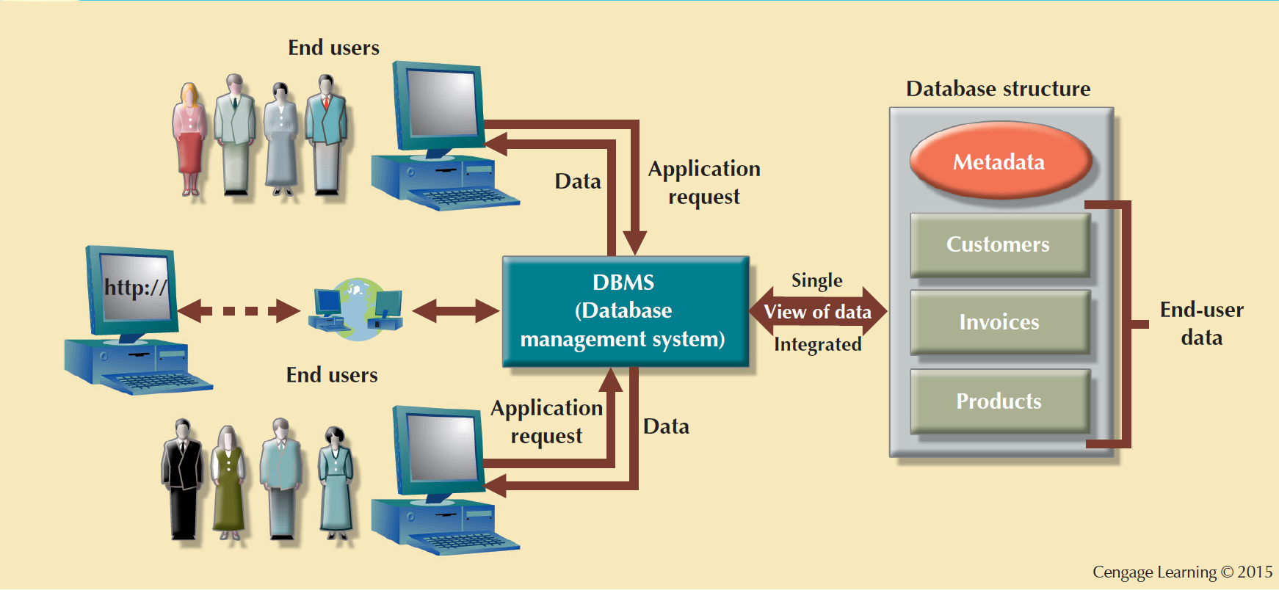
The DBMS Manages the Interaction between the End User and the Database

Slide 6
Advantages of the DBMS
Better data integration and less data inconsistency
Data inconsistency: Different versions of the same data appear in different places
Increased end-user productivity
Improved:
Data sharing
Data security
Data access
Decision making
Data quality: Promoting accuracy, validity, and timeliness of data

Slide 7
Types of Databases
Single-user database: Supports one user at a time
Desktop database: Runs on PC
Multiuser database: Supports multiple users at the same time
Workgroup databases: Supports a small number of users or a specific department
Enterprise database: Supports many users across many departments

Slide 8
Types of Databases
Centralized database: Data is located at a single site
Distributed database: Data is distributed across different sites
Cloud database: Created and maintained using cloud data services that provide defined performance measures for the database

Slide 9
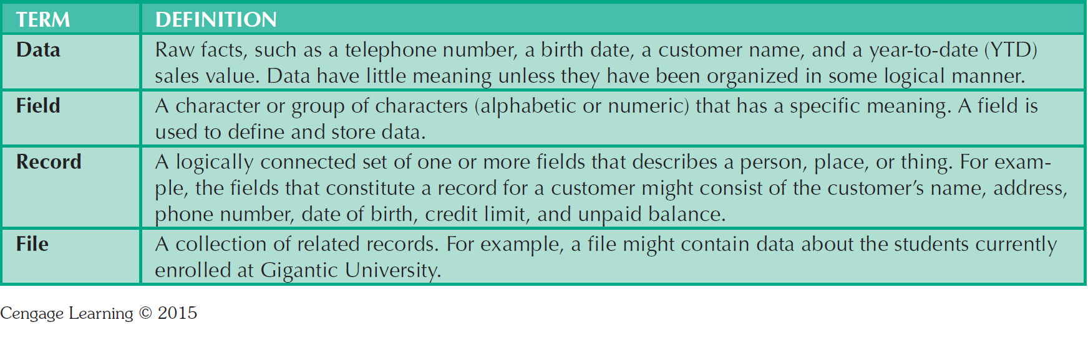
Basic File Terminology
First Name | Last Name | Birthday | Major
Joe | Smith | 02/11/1983 | Computer Science
Susie | Jones | 03/10/1987 | History

Slide 10
Database Systems
Logically related data stored in a single logical data repository
Physically distributed among multiple storage facilities
DBMS eliminates most of file system’s problems
Current generation DBMS software:
Stores data structures, relationships between structures, and access paths
Defines, stores, and manages all access paths and components

Slide 11
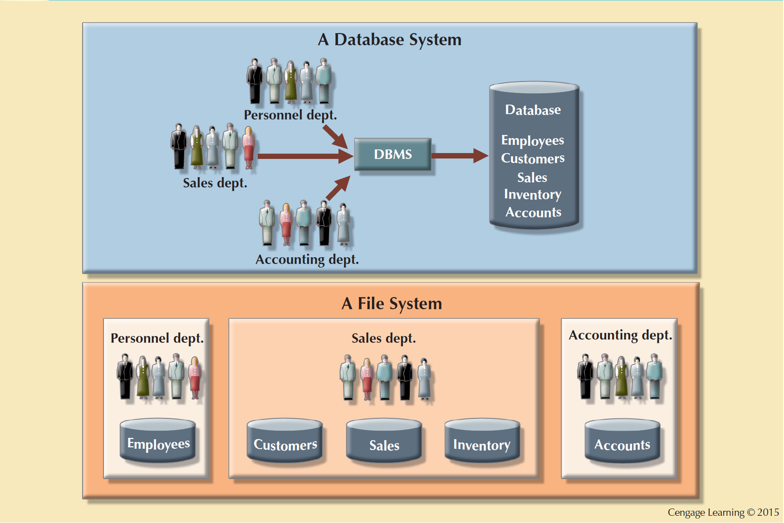
Contrasting Database and File Systems

Slide 12
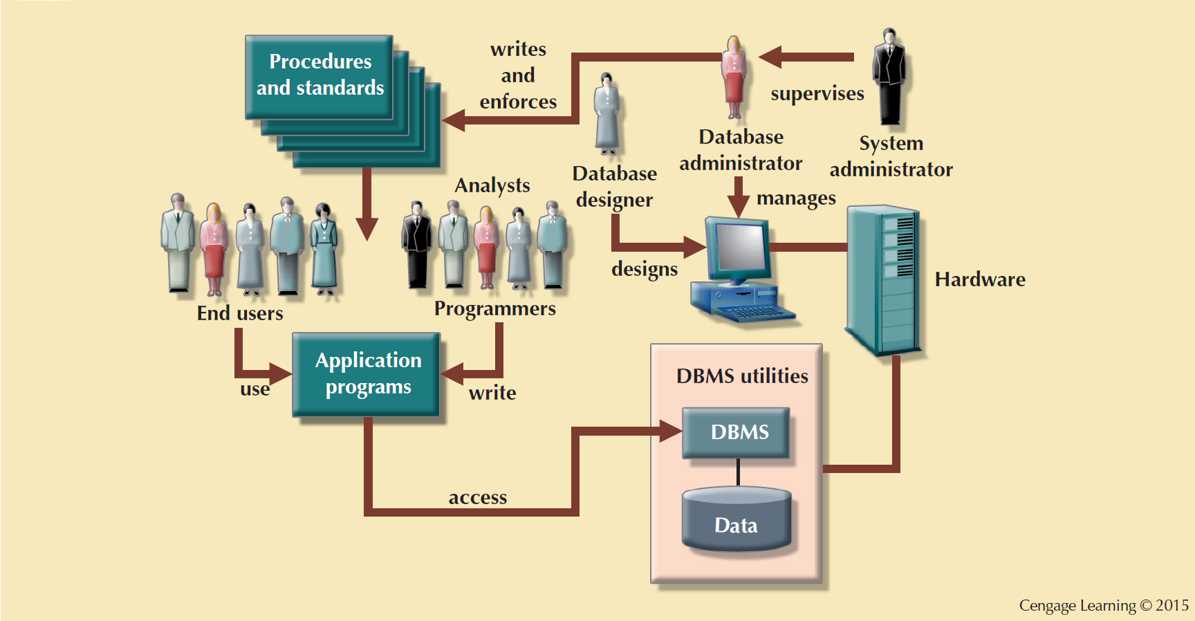
The Database System Environment

Slide 13
DBMS Functions
Data dictionary management
Data dictionary: Stores definitions of the data elements and their relationships
Data storage management
Performance tuning: Ensures efficient performance of the database in terms of storage and access speed
Data transformation and presentation
Transforms entered data to conform to required data structures
Security management
Enforces user security and data privacy

Slide 14
DBMS Functions
Multiuser access control
Sophisticated algorithms ensure that multiple users can access the database concurrently without compromising its integrity
Backup and recovery management
Enables recovery of the database after a failure
Data integrity management
Minimizes redundancy and maximizes consistency

Slide 15
DBMS Functions
Database access languages and application programming interfaces
Query language: Lets the user specify what must be done without having to specify how
Structured Query Language (SQL): De facto query language and data access standard supported by the majority of DBMS vendors
Database communication interfaces
Accept end-user requests via multiple, different network environments

Slide 16
Data Modeling and Data Models
Data modeling: Iterative and progressive process of creating a specific data model for a determined problem domain
Data models: Simple representations of complex real-world data structures
Useful for supporting a specific problem domain
Model - Abstraction of a real-world object or event

Slide 17
Importance of Data Models
Are a communication tool
Give an overall view of the database
Organize data for various users
Are an abstraction for the creation of good database

Slide 18
Data Model Basic Building Blocks
Entity: Unique and distinct object used to collect and store data
Attribute: Characteristic of an entity
Relationship: Describes an association among entities
One-to-many (1:M)
Many-to-many (M:N or M:M)
One-to-one (1:1)
Constraint: Set of rules to ensure data integrity

Slide 19
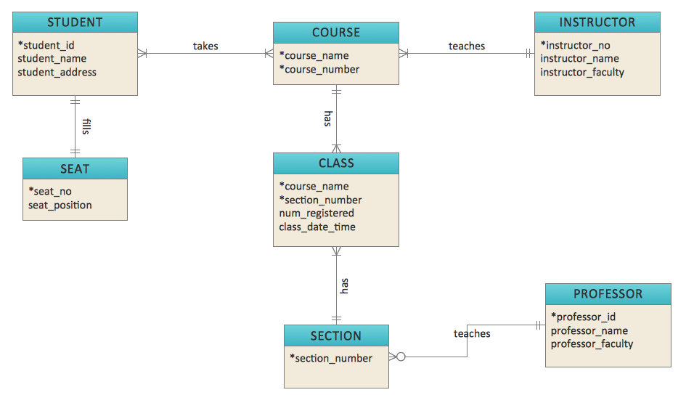
Example of Entity Relationship Diagram (ERD)

Slide 20
Business Rules
Brief, precise, and unambiguous description of a policy, procedure, or principle
Enable defining the basic building blocks
Describe main and distinguishing characteristics of the data

Slide 21
Sources of Business Rules
Company managers
Policy makers
Department managers
Written documentation
Direct interviews with end users

Slide 22
Reasons for Identifying and Documenting Business Rules
Help standardize company’s view of data
Communications tool between users and designers
Allow designer to:
Understand the nature, role, scope of data, and business processes
Develop appropriate relationship participation rules and constraints
Create an accurate data model

Slide 23
Translating Business Rules into Data Model Components
Nouns translate into entities
Verbs translate into relationships among entities
Relationships are bidirectional
Questions to identify the relationship type
How many instances of B are related to one instance of A?
How many instances of A are related to one instance of B?

Slide 24
Naming Conventions
Entity names - Required to:
Be descriptive of the objects in the business environment
Use terminology that is familiar to the users
Attribute name - Required to be descriptive of the data represented by the attribute
Proper naming:
Facilitates communication between parties
Promotes self-documentation

Slide 25
The Relational Model
Produced an automatic transmission database that replaced standard transmission databases
Based on a relation
Relation or table: Matrix composed of intersecting tuple and attribute
Tuple: Rows
Attribute: Columns
Describes a precise set of data manipulation constructs

Slide 26
Relational Model
Advantages
Disadvantages
Structural independence is promoted using independent tables
Tabular view improves conceptual simplicity
Ad hoc query capability is based on SQL
Isolates the end user from physical-level details
Improves implementation and management simplicity
Requires substantial hardware and system software overhead
Conceptual simplicity gives untrained people the tools to use a good system poorly
May promote information problems

Slide 27
Relational Database Management System(RDBMS)
Performs basic functions provided by the hierarchical and network DBMS systems
Makes the relational data model easier to understand and implement
Hides the complexities of the relational model from the user
A relational database management system (RDBMS) is a database management system (DBMS) that is based on the relational model as invented by E. F. Codd, of IBM's San Jose Research Laboratory. Many popular databases currently in use are based on the relational database model.

Slide 28
Relational databases
The term "relational database" was invented by E. F. Codd at IBM in 1970. Codd introduced the term in his seminal paper "A Relational Model of Data for Large Shared Data Banks".
According to DB-Engines, in 2016, the most widely used systems are Oracle, MySQL (open source), Microsoft SQL Server, PostgreSQL (open source), IBM DB2, Microsoft Access, and SQLite (open source).(http://db-engines.com/en/ranking/relational+dbms)

Slide 29
Relational database management systems
Oracle
MySQL
Postgre SQL
MS Access
DB2
FileMaker
And many more…..
https://en.wikipedia.org/wiki/Comparison_of_relational_database_management_systems

Slide 30
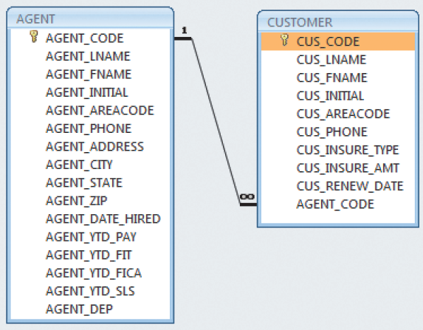
A Relational Diagram
An Agent has one or more Customers

Slide 31
SQL-Based Relational Database Application
End-user interface
Allows end user to interact with the data
Collection of tables stored in the database
Each table is independent from another
Rows in different tables are related based on common values in common attributes
SQL engine
Executes all queries

Slide 32
The Entity Relationship Model
Graphical representation of entities and their relationships in a database structure
Entity relationship diagram (ERD)
Uses graphic representations to model database components
Entity instance or entity occurrence
Rows in the relational table
Connectivity: Term used to label the relationship types

Slide 33
Entity Relationship Model
Advantages
Disadvantages
Visual modeling yields conceptual simplicity
Visual representation makes it an effective communication tool
Is integrated with the dominant relational model
Limited constraint representation
Limited relationship representation
No data manipulation language
Loss of information content occurs when attributes are removed from entities to avoid crowded displays

Slide 34
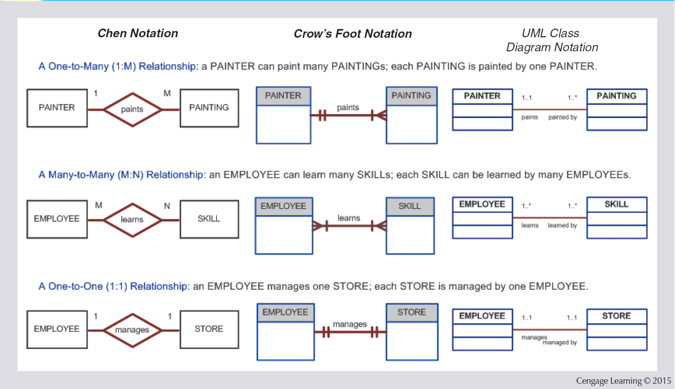
The ER Model Notations

Slide 35
The Object-Oriented Data Model (OODM) or Semantic Data Model
Object-oriented database management system(OODBMS)
Based on OODM
Object: Contains data and their relationships with operations that are performed on it
Basic building block for autonomous structures
Abstraction of real-world entity
Attributes - Describe the properties of an object

Slide 36
The Object-Oriented Data Model (OODM)
Class: Collection of similar objects with shared structure and behavior organized in a class hierarchy
Class hierarchy: Resembles an upside-down tree in which each class has only one parent
Inheritance: Object inherits methods and attributes of parent class
Unified Modeling Language (UML)
Describes sets of diagrams and symbols to graphically model a system

Slide 37
Object-Oriented Model
Advantages
Disadvantages
Semantic content is added
Visual representation includes semantic content
Inheritance promotes data integrity
Slow development of standards caused vendors to supply their own enhancements
Compromised widely accepted standard
Complex navigational system
Learning curve is steep
High system overhead slows transactions

Slide 38
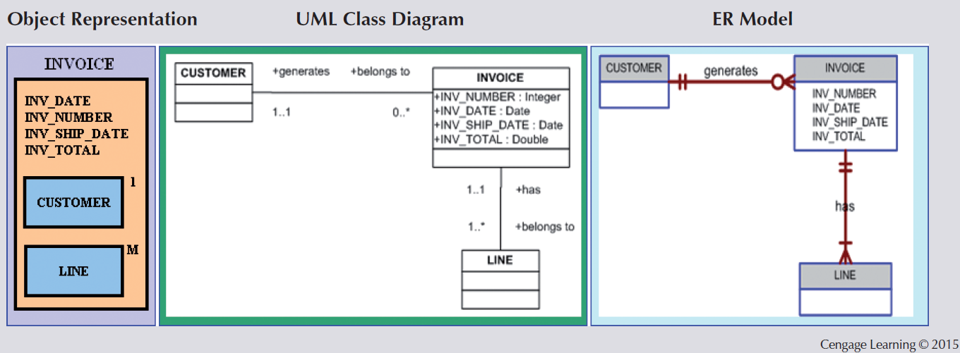
A Comparison of OO, UML, and ER Models

Slide 39
A Logical View of Data
Relational database model enables logical representation of the data and its relationships
Logical simplicity yields simple and effective database design methodologies
Facilitated by the creation of data relationships based on a logical construct called a relation

Slide 40
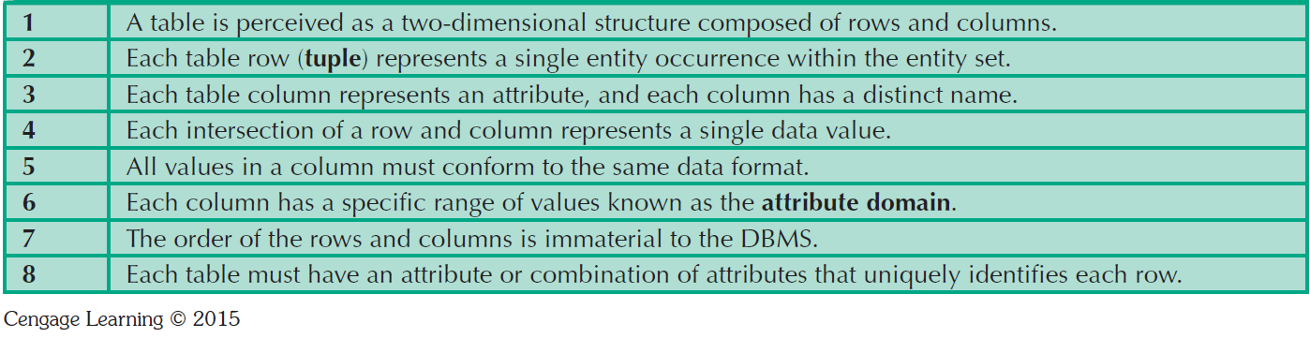
Characteristics of a Relational Table

Slide 41
Keys
Consist of one or more attributes that determine other attributes
Used to:
Ensure that each row in a table is uniquely identifiable
Establish relationships among tables and to ensure the integrity of the data
Primary key (PK): Attribute or combination of attributes that uniquely identifies any given row

Slide 42
Types of Keys
Composite key: Key that is composed of more than one attribute
Key attribute: Attribute that is a part of a key
Entity integrity: Condition in which each row in the table has its own unique identity
All of the values in the primary key must be unique
No key attribute in the primary key can contain a null

Slide 43
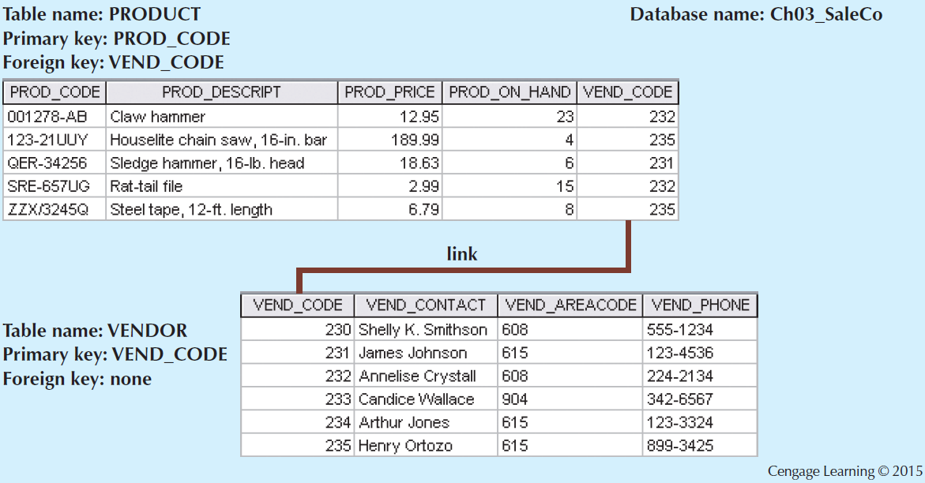
An Example of a Simple Relational Database
In this example, a Vendor supplies one or more Products

Slide 44
Relationships within the Relational Database
1:M relationship - Norm for relational databases
1:1 relationship - One entity can be related to only one other entity and vice versa
Many-to-many (M:N) relationship - Implemented by creating a new entity in 1:M relationships with the original entities
Composite entity (Bridge or associative entity): Helps avoid problems inherent to M:N relationships, includes the primary keys of tables to be linked

Slide 45
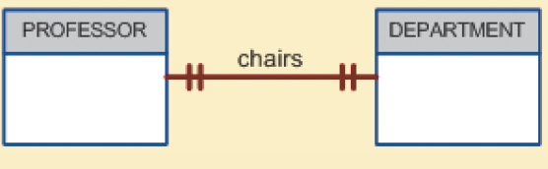
The 1:1 Relationship between PROFESSOR and DEPARTMENT

Slide 46
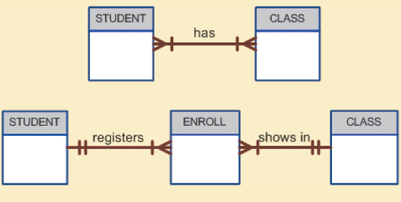
Changing the M:N Relationship to Two 1:M Relationships

Slide 47
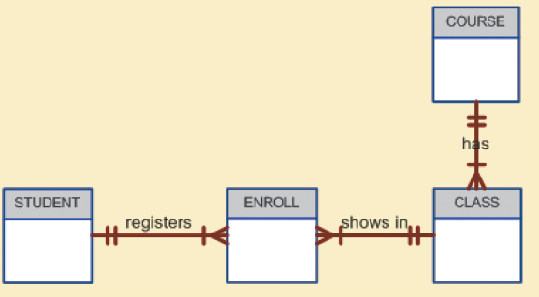
The Expanded ER Model

Slide 48
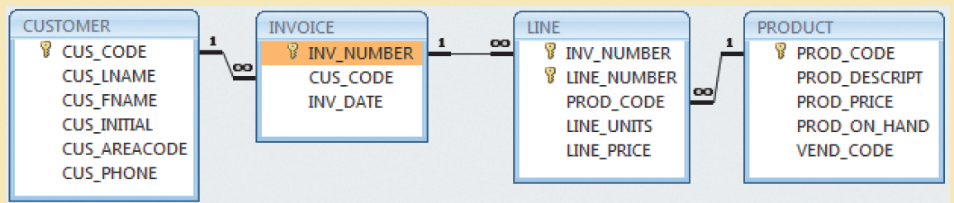
The Relational Diagram for the Invoicing System

Slide 49
Entity Relationship Model (ERM)
Basis of an entity relationship diagram (ERD)
ERD depicts the:
Conceptual database as viewed by end user
Database’s main components
Entities
Attributes
Relationships
Entity - Refers to the entity set and not to a single entity occurrence

Slide 50
Attributes
Characteristics of entities
Required attribute: Must have a value, cannot be left empty
Optional attribute: Does not require a value, can be left empty
Domain - Set of possible values for a given attribute
Identifiers: One or more attributes that uniquely identify each entity instance

Slide 51
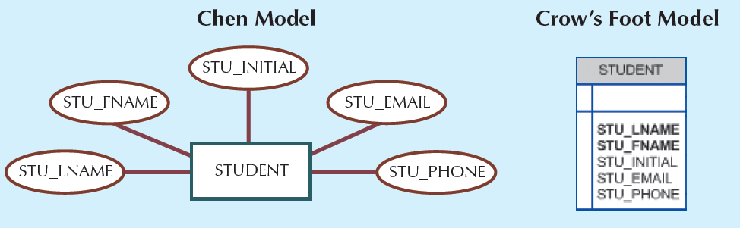
The Attributes of the Student Entity: Chen and Crow’s Foot

Slide 52
Attributes
Composite identifier: Primary key composed of more than one attribute
Composite attribute: Attribute that can be subdivided to yield additional attributes
Simple attribute: Attribute that cannot be subdivided
Single-valued attribute: Attribute that has only a single value
Multivalued attributes: Attributes that have many values

Slide 53
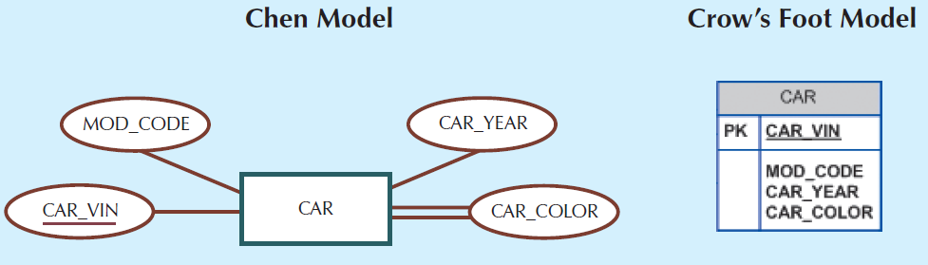
A Multivalued Attribute in an Entity

Slide 54
Attributes
Multivalued attributes: Attributes that have many values and require creating:
Several new attributes, one for each component of the original multivalued attribute
A new entity composed of the original multivalued attribute’s components
Derived attribute: Attribute whose value is calculated from other attributes
Derived using an algorithm

Slide 55
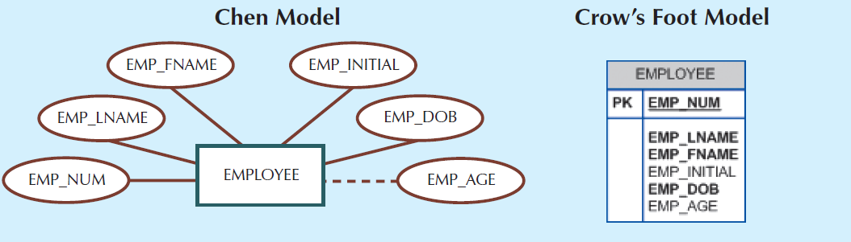
Depiction of a Derived Attribute

Slide 56
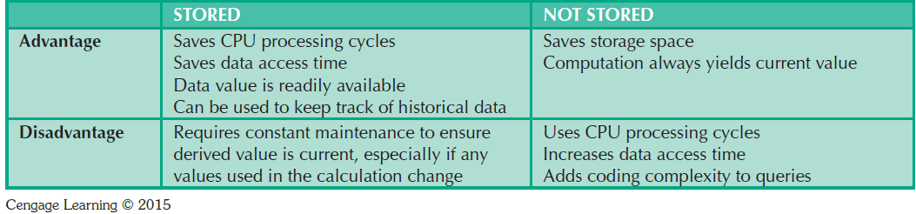
Advantages and Disadvantages of Storing Derived Attributes

Slide 57
Relationships
Association between entities that always operate in both directions
Participants: Entities that participate in a relationship
Connectivity: Describes the relationship classification
Cardinality: Expresses the minimum and maximum number of entity occurrences associated with one occurrence of related entity

Slide 58
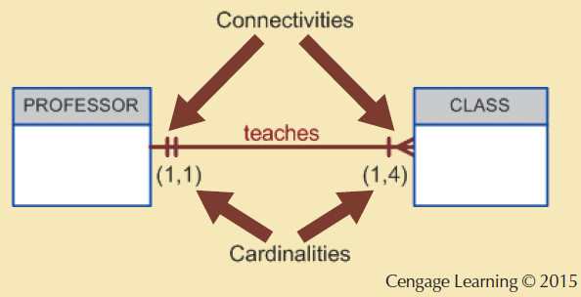
Connectivity and Cardinality in an ERD

Slide 59
Relationship Strength
Weak (non-identifying) relationship
Primary key of the related entity does not contain a primary key component of the parent entity
Strong (identifying) relationships
Primary key of the related entity contains a primary key component of the parent entity

Slide 60
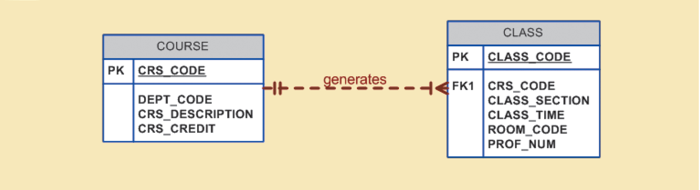
A Weak (Non-Identifying) Relationship between COURSE and CLASS

Slide 61
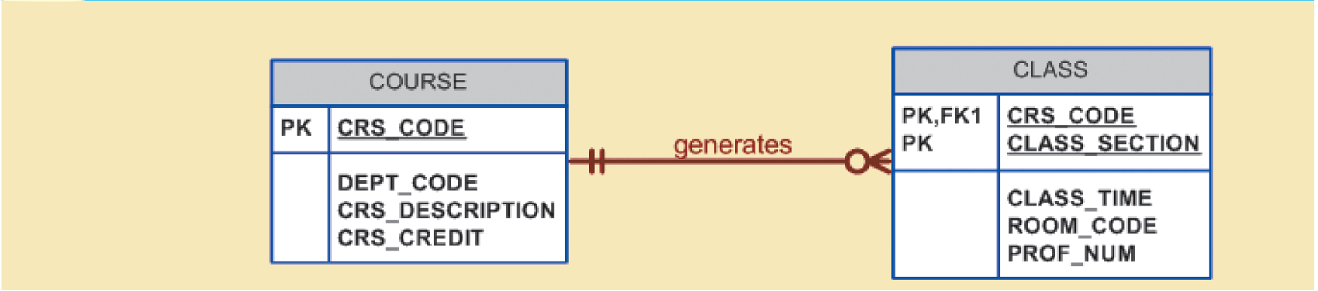
A Strong (Identifying) Relationship between COURSE and CLASS

Slide 62
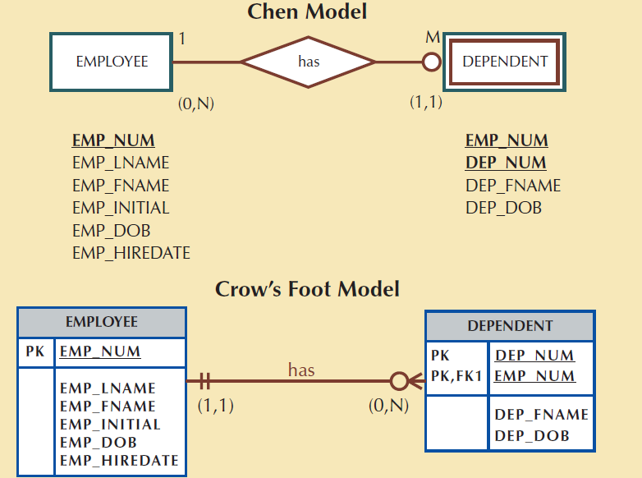
A Weak Entity in an ERD

Slide 63
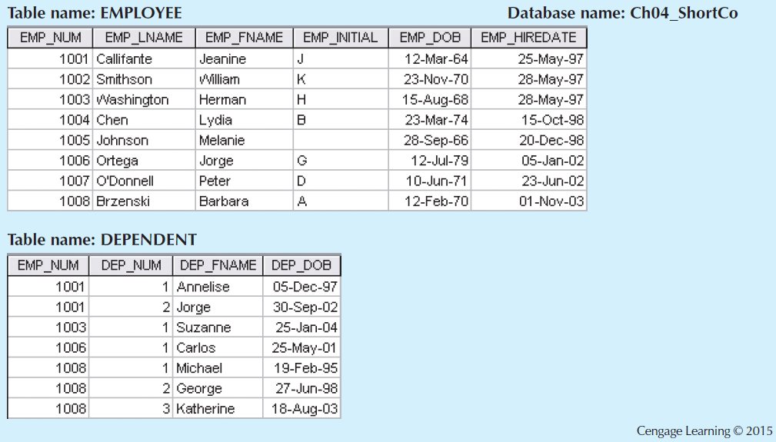
A Weak Entity in a Strong Relationship

Slide 64
Relationship Participation
Optional participation
One entity occurrence does not require a corresponding entity occurrence in a particular relationship
Mandatory participation
One entity occurrence requires a corresponding entity occurrence in a particular relationship

Slide 65
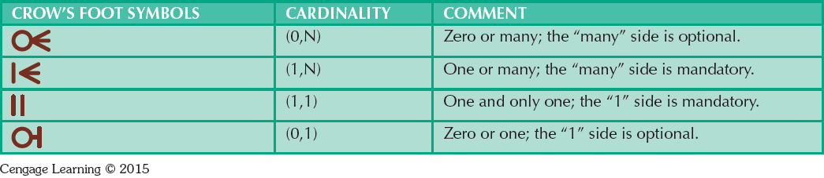
Crow’s Foot Symbols

Slide 66
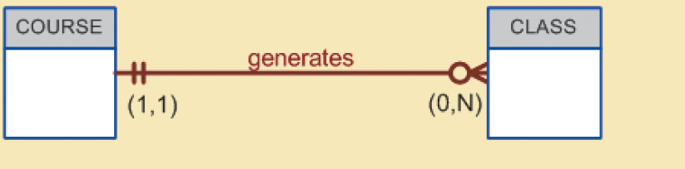
CLASS is Optional to COURSE

Slide 67
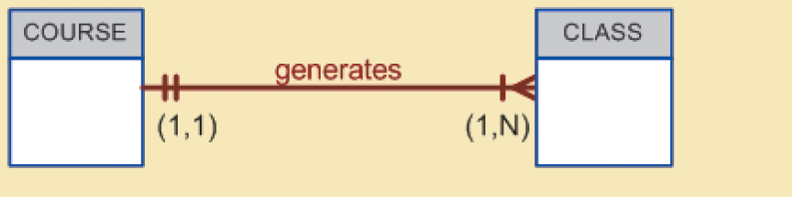
COURSE and CLASS in a Mandatory Relationship

Slide 68
Associative Entities
Also known as composite or bridge entities
Used to represent an M:N relationship between two or more entities
Is in a 1:M relationship with the parent entities
Composed of the primary key attributes of each parent entity
May also contain additional attributes that play no role in connective process

Slide 69
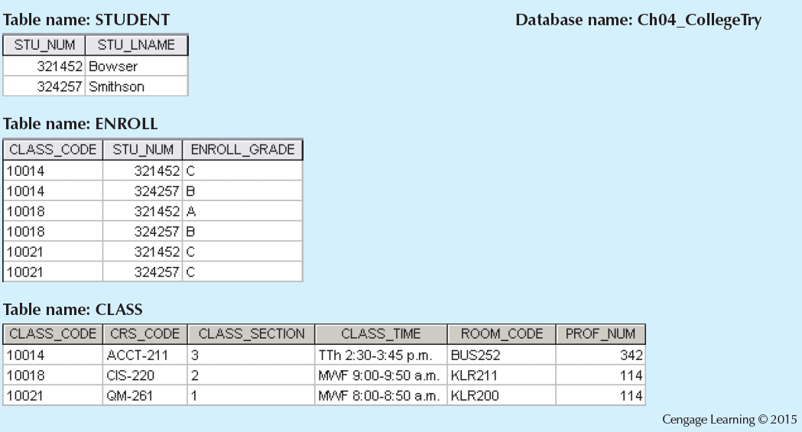
Converting the M:N Relationship into Two 1:M Relationships

Slide 70
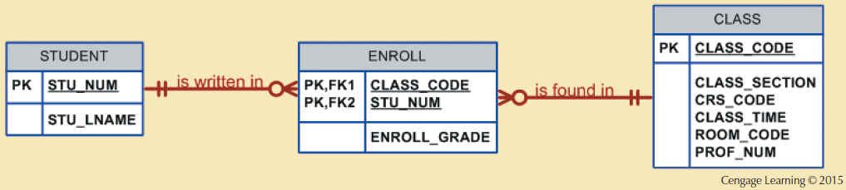
A Composite Entity in an ERD

Slide 71
Developing an ER Diagram
Create a detailed narrative of the organization’s description of operations
Identify business rules based on the descriptions
Identify main entities and relationships from the business rules
Develop the initial ERD
Identify the attributes and primary keys that adequately describe entities
Revise and review ERD

Slide 72
Database Design Challenges: Conflicting Goals
Database design must conform to design standards
Need for high processing speed may limit the number and complexity of logically desirable relationships
Need for maximum information generation may lead to loss of clean design structures and high transaction speed

Slide 73
Exercise
We are going to use thee following business rules to create a Crow’s Foot ERD.
A department employs many employees, but each employee is employed by one department.
Some employees, known as “rovers,” are not assigned to any department.
A division operates many departments, but each department is operated by one division.
An employee may be assigned many projects, and a project may have many employees assigned to it.
A project must have at least one employee assigned to it.
One of the employees manages each department, and each department is managed by only one employee.
One of the employees runs each division, and each division is run by only one employee.

Slide 74
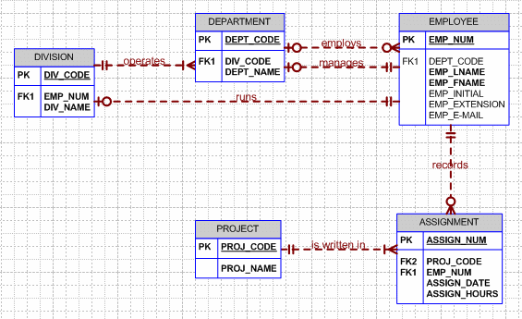
A department employs many employees, but each employee is employed by one department.
Some employees, known as “rovers,” are not assigned to any department.
A division operates many departments, but each department is operated by one division.
An employee may be assigned many projects, and a project may have many employees assigned to it.
A project must have at least one employee assigned to it.
One of the employees manages each department, and each department is managed by only one employee.
One of the employees runs each division, and each division is run by only one employee.

