Slide 1
Voltage Divider Lab
ECE 2630 Fun 1
Eric Kleppinger (erk6bx)

Slide 2
Objectives
Learn about voltage dividers
Gain knowledge about circuit design
Learn about electric loads

Slide 3
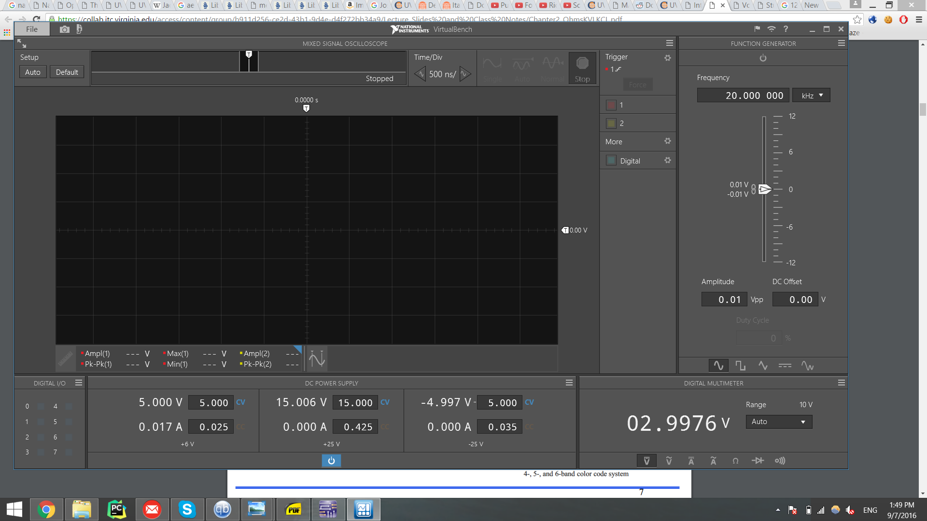
Power Limit
Given limitation of 0.125 W
Starting voltage of 5V
Using P = IV; 0.125 = 5 * I
Maximum Current Drawn: I = 0.025 A
We drew 0.017 A, less than the maximum 0.025 A

Slide 4
Output Voltage
The minimums for R2 and R1 were determined by assuming an open circuit (RL = ∞)
-5V + (0.025 A) * (R1 + R2) = 0
0.025 = 5 / (R1 + R2)
R1 + R2 = 200 Ω
Solving for each: R1 = 2/3R2
Minimum R1 = 80Ω and R2 = 120Ω drew too much current
Used values: R1 = 120Ω and R2 = 180Ω drew 0.017A
R1 = 120Ω and R2 = 180Ω allowed for a less than 5% change from 3V with RL between 10kΩ and ∞

Slide 5
Varying Load and Power Optimization
2.85V = 5*(R2/(RL+R2)
2.85/5 = (R2/(10kΩ+R2)
R2 max = 13kΩ
R1 max = 2/3*R2
R1 max = 8.8kΩ
Ratio is R1 = 2/3 R2

