Slide 1
Sprint 1
GOAL: Publish incoming requests to the utilization management platform

Slide 2
***TODO
**** Install Azure CLI ****
??? Include App Insights when publishin???
Do we need to ensure Azure emulator installed?
Add completed solution to sprint 2

Slide 3

User Story 1-1
As a TAH developer, I need all incoming requests for service to be available to all current and future components of the utilization management platform so that I can implement the features provided by TAH.
Acceptance Criteria
Requests are available to current and future services within 10 seconds of arriving on the network
Consumers must be able to receive the requests in the order they were received
Consumers should be able to
receive requests asynchronously
replay previously received requests
System must be able to receive up to 10,000 incoming requests per minute

Slide 4
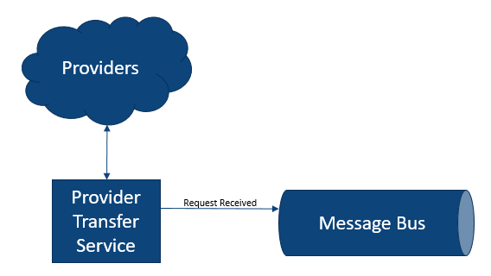
User Story 1-1: Design
We’ll simulate incoming requests for service by generating random requests in the Provider Transfer Service
What Azure resources to use for message bus and service?
Generally prefer PaaS (Platform as a Service) over IaaS (Infrastructure as a Service)

Slide 5
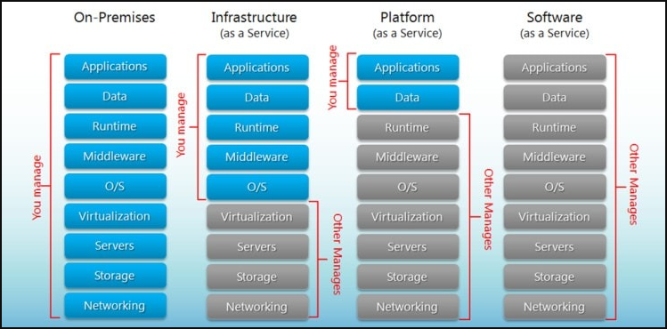
Cloud Maturity Model
https://www.hostingadvice.com/how-to/iaas-vs-paas-vs-saas/?_ga=2.28238708.972024003.1631988165-2010794804.1631988165

Slide 6
Azure Messaging Options
 | Service Bus | Event Hubs | Event Grid
Purpose | High-value enterprise data | Big data pipeline | Reactive programming
Unit of work | Message | Event (streams) | Event (discrete)
Throughput | Thousands of messages per second | Millions of messages per second | Thousands of messages per second
Cost | $0.0135/hour + $0.80 per million operations (after 13M operations) | $0.03/hour + $0.028 per million events | $0.60 per million operations
Consume previously published messages / replay | No | Yes | No

Slide 7
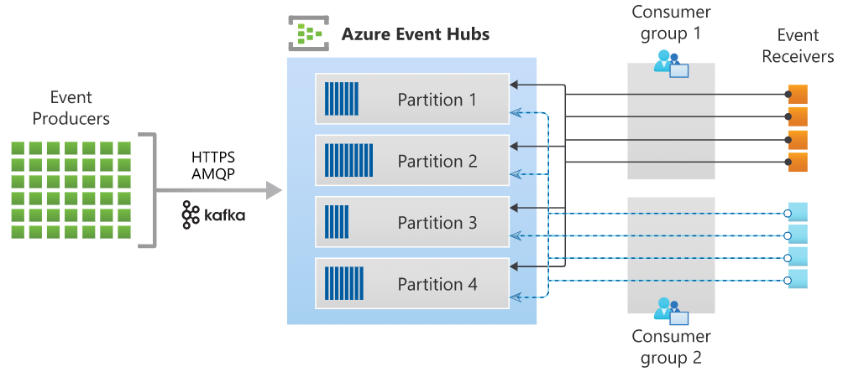
User Story 1-1: Message Bus Design
Choosing Event Hub
Can handle huge volumes – millions of messages per second
Can add consumers after messages published
Can replay messages (until removed)
Key Terms
Namespace (i.e. cluster)
Hub (i.e. topic)
Publisher (i.e. producer)
Consumer (i.e. subscriber)

Slide 8
User Story 1-1: Provider Transfer Service Design
Choosing Azure Function
Azure’s event-driven, serverless compute option
Automatically scales – up to 200 parallel instances
We’ll discuss other hosting options in later sprint
Possible triggers
HTTP call
Timer
Message arrived / event occurred
Database record created, updated, or deleted
BLOB created, updated, or deleted
Most often used in consumption mode – only charged for use
Based on number of executions, execution time, and memory used
Generally inexpensive for lightweight, infrequently used functionality

Slide 9
Task 1-1: Create Azure Event Hub
Develop in Azure Portal
Create Azure Hub Namespace
Name must globally unique (so we can’t all use the same name)
Pricing tier: Standard so we can have multiple consumer groups
Create Azure Hub for received requests
Create Shared Access Policy for publisher

Slide 10
Task 1-2: Create Provider Transfer Service
Simulate incoming requests by generating and sending randomly requests
Start with ThreeAmigosHealth.sln in Sprint1
Ensure logged into Azure (via CLI)
i.e. az login
Add Azure Functions / c# with Timer Trigger
Timer will send a request each time it fires
Use EventHubProducerClient from Azure.Messaging.EventHubs nugget package
Requires Shared Access Policy connection string from receivedRequests hub
Business logic in BusinessLogic project in solution

Slide 11
Task 1-3: Deploy Provider Transfer Service
Publish from Visual Studio to Azure
Create Publish Profile
App Service name must globally unique
Requires Azure credentials
Azure Windows / Linux
Double check Account, Subscription, Resource Group, and Location
New Function App
New Storage Account
Publish
Ensure messages making it to receivedRequests hub

Slide 12
Sprint 1: Retrospective
We have the beginning of our utilization management platform
Incoming requests are available to any platform components
We are taking advantage of asynchronous messaging
Publishing requests with little concern for who will consume them or how many consumers there will be
We are using PaaS options to minimize development and maintenance work
Everything about the platform is scalable

