Slide 1
Sprint 3
GOAL: Route undecided requests to a physician so they can make a decision on the request

Slide 2

User Story 3-1
As a TAH physician, I need to be able to view undecided requests for service so that I can decide if they should be approved or denied.
Acceptance Criteria
Retrieve and view an undecided request without need to install an application
Should not be able to retrieve a request that has previously been decided
Should not be able to retrieve a request that has been assigned to another physician
Ability to approve or deny a request I’m viewing

Slide 3
User Story 3-1: Design
1
Request Not Auto Approved
Routing Service
4
Request
Assigned
Routing Service consumes requests that were not auto approved
User asks for an undecided request to work on
Routing Service consumes the request to get a request for the user
Routing Service finds an undecided request, assigns it to the user, and sends an event for the assignment
UI consumes the assignment event and displays the request to the user
User makes a decision on the request and the UI sends an event for the decision
Routing Service consumes the decision event and removes the request from its database since it no longer needs to be routed
Side note: The Provider Transfer Service would also consume the decision event so it can notify the provider.
Message Bus
3
7
Get Request
Request Decided
2
User Interface
Get
Request
Request
Assigned
5
Request
Decided
6

Slide 4
Routing Service
Maintains database of routable requests
Routable requests include anything not already decided and not assigned to another user
No need to store anything already decided
For this workshop, we’re only going to store requests in memory
Note that this isn’t possible with an Azure Function on the consumption plan
How to host this functionality?

Slide 5
Azure Function vs App Service
 | Azure Function (Consumption Plan) | Azure App Service
Cost | Cheaper for smaller, infrequent workloads. First 400,000 GB/s and 1,000,000 executions free. | Can be cheaper for larger, frequent workloads. Min for production app about $70/month without any use. Can be much higher.
Development Time | Simple to develop, debug, and deploy. Can all be done in portal, but not recommended. | Requires more time to develop, debug, configure, and deploy
Execution Time Limit | Generally 10 minutes, but 230 seconds for HTTP triggers | Unlimited
Scalability | Scales out well without configuration | Can be configured to scale out and/or up
Latency | Can take 10 – 20 seconds to warm up | Can be configured as “Always on” to eliminate cold start
Maintain State in Memory | Not possible | Technically possible when always on, but not recommended because it limits scaling out
General Use Case | Small, isolated, lightweight functionality | Larger set of cohesive functionality

Slide 6
User Interface
Could use almost any web technology since there is a JavaScript Azure Event Hub Client SDK
Choosing ASP.NET Blazor to consolidate technologies for the workshop

Slide 7
Development Approach
Routing Service already developed and almost ready to deploy
Needs some configuration updates as defined in following tasks
Use Azure Resource Manager (ARM) templates to generate the new event hubs, shared access policies, and BLOB containers for hub offsets
We’ll just use the UI locally without deploying

Slide 8
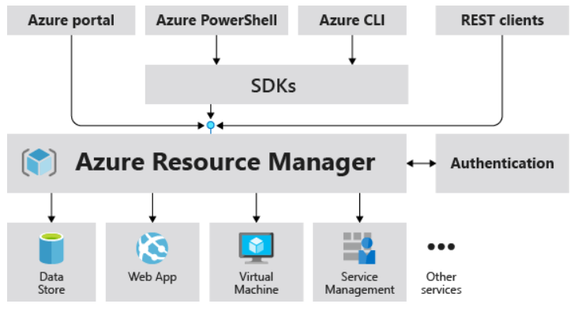
Azure Resource Manager (ARM)
Management layer that enables creating, updating, and deleting Azure resources
We’ve been using directly via the Portal
Now we’re going to use ARM
Templates to create new resources
Infrastructure as Code (IaC)

Slide 9
Task 3-1: Deploy Routing Service Messaging Items
BusinessLogic\Snippets\ArmScripts\Sprint3_1_RoutingServiceMessagingItems.json
Use the name of your Hub namespace
New hubs
getRequest
requestAssigned
Share Access Policies
requestNotAutoApproved listener
decidedRequests listener
getRequest listener
requestAssigned sender
Consumer Groups
requestNotAutoApproved
decidedRequests
getRequest

Slide 10
Task 3-2: Deploy UI Messaging Items
BusinessLogic\Snippets\ArmScripts\Sprint3_2_UIMessagingItems.json
Use the name of your Hub namespace
Share Access Policies
getRequest sender
requestAssigned listener
decidedRequests sender
Consumer Groups
requestAssigned
There are other items in this script, but may not use

Slide 11
Task 3-3: Deploy Hub Offset Storage
BusinessLogic\Snippets\ArmScripts\Sprint3_3_StorageItems.json
Set “Storage Account Name” to your unique name
Component | Hub | Blob Container
Routing Service | notAutoApproved | routingNotAutoApprovedConsumer
Routing Service | requestDecided | routingRequestDecidedConsumer
Routing Service | getRequest | routingGetRequestConsumer
UI | requestAssigned | uiRequestAssignedConsumer

Slide 12
Task 3-4: Deploy Routing Service
Update connection strings in the service
Top of RoutingService\Program.cs
Publish Routing Service from Visual Studio
Target: Azure -> WebJobs
Use + to create new App Service
Name must be globally unique
Use same Resource group you’ve been using
Create new Hosting Plan
Name must be globally unique
Size: Shared to save money on features we don’t need for the workshop
Must select WebJob Type = Continuous on publish summary page

Slide 13
Task 3-5: Create UI
Update connection strings in UI\Variables.cs
Double check other variables are correct too
Just run locally without deploying

Slide 14
Sprint 3: Retrospective
When compared with Azure Functions, App Services are generally used for larger, heavier, and cohesive set of functionality, but comes with added cost and complexity
ARM Templates can be used to create Azure resources
Asynchronous messaging can be used for request/response
Event Hubs can be used with a variety of technologies

