Slide 1

Event-Driven Architecture Workshop

Slide 2
Pre-Work
Ensure you have an Azure Subscription
http://portal.azure.com
!!!Could be around $5 in charges to complete workshop, but there’s a $200 when you first signup and you may be eligible for an ongoing monthly Visual Studio credit.
Ensure you have Visual Studio installed
Community version is fine
Clone https://github.com/scottctr/EdaWorkshop
Introduction to event-driven architecture article
https://developer.ibm.com/articles/advantages-of-an-event-driven-architecture/

Slide 3
Overview
What are we going to learn?
How are we going to learn it?
How long until we start writing some code?

Slide 4
Who Are We?
Developers using event-driven architecture
Impressed with improvements over other architectures and want to help spread the word
Selfishly: The more we “raise the bar” the more new and interesting stuff we can move on to
Worked with a few NSS graduates and glad to be a part of that wonderful organization as well

Slide 5
What are we going to learn?
Event-driven architecture (EDA) design concepts
How to use EDA to improve your solutions
How to implement an EDA solution on Azure

Slide 6
How are we going to learn?
Start by looking at issues with traditional systems
Define goals for an improved system
Walk through EDA solution design
Introduce key terms and concepts
Implement EDA solution on Azure
More key terms and concepts

Slide 7
What are we going to build?

Slide 8
Traditional vs Event-Driven Design

Slide 9
Context
Three Amigo’s Health provides utilization management reviews for health care insurers. The insurers that employee TAH require providers to get approval before administering sleep studies, fertility treatments, or long-term care to their patients. This process helps ensure that the services are appropriate for the patient at the time.
The process starts when the providers send their requests to TAH. TAH has a process to automatically approve many of the requests, but those that can’t be automatically approved are routed to a TAH physician for a decision. Once a decision is made, the decision is sent back to the provider. The providers usually get a decision in 1 to 3 days.

Slide 10
Current Solution
Incoming Files
Auto Approval Service
Routing Service
Providers
Database
Provider Transfer Service
User Interface
Outgoing Files

Slide 11
Current Issues
Solution not keeping pace with rapidly growing business
Users receive timeout errors during busy times
Lead time for new hardware limiting system’s ability to scale
Management hesitant to let servers to sit idle during non-peak times
Team does not have skills to manage network load balancing
Turnaround time for providers needs to be reduced from days to hours
Input/output from/to providers only done in nightly jobs
New features and enhancements take too long or not possible
Need real-time view of active requests, but additional load likely to lead to additional performance issues
Users want to be able to automate requesting additional info from providers before decision
System has to be taken down during deployments and deployments occasionally fail because of uncoordinated changes across development teams

Slide 12
Goals of Event-Driven System
Performance / Scalability
Eliminate sources of timeout issues
Scale hardware to meet peak demands without wasting resources during non-peak times
Avoid lead-time required for new hardware
Enable near real-time view of active messages
Allow processing of requests as received and returning decisions as soon as made
Continue to scale with business
Must be easy to add new features
Decouple components and teams

Slide 13
Approach for Event-Driven System
Take advantage of cloud platform, such as Azure
Components can be added/removed dynamically (in minutes) based on load
Workload will adjust seamlessly as components added/removed
All system changes published as events via asynchronous message bus
Event: notification that something has occurred
Publishers send messages to a message bus
Subscribers receive messages from the event bus
Central database replaced with message bus and local repositories
Serves events, including historical events, to any component at any time
Each service should have own repository with materialized views

Slide 14
Final Solution
Message Bus
Providers
Auto Approval
Service
Request Not Auto Approved
Routing Service
Request
Assigned
Request Received
Request Not Auto Approved
Get Request
Request Decided
Request Decided
Provider Transfer Service
Request Received
Request Decided
User Interface
Get
Request
Request
Assigned
Request
Decided

Slide 15
Sprint 1
GOAL: Publish incoming requests to the utilization management platform

Slide 16
User Story 1-1
As a TAH developer, I need all incoming requests for service to be available to all current and future components of the utilization management platform so that I can implement the features provided by TAH.
Acceptance Criteria
Requests are available to current and future services within 10 seconds of arriving on the network
Consumers must be able to receive the requests in the order they were received
Consumers should be able to
receive requests asynchronously
replay previously received requests
System must be able to receive up to 10,000 incoming requests per minute

Slide 17
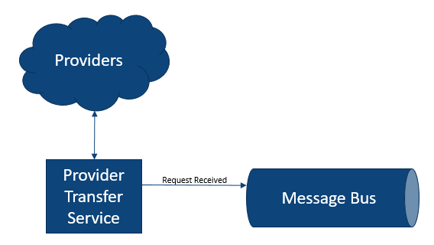
User Story 1-1: Design
We’ll simulate incoming requests for service by generating random requests in the Provider Transfer Service
Generally prefer PaaS (Platform as a Service) over IaaS (Infrastructure as a Service)

Slide 18
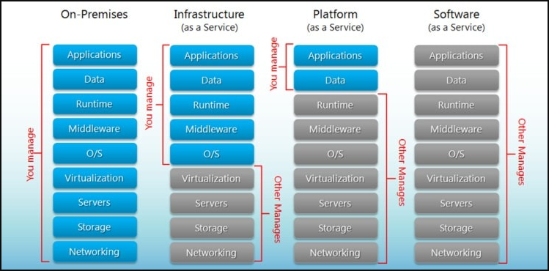
Cloud Maturity Model
https://www.hostingadvice.com/how-to/iaas-vs-paas-vs-saas/?_ga=2.28238708.972024003.1631988165-2010794804.1631988165

Slide 19
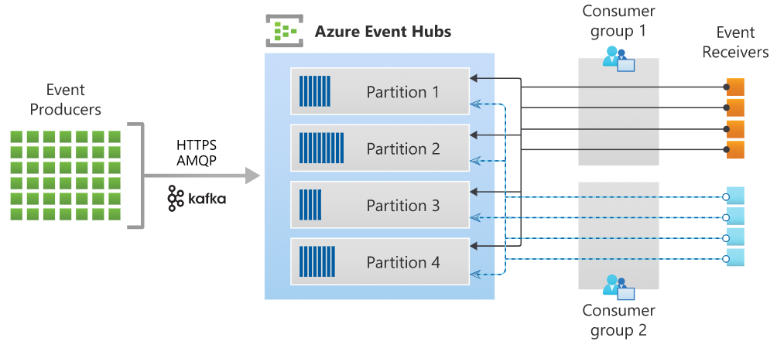
Message Bus: Azure Event Hub
Azure’s implementation of a real-time, asynchronous message stream
Similar to Kafka
Azure has many messaging options
Using Event Hub because
Can handle huge volumes – millions of messages per second
Can add consumers after messages published
Can replay messages (until removed)
Key Terms
Namespace (i.e. cluster)
Hub (i.e. topic)
Publisher (i.e. producer)
Consumer (i.e. subscriber)

Slide 20
Provider Transfer Service: Azure Function
Azure’s event-driven, serverless compute option
Automatically scales – up to 200 parallel instances
Possible triggers
HTTP call
Timer
Message arrived / event occurred
Database record created, updated, or deleted
BLOB created, updated, or deleted
Most often used in consumption mode – only charged for use
Based on number of executions, execution time, and memory used
Does have some limitations when compared to Azure App Services
We’ll discuss some of these in a later sprint

Slide 21
Task 1-1: Create Azure Event Hub
Develop in Azure Portal
Create Azure Hub Namespace
Name must globally unique (so we can’t all use the same name)
Pricing tier: Standard so we can have multiple consumer groups
Create Azure Hub for received requests
Create Shared Access Policy for publisher

Slide 22
Task 1-2: Provider Transfer Service
Simulate incoming requests by generating and sending randomly requests
Start with ThreeAmigosHealth.sln in Sprint1/Initial
Add Azure Functions / c# with Timer Trigger
Timer will send 1 or more requests each time it fires
Use EventHubProducerClient from Azure.Messaging.EventHubs nugget package
Requires Shared Access Policy connection string from received request hub
Business logic in BusinessLogic project in solution
Publish to Azure

Slide 23
Sprint 1: Retrospective
We have the beginning of our utilization management platform
Incoming requests are available to any platform components
We are taking advantage of asynchronous messaging
Publishing requests with little concern for who will consume them or how many consumers there will be
Everything about the platform is scalable
Later exercises will demonstrate asynchronous messaging

Slide 24
Sprint 2
Auto Approval Service

Slide 25
ToDo
May want to discuss fact that trigger takes multiple events per call

Slide 26
Auto Approval Service
Prep
Use previous Request class
In class
Create topic function in VS
Subscribe to topic
Randomly approve/deny each request in function
Send event to appropriate topic
Deploy function to Azure
Simulates automatic approve of requests that meet criteria
Our implementation will just randomize approvals
C# Azure Function triggered by messages on the RequestReceived topic
Auto scales to meet incoming demand
Approved requests sent to RequestAutoApproved topic
Requests not automatically approved sent to RequestNotAutoApproved topic

Slide 27
Sprint 2: Summary
Azure Function App is an Azure serverless hosting option
Serverless: don’t have to procure or configure hardware
Consumption model: only charged for usage
Autoscales to meet demand

Slide 28
Sprint 3
Routing Service

Slide 29
ToDo
Have Routing Service completely pre-packaged
Help students deploy
Talk through logic and key points

Slide 30
Request Routing Service
Prep
Request class from generator
Router class
Get stats by specialty and state???
In class
1. Create Web API in VS
1. Subscribe to NotApproved topic/c#
1. Store requests in memory
1. Deploy to Azure app service
2. Subscribe to request command queue
2. Get request from router class
2. Send request via SignalR
2. Re-dDeploy to Azure app service
When users request work, this service routes a request to the user based on user’s role, request type, request priority, and request status
Also maintains the state of each request as they are received and worked by users
Needs review
Assigned to user
Needs additional documentation???
Approved
Denied
Receives incoming requests for service from the RequestNotApproved topic
Auto approved request don’t need routing so this service doesn’t need to subscribe to those
Implemented as an Asp.Net Core Web API deployed as an Azure App Service
For this workshop, requests will only be stored in memory. Normally the requests would be saved to persistent storage, such as Cosmos DB or Azure SQL

Slide 31
User Interface Application
Prep
Shell application
Login / select specialty
View request
Approve / deny / more info
Dashboard???
In class
Send request for request to queue
Send updated requests to topic
Need more info???
Allows users to retrieve requests needing a decision based on their specialty
Users can
Approve a request
Deny a request
Request additional information
???Includes dashboard so users can track requests by specialty and status
??? User is notified of changes to requests they’ve recently touched???
Implemented as Blazor ??? Application and deployed as ???

Slide 32
Sprint 4
UI for Manual Decisions

Slide 33
To Do
Get request
Handle no current request
Approve / Disapprove
Clean Login Screen
Starting point
UI with a hard-coded, but dynamic request
Disabled dashboard
Stats for manually approved/disapproved
Assigned?
Make stats viewable from decision screen

Slide 34
User Story 4-1
As a TAH physician, I need to be able to view requests that have not been automatically approved so that I can determine if they should be approved or not.
Acceptance Criteria
Retrieve a request that has not been automatically approved
View request details
Approve or disapprove the request

Slide 35
User Story 4-1: Current Status
UI already exists with the ability to view a static request for service.
It does not have the ability to retrieve a request from the routing service.
UI developed in Blazor, but Blazor knowledge not required.
Blazor is a Microsoft ASP.NET tool for creating web UIs with C# instead of JavaScript, but can easily call JavaScript APIs and libraries.

Slide 36
Command vs Event
Event is something that has already occurred in the system
Command is something that someone or some component needs to be done and typically expects some form of response
The execution of a command can generate many events

Slide 37
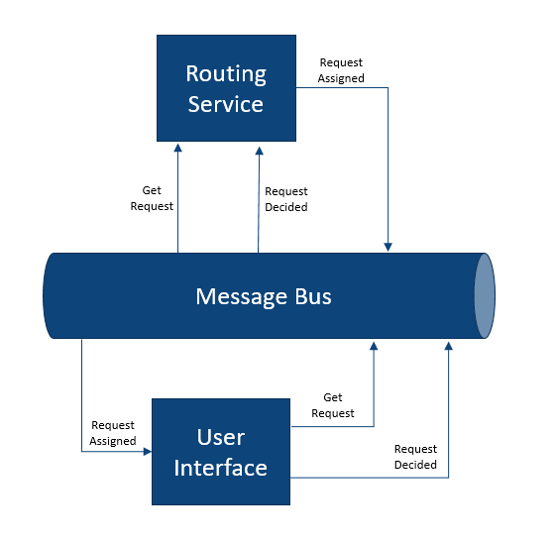
User Story 4-1: Design

Slide 38
User Story 4-1: Design Details
Just as we’re doing with service-to-service communications, we’re going to use async messaging to make a request from the UI to retrieve a request for the user.
Send a command to a new Azure Hub called getRequest to get the next request for the current user from the Routing Service.
The response will come on another new Hub called requestAssigned.
When the user makes a decision on a request, we’ll send an event to the requestDecided we’re already using from the Auto Approval service.

Slide 39
Task 4-1: Create Azure Event Hub
Similar to Task 1-1
Create getRequest Azure hub
Create Shared Access Policy for publisher

Slide 40
Task 4-2: Update UI to Get Next Request
Install Azure.Messaging.EventHubs.Producer

Slide 41
Task 4-3: Create requestAssigned Hub
Create requestAssigned Azure hub
Create Shared Access Policy for publisher

Slide 42
Task 4-4: Update UI to Display Assigned Request

Slide 43
Sprint 4: Retrospective
We now have an end-to-end solution for managing requests for health-care services.
Asynchronous messaging can be used with the UI, just as it is for service-to-service communications.
Asynchronous messaging can include requests and responses in addition to event notifications.
In comparison to real-time request/response, such as HTTP, managing expected responses requires a different approach
There can be multiple publishers of a single event.
Consider a field to identify publisher

Slide 44
Azure App Service
Azure’s PaaS option for hosting applications and containers
Key terms
App Service Plan
Features
Reliable
Scalable
CI/CI integration
Great integration for ASP.Net applications

Slide 45
Sprint 3: Summary
Infrastructure as a Service (IaaS) vs Platform as a Service (PaaS)
Azure App Plan and Azure App services are PaaS options
Instantiating Virtual Machines is IaaS alternative to PaaS
Neither option requires difficult procurement process
Request / response pattern

Slide 46
Sprint 5
New Feature - Dashboard

Slide 47
Document Support
Prep
Document creator class
In class
UI: Send command for doc
Intake: Subscribes to command queue, generates doc, sends to topic
Router: subscribes to doc topic, updates request, sends to UI via SignalR
UI: notifies user of new doc for current request and allows them to refresh
Users can request additional documentation during review
The system will try to retrieve the documentation in real-time so the user is able to complete the review quickly
Changes include:
UI requests documentation via new command queue??
Intake service retrieves the command and tries to fullful the request; sending to new topic if successful
Request router subscribes to document topic, updates request, and sends update to UI

Slide 48
New Requirement
??? Should be something that just consumes existing event/s

Slide 49
Demo Scalability
Adjust timer on Intake Service
Setup auto scaling on Routing Service
???Use Task.Delay(variable) on Routing Service to simulate load
??? Show how instances grow from 1 to 2???

Slide 50
Wrap Up

Slide 51
Cleanup Azure Resources
Don’t want to leave this resources running because they will cost you, but we can export scripts that you can reapply later if you might want to work on this more later
Delete resources

Slide 52
What Have We Learned?

Slide 53
Limitations

Slide 54
Contact Us

