Slide 1

Event-Driven Architecture Workshop

Slide 2
Pre-Work
Ensure you have an Azure Subscription
http://portal.azure.com
Could be around $5 in charges to complete workshop, but there’s a $200 when you first signup and you may be eligible for an ongoing monthly Visual Studio credit.
Ensure you have Visual Studio installed
Community version is fine
Clone https://github.com/scottctr/EdaWorkshop
Introduction to event-driven architecture article
https://developer.ibm.com/articles/advantages-of-an-event-driven-architecture/

Slide 3
Overview
What are we going to learn?
How are we going to learn it?
How long until we start writing some code?

Slide 4
Who Are We?
Developers using event-driven architecture
Impressed with improvements over other architectures and want to help spread the word
Worked with a few NSS graduates and glad to be a part of that wonderful organization as well

Slide 5
What are we going to learn?
Event-driven architecture (EDA) design concepts
How to use EDA to improve your solutions
How to implement an EDA solution on Azure

Slide 6
How are we going to learn?
Start by looking at issues with traditional systems
Define goals for an improved system
Walk through EDA solution design
Introduce key terms and concepts
Implement EDA solution on Azure
More key terms and concepts
Follow an agile/scrum structure

Slide 7


Overly Simplified Analogy
VS

Slide 8
Overly Simplified Analogy

Slide 9
Overly Simplified Analogy

Slide 10



Overly Simplified Analogy

Slide 11

Overly Simplified Analogy

Slide 12

Overly Simplified Analogy

Slide 13
Overly Simplified Analogy

Slide 14

Overly Simplified Analogy

Slide 15
Overly Simplified Analogy

Slide 16
Overly Simplified Analogy

Slide 17

Overly Simplified Analogy

Slide 18
Old School Architecture
Application
Service
Service
Service
Central Database
Service
Service

Slide 19
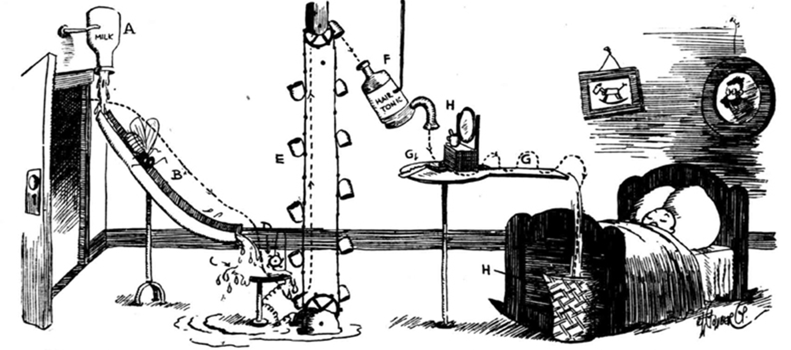
Highly Coupled Systems

Slide 20
EDA Architecture
Service
Service
DB
DB
Service
Message Bus
DB
Service
Service
DB
DB

Slide 21
Context
Three Amigo’s Health provides utilization management reviews for health care insurers. The insurers that employ TAH require providers to get approval before administering sleep studies, fertility treatments, or long-term care to their patients. This process helps ensure that the services are appropriate for the patient at the time.
The process starts when the providers send their requests to TAH. TAH has a process to automatically approve many of the requests, but those that can’t be automatically approved are routed to a TAH physician for a decision. Once a decision is made, the decision is sent back to the provider. The providers usually get a decision in 1 to 3 days.

Slide 22



Process Flow
Health Insurer
Request
Decision
Condition
Request
Decision
Patient
Doctor

Slide 23
Current Solution
Incoming Files
Auto Approval Service
Routing Service
Providers
Database
Provider Transfer Service
User Interface
Outgoing Files

Slide 24
Current Issues
Solution not keeping pace with rapidly growing business
Users receive timeout errors during busy times
Lead time for new hardware limiting system’s ability to scale
Management hesitant to let servers to sit idle during non-peak times
Team does not have skills to manage network load balancing
Turnaround time for providers needs to be reduced from days to hours
Input/output from/to providers only done in nightly jobs
New features and enhancements take too long or not possible
Need real-time view of active requests, but additional load likely to lead to additional performance issues

Slide 25
Goals of Event-Driven System
Performance / Scalability
Eliminate sources of timeout issues
Scale hardware to meet peak demands without wasting resources during non-peak times
Avoid lead-time required for new hardware
Enable near real-time view of active messages
Allow processing of requests as received and returning decisions as soon as made
Continue to scale with business
Must be easy to add new features
Decouple components and teams

Slide 26
Approach for Event-Driven System
Take advantage of cloud platform, such as Azure
Instances can be added/removed dynamically (in minutes) based on load
Workload will adjust seamlessly as components added/removed
All system changes published as events via asynchronous message bus
Event: notification that something has occurred
Publishers send messages to a message bus
Consumers receive messages from the message bus
Central database replaced with message bus and local repositories
Serves events, including historical events, to any component at any time

Slide 27
Final Solution
Message Bus
Providers
Auto Approval
Service
Not Auto Approved Requests
Routing Service
Request
Assigned
Received Requests
Not Auto Approved Requests
Get Request
Decided Requests
Decided Requests
Provider Transfer Service
Received Requests
Decided Requests
User Interface
Get
Request
Request
Assigned
Decided Requests

