Slide 1
Sprint 1
GOAL: Publish incoming requests to the utilization management platform

Slide 2
***TODO
Do we need to ensure Azure emulator installed?
Add completed solution to sprint 2
Create ARM templates for sprint 2

Slide 3

User Story 1-1
As a TAH developer, I need all incoming requests for service to be available to all current and future components of the utilization management platform so that I can implement the features provided by TAH.
Acceptance Criteria
Requests are available to current and future services within 10 seconds of arriving on the network
Consumers must be able to receive the requests in the order they were received
Consumers should be able to
receive requests asynchronously
replay previously received requests
System must be able to receive up to 10,000 incoming requests per minute

Slide 4
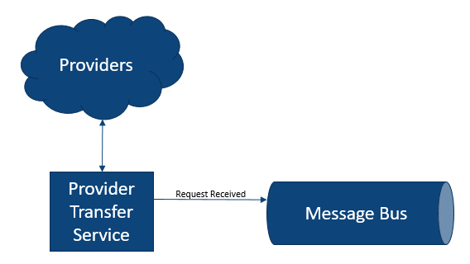
User Story 1-1: Design
We’ll simulate incoming requests for service by generating random requests in the Provider Transfer Service
Generally prefer PaaS (Platform as a Service) over IaaS (Infrastructure as a Service)

Slide 5
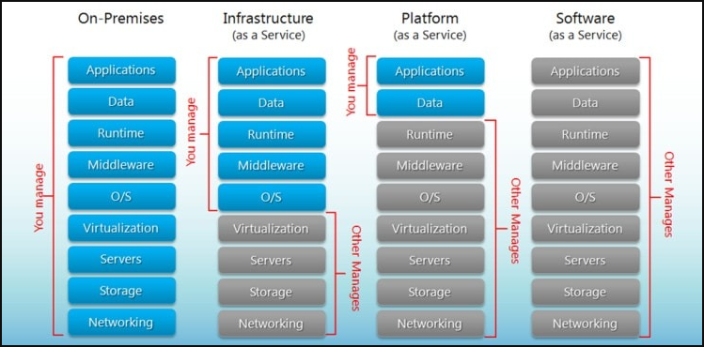
Cloud Maturity Model
https://www.hostingadvice.com/how-to/iaas-vs-paas-vs-saas/?_ga=2.28238708.972024003.1631988165-2010794804.1631988165

Slide 6
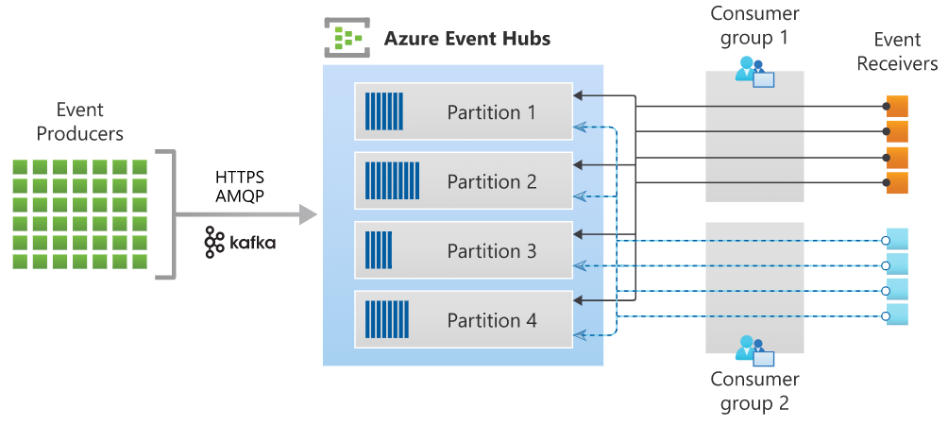
Message Bus: Azure Event Hub
Azure’s implementation of a real-time, asynchronous message stream
Similar to Kafka
Azure has many messaging options
Using Event Hub because
Can handle huge volumes – millions of messages per second
Can add consumers after messages published
Can replay messages (until removed)
Key Terms
Namespace (i.e. cluster)
Hub (i.e. topic)
Publisher (i.e. producer)
Consumer (i.e. subscriber)

Slide 7
Provider Transfer Service: Azure Function
Azure’s event-driven, serverless compute option
Automatically scales – up to 200 parallel instances
Possible triggers
HTTP call
Timer
Message arrived / event occurred
Database record created, updated, or deleted
BLOB created, updated, or deleted
Most often used in consumption mode – only charged for use
Based on number of executions, execution time, and memory used
Does have some limitations when compared to Azure App Services
We’ll discuss some of these in a later sprint

Slide 8
Task 1-1: Create Azure Event Hub
Develop in Azure Portal
Create Azure Hub Namespace
Name must globally unique (so we can’t all use the same name)
Pricing tier: Standard so we can have multiple consumer groups
Create Azure Hub for received requests
Create Shared Access Policy for publisher

Slide 9
Task 1-2: Provider Transfer Service
Simulate incoming requests by generating and sending randomly requests
Start with ThreeAmigosHealth.sln in Sprint1/Initial
Add Azure Functions / c# with Timer Trigger
Timer will send a request each time it fires
Use EventHubProducerClient from Azure.Messaging.EventHubs nugget package
Requires Shared Access Policy connection string from receivedrequest hub
Business logic in BusinessLogic project in solution

Slide 10
Task 1-3: Deploy to Azure
Publish from Visual Studio to Azure
Create Profile
Requires Azure credentials
Azure Windows / Linux
Double check Account, Subscription, Resource Group, and Location
New Function App
New Storage Account
Publish
Ensure messages making it to receivedrequest hub

Slide 11
Sprint 1: Retrospective
We have the beginning of our utilization management platform
Incoming requests are available to any platform components
We are taking advantage of asynchronous messaging
Publishing requests with little concern for who will consume them or how many consumers there will be
Everything about the platform is scalable

