Slide 1
Sprint 4
UI for Manual Decisions

Slide 2
To Do
Get request
Handle no current request
Approve / Disapprove
Clean Login Screen
Starting point
UI with a hard-coded, but dynamic request
Disabled dashboard
Stats for manually approved/disapproved
Assigned?
Make stats viewable from decision screen
Final solution for sprint 5
Arm scrips for sprint 5

Slide 3

User Story 4-1
As a TAH physician, I need to be able to view requests that have not been automatically approved so that I can determine if they should be approved or not.
Acceptance Criteria
Retrieve a request that has not been automatically approved
View request details
Approve or disapprove the request

Slide 4
User Story 4-1: Current Status
UI already exists with the ability to view a static request for service.
It does not have the ability to retrieve a request from the routing service.
UI developed in Blazor, but Blazor knowledge not required.
Blazor is a Microsoft ASP.NET tool for creating web UIs with C# instead of JavaScript, but can easily call JavaScript APIs and libraries.

Slide 5
Command vs Event
Event is something that has already occurred in the system
Command is something that someone or some component needs to be done and typically expects some form of response
The execution of a command can generate many events

Slide 6
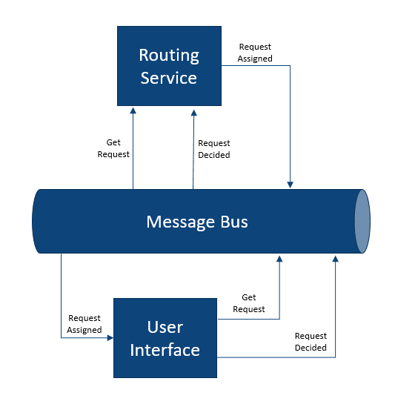
User Story 4-1: Design

Slide 7
User Interface Application
Prep
Shell application
Login / select specialty
View request
Approve / deny / more info
Dashboard???
In class
Send request for request to queue
Send updated requests to topic
Need more info???
Allows users to retrieve requests needing a decision based on their specialty
Users can
Approve a request
Deny a request
Request additional information
???Includes dashboard so users can track requests by specialty and status
??? User is notified of changes to requests they’ve recently touched???
Implemented as Blazor ??? Application and deployed as ???

Slide 8
User Story 4-1: Design Details
Just as we’re doing with service-to-service communications, we’re going to use async messaging to make a request from the UI to retrieve a request for the user.
Send a command to a new Azure Hub called getRequest to get the next request for the current user from the Routing Service.
The response will come on another new Hub called requestAssigned.
When the user makes a decision on a request, we’ll send an event to the requestDecided we’re already using from the Auto Approval service.

Slide 9
Task 4-1: Create Azure Event Hub
Similar to Task 1-1
Create getRequest Azure hub
Create Shared Access Policy for publisher

Slide 10
Task 4-2: Update UI to Get Next Request
Install Azure.Messaging.EventHubs.Producer

Slide 11
Task 4-3: Create requestAssigned Hub
Create requestAssigned Azure hub
Create Shared Access Policy for publisher

Slide 12
Task 4-4: Update UI to Display Assigned Request

Slide 13
Sprint 4: Retrospective
We now have an end-to-end solution for managing requests for health-care services.
Asynchronous messaging can be used with the UI, just as it is for service-to-service communications.
Asynchronous messaging can include requests and responses in addition to event notifications.
In comparison to real-time request/response, such as HTTP, managing expected responses requires a different approach
There can be multiple publishers of a single event.
Consider a field to identify publisher

Slide 14
Azure App Service
Azure’s PaaS option for hosting applications and containers
Key terms
App Service Plan
Features
Reliable
Scalable
CI/CI integration
Great integration for ASP.Net applications

