Slide 1
Sprint 3
Routing Service

Slide 2
***ToDo
Arm templates
Have Routing Service completely pre-packaged
Help students deploy
Talk through logic and key points

Slide 3

User Story 3-1

Slide 4
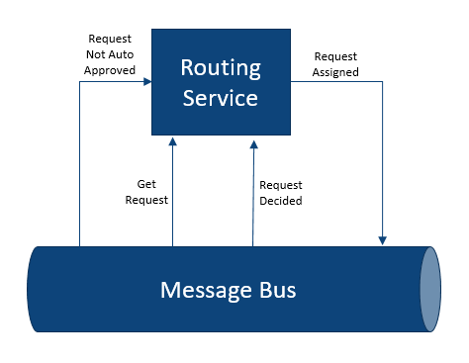
User Story 3-1: Design

Slide 5
Request Routing Service
Prep
Request class from generator
Router class
Get stats by specialty and state???
In class
1. Create Web API in VS
1. Subscribe to NotApproved topic/c#
1. Store requests in memory
1. Deploy to Azure app service
2. Subscribe to request command queue
2. Get request from router class
2. Send request via SignalR
2. Re-dDeploy to Azure app service
When users request work, this service routes a request to the user based on user’s role, request type, request priority, and request status
Also maintains the state of each request as they are received and worked by users
Needs review
Assigned to user
Needs additional documentation???
Approved
Denied
Receives incoming requests for service from the RequestNotApproved topic
Auto approved request don’t need routing so this service doesn’t need to subscribe to those
Implemented as an Asp.Net Core Web API deployed as an Azure App Service
For this workshop, requests will only be stored in memory. Normally the requests would be saved to persistent storage, such as Cosmos DB or Azure SQL

Slide 6
Task 3-1:
TODO

Slide 7
Sprint 3: Retrospective
TODO

