Slide 1
.Net state machines

Slide 2
Overview
Me
Workshop to understand
what finite state machines are
when state machine are needed
naïve, standard, and advanced state machines implementations

Slide 3
Getting started
Latest Visual Studio 2019 with ASP.NET and web development module
Clone repo: https://github.com/scottctr/StateMachineWorkshop

Slide 4
Exercise 1: intro
Pop sells gas, oil, and snacks
Has point of sale that works – needs new constraints for new employees
Current functionality
Modify items
Add
change quantity
delete
Accept payment
Give change
Start a new sale

Slide 5
The solution
Use Exercise1_Initial\PointOfSaleStateManagement.sln
Demo…
Logging
solution structure…
Unit tests

Slide 6
Exercise 1: new rules
Can only accept payment if balance < 0
Can only give change when balance > 0
No changes to paid sales
Paid = 0 balance, 1+ items, 1+ payments

Slide 7
Exercise 1: implementation details
Rules in Rules.txt
Changes should go in Data\Sale.cs or create new classes to be used by Sale.cs
i.e. don’t implement rules in UI
Couple of unit tests will require small changes – marked as TODO
When rules are violated, return appropriate ActionResult
IsSuccess = false and an error message
Be sure to address all TODOs
All unit tests should pass when new rules implemented

Slide 8
Exercise 1: new rules II
Need to be able to cancel a sale
If payments on sale, must give change for total payment amounts before cancelling
This negates rule 2: “Can only give change when balance > 0”
No changes to cancelled sales
Can’t modify items, add payments, give change, or cancel
Can’t create a new sale until current sale is paid or cancelled
Implementation note: Set Index.cs/IncludeCancel = true

Slide 9
Exercise 1: Retrospective
Need to recognize when state machine is needed
i.e. managing behavior/actions based on current state
Usually not presented as state management by product owners
Initially simple rules frequently grow complex over time
Naïve state machine implementations can become complex
Multiple Boolean flags, IF (<currentState>) {…}, switch statements, etc.
Frequently violate Single Responsibility and Open/Closed principles
Exercise1_Final\PointOfSaleStateManagement.sln is my version of this exercise

Slide 10
Lesson 1: recognize state based behavior
Very frequent pattern
Requirement/story language
“Only accept payment if balance < 0”
“only give change when balance > 0”
“No changes to paid sales”
“No changes to cancelled sale”
Code
Mutually exclusive Boolean flags
isOpen
isOverpaid
IsPaid
isCancelled
Repeated checks for state before actions
If (<objectState>) {…}
Switch (<objectState>) {...<doSomething>…}
Once you realize you need a state machine, next step is to create a state diagram

Slide 11
FINITE SET OF sale STATES
“payment if balance < 0” -> Open
Can modify items
If balance < 0, can pay
If payments = 0, can cancel
Can give change up to total payment amount
“balance > 0” -> Overpaid
Can give change up to total payment amount
Can modify items (possibly add in lieu of change)
Cannot pay
Cannot cancel
“cancelled sale” -> Cancelled
No actions allowed
“Paid sales” -> Completed
No actions allowed

Slide 12
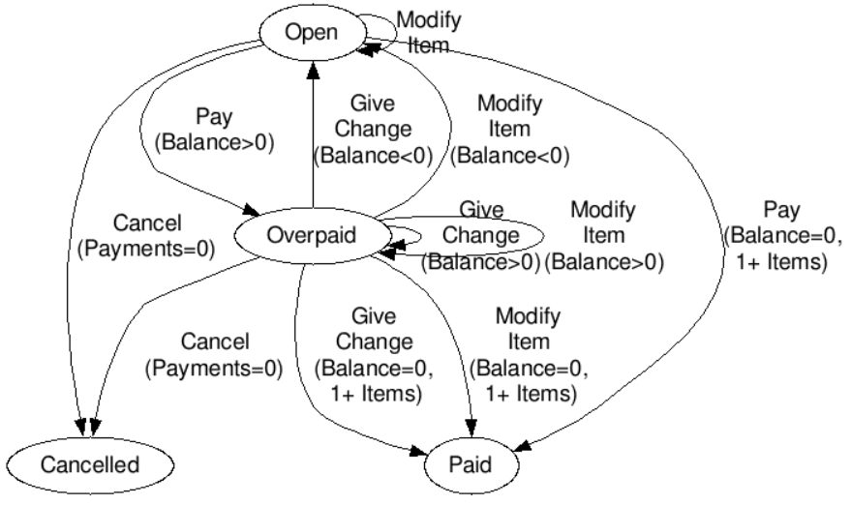
Sale State diagram

Slide 13
Lesson 2: state design pattern
The state design pattern is a well known implementation of a state machine
A base class/interface defines state based actions for the context
A concrete state implementation is created for each state (i.e. finite set of states)
Action methods implemented according to business rules
Action methods also transitions context’s state as needed
The context class has a reference to a concreate state (as base class)
Must be initialized to starting state
What about when loading????
The context forwards all actions to the state implementation
!!! https://refactoring.guru/design-patterns/state/csharp/example

Slide 14
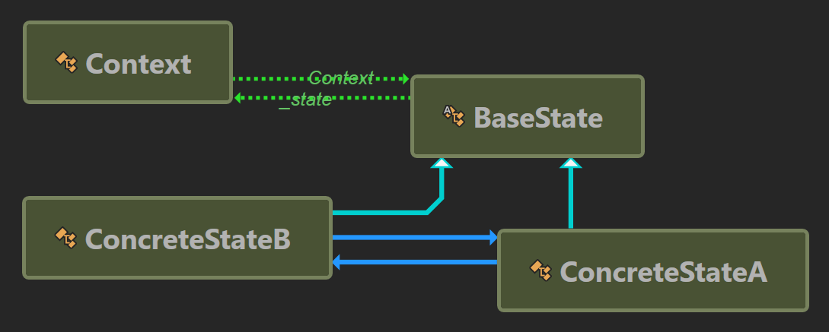
Sale State design

Slide 15
Exercise 2: implement sale state design
Start from Exercise2_Initial\PointOfSaleStateManagement.sln
The initial solution includes
Base class for the states (???!!!)
Stubbed out concrete states
Reference from sale to current state (initialized to Open)
Reference from state to sale
unit tests should pass when rules implemented

Slide 16
Exercise 2: Rules
Open: !Overpaid and !Cancelled and !Paid
Can modify items
If balance < 0, can pay
If payments = 0, can cancel
Can give change up to total payment amount
Overpaid: Balance > 0
Can give change
Can modify items (possibly add in lieu of change)
Cannot pay
Can give change up to previous payments amount, can cancel
Cancelled: Cancelled successfully executed
No actions allowed
Paid: Balance = 0, 1+ Items, 1+ Payments
No actions allowed

Slide 17
Exercise 2: Extra credit 1
Take advantage of similarities in states to reduce code duplication
Open/Overpaid
Can modify items
If balance < 0, can pay
Can give change up to total payment amount
Paid/Cancelled
No actions allowed
Each is just a marker for how it was finalized

Slide 18
Exercise 2: Extra credit 2
Account for loading a sale that wasn’t in the initial state when saved

Slide 19
Exercise 2: retrospective
Logic organized, componentized, and much cleaner
Removes many conditionals and/or switches in most naïve implementations
Explicit action defined for every state
Can require writing lots code
<number of methods> = ~(<number of states> * <number of actions>) + <number of transitions>
Without care, can lead to code duplication
SOLID design principles alignment
single responsibility principle : Concrete states manage actions and transitions
open/closed principle: adding new states can require changes to existing states
Can take some work to derive overall workflow from concrete states
Exercise2_Final\PointOfSaleStateManagement.sln is my version of this exercise

Slide 20
Improving upon the state design pattern
What if we could…
Reduce the amount of code required by the state design pattern?
Including the likelihood of duplicate code
Better align with SOLID principles?
Make it easy to derive workflow from state machine implementation?

Slide 21
Lesson 3: State management libraries
Define and configure states in a simple format
Transitions and conditions
Substates
Shortcuts for common transition patterns
Define actions on state transition events
Entry, Exit, Reenter
Automatically transition after an action
AutoForward/Fallback
Dynamically define transitions at run time
Derive workflow from code
Excel table
State diagram
Available libraries…
Note that “Actions” are frequently referred to as “triggers”, “events”, or “trigger events”

Slide 22
Exercise 3: sale state machine with library
Start from Exercise3_Initial\PointOfSaleStateManagement.sln
NStateManager already loaded
???Only make changes to Sale.cs
Skip the UI constraints
unit tests should pass when new rules implemented

Slide 23
Exercise 3: implementation details

Slide 24
Exercise 3: retrospective
Exercise3_Final\PointOfSaleStateManagement.sln is my version of this exercise

Slide 25
summary
recognize need manage state
More of a technical responsibility than business/product owner
Avoid managing multiple state flags, confusing if blocks, and lengthy switch statements
Understand the state design, consider using one of the available libraries to overcome its anti-patterns

