Slide 1
Contributing to OpenStack 201:
For the Not-so-New Contributor

Slide 2
About us
Andrea Rosa:
- Software Engineer @ hp
- Midclass OpenStack citizen* since Diablo release
- Twitter: @reclaro
- Email: andrea.rosa@hpe.com
- irc: andrearosa (not a registered nick yet :( )
Scott D'Angelo
- Senior Software Engineer @HP
- HP Public Cloud and Helion since Folsom release
- Email: scott.dangelo@hpe.com
- irc: scottda

Slide 3

Middle class OpenStack citizen

Slide 4




OpenStack contributors
MiddleClass

Slide 5

Share suggestions and tips

Slide 6


We do not want to get...
BANNED
BANNED

Slide 7

Share the pain
I've got a -1 on
my Patch set
Number 45
Because of a
Trailing white
Space

Slide 8

Why we are here

Slide 9


Slide 10

OpenStack community

Slide 11
What slow down the process: bad review
- 1

Slide 12

What slow down the process: you

Slide 13

What slow down the process: core reviewers

Slide 14
One Core Reviewers Most Annoying Thing:
“Bad Commit Messages”
“Poor explanation of a patch's purpose.”

Slide 15

Annoying Commit Messages:
“Bad Commit Messages”

Slide 16

Annoying:
no attempt to read the openstack guidelines

Slide 17

Annoying:
“Poor explanation of a patch's purpose.”

Slide 18
Commit Message < 72 characters
[openstack-dev] [all] -1 due to line length violation in commit messages Ihar Hrachyshka
[openstack-dev] [all] -1 due to line length violation in commit messages Dmitry Tantsur
[openstack-dev] [all] -1 due to line length violation in commit messages Vikram Choudhary
[openstack-dev] [all] -1 due to line length violation in commit messages Doug Hellmann
[openstack-dev] [all] -1 due to line length violation in commit messages Ivan Kolodyazhny
[openstack-dev] [all] -1 due to line length violation in commit messages Daniel P. Berrange
[openstack-dev] [all] -1 due to line length violation in commit messages Julien Danjou
[openstack-dev] [all] -1 due to line length violation in commit messages Victor Stinner
[openstack-dev] [all] -1 due to line length violation in commit messages Ryan Brown
[openstack-dev] [all] -1 due to line length violation in commit messages Thomas Goirand
[openstack-dev] [all] -1 due to line length violation in commit messages Jeremy Stanley
[openstack-dev] [all] -1 due to line length violation in commit messages Jim Rollenhagen
[openstack-dev] [all] -1 due to line length violation in commit messages Fox, Kevin M
[openstack-dev] [all] -1 due to line length violation in commit messages Russell Bryant
[openstack-dev] [all] -1 due to line length violation in commit messages Jeremy Stanley
[openstack-dev] [all] -1 due to line length violation in commit messages Ian Wells
[openstack-dev] [all] -1 due to line length violation in commit messages Morgan Fainberg
[openstack-dev] [all] -1 due to line length violation in commit messages Gorka Eguileor
[openstack-dev] [all] -1 due to line length violation in commit messages Miguel Angel Ajo
[openstack-dev] [all] -1 due to line length violation in commit messages Andreas Jaeger
[openstack-dev] [all] -1 due to line length violation in commit messages Gorka Eguileor
[openstack-dev] [all] -1 due to line length violation in commit messages Zane Bitter
[openstack-dev] [all] -1 due to line length violation in commit messages Assaf Muller
[openstack-dev] [all] -1 due to line length violation in commit messages Kyle Mestery
[openstack-dev] [all] -1 due to line length violation in commit messages Jeremy Stanley
[openstack-dev] [all] -1 due to line length violation in commit messages Kevin Benton
[openstack-dev] [all] -1 due to line length violation in commit messages Clint Byrum
[openstack-dev] [all] -1 due to line length violation in commit messages Gorka Eguileor
[openstack-dev] [all] -1 due to line length violation in commit messages Mike Spreitzer
[openstack-dev] [all] -1 due to line length violation in commit messages Assaf Muller
[openstack-dev] [all] -1 due to line length violation in commit messages Doug Wiegley
[openstack-dev] [all] -1 due to line length violation in commit messages Clint Byrum
[openstack-dev] [all] -1 due to line length violation in commit messages Fox, Kevin M
[openstack-dev] [all] -1 due to line length violation in commit messages Ihar Hrachyshka
[openstack-dev] [all] -1 due to line length violation in commit messages Zane Bitter

Slide 19

Testing

Slide 20

New feature

Slide 21

No Unit Tests

Slide 22

Bug fixing
Write a RED test
Fix the code

Slide 23

There is always a reason to -1
Nitpicking
Opinion over style
Grammar error and Typos
Give a 0

Slide 24
Annoying:
“Nothing, really. Every annoyance probably refers to a person not knowing the workflow. Therefore, it's just a new opportunity to share, explain and improve. I guess I'm really annoyed by jerks but we don't have those... not many at least ;) “

Slide 25
Annoying:
“Other reviewers not reading history of patch sets, also nitpicking.”
“-1s that are for matters of opinion over style, or grammar errors that don't matter“

Slide 26


Typos and grammar

Slide 27
Suggestion: use conventional english
Super fish oil
Is not
Superficial

Slide 28

Suggestion: read the history of the patch

Slide 29

Advice:
figure out what the project priorities are at this time and ask PTL where you can help.

Slide 30
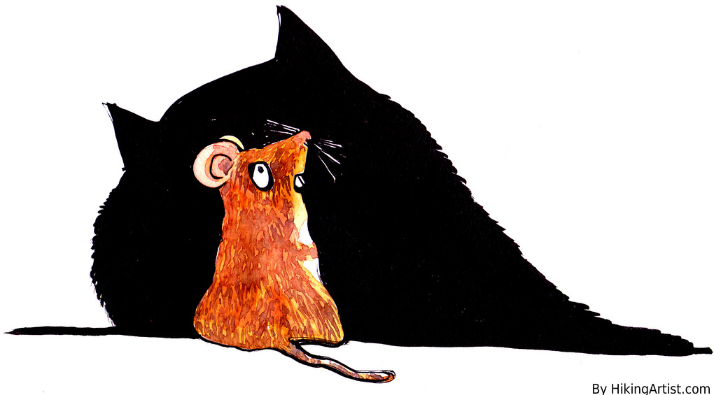
Typos attract Type A's

Slide 31

Advice:
“Be prepared to be patient, reviews and merging take time. Even quick, simple things can often take a couple of weeks to crank through the system. “

Slide 32

Advice:
“Be prepared to be patient, reviews and merging take time. Even quick, simple things can often take a couple of weeks to crank through the system. “

Slide 33

Commit Message:
Should Have Bug or Blueprint Reference for tracking
Should not link to information, should contain the information

Slide 34
Add atomic conditional updates to objects
To allow atomic state changes across Cinder services we need to
implement a way to easily do compare-and-swap.
This patch adds methods to allow compare-and-swap on DB models and on
Cinder Versioned Objects as well.
Conditions for the compare part of the update can consist of:
- Inclusion: status == 'available'
- Exclusion: status != 'in-use'
- Multi-inclusion: status in ('available', 'error')
- Multi-exclusion: status not in ('attaching', 'in-use')
- Sqlalchemy filters
A complete example of usage would be the compare-and-swap used in volume
delete requests that has to take in consideration not only the status
but the attach and migration status as well as the volume not having
snapshots:
now = timeutils.utcnow()
expected = {'attach_status': db.Not('attached'),
'migration_status': None,
'consistencygroup_id': None}
good_status = ('available', 'error', 'error_restoring',
'error_extending')
if not force:
expected.update(status=good_status)
# Volume cannot have snapshots if we want to delete it
filters = [~sql.exists().where(models.Volume.id ==
models.Snapshot.volume_id)]
updated = vol_obj.conditional_update(
{'status': 'deleting',
'previous_status': vol_obj.model.status,
'terminated_at': now},
expected,
filters)
It can also be specified whether to save already dirtied fields from the
objects or not and by default (if no expected_values argument is
provided) it will make sure that the entry in the DB has the same values
as the objected we are saving.
We can select values based on conditions using Case objects in the
'values' argument. For example:
has_snapshot_filter = sql.exists().where(
models.Snapshot.volume_id == models.Volume.id)
case_values = volume.Case([(has_snapshot_filter, 'has-snapshot')],
else_='no-snapshot')
volume.conditional_update({'status': case_values},
{'status': 'available'}))
Exclusion and multi-exclusion will handle, by default, NULL values like
Python does instead of like SQL does, so NULL values will be considered
different than any non NULL values. That way if we search for something
not equal to 1 we will also get NULL values.

Slide 35


Slide 36
Testing Tools
Run Unit tests on your Workstation!
Pep8 is your friend

Slide 37

Manually Test the Code

Slide 38

Timing:
“Major Features can take longer than one release. Start early to gather opinions and discuss, write Blueprints and Specs, post POC code...”

Slide 39
IRC
Advice:
“Pay Attention”
“Ask more questions in IRC & ML & IRL“

Slide 40


Slide 41
Reviews
Advice:
“Read more reviews!!”
“Review as much as possible”

Slide 42
Annoying:
Submitters arguing when they are asked to change something.

Slide 43


Slide 44


Slide 45
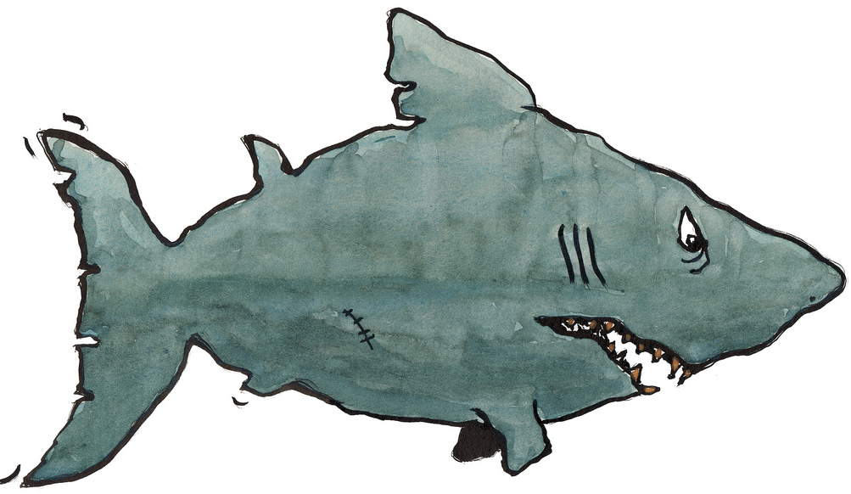
Annoying:
“patch authors that bully, guilt trip, or otherwise coerce people into reviewing their patches”

Slide 46

Influence and Fame
:

Slide 47
How Much are you Influenced by the Author:
“A lot, because if I know the author I'm likely to have an opinion of their competence.“

Slide 48
Advice:
“ Be prepared to stand up for your design decisions if you think they are right, at least for the first person who disagrees. If you change your code every time somebody makes a suggestion, then you can end up being flipped and flopped between two choices. Wait for consensus, and if one doesn't seem to be emerging, ask a core to get one for you.”

Slide 49
Advice:
“ Not all -1s are created equally. A doubtful -1 from a none core can be ignored by cores when merging, but if you post up a new patch then it has to wait for CI etc to run again, and often falls down core review queues.”

Slide 50
Advice:
Do more reviews, see where the project is going and make sure it applies to existing deployments, users, and use cases.

Slide 51
“Dissenting viewpoints are tolerated, not well represented, and generally ignored (or glossed over) with consensus-based decision making.”

Slide 52
“Minority views can overly tolerated. It is very easy for one person to make a big stink about a small issue which the community does not agree with. From an outsiders perspective this can be damaging to the project or community as they do not have context for the discussion. Incumbent core reviewers can have minority view points and are allowed to push to a project in a certain way which is very difficult to dissuade without intervention from other cores.”

Slide 53


