Slide 1
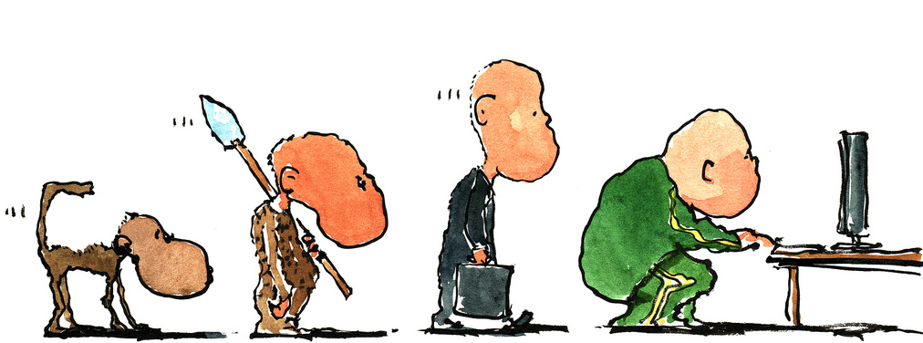
Contributing to OpenStack 201:
For the Not-so-New Contributor
Notes:
Scott: Begin.

Slide 2
What we are going to say
Notes:
Scott: We'll share our experiences, we'll share some pain. We've conducted a survery of contributors, some Core members, PTLs, new , old contributors. We'll share their advice and things that bother them.
Blah blah

Slide 3
About us
Andrea Rosa:
- Software Engineer @ hp
- Midclass OpenStack citizen* since Diablo release
- Twitter: @reclaro
- Email: andrea.rosa@hpe.com
- irc: andrearosa (not a registered nick yet :( )
Scott D'Angelo
- Senior Software Engineer @HP
- HP Public Cloud and Helion since Folsom release
- Email: scott.dangelo@hpe.com
- irc: scottda
Notes:
Andrea: himself
Scott: himself

Slide 4

Middle class OpenStack citizen
Notes:
Andrea:

Slide 5




OpenStack contributors
MiddleClass
Notes:
Andrea: Describe Newbie. Describe Rock Star
Scott: Describe Middle Class

Slide 6

Share suggestions and tips
Notes:
Scott: We sent out an anonymous survery.
Analyze results
The following questions.

Slide 7


We do not want to get...
BANNED
BANNED
Notes:
Andrea:

Slide 8

Share the pain
I've got a -1 on
my Patch set
Number 45
Because of a
Trailing white
Space
Notes:
Scott:

Slide 9

Why we are here
Notes:
Andrea:

Slide 10


Slide 11

OpenStack community
Notes:
Scott: OS is a nice community, but very busy
It can be like a traffic jam, things can slow down...

Slide 12
What slows down the process: bad review
- 1
Notes:
Andrea:

Slide 13

What slows down the process: you
Notes:
Scott: Bad Commit message
Typos
Format
There are things the author can control, so control them!

Slide 14
Annoying:
“Bad Commit Messages”
“Poor explanation of a patch's purpose.”
Notes:
Scott:

Slide 15
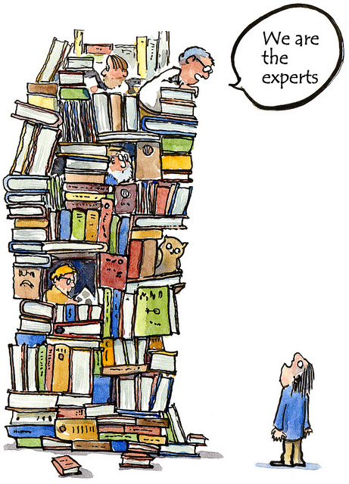
What slows down the process: core reviewers
Notes:
Andrea:

Slide 16
Annoying: don't be rude....
Notes:
Andrea:

Slide 17

Annoying Commit Messages:
“Bad Commit Messages”
Notes:
Scott: Common complaint
Include typos, grammer, length of commit

Slide 18
Commit Message < 72 characters
[openstack-dev] [all] -1 due to line length violation in commit messages Ihar Hrachyshka
[openstack-dev] [all] -1 due to line length violation in commit messages Dmitry Tantsur
[openstack-dev] [all] -1 due to line length violation in commit messages Vikram Choudhary
[openstack-dev] [all] -1 due to line length violation in commit messages Doug Hellmann
[openstack-dev] [all] -1 due to line length violation in commit messages Ivan Kolodyazhny
[openstack-dev] [all] -1 due to line length violation in commit messages Daniel P. Berrange
[openstack-dev] [all] -1 due to line length violation in commit messages Julien Danjou
[openstack-dev] [all] -1 due to line length violation in commit messages Victor Stinner
[openstack-dev] [all] -1 due to line length violation in commit messages Ryan Brown
[openstack-dev] [all] -1 due to line length violation in commit messages Thomas Goirand
[openstack-dev] [all] -1 due to line length violation in commit messages Jeremy Stanley
[openstack-dev] [all] -1 due to line length violation in commit messages Jim Rollenhagen
[openstack-dev] [all] -1 due to line length violation in commit messages Fox, Kevin M
[openstack-dev] [all] -1 due to line length violation in commit messages Russell Bryant
[openstack-dev] [all] -1 due to line length violation in commit messages Jeremy Stanley
[openstack-dev] [all] -1 due to line length violation in commit messages Ian Wells
[openstack-dev] [all] -1 due to line length violation in commit messages Morgan Fainberg
[openstack-dev] [all] -1 due to line length violation in commit messages Gorka Eguileor
[openstack-dev] [all] -1 due to line length violation in commit messages Miguel Angel Ajo
[openstack-dev] [all] -1 due to line length violation in commit messages Andreas Jaeger
[openstack-dev] [all] -1 due to line length violation in commit messages Gorka Eguileor
[openstack-dev] [all] -1 due to line length violation in commit messages Zane Bitter
[openstack-dev] [all] -1 due to line length violation in commit messages Assaf Muller
[openstack-dev] [all] -1 due to line length violation in commit messages Kyle Mestery
[openstack-dev] [all] -1 due to line length violation in commit messages Jeremy Stanley
[openstack-dev] [all] -1 due to line length violation in commit messages Kevin Benton
[openstack-dev] [all] -1 due to line length violation in commit messages Clint Byrum
[openstack-dev] [all] -1 due to line length violation in commit messages Gorka Eguileor
[openstack-dev] [all] -1 due to line length violation in commit messages Mike Spreitzer
[openstack-dev] [all] -1 due to line length violation in commit messages Assaf Muller
[openstack-dev] [all] -1 due to line length violation in commit messages Doug Wiegley
[openstack-dev] [all] -1 due to line length violation in commit messages Clint Byrum
[openstack-dev] [all] -1 due to line length violation in commit messages Fox, Kevin M
[openstack-dev] [all] -1 due to line length violation in commit messages Ihar Hrachyshka
[openstack-dev] [all] -1 due to line length violation in commit messages Zane Bitter
Notes:
Scott: long running thread about whether 72 character limit is still a good idea, is it a “must” or “should”

Slide 19

Annoying:
no attempt to read the openstack guidelines
http://docs.openstack.org/infra/manual/developers.html
Notes:
Andrea: The takeaway of this is to find the openstack guidelines and Read Them. Memorize them! Live them!
TODO: post link in slide

Slide 20

Annoying:
“Poor explanation of a patch's purpose.”
Notes:
Scott: communication here is important. This is documentation for the patch that lives in the git log.

Slide 21

Commit Message:
Should Have Bug or Blueprint Reference for tracking
Should not link to information, should contain the information
Notes:
Andrea:

Slide 22
Add atomic conditional updates to objects
To allow atomic state changes across Cinder services we need to
implement a way to easily do compare-and-swap.
This patch adds methods to allow compare-and-swap on DB models and on
Cinder Versioned Objects as well.
Conditions for the compare part of the update can consist of:
- Inclusion: status == 'available'
- Exclusion: status != 'in-use'
- Multi-inclusion: status in ('available', 'error')
- Multi-exclusion: status not in ('attaching', 'in-use')
- Sqlalchemy filters
A complete example of usage would be the compare-and-swap used in volume
delete requests that has to take in consideration not only the status
but the attach and migration status as well as the volume not having
snapshots:
now = timeutils.utcnow()
expected = {'attach_status': db.Not('attached'),
'migration_status': None,
'consistencygroup_id': None}
good_status = ('available', 'error', 'error_restoring',
'error_extending')
if not force:
expected.update(status=good_status)
# Volume cannot have snapshots if we want to delete it
filters = [~sql.exists().where(models.Volume.id ==
models.Snapshot.volume_id)]
updated = vol_obj.conditional_update(
{'status': 'deleting',
'previous_status': vol_obj.model.status,
'terminated_at': now},
expected,
filters)
It can also be specified whether to save already dirtied fields from the
objects or not and by default (if no expected_values argument is
provided) it will make sure that the entry in the DB has the same values
as the objected we are saving.
We can select values based on conditions using Case objects in the
'values' argument. For example:
has_snapshot_filter = sql.exists().where(
models.Snapshot.volume_id == models.Volume.id)
case_values = volume.Case([(has_snapshot_filter, 'has-snapshot')],
else_='no-snapshot')
volume.conditional_update({'status': case_values},
{'status': 'available'}))
Exclusion and multi-exclusion will handle, by default, NULL values like
Python does instead of like SQL does, so NULL values will be considered
different than any non NULL values. That way if we search for something
not equal to 1 we will also get NULL values.
Notes:
Scott: Break up into 2-3 slides that are bigger

Slide 23
Add atomic conditional updates to objects
To allow atomic state changes across Cinder services we need to
implement a way to easily do compare-and-swap.
This patch adds methods to allow compare-and-swap on DB models and on
Cinder Versioned Objects as well.
Conditions for the compare part of the update can consist of:
- Inclusion: status == 'available'
- Exclusion: status != 'in-use'
- Multi-inclusion: status in ('available', 'error')
- Multi-exclusion: status not in ('attaching', 'in-use')
- Sqlalchemy filters
A complete example of usage would be the compare-and-swap used in volume
delete requests that has to take in consideration not only the status
but the attach and migration status as well as the volume not having
snapshots:

Slide 24
now = timeutils.utcnow()
expected = {'attach_status': db.Not('attached'),
'migration_status': None,
'consistencygroup_id': None}
good_status = ('available', 'error', 'error_restoring',
'error_extending')
if not force:
expected.update(status=good_status)
# Volume cannot have snapshots if we want to delete it
filters = [~sql.exists().where(models.Volume.id ==
models.Snapshot.volume_id)]
updated = vol_obj.conditional_update(
{'status': 'deleting',
'previous_status': vol_obj.model.status,
'terminated_at': now},
expected,
filters)
It can also be specified whether to save already dirtied fields from the
objects or not and by default (if no expected_values argument is
provided) it will make sure that the entry in the DB has the same values
as the objects we are saving.

Slide 25
We can select values based on conditions using Case objects in the
'values' argument. For example:
has_snapshot_filter = sql.exists().where(
models.Snapshot.volume_id == models.Volume.id)
case_values = volume.Case([(has_snapshot_filter, 'has-snapshot')],
else_='no-snapshot')
volume.conditional_update({'status': case_values},
{'status': 'available'}))
Exclusion and multi-exclusion will handle, by default, NULL values like
Python does instead of like SQL does, so NULL values will be considered
different than any non NULL values. That way if we search for something
not equal to 1 we will also get NULL values.
WARNING: SQLAlchemy does not allow selecting order of SET clauses, so
for now we cannot do things like
{'previous_status': model.status, 'status': 'retyping'}
because it will result in both previous_status and status being set to
'retyping'. Issue has been reported [1] and a patch to fix it [2] has
been submitted.
[1]: https://bitbucket.org/zzzeek/sqlalchemy/issues/3541
[2]: https://github.com/zzzeek/sqlalchemy/pull/200

Slide 26
Specs: https://review.openstack.org/232599/
Implements: blueprint cinder-volume-active-active-support
Related-Bug: #1490944
Related-Bug: #1238093
Related-Bug: #1490946
Related-Bug: #1469659
Related-Bug: #1493120
Related-Bug: #1493419
Related-Bug: #1493476
Related-Bug: #1494466

Slide 27

Testing
Notes:
Andrea:

Slide 28

New feature
Notes:
Andrea:

Slide 29

No Unit Tests
Notes:
Scott: Fast way to a -1 is not unit tests

Slide 30

Pep8 and Tox

Slide 31

Bug fixing
Write a RED test
Fix the code
Notes:
Andrea:

Slide 32

There is always a reason to -1
Nitpicking
Opinion over style
Grammar error and Typos
Give a 0
Notes:
Andrea: Add survey response

Slide 33
Annoying:
“Nothing, really. Every annoyance probably refers to a person not knowing the workflow. Therefore, it's just a new opportunity to share, explain and improve. I guess I'm really annoyed by jerks but we don't have those... not many at least ;) “
Notes:
Scott: nice example of turning something annoying into a way to help.
You can learn the workflow to avoid mistakes, and you can share your knowledge to help others.

Slide 34


Typos and grammar
Notes:
Andrea:

Slide 35
Annoying:
“-1s that are for matters of opinion over style, or grammar errors that don't matter“
Notes:
Scott: In Cinder we're trying to change the culture on avoiding -1 for nits

Slide 36
Suggestion: use conventional english
Super fish oil
Is not
Superficial
Notes:
Andrea:

Slide 37

Suggestion: read the history of the patch
Notes:
Andrea:

Slide 38
Annoying:
“Other reviewers not reading history of patch sets, also nitpicking.”
Notes:
Andrea:

Slide 39

Advice:
figure out what the project priorities are at this time and ask PTL where you can help.
Notes:
Scott:

Slide 40

Respond reviews ASAP
Notes:
Andrea: When you got a review with some comments try to go back to it as soon as you can.
Same if you are doing reviews
TODO: put advice in quotes, here or next slide

Slide 41

Co-authoring
Notes:
Andrea: Co-authoring can give good results in speed up a patch, for example it the co-author is on a different TZ but you need to have a good communication
Scott: Your partner may be busy. Be prepared to post a fix for their bugs, respond for them, or take over
NOTE: Andrea and Scott have never met until now. We've had to use Google Hangout, IRC, GitHub, to colloborate virtually.

Slide 42
Todo: patch for nova spec with 58 patch sets...then abandoned

Slide 43
Reference Version:
Patch Set 1
85ecbdd47826e24c427f8e038ed90efb4099ff2f (gitweb)
Patch Set 2
55397acd139f947688b9df78cd915272a7a874e9 (gitweb)
Patch Set 3
662128d2ef6a964630e5ea24e5a2977d3f75b725 (gitweb)
Patch Set 4
c622ba1133f1f160e38f4e725719f711dbaffb85 (gitweb)
Patch Set 5
1c0b289711452c289f6e6193dc30c45cf058faef (gitweb)
Patch Set 6
ce6d55d8aac0dcec81f1e66c914c78d130b7a362 (gitweb)
Patch Set 7
27c82a454b842b8e82bd38d21a8739c14f6d6364 (gitweb)
Patch Set 8
09ec2fef8699b64872d0051268b6a9350f5b78ff (gitweb)
Patch Set 9
07cbd9108e9bdb1ca7d121ea53255ef8f46b5bd4 (gitweb)
Patch Set 10
3c39ae61fc1e434c6012d6231eb0147e3c610b1e (gitweb)
Patch Set 11
e1f31279a50004a0ec39ac06fba298e8d4db69ae (gitweb)
Patch Set 12
4b4a98c895a9dbf2fe76ca7be0ca47fb2205c01a (gitweb)
Patch Set 13
7a50293597dd1e45daceaa22094d9b3d1f08ae8e (gitweb)
Patch Set 14
d50dca39145804c6ddd1d384e7aabf12f70747c0 (gitweb)
Patch Set 15
92347633bf81da9ee0743803550954b2a6e4cace (gitweb)
Patch Set 16
1f5474c37217295c5b288f2410c93e64a11c1fa2 (gitweb)
Patch Set 17
10007759347bbb0e779cec93131beabaa4af0151 (gitweb)
Patch Set 18
36e6a9d489efc05c14e570931e5a890114fab27a (gitweb)
Patch Set 19
9bf6f8c34cd66fe851ff55eecf5fb27f59a8f754 (gitweb)
Patch Set 20
ab02df25067c37688d9f14db8e540e57ce1918b5 (gitweb)
Patch Set 21
dc6bd9543898b448408f95c77f82b098bd45b5d1 (gitweb)
Patch Set 22
64800e62de5e0f9b2dddc3a77bd1bb4a35fa4940 (gitweb)
Patch Set 23
b7179b36ce083b6d6d733901233b212d052839e0 (gitweb)
Patch Set 24
4e42b19f5b71d2c9f64481131e5377f25eaa72e4 (gitweb)
Patch Set 25
e18b9a633fcc95a084f13c43694e8464198e08a7 (gitweb)
Patch Set 26
baf392f63fb356d59f20e633216cbc6dc549dfff (gitweb)
Patch Set 27
3a9411af77cfd2710cffd007c6b3412faf70fcba (gitweb)
Patch Set 28
584604aeb2d25947d62324faf0b5cafc77ec416a (gitweb)
Patch Set 29
8f498b481bccaa3029ac0604511d2dc87b047b8f (gitweb)
Patch Set 30
003fe8c09713c231eb166e15186e2f25e652fef6 (gitweb)
Patch Set 31
7df45be07dce2d6931a53a82e84081afec041aca (gitweb)
Patch Set 32
03cd63a2810c4207a8d406cf5d01e1587d2e14db (gitweb)
Patch Set 33
14a6cf3b4beee82d53206f2d95c5a4a4aba90e88 (gitweb)
Patch Set 34
14bf7f2bb9886ad97c321567911d4bb86b59b8d3 (gitweb)
Patch Set 35
b4ed92c9806d2163f85998c42f948eb4343bd61a (gitweb)
Patch Set 36
b0eaf3f462bd13fb2b042654deee1ef2929a4da4 (gitweb)
Patch Set 37
4b97e1215816918f43908e717609f5b625329934 (gitweb)
Patch Set 38
3c4d80351e4b794b8bce4db97ddb7a49e2503bfc (gitweb)
Patch Set 39
18a8792285552d8b6ef88e1c493646ab57cd5549 (gitweb)
Patch Set 40
4c3ad9676eae44f58ee00547e53b469530a01758 (gitweb)
Patch Set 41
14a4102042608f888185ab03305c7de37ba721db (gitweb)
Patch Set 42
ff303133e28dc4a0dd6897283a057fd6bf299932 (gitweb)
Patch Set 43
fede8baa5c1fa8cd93b601c8276f8566deb3f309 (gitweb)
Patch Set 44
4abf90d6d0e769a480895158748158f5df1eb044 (gitweb)
Patch Set 45
504c3841ff1abd280760720d5f9b4228abec99a0 (gitweb)
Patch Set 46
29b21d381b9fbbc076e470ef3ee5d16324c8e755 (gitweb)
Patch Set 47
26fa25b1fb33556f00c810387eb18b815b615684 (gitweb)
Patch Set 48
7f84828bcb7689f6a25a50636b3a28f9a8c64413 (gitweb)
Patch Set 49
1bd892d373d924c73c3b3185be4f5a8e7831a976 (gitweb)
Patch Set 50
179b4fcabf221158254ac52caa9fb5aac098c036 (gitweb)
Patch Set 51
b3e8d30935880665aa689c61ee55aa78738bee70 (gitweb)
Patch Set 52
4e4497a82671baea6300d4e475052f850d3d2896 (gitweb)
Patch Set 53
43732d210ec9830a9aba45c98332051a85383cee (gitweb)
Author
wanghao<wanghao749@huawei.com>Mar 30, 2014 9:51 PM
Committer
scottda<scott.dangelo@hp.com>Jul 30, 2015 5:38 PM
Parent(s)
c58093b2742bdd771516a580e074e2ef679d9f7c
Merge "Proposes Implements RequestSpec object"
Download
checkoutpullcherry-pickpatchAnonymous HTTPSSHHTTPgit fetch https://review.openstack.org/openstack/nova-specs refs/changes/48/84048/53 && git checkout FETCH_HEAD
File Path
Comments
Size
Diff
Reviewed
Commit Message
2 comments
Side-by-Side
Unified
A
specs/liberty/approved/add-force-detach-to-nova.rst
150 lines
Side-by-Side
Unified
+150, -0
All Side-by-Side
All Unified
Comments
Expand RecentExpand AllCollapse All
wanghao
Uploaded patch set 2.
Mar 31, 2014
huangtianhua
Patch Set 2: I would prefer that you didn't merge this
Mar 31, 2014
huangtianhua
Patch Set 1: (3 inline comments)
Mar 31, 2014
Russell Bryant
Patch Set 2: Do not merge We're not quite ready to open up spec reviews …
Mar 31, 2014
Russell Bryant
Patch Set 2: No score
Mar 31, 2014
Dan Smith
Patch Set 2: I would prefer that you didn't merge this (6 inline …
Mar 31, 2014
wanghao
Patch Set 2: (6 inline comments) to Dan Smith: Thank you very much, I …
Mar 31, 2014
wanghao
Uploaded patch set 3.
Mar 31, 2014
wanghao
Uploaded patch set 4.
Mar 31, 2014
wanghao
Uploaded patch set 5.
Mar 31, 2014
wanghao
Uploaded patch set 6.
Apr 1, 2014
wanghao
Uploaded patch set 7.
Apr 1, 2014
wanghao
Uploaded patch set 8.
Apr 1, 2014
John Garbutt
Patch Set 8: I would prefer that you didn't merge this (14 inline …
Apr 1, 2014
Dan Smith
Patch Set 8: (1 inline comment)
Apr 1, 2014
wanghao
Patch Set 8: (11 inline comments)
Apr 1, 2014
wanghao
Uploaded patch set 9.
Apr 3, 2014
wanghao
Uploaded patch set 10.
Apr 3, 2014
liusheng
Patch Set 10: Looks good to me, but someone else must approve
Apr 4, 2014
huangtianhua
Patch Set 10: I would prefer that you didn't merge this (3 inline …
Apr 4, 2014
Dan Smith
Patch Set 10: I would prefer that you didn't merge this (3 inline …
Apr 4, 2014
wanghao
Patch Set 10: (6 inline comments)
Apr 8, 2014
wanghao
Uploaded patch set 11.
Apr 8, 2014
ling-yun
Patch Set 11: Looks good to me, but someone else must approve
Apr 8, 2014
huangtianhua
Patch Set 11: Looks good to me, but someone else must approve
Apr 8, 2014
Ken'ichi Ohmichi
Patch Set 11: I would prefer that you didn't merge this (5 inline …
Apr 8, 2014
Phil Day
Patch Set 11: I would prefer that you didn't merge this (5 inline …
Apr 8, 2014
wanghao
Patch Set 11: (10 inline comments)
Apr 9, 2014
wanghao
Uploaded patch set 12.
Apr 9, 2014
Daniel Berrange
Patch Set 12: I would prefer that you didn't merge this (1 inline …
Apr 9, 2014
wanghao
Patch Set 12: (1 inline comment)
Apr 9, 2014
wanghao
Uploaded patch set 13.
Apr 9, 2014
Phil Day
Patch Set 13: Looks good to me, but someone else must approve
Apr 9, 2014
Ken'ichi Ohmichi
Patch Set 11: (1 inline comment)
Apr 9, 2014
wanghao
Uploaded patch set 14.
Apr 9, 2014
wanghao
Uploaded patch set 15.
Apr 9, 2014
wanghao
Uploaded patch set 16.
Apr 9, 2014
wanghao
Uploaded patch set 17.
Apr 9, 2014
wanghao
Uploaded patch set 18.
Apr 9, 2014
wanghao
Uploaded patch set 19.
Apr 9, 2014
wanghao
Uploaded patch set 20.
Apr 9, 2014
Trivial Rebase
Patch Set 20: New patchset patch-id matches previous patchset, but …
Apr 9, 2014
wanghao
Uploaded patch set 21.
Apr 9, 2014
Trivial Rebase
Patch Set 21: New patchset patch-id matches previous patchset, but …
Apr 9, 2014
wanghao
Uploaded patch set 22.
Apr 9, 2014
Trivial Rebase
Patch Set 22: New patchset patch-id matches previous patchset, but …
Apr 9, 2014
huangtianhua
Patch Set 22: Looks good to me, but someone else must approve
Apr 9, 2014
John Garbutt
Patch Set 22: (3 inline comments) Many thanks for the hard work on this, …
Apr 11, 2014
John Garbutt
Patch Set 22: I would prefer that you didn't merge this
Apr 11, 2014
wanghao
Patch Set 22: (3 inline comments)
Apr 13, 2014
wanghao
Uploaded patch set 23.
Apr 13, 2014
ling-yun
Patch Set 23: Looks good to me, but someone else must approve
Apr 17, 2014
Ken'ichi Ohmichi
Patch Set 23: I would prefer that you didn't merge this (6 inline …
Apr 22, 2014
wanghao
Patch Set 23: (3 inline comments)
Apr 23, 2014
Ken'ichi Ohmichi
Patch Set 23: (1 inline comment)
Apr 23, 2014
wanghao
Patch Set 23: (1 inline comment)
Apr 23, 2014
wanghao
Patch Set 23: (3 inline comments)
Apr 23, 2014
wanghao
Uploaded patch set 24.
Apr 23, 2014
wanghao
Uploaded patch set 25.
Apr 23, 2014
Trivial Rebase
Patch Set 25: New patchset patch-id matches previous patchset, but …
Apr 23, 2014
wanghao
Uploaded patch set 26.
Apr 23, 2014
Trivial Rebase
Patch Set 26: New patchset patch-id matches previous patchset, but …
Apr 23, 2014
wanghao
Uploaded patch set 27.
Apr 23, 2014
wanghao
Uploaded patch set 28.
Apr 23, 2014
Trivial Rebase
Patch Set 28: New patchset patch-id matches previous patchset, but …
Apr 23, 2014
Ken'ichi Ohmichi
Patch Set 28: I would prefer that you didn't merge this (6 inline …
Apr 23, 2014
wanghao
Patch Set 28: (6 inline comments)
Apr 23, 2014
wanghao
Uploaded patch set 29.
Apr 23, 2014
Ken'ichi Ohmichi
Patch Set 29: Looks good to me, but someone else must approve LGTM, …
Apr 23, 2014
John Garbutt
Patch Set 29: Code-Review+2 (4 comments) Many thanks, its much easier to …
Apr 28, 2014
liusheng
Patch Set 29: Code-Review+1 ++
Apr 28, 2014
huangtianhua
Patch Set 29: Code-Review+1
Apr 28, 2014
wanghao
Patch Set 29: (4 comments)
Apr 28, 2014
Phil Day
Patch Set 29: Code-Review+1
May 2, 2014
wanghao
Uploaded patch set 30.
May 3, 2014
wanghao
Uploaded patch set 31.
May 3, 2014
John Garbutt
Patch Set 31: Code-Review-1 (3 comments) Sorry, I forgot before, we need …
May 7, 2014
wanghao
Patch Set 31: (1 comment)
May 7, 2014
wanghao
Uploaded patch set 32.
May 7, 2014
Phil Day
Patch Set 32: Code-Review+1
May 9, 2014
Joe Gordon
Patch Set 32: Code-Review-1 (4 comments) Can you clarify the problem …
May 9, 2014
wanghao
Patch Set 32: (3 comments)
May 10, 2014
Nikola Dipanov
Patch Set 32: Code-Review-1 (1 comment)
May 21, 2014
John Garbutt
Patch Set 32: Code-Review-2 So there seems to be agreement we should fix …
May 21, 2014
John Garbutt
Abandoned This spec looks to be abandoned, so I am marking this as …
Jun 25, 2014
John Garbutt
Restored
May 20 2:50 PM
John Garbutt
Patch Set 32: Code-Review-1 please resubmit for liberty
May 20 2:50 PM
wanghao
Uploaded patch set 33.
May 20 9:18 PM
wanghao
Patch Set 33: Resubmit for liberty
May 20 9:18 PM
wanghao
Uploaded patch set 34.
May 21 12:37 AM
wanghao
Uploaded patch set 35.
May 21 12:54 AM
wanghao
Uploaded patch set 36.
May 21 1:12 AM
wanghao
Uploaded patch set 37.
May 21 2:01 AM
wanghao
Uploaded patch set 38.
May 21 2:32 AM
wanghao
Uploaded patch set 39.
May 21 2:45 AM
Paul Murray
Patch Set 39: Code-Review-1 (2 comments) I do support this spec, but …
May 21 10:45 AM
wanghao
Patch Set 39: Hi Paul, I agree with you to update the use case in this …
May 21 8:40 PM
wanghao
Uploaded patch set 40.
May 22 3:23 AM
wanghao
Uploaded patch set 41.
May 26 12:25 AM
wanghao
Uploaded patch set 42.
May 26 12:38 AM
Matthew Gilliard
Patch Set 42: Code-Review-1 Please add "APIImpact" to the commit so that …
May 26 7:00 AM
wanghao
Patch Set 42: @Matthew, Sure, have done.
May 26 8:07 PM
wanghao
Uploaded patch set 43.
May 26 8:09 PM
Andrea Rosa
Patch Set 43: Code-Review-1 (2 comments) Thanks for the spec. I added a …
May 27 2:44 AM
wanghao
Patch Set 43: (2 comments) @Andrea: Sure, I will update it soon.
May 27 3:01 AM
wanghao
Uploaded patch set 44.
May 27 3:08 AM
jichenjc
Patch Set 44: (5 comments)
May 28 10:13 AM
Andrea Rosa
Patch Set 44: (1 comment) I have a question about the notification, can …
May 29 4:25 AM
Scott DAngelo
Patch Set 44: (3 comments)
Jun 3 4:22 PM
Andrea Rosa
Patch Set 44: (1 comment)
Jun 4 3:41 AM
John Garbutt
Patch Set 44: Code-Review-1 (5 comments) This seems almost ready to …
Jun 8 11:12 AM
wanghao
Patch Set 44: (6 comments)
Jun 9 12:28 AM
wanghao
Uploaded patch set 45.
Jun 9 12:29 AM
Andrea Rosa
Uploaded patch set 46.
Jun 9 4:36 AM
Paul Murray
Patch Set 46: Code-Review+1 (1 comment) One nit but otherwise good to go …
Jun 10 7:38 PM
Andrea Rosa
Patch Set 46: (1 comment)
Jun 11 3:42 AM
Andrea Rosa
Uploaded patch set 47.
Jun 11 3:42 AM
Matthew Gilliard
Patch Set 47: (3 comments) Couple of nits inline, and a question.
Jun 11 3:59 AM
Andrea Rosa
Patch Set 47: (3 comments) @Matthew I replied to your comments.
Jun 11 4:49 AM
Andrea Rosa
Uploaded patch set 48.
Jun 11 4:50 AM
Matthew Gilliard
Patch Set 48: Code-Review+1 Thanks for explaining
Jun 11 4:51 AM
John Garbutt
Patch Set 44: (3 comments)
Jun 12 7:05 AM
John Garbutt
Patch Set 48: Code-Review+2 Nice job, thanks for pushing on this one.
Jun 12 7:08 AM
Scott DAngelo
Patch Set 44: (1 comment)
Jun 12 8:28 AM
Nikola Dipanov
Patch Set 48: Code-Review-1 (4 comments) -1 as this is just adding …
Jun 12 10:29 AM
Joe Gordon
Patch Set 48: Code-Review-1 (2 comments) Nikola makes some good points. …
Jun 15 1:42 AM
wanghao
Patch Set 48: (2 comments)
Jun 15 4:36 AM
Andrea Rosa
Patch Set 48: (4 comments) Thanks for the reviews. I replied to the …
Jun 15 4:40 AM
Scott DAngelo
Patch Set 48: (3 comments) I agree that it is important to improve the …
Jun 15 9:17 AM
Paul Murray
Patch Set 48: (2 comments) Hi All, I talked to Nikola in IRC about …
Jun 15 9:35 AM
Nikola Dipanov
Patch Set 48: (3 comments) A suggestion inline on how to make this …
Jun 15 3:43 PM
Scott DAngelo
Patch Set 48: (1 comment) I agree that this situation is a great example …
Jun 15 4:06 PM
Joe Gordon
Patch Set 48: I would rather priorize fixing the nova/cinder integration …
Jun 16 2:08 AM
Joe Gordon
Patch Set 48: I would rather prioritize fixing the nova/cinder …
Jun 16 2:09 AM
wanghao
Patch Set 48: I fell it's not conflict between nova/cinder integration …
Jun 16 3:09 AM
Nikola Dipanov
Patch Set 48: wanghao - well we should really try to design this …
Jun 17 7:27 AM
Duncan Thomas
Patch Set 48: Code-Review+1 (1 comment) Reply to Nikola inline.
Jun 17 7:37 AM
Nikola Dipanov
Patch Set 48: (1 comment) Back at Duncan - also inline
Jun 17 9:50 AM
John Garbutt
Patch Set 48: To be clear, we are currently forcing our users to manually …
Jun 22 6:03 AM
Nikola Dipanov
Patch Set 48: -Code-Review Removing my -1. I have lost all hope that …
Jun 22 6:36 AM
Andrea Rosa
Patch Set 48: We can probably find a solution which doesn't require to …
Jun 22 8:03 AM
Duncan Thomas
Patch Set 48: -Code-Review @Andrea Rosa That actually sounds like a …
Jun 22 9:07 AM
wanghao
Patch Set 48: @Andrea, Duncan, There are some points need to be clarity …
Jun 22 8:55 PM
Andrea Rosa
Patch Set 48: @wanghao the idea is to change the code to allow nova to …
Jun 23 2:06 AM
wanghao
Patch Set 48: @Andrea, Thanks for clarification. I feel good with your …
Jun 24 12:35 AM
Nikola Dipanov
Patch Set 48: FWIW - this is exactly what I've been saying all along in …
Jun 24 4:32 AM
Walter A. Boring IV (hemna)
Patch Set 48: Code-Review-1 (2 comments)
Jun 24 10:38 AM
Jay Pipes
Patch Set 48: Code-Review-1 I am a really strong -1 on this proposal. …
Jun 24 1:37 PM
Matt Riedemann
Patch Set 48: (5 comments)
Jun 25 11:50 AM
Jay Pipes
Patch Set 48: (1 comment)
Jun 25 11:53 AM
wanghao
Patch Set 48: (2 comments) Update this spec according folks'comments and …
Jun 28 9:43 PM
wanghao
Uploaded patch set 49.
Jun 28 10:22 PM
ijw-ubuntu
Patch Set 49: Code-Review-1 (3 comments)
Jun 28 10:38 PM
wanghao
Uploaded patch set 50.
Jun 29 12:57 AM
wanghao
Uploaded patch set 51.
Jun 29 1:00 AM
wanghao
Patch Set 49: (3 comments)
Jun 29 1:01 AM
Andrea Rosa
Patch Set 51: I am a bit lost here. My understanding is that: we agree …
Jul 13 10:14 AM
John Garbutt
Patch Set 51: This seems to have got lost in the gaps. I think we are …
Jul 15 7:19 AM
John Garbutt
Patch Set 51: Code-Review-2 So I should vote on this, I think the …
Jul 15 7:20 AM
wanghao
Patch Set 51: @John, I'm glad that we can have consensus to solve this …
Jul 15 7:00 PM
wanghao
Patch Set 51: @Andrea, I think the bug like is correct, but looks like …
Jul 15 7:06 PM
wanghao
Abandoned There is a consensus that we don't need a spec but a bug fix to …
Jul 15 7:08 PM
John Garbutt
Restored
Jul 24 10:40 AM
Mike Perez
Patch Set 48: Does anyone here have the bug people keep talking about? I …
Jul 24 10:40 AM
Mike Perez
Patch Set 48: found it https://bugs.launchpad.net/nova/+bug/1449221
Jul 24 10:48 AM
Scott DAngelo
Uploaded patch set 52.
Jul 30 3:52 PM
Jay Pipes
Patch Set 52: Code-Review+1 (1 comment) Left a note you might want to …
Jul 30 5:31 PM
Scott DAngelo
Uploaded patch set 53.
Jul 30 5:39 PM
Scott DAngelo
Patch Set 52: (1 comment)
Jul 30 5:40 PM
Jay Pipes
Patch Set 53: Code-Review+1 John, this is something that has a very high …
Aug 1 9:42 AM
John Garbutt
Patch Set 53: Jay, I am (more than) happy for this work to go ahead. If …
Aug 6 4:45 AM
Matt Riedemann
Patch Set 53: (1 comment)
Aug 6 9:19 AM
wanghao
Patch Set 53: (1 comment) @Jay and John, As we discussed before, it's …
Aug 6 9:52 AM
wanghao
Aug 6 9:57 AM
Abandoned
As we discussed before, it's not affecting Rest API and we could abandon this spec. Code is reviewing now(https://review.openstack.org/#/c/184537/), so we may merge it soon. This spec will be abandoned. Of course, if there is still something that requires more discussion, it can be restored again.

Slide 44


Slide 45


Slide 46


Slide 47


Slide 48


Slide 49


Slide 50


Slide 51

Advice:
“Be prepared to be patient, reviews and merging take time. Even quick, simple things can often take a couple of weeks to crank through the system. “
Notes:
Try to re-use Image

Slide 52

Advice:
“Be prepared to be patient, reviews and merging take time. Even quick, simple things can often take a couple of weeks to crank through the system. “
Notes:
Scott:

Slide 53
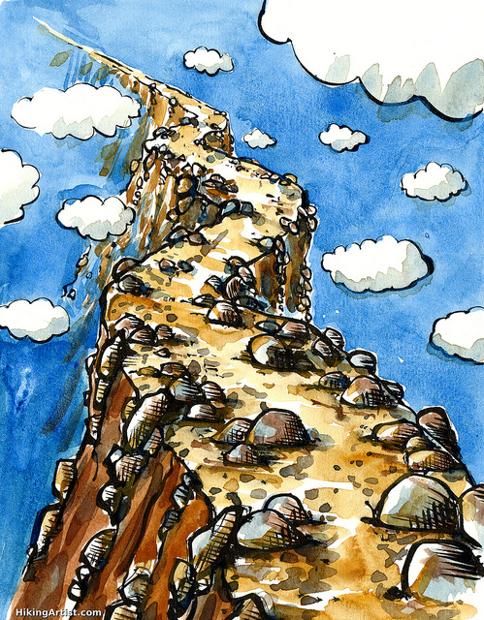
It is never easy
Notes:
Andrea: Gives example
TODO: use fish image

Slide 54

Notes:
Andrea:

Slide 55

Notes:
Andrea:

Slide 56
“What could possibly go wrong?”
Notes:
Andrea:

Slide 57

Notes:
Andrea:

Slide 58

8 Patches
5 weeks
13 modified files
Not “just a single line change”
Notes:
Andrea:

Slide 59

It is never easy
Notes:
Scott: You don't really ever know everything, that's why we do reviews
Many things are discovered during the process of review. Be Prepared!

Slide 60

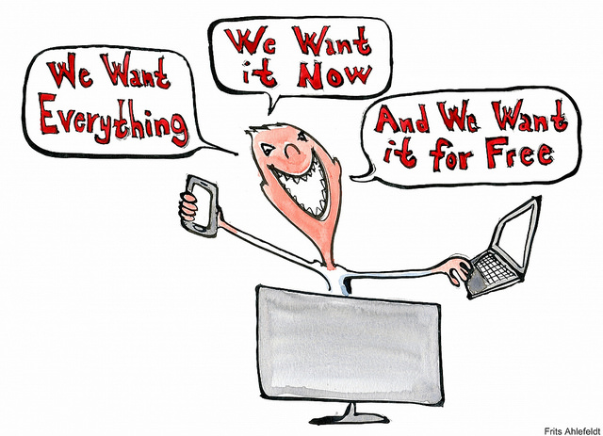
Set your goal in advance
Notes:
Andrea: Discuss employer demands, different expectaions

Slide 61

Timing:
“Major Features can take longer than one release. Start early to gather opinions and discuss, write Blueprints and Specs, post POC code...”
Notes:
Scott: Waiting for the summit to introduce a feature is usually too late for that release.
If you are here, now, with a feature idea, it may be too late!!
Andrea: Specs should be ready, before your project opens for spec. Nova example
Scott: If you're very proactive, have POC code ready. You can submit WIP code and the few most interested can start to look.

Slide 62

Get Known!
Advice:
“Pay Attention”
“Ask more questions in IRC & ML & IRL“

Slide 63


Slide 64
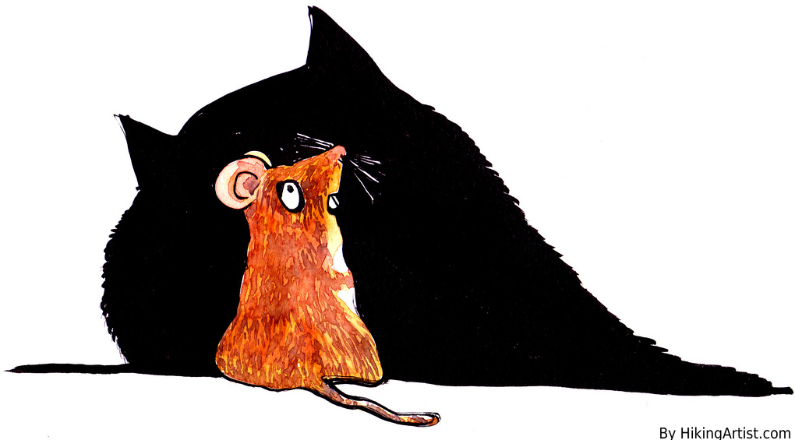
Typos attract Type A's

Slide 65
Reviews
Advice:
“Read more reviews!!”
“Review as much as possible”

Slide 66
Annoying:
Submitters arguing when they are asked to change something.

Slide 67


Slide 68


Slide 69

Annoying:
“patch authors that bully, guilt trip, or otherwise coerce people into reviewing their patches”

Slide 70

Influence and Fame
:

Slide 71
How Much are you Influenced by the Author:
“A lot, because if I know the author I'm likely to have an opinion of their competence.“

Slide 72
Advice:
“ Be prepared to stand up for your design decisions if you think they are right, at least for the first person who disagrees. If you change your code every time somebody makes a suggestion, then you can end up being flipped and flopped between two choices. Wait for consensus, and if one doesn't seem to be emerging, ask a core to get one for you.”

Slide 73
Advice:
“ Not all -1s are created equally. A doubtful -1 from a none core can be ignored by cores when merging, but if you post up a new patch then it has to wait for CI etc to run again, and often falls down core review queues.”

Slide 74
Advice:
Do more reviews, see where the project is going and make sure it applies to existing deployments, users, and use cases.

Slide 75
“Dissenting viewpoints are tolerated, not well represented, and generally ignored (or glossed over) with consensus-based decision making.”

Slide 76
“Minority views can overly tolerated. It is very easy for one person to make a big stink about a small issue which the community does not agree with. From an outsiders perspective this can be damaging to the project or community as they do not have context for the discussion. Incumbent core reviewers can have minority view points and are allowed to push to a project in a certain way which is very difficult to dissuade without intervention from other cores.”

Slide 77


