Slide 1
Contributing to OpenStack 201:
For the Not-so-New Contributor

Slide 2
Why are we here?
To learn from experience
To get Advice from others
To be better contributors
To have fun

Slide 3
About us
Andrea Rosa:
- Software Engineer @ hp
- Midclass OpenStack citizen* since Diablo release
- Twitter: @reclaro
- Email: andrea.rosa@hpe.com
- irc: andrearosa (not a registered nick yet :( )
Scott D'Angelo
- Senior Software Engineer @HP
- HP Public Cloud and Helion since Folsom release
- irc: scottda

Slide 4

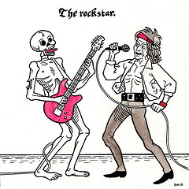
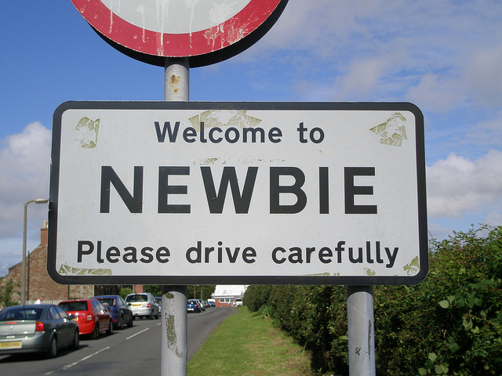

OpenStack contributors
MiddleClass

Slide 5

Middle class OpenStack citizen

Slide 6
Advice:
“Be prepared to be patient, reviews and merging take time. Even quick, simple things can often take a couple of weeks to crank through the system. “

Slide 7

Commit Messages
Bait for -1
Don't Feed the Bears!!

Slide 8
One Core Reviewers Most Annoying Thing:
“Bad Commit Messages”
“Poor explanation of a patch's purpose.”

Slide 9
Commit Message < 72 characters
[openstack-dev] [all] -1 due to line length violation in commit messages Ihar Hrachyshka
[openstack-dev] [all] -1 due to line length violation in commit messages Dmitry Tantsur
[openstack-dev] [all] -1 due to line length violation in commit messages Vikram Choudhary
[openstack-dev] [all] -1 due to line length violation in commit messages Doug Hellmann
[openstack-dev] [all] -1 due to line length violation in commit messages Ivan Kolodyazhny
[openstack-dev] [all] -1 due to line length violation in commit messages Daniel P. Berrange
[openstack-dev] [all] -1 due to line length violation in commit messages Julien Danjou
[openstack-dev] [all] -1 due to line length violation in commit messages Victor Stinner
[openstack-dev] [all] -1 due to line length violation in commit messages Ryan Brown
[openstack-dev] [all] -1 due to line length violation in commit messages Thomas Goirand
[openstack-dev] [all] -1 due to line length violation in commit messages Jeremy Stanley
[openstack-dev] [all] -1 due to line length violation in commit messages Jim Rollenhagen
[openstack-dev] [all] -1 due to line length violation in commit messages Fox, Kevin M
[openstack-dev] [all] -1 due to line length violation in commit messages Russell Bryant
[openstack-dev] [all] -1 due to line length violation in commit messages Jeremy Stanley
[openstack-dev] [all] -1 due to line length violation in commit messages Ian Wells
[openstack-dev] [all] -1 due to line length violation in commit messages Morgan Fainberg
[openstack-dev] [all] -1 due to line length violation in commit messages Gorka Eguileor
[openstack-dev] [all] -1 due to line length violation in commit messages Miguel Angel Ajo
[openstack-dev] [all] -1 due to line length violation in commit messages Andreas Jaeger
[openstack-dev] [all] -1 due to line length violation in commit messages Gorka Eguileor
[openstack-dev] [all] -1 due to line length violation in commit messages Zane Bitter
[openstack-dev] [all] -1 due to line length violation in commit messages Assaf Muller
[openstack-dev] [all] -1 due to line length violation in commit messages Kyle Mestery
[openstack-dev] [all] -1 due to line length violation in commit messages Jeremy Stanley
[openstack-dev] [all] -1 due to line length violation in commit messages Kevin Benton
[openstack-dev] [all] -1 due to line length violation in commit messages Clint Byrum
[openstack-dev] [all] -1 due to line length violation in commit messages Gorka Eguileor
[openstack-dev] [all] -1 due to line length violation in commit messages Mike Spreitzer
[openstack-dev] [all] -1 due to line length violation in commit messages Assaf Muller
[openstack-dev] [all] -1 due to line length violation in commit messages Doug Wiegley
[openstack-dev] [all] -1 due to line length violation in commit messages Clint Byrum
[openstack-dev] [all] -1 due to line length violation in commit messages Fox, Kevin M
[openstack-dev] [all] -1 due to line length violation in commit messages Ihar Hrachyshka
[openstack-dev] [all] -1 due to line length violation in commit messages Zane Bitter

Slide 10
TypeOs
Typos attract Type A's
Can be useful for getting attention to your patch

Slide 11
Lacks Bug or Blueprint reference
Don't use links to info, put in the info

Slide 12
Add atomic conditional updates to objects
To allow atomic state changes across Cinder services we need to
implement a way to easily do compare-and-swap.
This patch adds methods to allow compare-and-swap on DB models and on
Cinder Versioned Objects as well.
Conditions for the compare part of the update can consist of:
- Inclusion: status == 'available'
- Exclusion: status != 'in-use'
- Multi-inclusion: status in ('available', 'error')
- Multi-exclusion: status not in ('attaching', 'in-use')
- Sqlalchemy filters
A complete example of usage would be the compare-and-swap used in volume
delete requests that has to take in consideration not only the status
but the attach and migration status as well as the volume not having
snapshots:
now = timeutils.utcnow()
expected = {'attach_status': db.Not('attached'),
'migration_status': None,
'consistencygroup_id': None}
good_status = ('available', 'error', 'error_restoring',
'error_extending')
if not force:
expected.update(status=good_status)
# Volume cannot have snapshots if we want to delete it
filters = [~sql.exists().where(models.Volume.id ==
models.Snapshot.volume_id)]
updated = vol_obj.conditional_update(
{'status': 'deleting',
'previous_status': vol_obj.model.status,
'terminated_at': now},
expected,
filters)
It can also be specified whether to save already dirtied fields from the
objects or not and by default (if no expected_values argument is
provided) it will make sure that the entry in the DB has the same values
as the objected we are saving.
We can select values based on conditions using Case objects in the
'values' argument. For example:
has_snapshot_filter = sql.exists().where(
models.Snapshot.volume_id == models.Volume.id)
case_values = volume.Case([(has_snapshot_filter, 'has-snapshot')],
else_='no-snapshot')
volume.conditional_update({'status': case_values},
{'status': 'available'}))
Exclusion and multi-exclusion will handle, by default, NULL values like
Python does instead of like SQL does, so NULL values will be considered
different than any non NULL values. That way if we search for something
not equal to 1 we will also get NULL values.

Slide 13
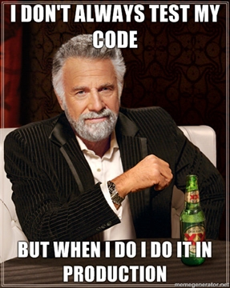
Testing

Slide 14
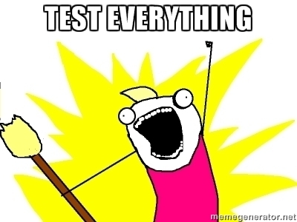
New feature

Slide 15
No Unit Tests
-1

Slide 16
Testing Tools
Run Unit tests on your Workstation!
Manually test the code!
Pep8 is your friend

Slide 17

Bug fixing
Write a RED test
Fix the code

Slide 18
Golden Rules
New feature
  Unit tests: Mandatory
  Functional Tests: Very Nice to have, in some cases mandatory
BUG fixing
  99% Unit test is still mandatory. Probably the bug is there because there is not enough tests for it.
  Write a failing test to prove the bug and then fix it: You rock!

Slide 20
IRC
Advice:
“Pay Attention”
“Ask more questions in IRC & ML & IRL“

Slide 21
Reviews
Advice:
“Read more reviews!!”
“Review as much as possible”

Slide 22
Annoying:
“Other reviewers not reading history of patch sets, also nitpicking.”
“-1s that are for matters of opinion over style, or grammar errors that don't matter“

Slide 23
Influence and Fame

Slide 24
How much are you influenced by the author?
“A lot, because if I know the author I'm likely to have an opinion of their competence.“

Slide 25
Advice:
“ Be prepared to stand up for your design decisions if you think they are right, at least for the first person who disagrees. If you change your code every time somebody makes a suggestion, then you can end up being flipped and flopped between two choices. Wait for conscientious, and if one doesn't seem to be emerging, ask a core to get one for you.”

Slide 26
Advice:
“ Not all -1s are created equally. A doubtful -1 from a none core can be ignored by cores when merging, but if you post up a new patch then it has to wait for CI etc to run again, and often falls down core review queues.”

