Slide 1
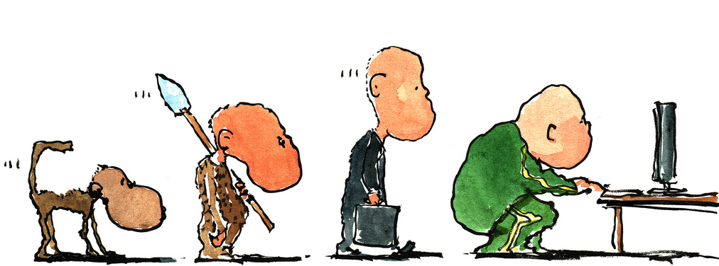
Contributing to OpenStack 201:
For the Not-so-New Contributor
Notes:
Scott: Begin.

Slide 2
What we are going to say
Notes:
Scott: We'll share our experiences, we'll share some pain. We've conducted a survery of contributors, some Core members, PTLs, new , old contributors. We'll share their advice and things that bother them.
Blah blah

Slide 3
About us
Andrea Rosa:
- Software Engineer @ hp
- Midclass OpenStack citizen* since Diablo release
- Twitter: @reclaro
- Email: andrea.rosa@hpe.com
- irc: andrearosa (not a registered nick yet :( )
Scott D'Angelo
- Senior Software Engineer @HP
- HP Public Cloud and Helion since Folsom release
- Email: scott.dangelo@hpe.com
- irc: scottda
Notes:
Andrea: himself
Scott: himself

Slide 4

Middle class OpenStack citizen
Notes:
Andrea:

Slide 5




OpenStack contributors
MiddleClass
Notes:
Andrea: Describe Newbie. Describe Rock Star
Scott: Describe Middle Class

Slide 6

Share suggestions and tips
Notes:
Scott: We sent out an anonymous survery.
Analyze results
The following questions.

Slide 7


We do not want to get...
BANNED
BANNED
Notes:
Andrea:

Slide 8

Share the pain
I've got a -1 on
my Patch set
Number 45
Because of a
Trailing white
Space
Notes:
Scott:

Slide 9

Why we are here
Notes:
Andrea:

Slide 10


Slide 11

OpenStack community
Notes:
Scott: OS is a nice community, but very busy
It can be like a traffic jam, things can slow down...

Slide 12
What slows down the process: bad review
- 1
Notes:
Andrea:

Slide 13

What slows down the process: you
Notes:
Scott: Bad Commit message
Typos
Format
There are things the author can control, so control them!

Slide 14
Annoying:
“Bad Commit Messages”
“Poor explanation of a patch's purpose.”
Notes:
Scott:

Slide 15

What slows down the process: core reviewers
Notes:
Andrea:

Slide 16
Annoying: don't be rude....
Notes:
Andrea:

Slide 17

Annoying Commit Messages:
“Bad Commit Messages”
Notes:
Scott: Common complaint
Include typos, grammer, length of commit

Slide 18
Commit Message < 72 characters
[openstack-dev] [all] -1 due to line length violation in commit messages Ihar Hrachyshka
[openstack-dev] [all] -1 due to line length violation in commit messages Dmitry Tantsur
[openstack-dev] [all] -1 due to line length violation in commit messages Vikram Choudhary
[openstack-dev] [all] -1 due to line length violation in commit messages Doug Hellmann
[openstack-dev] [all] -1 due to line length violation in commit messages Ivan Kolodyazhny
[openstack-dev] [all] -1 due to line length violation in commit messages Daniel P. Berrange
[openstack-dev] [all] -1 due to line length violation in commit messages Julien Danjou
[openstack-dev] [all] -1 due to line length violation in commit messages Victor Stinner
[openstack-dev] [all] -1 due to line length violation in commit messages Ryan Brown
[openstack-dev] [all] -1 due to line length violation in commit messages Thomas Goirand
[openstack-dev] [all] -1 due to line length violation in commit messages Jeremy Stanley
[openstack-dev] [all] -1 due to line length violation in commit messages Jim Rollenhagen
[openstack-dev] [all] -1 due to line length violation in commit messages Fox, Kevin M
[openstack-dev] [all] -1 due to line length violation in commit messages Russell Bryant
[openstack-dev] [all] -1 due to line length violation in commit messages Jeremy Stanley
[openstack-dev] [all] -1 due to line length violation in commit messages Ian Wells
[openstack-dev] [all] -1 due to line length violation in commit messages Morgan Fainberg
[openstack-dev] [all] -1 due to line length violation in commit messages Gorka Eguileor
[openstack-dev] [all] -1 due to line length violation in commit messages Miguel Angel Ajo
[openstack-dev] [all] -1 due to line length violation in commit messages Andreas Jaeger
[openstack-dev] [all] -1 due to line length violation in commit messages Gorka Eguileor
[openstack-dev] [all] -1 due to line length violation in commit messages Zane Bitter
[openstack-dev] [all] -1 due to line length violation in commit messages Assaf Muller
[openstack-dev] [all] -1 due to line length violation in commit messages Kyle Mestery
[openstack-dev] [all] -1 due to line length violation in commit messages Jeremy Stanley
[openstack-dev] [all] -1 due to line length violation in commit messages Kevin Benton
[openstack-dev] [all] -1 due to line length violation in commit messages Clint Byrum
[openstack-dev] [all] -1 due to line length violation in commit messages Gorka Eguileor
[openstack-dev] [all] -1 due to line length violation in commit messages Mike Spreitzer
[openstack-dev] [all] -1 due to line length violation in commit messages Assaf Muller
[openstack-dev] [all] -1 due to line length violation in commit messages Doug Wiegley
[openstack-dev] [all] -1 due to line length violation in commit messages Clint Byrum
[openstack-dev] [all] -1 due to line length violation in commit messages Fox, Kevin M
[openstack-dev] [all] -1 due to line length violation in commit messages Ihar Hrachyshka
[openstack-dev] [all] -1 due to line length violation in commit messages Zane Bitter
Notes:
Scott: long running thread about whether 72 character limit is still a good idea, is it a “must” or “should”

Slide 19

Annoying:
no attempt to read the openstack guidelines
http://docs.openstack.org/infra/manual/developers.html
Notes:
Andrea: The takeaway of this is to find the openstack guidelines and Read Them. Memorize them! Live them!
TODO: post link in slide

Slide 20

Annoying:
“Poor explanation of a patch's purpose.”
Notes:
Scott: communication here is important. This is documentation for the patch that lives in the git log.

Slide 21

Commit Message:
Should Have Bug or Blueprint Reference for tracking
Should not link to information, should contain the information
Notes:
Andrea:

Slide 22
Add atomic conditional updates to objects
To allow atomic state changes across Cinder services we need to
implement a way to easily do compare-and-swap.
This patch adds methods to allow compare-and-swap on DB models and on
Cinder Versioned Objects as well.
Conditions for the compare part of the update can consist of:
- Inclusion: status == 'available'
- Exclusion: status != 'in-use'
- Multi-inclusion: status in ('available', 'error')
- Multi-exclusion: status not in ('attaching', 'in-use')
- Sqlalchemy filters
A complete example of usage would be the compare-and-swap used in volume
delete requests that has to take in consideration not only the status
but the attach and migration status as well as the volume not having
snapshots:
now = timeutils.utcnow()
expected = {'attach_status': db.Not('attached'),
'migration_status': None,
'consistencygroup_id': None}
good_status = ('available', 'error', 'error_restoring',
'error_extending')
if not force:
expected.update(status=good_status)
# Volume cannot have snapshots if we want to delete it
filters = [~sql.exists().where(models.Volume.id ==
models.Snapshot.volume_id)]
updated = vol_obj.conditional_update(
{'status': 'deleting',
'previous_status': vol_obj.model.status,
'terminated_at': now},
expected,
filters)
It can also be specified whether to save already dirtied fields from the
objects or not and by default (if no expected_values argument is
provided) it will make sure that the entry in the DB has the same values
as the objected we are saving.
We can select values based on conditions using Case objects in the
'values' argument. For example:
has_snapshot_filter = sql.exists().where(
models.Snapshot.volume_id == models.Volume.id)
case_values = volume.Case([(has_snapshot_filter, 'has-snapshot')],
else_='no-snapshot')
volume.conditional_update({'status': case_values},
{'status': 'available'}))
Exclusion and multi-exclusion will handle, by default, NULL values like
Python does instead of like SQL does, so NULL values will be considered
different than any non NULL values. That way if we search for something
not equal to 1 we will also get NULL values.
Notes:
Scott: Break up into 2-3 slides that are bigger

Slide 23
Add atomic conditional updates to objects
To allow atomic state changes across Cinder services we need to
implement a way to easily do compare-and-swap.
This patch adds methods to allow compare-and-swap on DB models and on
Cinder Versioned Objects as well.
Conditions for the compare part of the update can consist of:
- Inclusion: status == 'available'
- Exclusion: status != 'in-use'
- Multi-inclusion: status in ('available', 'error')
- Multi-exclusion: status not in ('attaching', 'in-use')
- Sqlalchemy filters
A complete example of usage would be the compare-and-swap used in volume
delete requests that has to take in consideration not only the status
but the attach and migration status as well as the volume not having
snapshots:

Slide 24
now = timeutils.utcnow()
expected = {'attach_status': db.Not('attached'),
'migration_status': None,
'consistencygroup_id': None}
good_status = ('available', 'error', 'error_restoring',
'error_extending')
if not force:
expected.update(status=good_status)
# Volume cannot have snapshots if we want to delete it
filters = [~sql.exists().where(models.Volume.id ==
models.Snapshot.volume_id)]
updated = vol_obj.conditional_update(
{'status': 'deleting',
'previous_status': vol_obj.model.status,
'terminated_at': now},
expected,
filters)
It can also be specified whether to save already dirtied fields from the
objects or not and by default (if no expected_values argument is
provided) it will make sure that the entry in the DB has the same values
as the objects we are saving.

Slide 25
We can select values based on conditions using Case objects in the
'values' argument. For example:
has_snapshot_filter = sql.exists().where(
models.Snapshot.volume_id == models.Volume.id)
case_values = volume.Case([(has_snapshot_filter, 'has-snapshot')],
else_='no-snapshot')
volume.conditional_update({'status': case_values},
{'status': 'available'}))
Exclusion and multi-exclusion will handle, by default, NULL values like
Python does instead of like SQL does, so NULL values will be considered
different than any non NULL values. That way if we search for something
not equal to 1 we will also get NULL values.
WARNING: SQLAlchemy does not allow selecting order of SET clauses, so
for now we cannot do things like
{'previous_status': model.status, 'status': 'retyping'}
because it will result in both previous_status and status being set to
'retyping'. Issue has been reported [1] and a patch to fix it [2] has
been submitted.
[1]: https://bitbucket.org/zzzeek/sqlalchemy/issues/3541
[2]: https://github.com/zzzeek/sqlalchemy/pull/200

Slide 26
Specs: https://review.openstack.org/232599/
Implements: blueprint cinder-volume-active-active-support
Related-Bug: #1490944
Related-Bug: #1238093
Related-Bug: #1490946
Related-Bug: #1469659
Related-Bug: #1493120
Related-Bug: #1493419
Related-Bug: #1493476
Related-Bug: #1494466

Slide 27

Testing
Notes:
Andrea:

Slide 28

New feature
Notes:
Andrea:

Slide 29

No Unit Tests
Notes:
Scott: Fast way to a -1 is not unit tests

Slide 30
Pep8
Notes:
Scott: Common failure, easy run, no reason not to....
Can be hard to fix.
Tools exist to fix : VIM plugin or autoPep8 (look for emacs)
noqa needed sometimes (api-microversions)

Slide 31

Bug fixing
Write a RED test
Fix the code
Notes:
Andrea:

Slide 32

There is always a reason to -1
Nitpicking
Opinion over style
Grammar error and Typos
Give a 0
Notes:
Andrea: Add survey response

Slide 33
Annoying:
“Nothing, really. Every annoyance probably refers to a person not knowing the workflow. Therefore, it's just a new opportunity to share, explain and improve. I guess I'm really annoyed by jerks but we don't have those... not many at least ;) “
Notes:
Scott: nice example of turning something annoying into a way to help.
You can learn the workflow to avoid mistakes, and you can share your knowledge to help others.

Slide 34


Typos and grammar
Notes:
Andrea:

Slide 35
Annoying:
“-1s that are for matters of opinion over style, or grammar errors that don't matter“
Notes:
Scott: In Cinder we're trying to change the culture on avoiding -1 for nits

Slide 36
Suggestion: use conventional english
Super fish oil
Is not
Superficial
Notes:
Andrea:

Slide 37

Suggestion: read the history of the patch
Notes:
Andrea:

Slide 38
Annoying:
“Other reviewers not reading history of patch sets, also nitpicking.”
Notes:
Andrea:

Slide 39

Advice:
figure out what the project priorities are at this time and ask PTL where you can help.
Notes:
Scott:

Slide 40

Respond reviews ASAP
Notes:
Andrea: When you got a review with some comments try to go back to it as soon as you can.
Same if you are doing reviews
TODO: put advice in quotes, here or next slide

Slide 41

Co-authoring
Notes:
Andrea: Co-authoring can give good results in speed up a patch, for example it the co-author is on a different TZ but you need to have a good communication
Scott: Your partner may be busy. Be prepared to post a fix for their bugs, respond for them, or take over
NOTE: Andrea and Scott have never met until now. We've had to use Google Hangout, IRC, GitHub, to colloborate virtually.

Slide 42
Todo: patch for nova spec with 58 patch sets...then abandoned

Slide 43

Advice:
“Be prepared to be patient, reviews and merging take time. Even quick, simple things can often take a couple of weeks to crank through the system. “
Notes:
Try to re-use Image

Slide 44

Advice:
“Be prepared to be patient, reviews and merging take time. Even quick, simple things can often take a couple of weeks to crank through the system. “
Notes:
Scott:

Slide 45
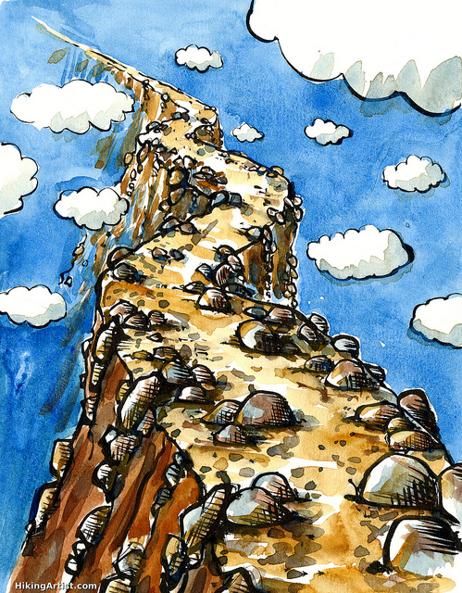
It is never easy
Notes:
Andrea: Gives example
TODO: use fish image

Slide 46

Notes:
Andrea:

Slide 47

Notes:
Andrea:

Slide 48
“What could possibly go wrong?”
Notes:
Andrea:

Slide 49

Notes:
Andrea:

Slide 50

8 Patches
5 weeks
13 modified files
Not “just a single line change”
Notes:
Andrea:

Slide 51

It is never easy
Notes:
Scott: You don't really ever know everything, that's why we do reviews
Many things are discovered during the process of review. Be Prepared!

Slide 52


Set your goal in advance
Notes:
Andrea: Discuss employer demands, different expectaions

Slide 53

Timing:
“Major Features can take longer than one release. Start early to gather opinions and discuss, write Blueprints and Specs, post POC code...”
Notes:
Scott: Waiting for the summit to introduce a feature is usually too late for that release.
If you are here, now, with a feature idea, it may be too late!!
Andrea: Specs should be ready, before your project opens for spec. Nova example
Scott: If you're very proactive, have POC code ready. You can submit WIP code and the few most interested can start to look.

Slide 54

Get Known!
Advice:
“Pay Attention”
“Ask more questions in IRC & ML & IRL“

Slide 55


Slide 56
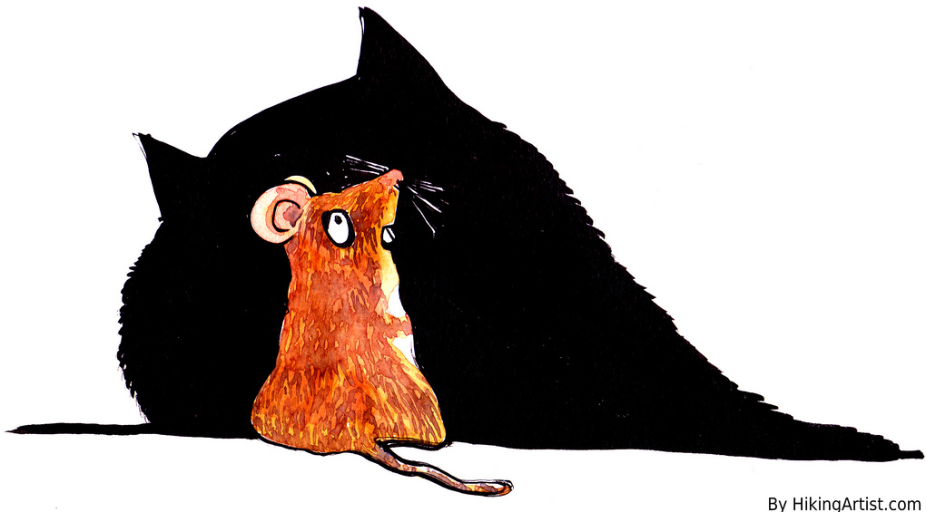
Typos attract Type A's

Slide 57
Reviews
Advice:
“Read more reviews!!”
“Review as much as possible”

Slide 58
Annoying:
Submitters arguing when they are asked to change something.

Slide 59


Slide 60


Slide 61

Annoying:
“patch authors that bully, guilt trip, or otherwise coerce people into reviewing their patches”

Slide 62

Influence and Fame
:

Slide 63
How Much are you Influenced by the Author:
“A lot, because if I know the author I'm likely to have an opinion of their competence.“

Slide 64
Advice:
“ Be prepared to stand up for your design decisions if you think they are right, at least for the first person who disagrees. If you change your code every time somebody makes a suggestion, then you can end up being flipped and flopped between two choices. Wait for consensus, and if one doesn't seem to be emerging, ask a core to get one for you.”

Slide 65
Advice:
“ Not all -1s are created equally. A doubtful -1 from a none core can be ignored by cores when merging, but if you post up a new patch then it has to wait for CI etc to run again, and often falls down core review queues.”

Slide 66
Advice:
Do more reviews, see where the project is going and make sure it applies to existing deployments, users, and use cases.

Slide 67
“Dissenting viewpoints are tolerated, not well represented, and generally ignored (or glossed over) with consensus-based decision making.”

Slide 68
“Minority views can overly tolerated. It is very easy for one person to make a big stink about a small issue which the community does not agree with. From an outsiders perspective this can be damaging to the project or community as they do not have context for the discussion. Incumbent core reviewers can have minority view points and are allowed to push to a project in a certain way which is very difficult to dissuade without intervention from other cores.”

Slide 69


