Slide 1
Troubleshooting OpenStack Networking
Phil Hopkins
cloud technology instructor

Slide 2

The Troubleshooting Process: Neutron Virtual Networks
OVERVIEW
Linux-based troubleshooting tools
DEMO
We will troubleshoot and repair a real-world problem by communicating with a VM and tracing the packet flow through a neutron-created Network.
1
2
Notes:
Many folks find the way Neutron builds virtual networks a mystery. For those of us who have set up OpenStack and created a VM that didn't get an IP or couldn't communicate out its network interface, this session will be for you.
<number>

Slide 3
The Troubleshooting Process

Slide 4
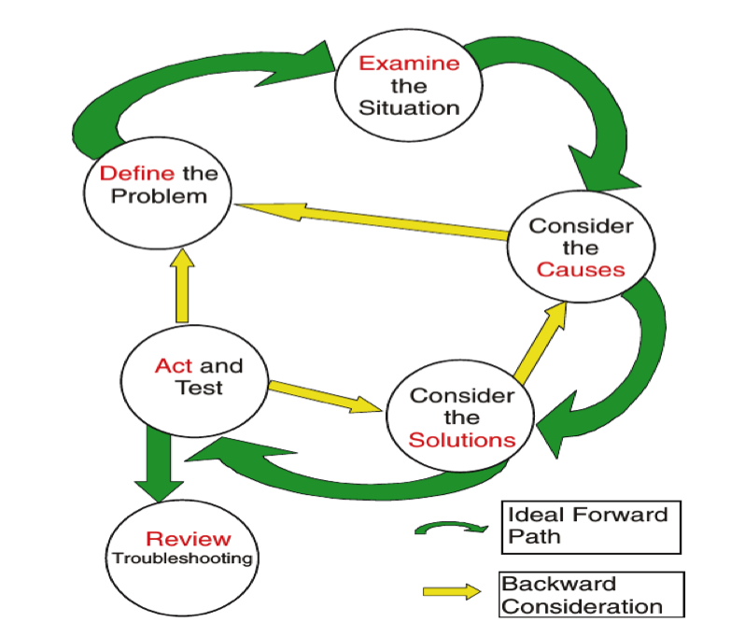
The Troubleshooting Process: An Iterative Approach
Ross, C. (2004).
The DECSAR method:
A new approach to troubleshooting

Slide 5
OpenStack Neutron Networking

Slide 6
Neutron Traffic Flow – Compute Node
Configured by Nova Compute
TAP device
vm1
Test Tenant
vm2
Test Tenant
vm3
Test1 Tenant
eth0
eth0
eth0
veth pair
eth0
tapxxx
tapyyy
tapzzz
Linux Bridge
qbrxxx
qbryyy
qbrzzz
qvbxxx
qvbyyy
qvbzz
Open vSwitch
qvoxxx
qvoyyy
qvozzz
Port VLAN tag:2
Port VLAN tag:3
br-int
Tenant flows are separated
by internally assigned VLAN ID
patch-tun
br-tun
Configured by L2 Agent
patch-int
gre-10.0.2.6
VLAN IDs are converted through the
flow table to GRE tunnels with
The tunnel key unique to each network
eth0
GRE encapsulated
From – Openstack Configuration
Reference Manual
Modified for GRE tunnels

Slide 7
Neutron Traffic Flow – Network Node
internal port
eth3
Open vSwitch
br-int
NAT with IPTABLES
qgyyy
IP
dnsmasq
Configured by L3 Agent
dnsmasq
Separate network namespaces
Configured by DHCP Agent
IP
IP
IP
tapxxx
qryyy
tapzzz
Port VLAN tag:2
br-int
Port VLAN tag:3
patch-tun
Configured by L2 Agent
br-tun
patch-int
gre-10.0.2.5
GRE tunnel keys are converted
through the flow table to
VLAN IDs unique to each network
eth1
GRE encapsulated
From – Openstack Configuration
Reference Manual
Modified for GRE tunnels

Slide 8
Network Troubleshooting — Linux Command Line Tools
✔
ip
address, route, netns, neighbor etc.
ifconfig, route and netstat are deprecated
Distros have started removing these commands
iptables
Useful options: -n --v --line-numbers
✗
ping, host, traceroute, tcpdump, ip neighbor, arp, arping
Protocol decoders: wireshark

Slide 9
Open vSwitch Command Summary
ovs-vsctl
show - overview of Open vSwitch configuration
add-br - add bridge
ovs-ofctl
dump-flows <br> – examine flow tables
dump-ports<br> - port statistics by port number
show <br> - port number to port name mapping
ovs-appctl
bridge/dump-flows <br> – examine flow tables
fdb/show <br> lists mac/vlan pairs learned
Use port mirroring to see traffic processed by a port

Slide 10
Open vSwitch Port Mirroring
Used to monitor traffic within Open vSwitch
Mirror selective ports or all the traffic
Useful for debugging network problems

Slide 11
Open vSwitch flow tables in Neutron
Open vSwitch br-tun flow table:
Table 0: All packets enter into this table
cookie=0x0, duration=575954.904s, table=0, n_packets=9855, n_bytes=857758, idle_age=941, hard_age=65534, priority=1,in_port=3 actions=resubmit(,2)
cookie=0x0, duration=575957.442s, table=0, n_packets=10090, n_bytes=685759, idle_age=1, hard_age=65534, priority=1,in_port=1 actions=resubmit(,1)
cookie=0x0, duration=279.046s, table=0, n_packets=386, n_bytes=56090, idle_age=0, priority=1,in_port=4 actions=resubmit(,2)
cookie=0x0, duration=575954.905s, table=0, n_packets=0, n_bytes=0, idle_age=65534, hard_age=65534, priority=1,in_port=2 actions=resubmit(,2)
cookie=0x0, duration=575957.383s, table=0, n_packets=4, n_bytes=288, idle_age=65534, hard_age=65534, priority=0 actions=drop

Slide 12
Open vSwitch flow tables in Neutron
Open vSwitch br-tun flow table:
Table 1: Packets coming from VMs are directed to table 20 for unicast packets and table 21 for multicast packets
cookie=0x0, duration=575957.261s, table=1, n_packets=9460, n_bytes=622184, idle_age=1, hard_age=65534, priority=0,dl_dst=01:00:00:00:00:00/01:00:00:00:00:00 actions=resubmit(,21)
cookie=0x0, duration=575957.321s, table=1, n_packets=630, n_bytes=63575, idle_age=83, hard_age=65534, priority=0,dl_dst=00:00:00:00:00:00/01:00:00:00:00:00 actions=resubmit(,20)

Slide 13
Open vSwitch flow tables in Neutron
Table 2: Packets coming from outside ((((((bug here)))))) have there tunnel headers changed to their internal VLAN ID and are directed to table 10
cookie=0x0, duration=282.627s, table=2, n_packets=365, n_bytes=53804, idle_age=0, priority=1,tun_id=0x1 actions=mod_vlan_vid:2,resubmit(,10)
cookie=0x0, duration=204.592s, table=2, n_packets=20, n_bytes=2216, idle_age=49, priority=1,tun_id=0x2 actions=mod_vlan_vid:3,resubmit(,10)
cookie=0x0, duration=575957.199s, table=2, n_packets=1, n_bytes=70, idle_age=204, hard_age=65534, priority=0 actions=drop

Slide 14
Open vSwitch flow tables in Neutron (Cont'd)
Table 3: Not used
cookie=0x0, duration=575957.126s, table=3, n_packets=0, n_bytes=0, idle_age=65534, hard_age=65534, priority=0 actions=drop
Table 10: Inserts return path rules into table 20 and sends the packet to br-int
cookie=0x0, duration=575957.057s, table=10, n_packets=10240, n_bytes=913778, idle_age=0, hard_age=65534, priority=1 actions=learn(table=20,hard_timeout=300,priority=1,NXM_OF_VLAN_TCI[0..11],NXM_OF_ETH_DST[]=NXM_OF_ETH_SRC[],load:0->NXM_OF_VLAN_TCI[],load:NXM_NX_TUN_ID[]->NXM_NX_TUN_ID[],output:NXM_OF_IN_PORT[]),output:1

Slide 15
Open vSwitch flow tables in Neutron (Cont'd)
Table 20: Handles unicast packets
cookie=0x0, duration=277.778s, table=20, n_packets=0, n_bytes=0, hard_timeout=300, idle_age=277, hard_age=0, priority=1,vlan_tci=0x0002/0x0fff,dl_dst=fa:16:3e:37:a7:50 actions=load:0->NXM_OF_VLAN_TCI[],load:0x1->NXM_NX_TUN_ID[],output:4
cookie=0x0, duration=203.706s, table=20, n_packets=0, n_bytes=0, hard_timeout=300, idle_age=203, hard_age=48,
cookie=0x0, duration=204.027s, table=20, n_packets=0, n_bytes=0, idle_age=204, priority=2,dl_vlan=3,dl_dst=fa:16:3e:37:a7:50 actions=strip_vlan,set_tunnel:0x2,output:4
cookie=0x0, duration=204.026s, table=20, n_packets=0, n_bytes=0, idle_age=204, priority=2,dl_vlan=3,dl_dst=fa:16:3e:03:e2:65 actions=strip_vlan,set_tunnel:0x2,output:4
cookie=0x0, duration=575956.997s, table=20, n_packets=0, n_bytes=0, idle_age=65534, hard_age=65534, priority=0 actions=resubmit(,21)
cookie=0x0, duration=204.681s, table=21, n_packets=87, n_bytes=4698, idle_age=49, hard_age=203, priority=1,dl_vlan=3 actions=strip_vlan,set_tunnel:0x2,output:4

Slide 16
Open vSwitch flow tables in Neutron (Cont'd)
Table 21: Handles multicast packets
cookie=0x0, duration=204.681s, table=21, n_packets=87, n_bytes=4698, idle_age=49, hard_age=203, priority=1,dl_vlan=3 actions=strip_vlan,set_tunnel:0x2,output:4
cookie=0x0, duration=765.74s, table=21, n_packets=0, n_bytes=0, idle_age=765, priority=1,dl_vlan=1 actions=strip_vlan,set_tunnel:0x1,output:2
cookie=0x0, duration=279.46s, table=21, n_packets=39, n_bytes=3810, idle_age=1, priority=1,dl_vlan=2 actions=strip_vlan,set_tunnel:0x1,output:4
cookie=0x0, duration=575956.934s, table=21, n_packets=16, n_bytes=1236, idle_age=205, hard_age=65534, priority=0 actions=drop

Slide 17
Configure Open vSwitch Port Mirrors
Create a virtual ethernet interface:
ip link add type veth
ip link set veth0 up
Add it into the Open vSwitch bridge br-int:
ovs-vsctl add-port br-int "veth0"
Create the mirror and mirror the packets from eth1, br-int, patch-tun:
ovs-vsctl -- set Bridge br-int mirrors=@m \
--id=@veth0 get Port veth0 \
--id=@eth1 get Port eth1 \
--id=@patch-tun get Port patch-tun \
--id=@br-int get Port br-int \
--id=@m create Mirror name=veth select-src-port=@eth1,@patch-tun,@br-int \
select-dst-port=@eth1,@patch-tun,@br-int output-port=@veth0
When finished, delete the mirror:
ovs-vsctl clear Bridge br-int mirrors

Slide 18
Neutron-debug Command (extension to the neutron command)
Sub-commands | Function | Option
probe-clear | Clear all probes. | -----
probe-create | Create probe port and interface, then plug it in | Network ID into which the probe will be injected
probe-delete | Delete probe - unplug and delete port. | Probe ID which will be removed
probe-exec | Execute commands in the namespace of the probe | Port-id command
probe-list | List probes | ----
ping-all | Ping all fixed_ips | Network id to be used to ping all assigned IPs

Slide 19
Neutron Troubleshooting Process
Define and understand the problem
Gather data
MAC and IP addresses of VM's, DHCP server, router
MAC and IP addresses of data network nodes
Set the neutron services to log at debug level
Where is the problem located
One tenant or all?
One network or all?
What protocols are used?
Is it an L2 or L3 problem?
Examine/locate
Look carefully at what is happening
Typically insufficient time is spent here
Isolate to tenant, network, VM, compute or network nodest

Slide 20
Neutron Troubleshooting Process
Consider causes
Need more data?
Lather, rinse and repeat
Consider Solutions
Test
Only adjust one thing at a time
if that did not fix it put it back the way it was
Keep a log of what was tried
If necessary, lather, rinse and repeat

Slide 21
Network Monitoring
Traffic Levels
Add sFlow to Open vSwitch
Watch for:
Failures
Blackhat behaviors
Ceilometer
Neutron metering agent
uses iptables stats to log traffic to and from particular IP ranges

Slide 22
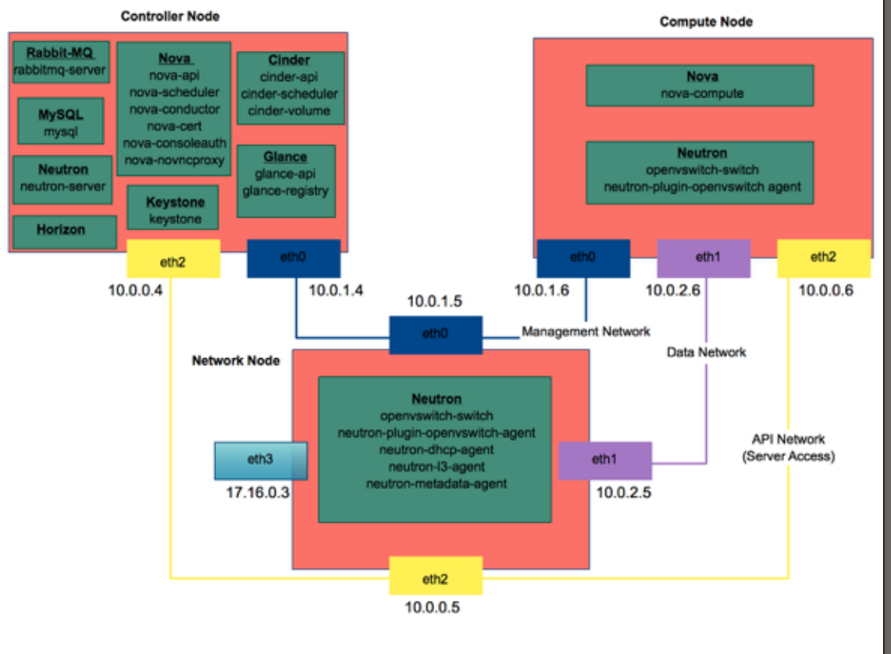
Base Environment

Slide 23
Packet Flow — Compute Node (GRE/VXLAN tunnels)
1
2
3
4
ping started on VM
tcpdump of ping on qvo interface
Packet enters Open vSwitch
Packet exits Open vSwitch

Slide 24
Packet Flow — Compute Node (GRE/VXLAN tunnels)
1
$ udpcpc
ping started on VM

Slide 25
Packet Flow — Compute Node (GRE/VXLAN tunnels)
2
root@compute:~# tcpdump -e -n -i qvoa8b8fd82-3d
tcpdump: WARNING: qvoa8b8fd82-3d: no IPv4 address assigned
tcpdump: verbose output suppressed, use -v or -vv for full protocol decode
listening on qvoa8b8fd82-3d, link-type EN10MB (Ethernet), capture size 65535 bytes
16:23:39.896100 fa:16:3e:91:3e:8e > ff:ff:ff:ff:ff:ff, ethertype IPv4 (0x0800), length 322: 0.0.0.0.68 > 255.255.255.255.67: BOOTP/DHCP, Request from fa:16:3e:91:3e:8e, length 280
16:23:39.898820 fa:16:3e:f5:64:e8 > fa:16:3e:91:3e:8e, ethertype IPv4 (0x0800), length 365: 10.0.0.3.67 > 10.0.0.7.68: BOOTP/DHCP, Reply, length 323
tcpdump of ping on qvo interface

Slide 26
Packet Flow — Compute Node (GRE/VXLAN tunnels)
Open vSwitch br-tun flow table:
cookie=0x0, duration=575957.442s, table=0, n_packets=10090, n_bytes=685759, idle_age=1, hard_age=65534, priority=1,in_port=1 actions=resubmit(,1)
cookie=0x0, duration=575957.261s, table=1, n_packets=9460, n_bytes=622184, idle_age=1, hard_age=65534, priority=0,dl_dst=01:00:00:00:00:00/01:00:00:00:00:00 actions=resubmit(,21)
cookie=0x0, duration=575957.321s, table=1, n_packets=630, n_bytes=63575, idle_age=83, hard_age=65534, priority=0,dl_dst=00:00:00:00:00:00/01:00:00:00:00:00 actions=resubmit(,20)
cookie=0x0, duration=204.681s, table=21, n_packets=87, n_bytes=4698, idle_age=49, hard_age=203, priority=1,dl_vlan=3 actions=strip_vlan,set_tunnel:0x2,output:4
cookie=0x0, duration=765.74s, table=21, n_packets=0, n_bytes=0, idle_age=765, priority=1,dl_vlan=1 actions=strip_vlan,set_tunnel:0x1,output:2
cookie=0x0, duration=279.46s, table=21, n_packets=39, n_bytes=3810, idle_age=1, priority=1,dl_vlan=2 actions=strip_vlan,set_tunnel:0x1,output:4
cookie=0x0, duration=575956.934s, table=21, n_packets=16, n_bytes=1236, idle_age=205, hard_age=65534, priority=0 actions=drop
3
Packet enters Open vSwitch

Slide 27
Packet Flow — Compute Node (GRE/VXLAN tunnels)
root@compute:~# tcpdump -e -n -i eth1 proto gre
tcpdump: verbose output suppressed, use -v or -vv for full protocol decode
listening on eth1, link-type EN10MB (Ethernet), capture size 65535 bytes
16:29:44.258945 fa:16:3e:9c:06:c4 > fa:16:3e:09:5f:15, ethertype IPv4 (0x0800), length 364: 10.0.2.6 > 10.0.2.5: GREv0, key=0x1, proto TEB (0x6558), length 330: fa:16:3e:91:3e:8e > ff:ff:ff:ff:ff:ff, ethertype IPv4 (0x0800), length 322: 0.0.0.0.68 > 255.255.255.255.67: BOOTP/DHCP, Request from fa:16:3e:91:3e:8e, length 280
16:29:44.261100 fa:16:3e:09:5f:15 > fa:16:3e:9c:06:c4, ethertype IPv4 (0x0800), length 407: 10.0.2.5 > 10.0.2.6: GREv0, key=0x1, proto TEB (0x6558), length 373: fa:16:3e:f5:64:e8 > fa:16:3e:91:3e:8e, ethertype IPv4 (0x0800), length 365: 10.0.0.3.67 > 10.0.0.7.68: BOOTP/DHCP, Reply, length 323
4
Packet exits Open vSwitch

Slide 28
Packet Flow — Network Node (GRE/VXLAN tunnels)
1
2
3
4
Packet enters network node
Packet enters Open vSwitch
Packet exits Open vSwitch into network namespace
Packet enters network namespace

Slide 29
Packet Flow — Network Node (GRE/VXLAN tunnels)
1
root@network:~# tcpdump -i eth1 -n proto gre -vvv -XX
tcpdump: listening on eth0, link-type EN10MB (Ethernet), capture size 65535 bytes
15:55:17.051637 IP (tos 0x0, ttl 64, id 20352, offset 0, flags [DF], proto GRE (47), length 130)
10.10.10.11 > 10.10.10.9: GREv0, Flags [key present], key=0x7, length 110
IP (tos 0x0, ttl 64, id 0, offset 0, flags [DF], proto ICMP (1), length 84)
10.5.5.35 > 8.8.8.8: ICMP echo request, id 27141, seq 0, length 64
Packet enters network node
1

Slide 30
Packet Flow — Network Node (GRE/VXLAN tunnels)
Open vSwitch br-tun flow table
root@network:~# ovs-ofctl dump-flows br-tun
NXST_FLOW reply (xid=0x4):
cookie=0x0, duration=578533.772s, table=0, n_packets=9355, n_bytes=622734, idle_age=4094, hard_age=65534, priority=1,in_port=5 actions=resubmit(,2)
cookie=0x0, duration=3613.207s, table=2, n_packets=616, n_bytes=57653, idle_age=17, priority=1,tun_id=0x1 actions=mod_vlan_vid:2,resubmit(,10)
cookie=0x0, duration=579490.949s, table=10, n_packets=10216, n_bytes=694503, idle_age=17, hard_age=65534, priority=1 actions=learn(table=20,hard_timeout=300,priority=1,NXM_OF_VLAN_TCI[0..11],NXM_OF_ETH_DST[]=NXM_OF_ETH_SRC[],load:0->NXM_OF_VLAN_TCI[],load:NXM_NX_TUN_ID[]->NXM_NX_TUN_ID[],output:NXM_OF_IN_PORT[]),output:1
2
Packet enters Open vSwitch
1

Slide 31
Packet Flow — Network Node (GRE/VXLAN tunnels)
3
root@network:~# ip netns exec qdhcp-4d68a72b-2af5-46d6-aacd-6516a063a6d0 tcpdump -e -n -l -itap33b41c4d-99
tcpdump: verbose output suppressed, use -v or -vv for full protocol decode
Packet exits Open vSwitch into network namespace
1

Slide 32
Packet Flow — Network Node (GRE/VXLAN tunnels)
root@network:~# ip netns exec qdhcp-4d68a72b-2af5-46d6-aacd-6516a063a6d0 tcpdump -e -n -l -itap33b41c4d-99
tcpdump: verbose output suppressed, use -v or -vv for full protocol decode
listening on tap33b41c4d-99, link-type EN10MB (Ethernet), capture size 65535 bytes
18:27:02.275785 fa:16:3e:05:a2:00 > ff:ff:ff:ff:ff:ff, ethertype IPv4 (0x0800), length 322: 0.0.0.0.68 > 255.255.255.255.67: BOOTP/DHCP, Request from fa:16:3e:05:a2:00, length 280
18:27:02.276020 fa:16:3e:44:71:b0 > fa:16:3e:05:a2:00, ethertype IPv4 (0x0800), length 365: 10.0.0.3.67 > 10.0.0.6.68: BOOTP/DHCP, Reply, length 323
4
Packet enters network namespace
1

Slide 33
Neutron Debugging
Set neutron logging to debug - debug=True
On all servers running a neutron service - controller, network, compute
Restart all neutron services to read the change
Set nova logging to debug - debug=True
On all servers running a nova service - controller, compute
Restart all nova services to read the change
Check the log files after the problem occurs for errors
I usually look at the compute nodes first
In Icehouse, neutron communicates directly to nova in some situations

