Slide 1
Africa

Slide 2
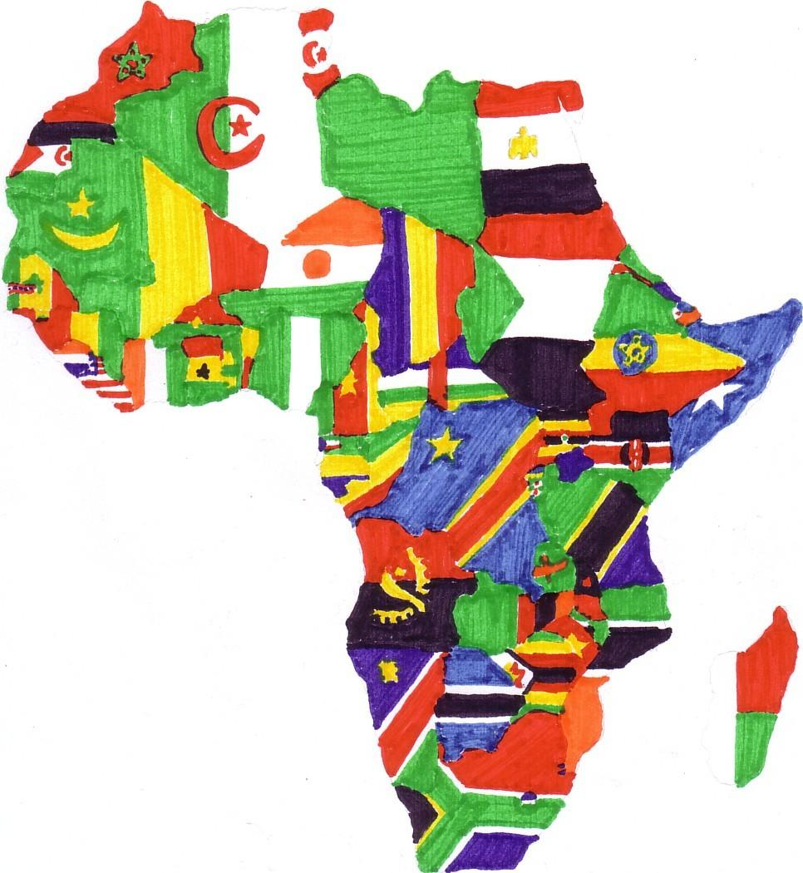

Slide 3
54
Countries

Slide 4
1bn
People

Slide 5
Of those 1bn

Slide 6
360m have no political freedoms at all
Freedom House Index

Slide 7
540m have very limited political freedoms
Freedom House Index

Slide 8
While only 100m live in countries considered free
Freedom House Index

Slide 9
Even then
Of those with political freedoms

Slide 10
More than 3/4
live in countries that have become democracies within the last 50 years

Slide 11
1/2
live in countries considered corrupt

Slide 12
What does this
Mean?

Slide 13
It means there are 1bn reasons to
do something

