Slide 1

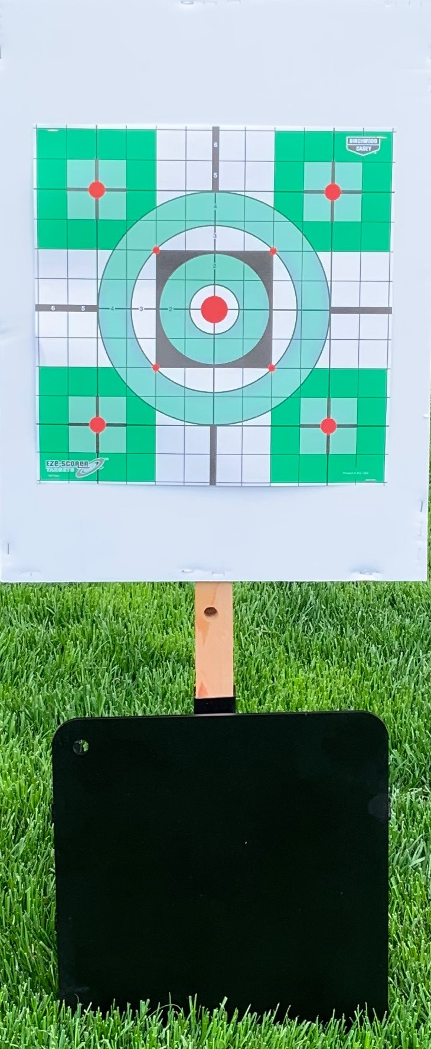
Gale Automated Targets Embedded Systems CS 6780 Scott Gale, u1203422

Slide 2
System Objectives
Problem Statement and Objectives: How do I engineer and build multiple interactive short range targets that are:
Highly portable
Operate autonomously
User programmable
Wirelessly controlled
Low cost (<$100/ target)
Rugged (.45 ACP from 5 meters / .308 from 50 meters)?
Purpose: Improve responsiveness, target acquisition, and accuracy for short range shooting scenarios (5-100 meters) – improve firearm competency.

Slide 3

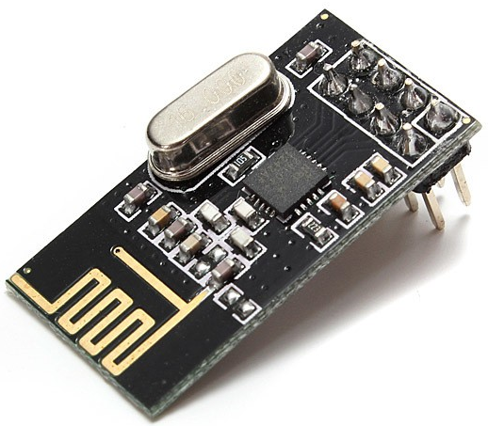

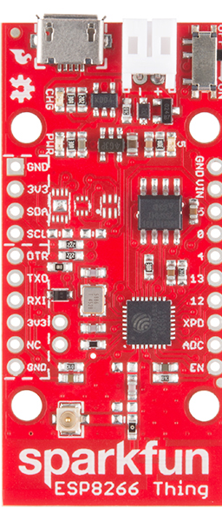
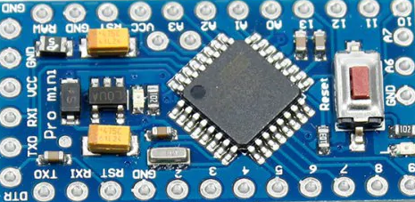
Block Diagram
NRF24L01
Transceiver
NRF24L01
Transceiver
Wi-Fi
HTTP
RF
SPI
SPI
Controlling
ESP8266
*Access point
*Web server
Web browser
Target Controller
Embedded in target
Mechanical Target
Base Station
Located @ shooter station

Slide 4
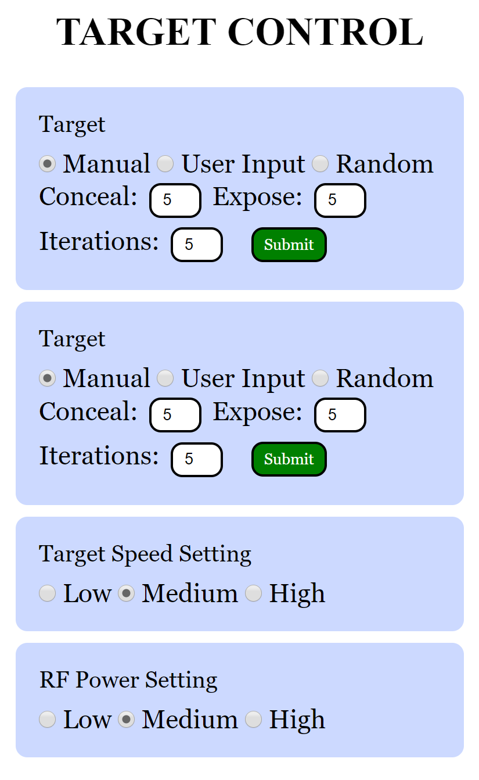
User Interface, Modes, Design
User Interface
Modes
Principles of Design
Manual:
Expose: 0-99 seconds
Iterations: 1
User Input:
Conceal: 0-99 seconds
Expose: 0-99 seconds
Iterations: 0-99
Random:
Conceal: min conceal / max expose
Expose: min conceal / max expose
Iterations: 0-99
Communication: HTTP, WiFi, SPI, RF
FSM – Hybrid polling / interrupts
PWM motor control
Feedback system (limit switches)
GPIO – LEDs, switches
PCB Soldering / wire wrap
Timer (used for counting delays)
Pull-up resistors ( limit switches)
Mechanical systems – bearings, steel protections, disposable targets, motor, PCB encapsulation

