Slide 1

XGBoost
By Dylan Scott
ml2

Slide 2
Motivation
This project is the final assignment for Machine Learning 2 as part of the MSDS Program at SMU.
The theme of the project is to take a concept in machine learning and break down all its parts to demonstrate how it works.
In preparation for future data scientist, we have been tasked to not only learn the material but understand it in a way where we can explain it to decision makers as well as others in the field.
My chosen topic is XGBoost.
I have made very few assumptions of the viewer’s background prior to viewing this.
Notes:
https://arxiv.org/pdf/1603.02754.pdf
https://dimleve.medium.com/xgboost-mathematics-explained-58262530904a
https://math.hmc.edu/calculus/hmc-mathematics-calculus-online-tutorials/single-variable-calculus/taylors-theorem/

Slide 3

Agenda
Background
What is it?
Why use it?
Mathematics behind the algorithm.
Closeout

Slide 4
Background
Stands for:
eXtreme Gradient Boosting.
Creator:
Tianqi Chen
Type:
Tree-based boosting algorithm
Unsupervised Machine Learning
Notes:
Tianqi Chen (tea-on-key chen) currently, as of 2022 is an Assistant Professor in the Machine Learning Department at Carnegie Mellon University
He create xgboost while at the University of Washington as a Master student

Slide 5
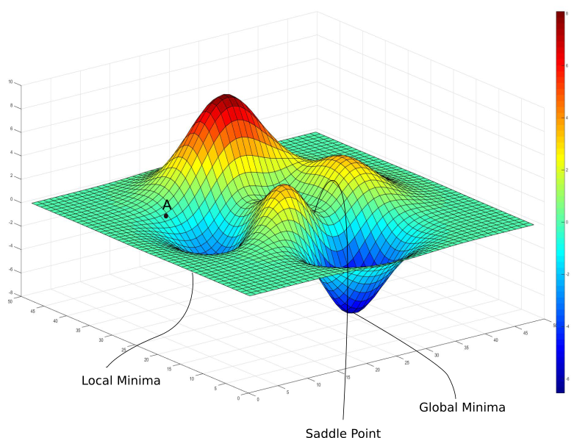
Notes:
Cite photo

Slide 6
The Math Behind XGBoost
Notes:
https://dimleve.medium.com/xgboost-mathematics-explained-58262530904a

Slide 7
Objective function

Slide 8
Taylor’s Theorem

Slide 9
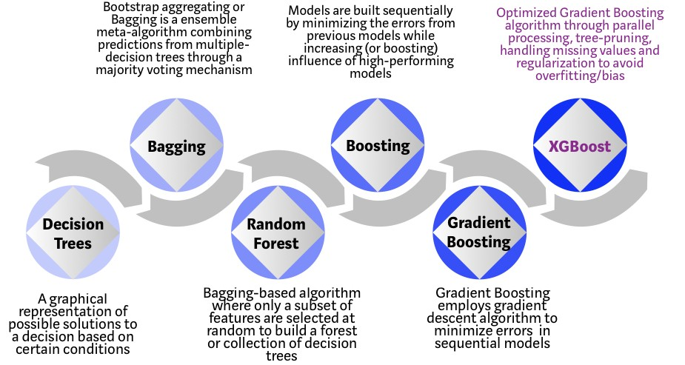
Evolution of Decision Trees
Decision Trees
Bagging
Random Forest
Boosting
Gradient Boosting
XGBoost
Notes:
XGBoost is part of the tree algorithm category which also includes other popular algorithms such as random forest and gradient boosting
Photo site: https://mesin-belajar.blogspot.com/2019/04/xgboost-algorithm-long-may-she-reign.html

Slide 10
Math
Objective function
Notes:
https://www.programmersought.com/article/13283190787/

