Slide 1

XGBoost For Regression
By Dylan Scott
ml2

Slide 2
Motivation
This project is the final assignment for Machine Learning 2 as part of the MSDS Program at SMU.
The theme of the project is to take a concept in machine learning and break down all its parts to demonstrate how it works.
In preparation for future data scientist, we have been tasked to not only learn the material but understand it in a way where we can explain it to decision makers as well as others in the field.
My chosen topic is XGBoost.
I have made very few assumptions of the viewer’s background prior to viewing this.
Notes:
https://arxiv.org/pdf/1603.02754.pdf
https://dimleve.medium.com/xgboost-mathematics-explained-58262530904a
https://math.hmc.edu/calculus/hmc-mathematics-calculus-online-tutorials/single-variable-calculus/taylors-theorem/

Slide 3

Agenda
Background
What is it?
Regression
Mathematics behind the algorithm.
Closeout

Slide 4
Background
Stands for: eXtreme Gradient Boosting.
Creator: Tianqi Chen
Type: Tree-based boosting algorithm
Notes:
Tianqi Chen (tea-on-key chen) currently, as of 2022 is an Assistant Professor in the Machine Learning Department at Carnegie Mellon University
He create xgboost while at the University of Washington as a Master student

Slide 5
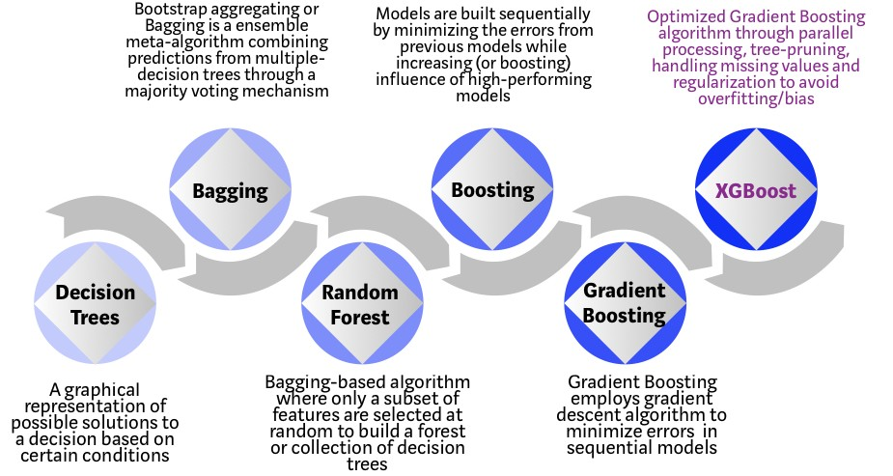
Evolution of Decision Trees
Notes:
XGBoost is part of the tree algorithm category which also includes other popular algorithms such as random forest and gradient boosting
Photo site: https://mesin-belajar.blogspot.com/2019/04/xgboost-algorithm-long-may-she-reign.html

Slide 6
Regression
XGBoost for Regression

Slide 7
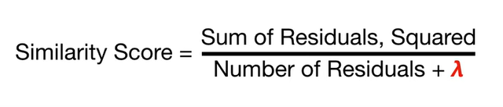
-10.5, 6.5, 7.5, -7.5
Similarity = 4
-10.5
6.5, 7.5, -7.5
Similarity = 110.25
Similarity = 14.08
Notes:
Numbers provided by: https://towardsdatascience.com/drug-dose-response-data-analysis-5d7d336ad8e9

Slide 8


-10.5, 6.5, 7.5, -7.5
Similarity = 4
-10.5
6.5, 7.5, -7.5
Similarity = 110.25
Similarity = 14.08

Slide 9
Gain = 120.33
-10.5, 6.5, 7.5, -7.5
-10.5
6.5, 7.5, -7.5
6.5, 7.5
-7.5
Similarity = 98
Similarity = 56.25
Gain = 140.17
Gamma = 130
140.17-130 = 10.17

Slide 10
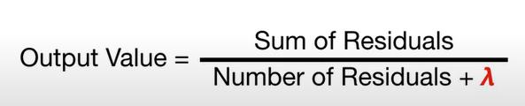
-10.5, 6.5, 7.5, -7.5
-10.5
6.5, 7.5, -7.5
Output = -10.5
6.5, 7.5
-7.5
Output = 7
Output = -7.5

Slide 11
-10.5, 6.5, 7.5, -7.5
-10.5
6.5, 7.5, -7.5
Output = -10.5
6.5, 7.5
-7.5
Output = 7
Output = -7.5
New Prediction = Initial Prediction +Learning Rate * Output
New Prediction = 0.5+0.3 * -10.5 = -2.65

Slide 12
Math Details
How do we know we have the best tree?

Slide 13
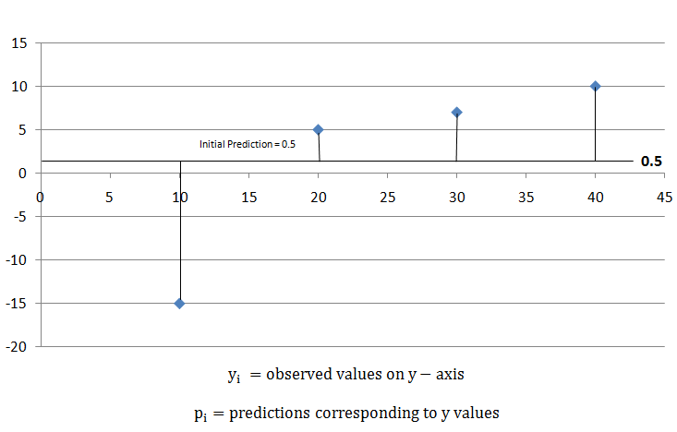
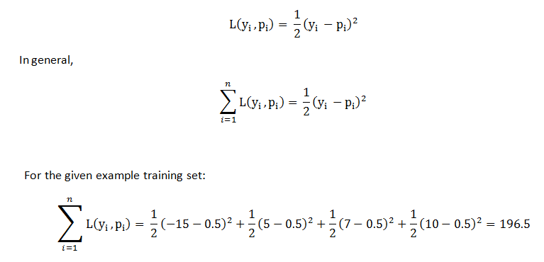
Loss Function
Notes:
https://www.geeksforgeeks.org/xgboost-for-regression/

Slide 14
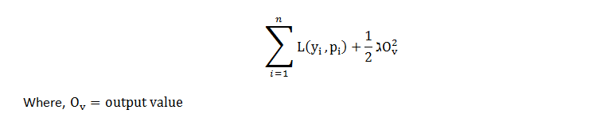
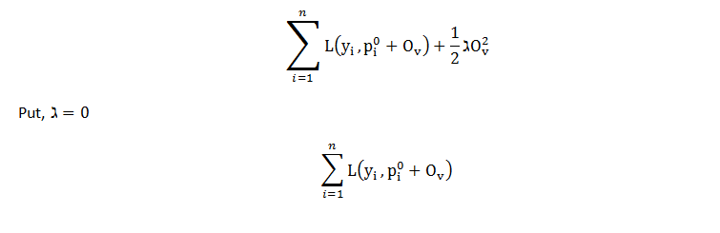
Objective Function
Notes:
https://www.geeksforgeeks.org/xgboost-for-regression/

Slide 15
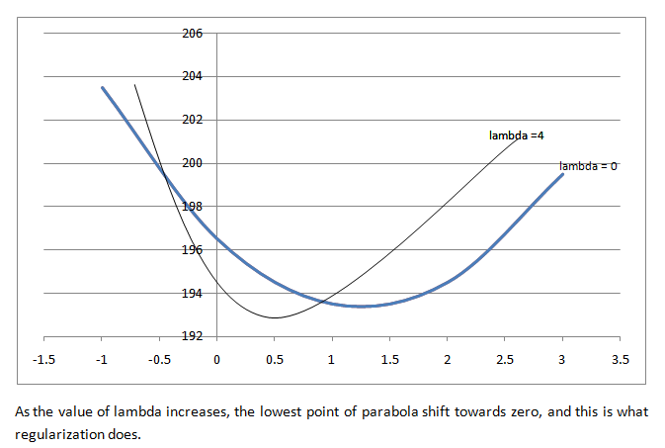
Impact of Lambda

Slide 16

Taylor’s Theorem
Notes:
https://www.geeksforgeeks.org/xgboost-for-regression/

Slide 17
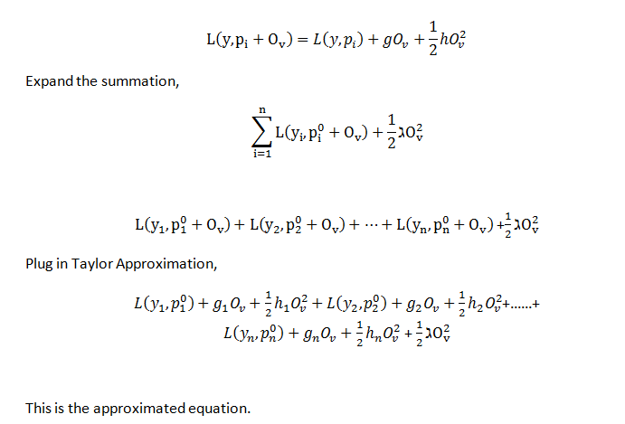
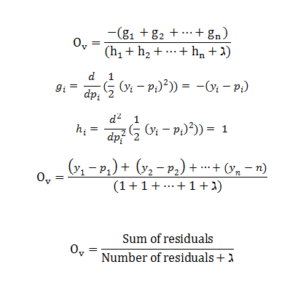
Simplify
Notes:
https://www.geeksforgeeks.org/xgboost-for-regression/

Slide 18
Finally
Notes:
https://www.geeksforgeeks.org/xgboost-for-regression/

