Slide 1
Budweiser
Exploratory data analysis
Authors: Dylan Scott, Sadik Aman
3/06/2021

Slide 2
Agenda
Breweries by state
Missing data values
ABV and IBU breakdown
Highest ABV
Highest IBU
Predictive model
Sky's the limit
Notes:
Breweries by state
How missing values were delt with
Breakdowns in ABV and IBU including the highest beer in each category

Slide 3
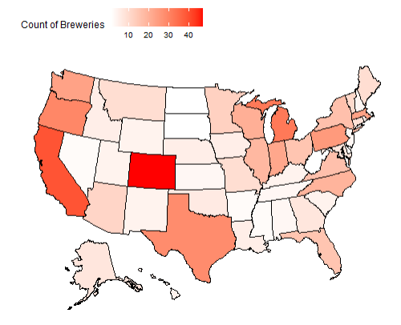
Brewery Count by State
Top 5 States:
Colorado
California
Michigan
Oregon
Texas

Slide 4
Data Cleaning
Started with 2410 beers.
We removed 1005 beers from the list due to missing values in:
ABV
IBU
Remaining observations of 1405 were complete enough to do our data analysis.
Notes:
This is a data loss in regards to beers of roughly 42%
Though that does seem substantial that does leave us with a good sample size of 1405 to do an initial analysis
We were comfortable moving forward with this amount

Slide 5
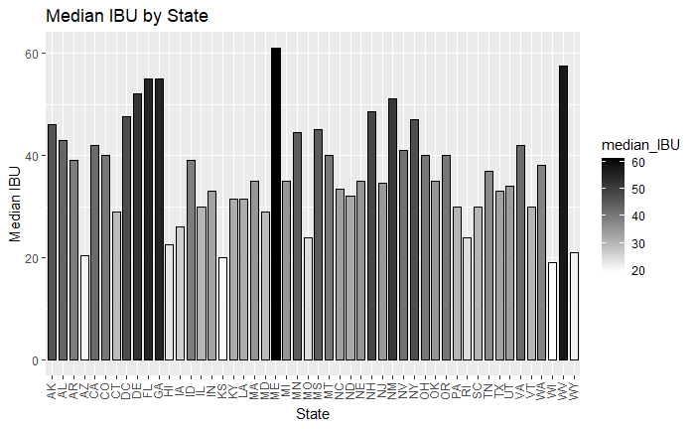
Median IBU by State
Location: Astoria, OR
Brewery: Astoria Brewing Company
Beer: Bitter Bitch Imperial IPA
IBU: 138
Style: American Double/ Imperial IPA
Notes:
Industry average of IBU: 35
This number was determined by the Median of the beer data
Highest also mane
West VA
Most popular IBU:

Slide 6
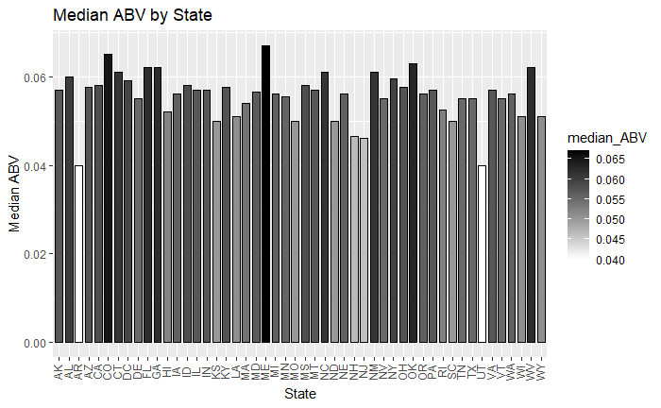
Median ABV by state
Location: Louisville, KY
Brewery: Against the Grain Brewery
Beer: London Balling
ABV: 12.5%
Style: English Barleywine
Notes:
Industry average of ABV: 5.7%
This number was determined by the Median of the beer data
Many states have heavy regulations on Beers sold above 12%
Many breweries have had to move states due to a change in state ABV regulations
Highest is meine
Lowest is Utah and Arkansas
Most popular ABV:

Slide 7
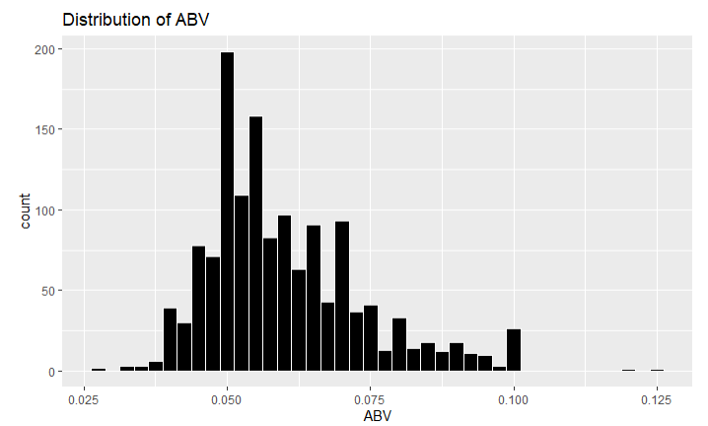
Breakdown of ABV
Mean: .060
Median: .057
Standard Deviation: .014
Max: .125
Min: .027
Notes:
The data looks slightly right skewed to us with a large spike at 5%
This skewness is largely due to states restrictions on ABV. States like Oklahoma (cold only) and Utah carry 4% ABV versions of your most popular beers relative to our industry “standard” 5% - these restrictions also apply to the local breweries meaning they can not produce or sell beer above those 4% ABV thresholds though this only applies to cold beers in Oklahoma’s case.
Iowa also has a 5% or less cap on beer further restricting our distribution

Slide 8
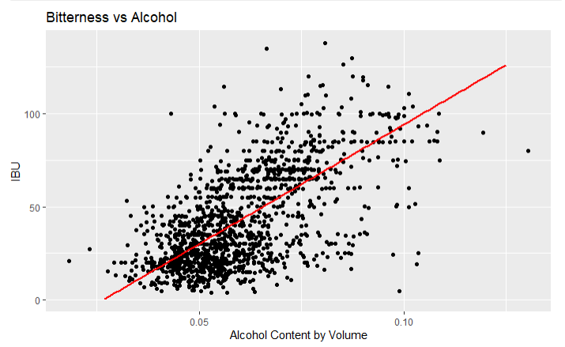
ABV and IBU
Given this graph we see strong evidence of a positive relationship between IBU and Alcohol Content.
In general, as the bitterness of a beer goes up so does the alcohol content.
Notes:
We believe this is largely due to the style of beer. the wildly popular beer category, IPA, is notorious for being bitter and is made in a way that demonstrates this relationship. Dog head fish in Delaware has a 60-minute IPA and a 90-Minute IPA. These boast a 60 IBU score and a 6% ABV and a 90 IBU score and a 9% ABV respectively. This shows how bitterness and alcohol content can increase overtime.

Slide 9
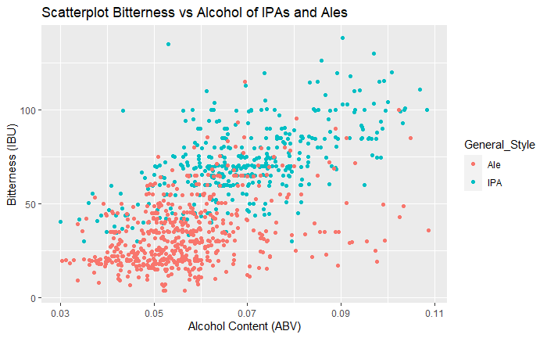
Can we tell IPAs from other Ales?
We used a predictive model that used ABV and IBU to categorize each beer
This model was optimized to ensure the most accurate outcome for a KNN model
Overall, we were 86% accurate in telling an Ale from an IPA
Notes:
We used the IBU and ABV to try and predict an IPA over other Ales
As you can see bitterness is a great identifier for IPAs however, ABV is a much more universal stat this is shown by the range
Confusion Matrix and Statistics
classifications
Ale IPA
Ale 137 20
IPA 21 105
Accuracy : 0.8551
95% CI : (0.8086, 0.894)
No Information Rate : 0.5583
P-Value [Acc > NIR] : <2e-16
Kappa : 0.7065
Mcnemar's Test P-Value : 1
Sensitivity : 0.8671
Specificity : 0.8400
Pos Pred Value : 0.8726
Neg Pred Value : 0.8333
Prevalence : 0.5583
Detection Rate : 0.4841
Detection Prevalence : 0.5548
Balanced Accuracy : 0.8535

Slide 10
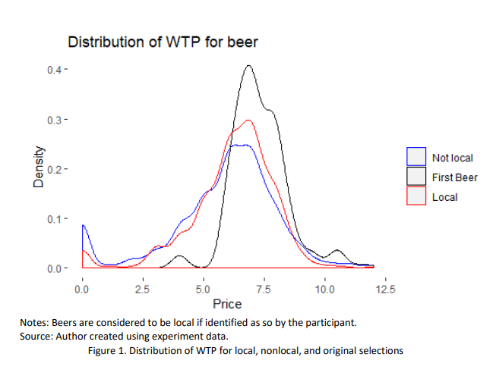
How does buy “local” impact sales?
Wiliness to pay study conducted in 2019
Factors considered:
First beer
Style
Local
ABV
Image obtained from: (Hart, 2018)
Notes:
The study showed that ‘local’ had a high variability in definitions
However, stats showed that people had a higher willingness to pay for a beer they considered local
Other factors considered were ABV, style of beer and first beer
People tend to pay higher for beers like sours opposed to the lesser priced lite/IPA
To maximize a willingness to pay score I would recommend a beer such
Using our current data we can see there is a potential market for a high ABV beer in:
This study of Willingness to pay was conducted in 2019 and was a study that showed how different factors in beer would equate to a higher average prices paid for beer
This study conclude that there are several factors associated with a higher willingness to pay for a beer:
factors include first beer, type of beer, local however this definition did depend on who you asked and ABV
Given the conclusion of this study we were able to surmise that a beer with a high ABV that was not a lite nor IPA, as these beers were considered to be lower priced would fetch a better price and sales in certain markets. We then used the other data set provided by you all to find a good release spot for our high margin beer

Slide 11
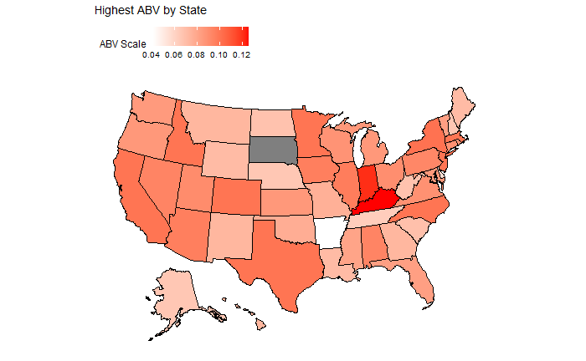
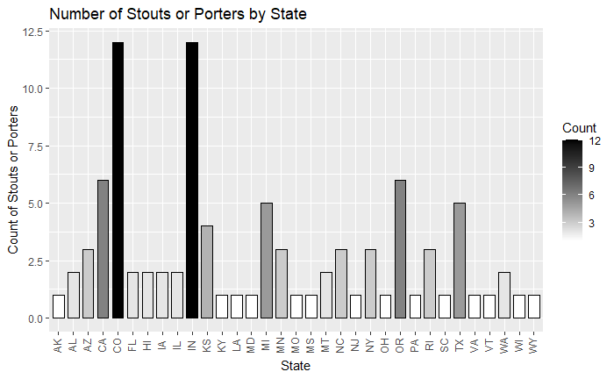
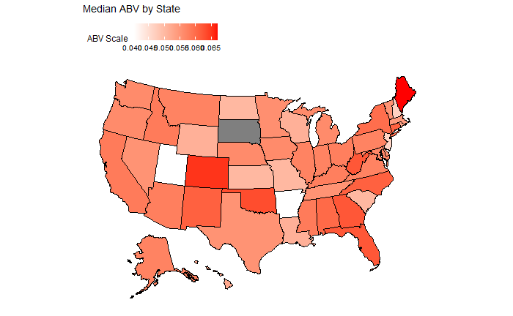
High Margin Beer Release!
The Midwest and Northeast had many states of interest
We were looking for a medium ABV max with a high ABV average
Maine has 0 Stouts/Porters made locally
Notes:
Factors considered from the data provided by yall in conjunction with the willingness to pay study were style and ABV
IPAs and Lite were considered to be cheap but more complex beers such as stouts and porters were considered to be worth a higher price point
Using that US data we found that Maine would be the perfect landing point for our new “skies the limit” Stout
This state allows for high ABV beers to be made locally, furthermore the compitision in this complex style beer is very limited. This result was determined by a middle of the road ABV max beer but a high average beer. With this data we think there is a market for a new stout with a high ABV and according to the other study done we could charge a perium for this new local beer
We concluded that this area contained contained the least amount of stouts for compitision

Slide 12
Questions?
Notes:
Do we have to present the final project again to the class? Or to just the power point?
Date to submit? Is it due on the 6th of march
Explain why the clustering is of their interest
Explain how abv impacts ibu
The study showed that ‘local’ had a high variability in definiitons
However, stats showed that people had a higher williningness to pay for a beer they considered local
Other factors considered were ABV, style of beer and first beer
People tend to pay higher for beers like sours opposed to the lesser priced lite/IPA
To maximize a willingness to pay score I would reccomed a beer such
Using our current data we can see there is a potential market for a high ABV beer in:

Slide 13
Citations
Hart, J. (2018). Drink beer for science: An experiment on consumer preferences for local craft beer. Journal of Wine Economics, 13(4), 429-441.
Hart (2018) linked in Github

