Slide 1
Explanatory Data Analysis Of Budweiser
Case Study
prepared by: Dylan Scott & Sadik Aman

Slide 2
Objective Of the Study
Objective:
Providing statical evidence to Budweiser company, on how to increase the profitability and make effective and efficient investment decisions.

Slide 3
Data sets used for Analysis
Two Data sets used for the study:
Beer Data set
Brewery Data set

Slide 4

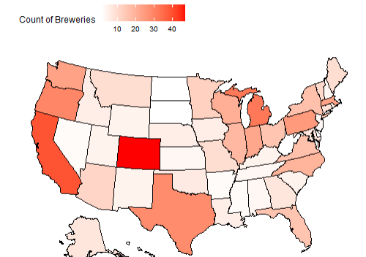
Brewery Count by State
Top 5 States:
Colorado
California
Michigan
Oregon
Texas

Slide 5
Data Cleaning
Started with 2410 beers.
We removed 1005 beers from
the list due to missing values in:
ABV
IBU
Remaining observations of 1405 were complete enough to do our data analysis.

Slide 6
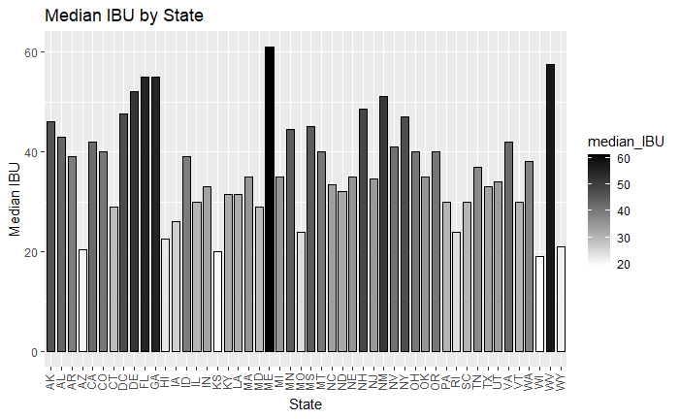
Median IBU by State
Location: Astoria, OR
Brewery: Astoria Brewing Company
Beer: Bitter Bitch Imperial IPA
IBU: 138
Style: American Double/ Imperial IPA
Findings:
Industry average of IBU: 35
This number was determined by the Median of the beer data
Highest also mane
West VA
Most popular IBU:

Slide 7
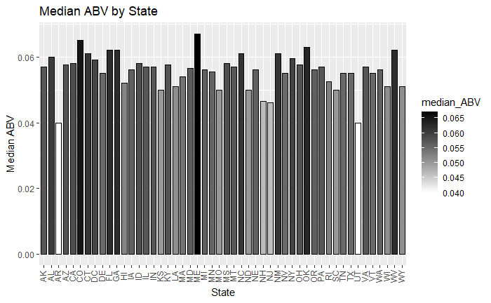
Median ABV by state
Location: Louisville, KY
Brewery: Against the Grain Brewery
Beer: London Balling
ABV: 12.5%
Style: English Barleywine
Findings:
Industry average of ABV: 5.7%
This number was determined by the Median of the beer data
Many states have heavy regulations on Beers sold above 12%
Many breweries have had to move states due to a change in state ABV regulations
Highest is meine
Lowest is Utah and Arkansas
Most popular ABV:

Slide 8
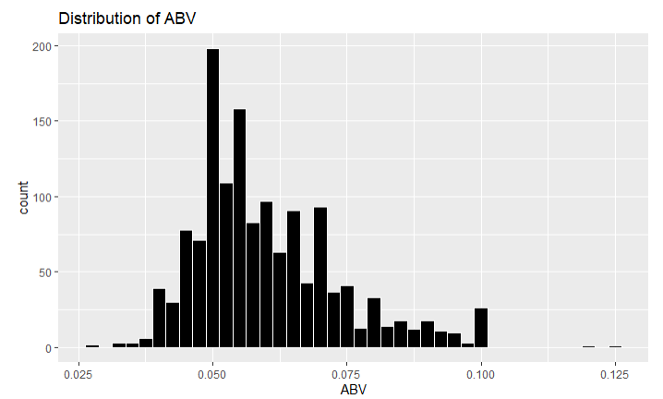
Breakdown of ABV
Mean: .060
Median: .057
Standard Deviation: .014
Max: .125
Min: .027
Findings:
The data looks slightly right skewed to us with a large spike at 5%
This skewness is largely due to states restrictions on ABV. States like Oklahoma (cold only) and Utah carry 4% ABV versions of your most popular beers relative to our industry “standard” 5% - these restrictions also apply to the local breweries meaning they can not produce or sell beer above those 4% ABV thresholds though this only applies to cold beers in Oklahoma’s case.
Iowa also has a 5% or less cap on beer further restricting our distribution

Slide 9
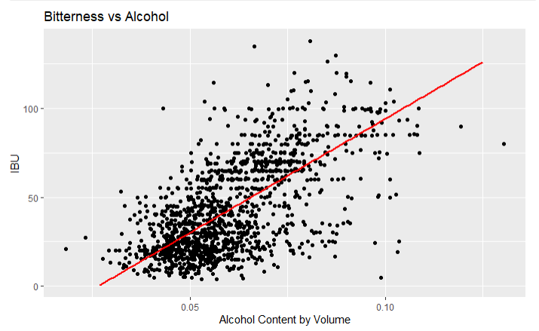
ABV and IBU
Given this graph we see strong evidence of a positive relationship between IBU and Alcohol Content.
In general, as the bitterness of a beer goes up so does the alcohol content.

Slide 10
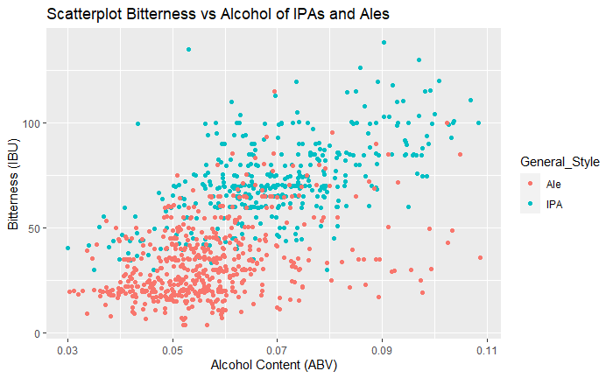
Can we tell IPAs from other Ales?
We used a predictive model that used ABV and IBU to categorize each beer
This model was optimized to ensure the most accurate outcome for a KNN model
Overall, we were 86% accurate in telling an Ale from an IPA
Findings:
We used the IBU and ABV to try and predict an IPA over other Ales
As you can see bitterness is a great identifier for IPAs however, ABV is a much more universal stat this is shown by the range
Confusion Matrix and Statistics

Slide 11
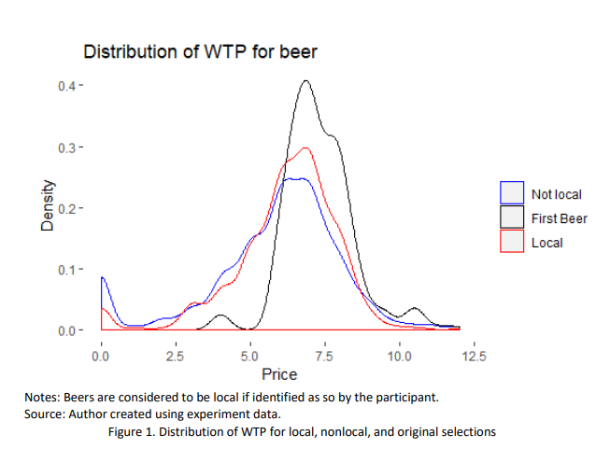
How does buy “local” impact sales?
Wiliness to pay study conducted in 2019
Factors considered:
First beer
Style
Local
ABV
Findings:
The study showed that ‘local’ had a high variability in definitions
However, stats showed that people had a higher willingness to pay for a beer they considered local
Other factors considered were ABV, style of beer and first beer
People tend to pay higher for beers like sours opposed to the lesser priced lite/IPA

Slide 12
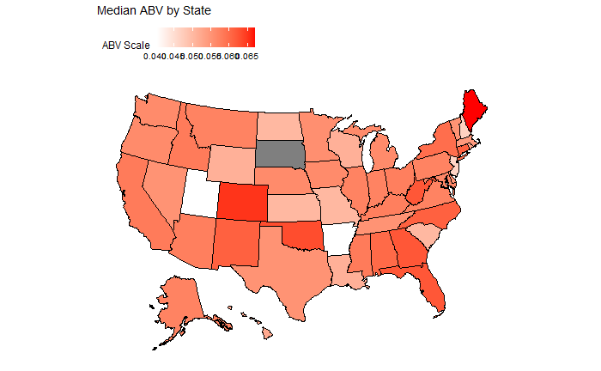
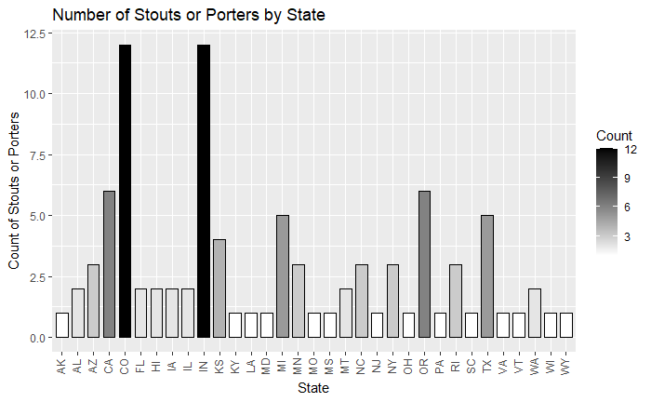
High Margin Beer Release! Maine has 0 Stouts/Porters made locally

Slide 13
Conclusion: “skies the limit”
Factors considered from the data provided by yall in conjunction with the willingness to pay study were style and ABV
IPAs and Lite were considered to be cheap but more complex beers such as stouts and porters were considered to be worth a higher price point
Using that US data we found that Maine would be the perfect landing point for our new “skies the limit” Stout
This state allows for high ABV beers to be made locally, furthermore the compitision in this complex style beer is very limited. This result was determined by a middle of the road ABV max beer but a high average beer. With this data we think there is a market for a new stout with a high ABV and according to the other study done we could charge a perium for this new local beer
We concluded that this area contained contained the least amount of stouts for compitision

Slide 14
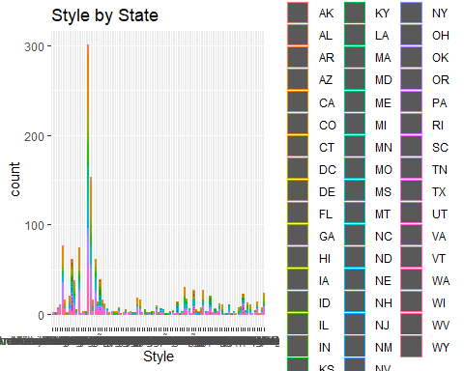
Conclusion: Style By State
Conclusion:
From the study we can see that There are various kind of Brew in different states.One Brew may be popular in one states, may not be poplar in another. This study will help companies to increase their production in states where the brand is famous. This also help to balance demand and supply curve and improve production capacity.

