Slide 1
Budweiser
Exploratory data analysis
Authors: Dylan Scott, Sadik Aman
2/23/2021

Slide 2
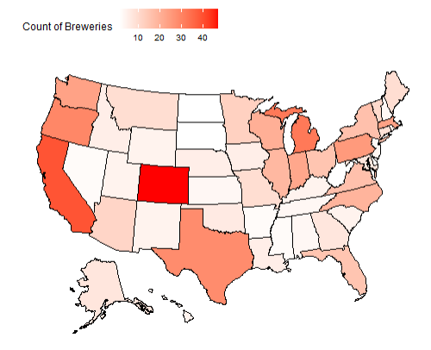
Brewery Count by State

Slide 3
Data Cleaning
Started with 2410 beers.
We removed 1005 beers from the list due to missing values in:
ABV
IBU
Remaining observations of 1405 were complete enough to do our data analysis.

Slide 4
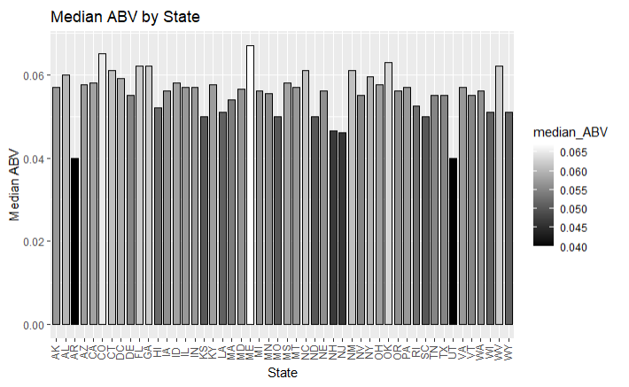
Median ABV by state
Location: Louisville, KY
Brewery: Against the Grain Brewery
Beer: London Balling
ABV: 0.125
Style: English Barlewine

Slide 5
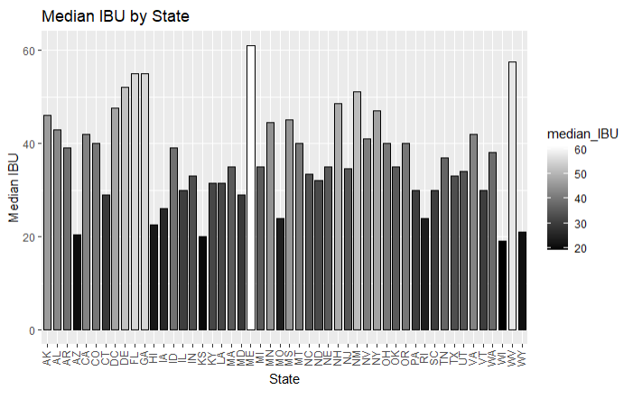
Median IBU by State
Location: Astoria
Brewery: Astoria Brewing Company
Beer: Bitter Bitch Imperial IPA
IBU: 138
Style: American Double/ Imperial IPA

Slide 6
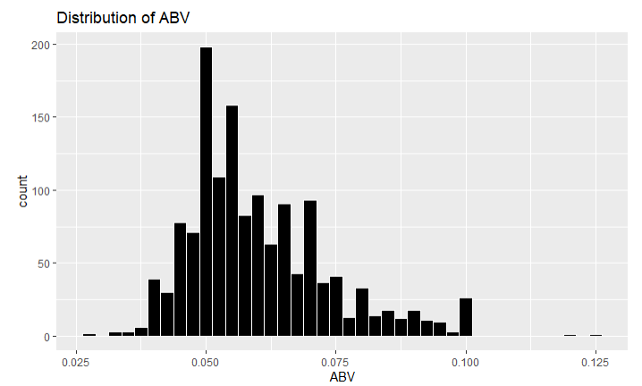
Breakdown of ABV
Mean: .060
Median: .057
Standard Deviation: .014
Max: .125
Min: .027

Slide 7
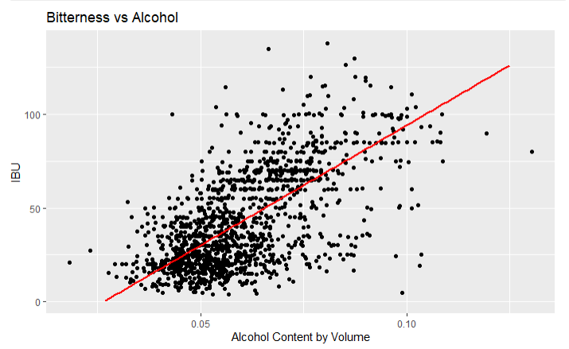
ABV and IBU
Given this graph we see strong evidence of a positive relationship between IBU and Alcohol Content.
In general, as the bitterness of a beer goes up so does the alcohol content.

Slide 8
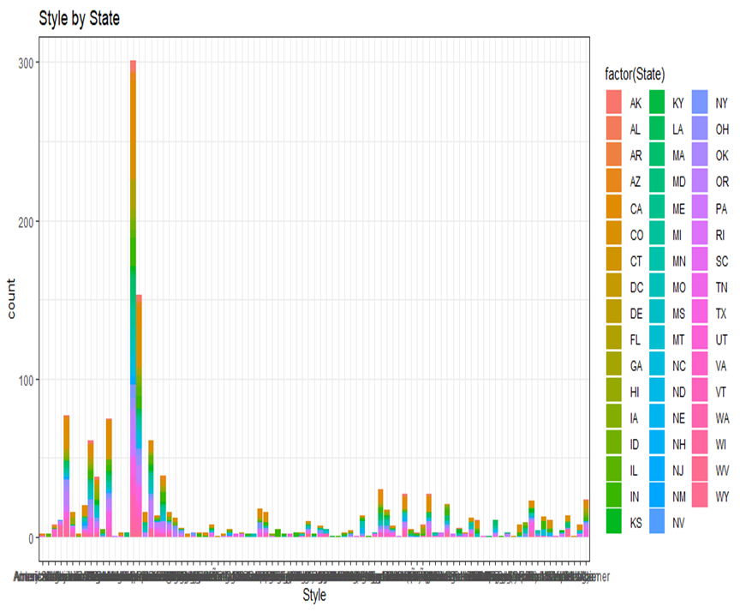
one other useful inference
Given this graph we can see that there are different styles in each state.
From the study we can see that There are various kind of Brew in different states. One Brew may be popular in one states, may not be poplar in another. This study will help companies to increase their production in states where the brand is famous. This also help to balance demand and supply curve and improve production capacity.

