Slide 1
Budweiser
Exploratory data analysis
Authors: Dylan Scott, Sadik Aman
2/23/2021

Slide 2
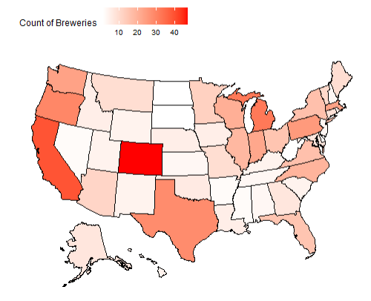
Brewery Count by State

Slide 3
Data Cleaning
Started with 2410 beers.
We removed 1005 beers from the list due to missing values in:
ABV
IBU
Remaining observations of 1405 were complete enough to do our data analysis.

Slide 4
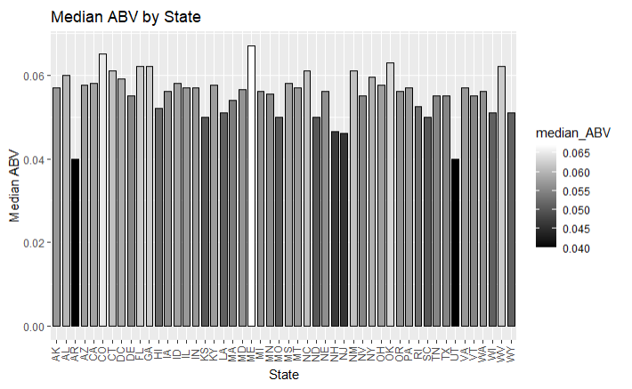
Median ABV by state
Location: Louisville, KY
Brewery: Against the Grain Brewery
Beer: London Balling
ABV: 0.125
Style: English Barlewine

Slide 5
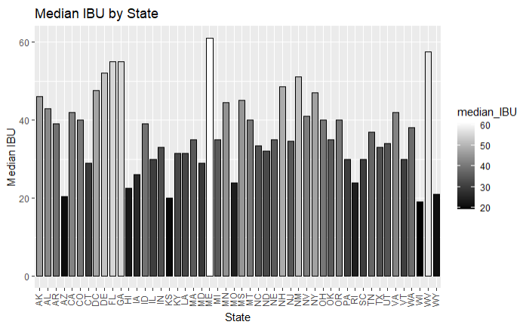
Median IBU by State
Location: Astoria
Brewery: Astoria Brewing Company
Beer: Bitter Bitch Imperial IPA
IBU: 138
Style: American Double/ Imperial IPA

Slide 6
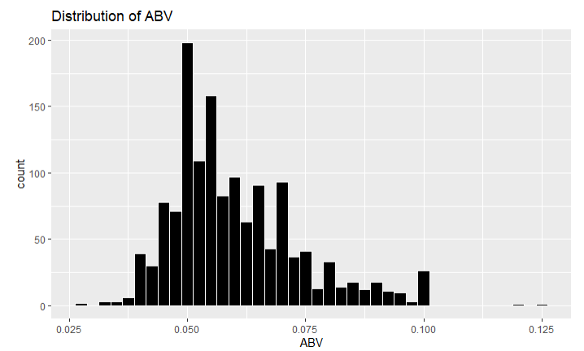
Breakdown of ABV
Mean: .060
Median: .057
Standard Deviation: .014
Max: .125
Min: .027

Slide 7
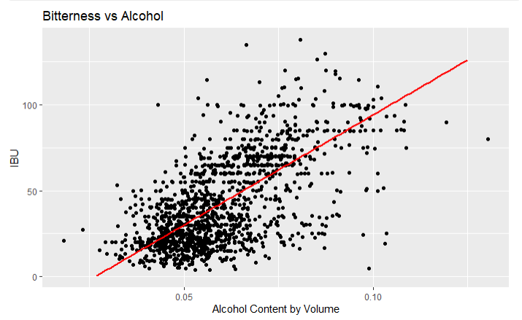
ABV and IBU
Given this graph we see strong evidence of a positive relationship between IBU and Alcohol Content.
In general, as the bitterness of a beer goes up so does the alcohol content.

