Slide 1
Budweiser
Exploratory data analysis
Authors: Dylan Scott, Sadik Aman
2/23/2021

Slide 2
Agenda
Breweries by state
Missing data values
ABV and IBU breakdown
Highest ABV
Highest IBU
Notes:
Breweries by state
How missing values were delt with
Breakdowns in ABV and IBU including the highest beer in each category

Slide 3
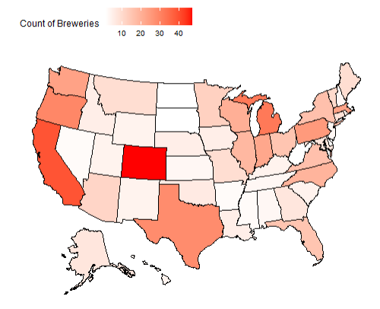
Brewery Count by State
Top 5 States:
Colorado
California
Michigan
Oregon
Texas

Slide 4
Data Cleaning
Started with 2410 beers.
We removed 1005 beers from the list due to missing values in:
ABV
IBU
Remaining observations of 1405 were complete enough to do our data analysis.
Notes:
This is a data loss in regards to beers of roughly 42%
Though that does seem substantial that does leave us with a good sample size of 1405 to do an initial analysis
We were comfortable moving forward with this amount

Slide 5
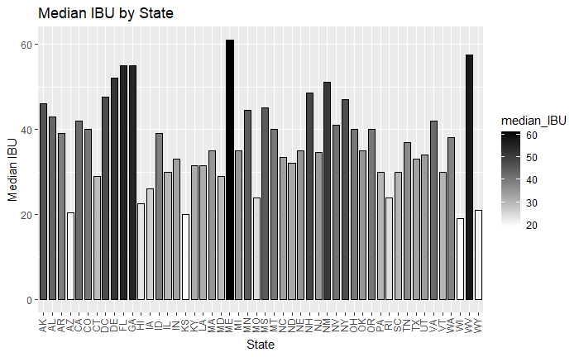
Median IBU by State
Location: Astoria, OR
Brewery: Astoria Brewing Company
Beer: Bitter Bitch Imperial IPA
IBU: 138
Style: American Double/ Imperial IPA
Notes:
Industry average of IBU: 35
This number was determined by the Median of the beer data
Highest also mane
West VA
Most popular IBU:

Slide 6
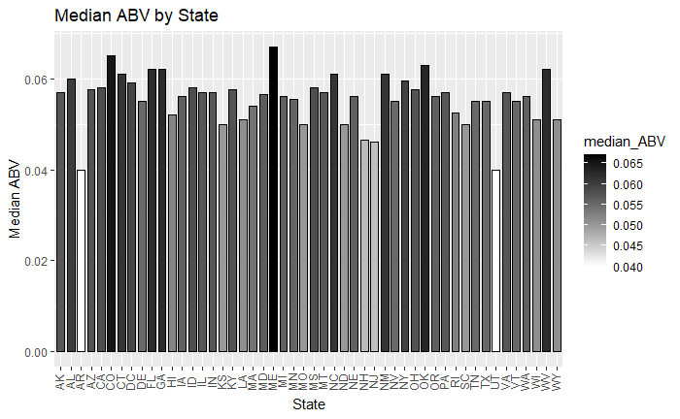
Median ABV by state
Location: Louisville, KY
Brewery: Against the Grain Brewery
Beer: London Balling
ABV: 12.5%
Style: English Barleywine
Notes:
Industry average of ABV: 5.7%
This number was determined by the Median of the beer data
Many states have heavy regulations on Beers sold above 12%
Many breweries have had to move states due to a change in state ABV regulations
Highest is meine
Lowest is Utah and Arkansas
Most popular ABV:

Slide 7
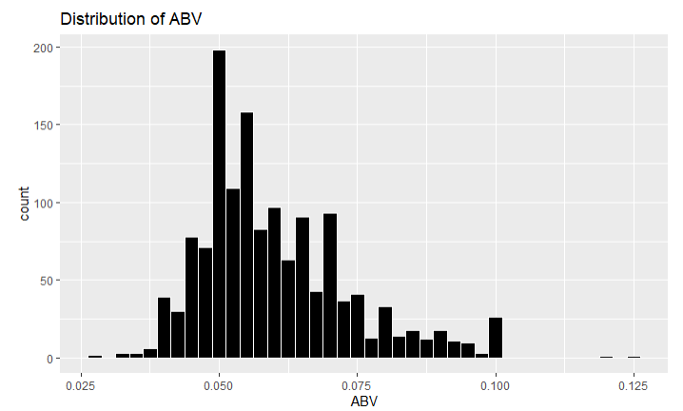
Breakdown of ABV
Mean: .060
Median: .057
Standard Deviation: .014
Max: .125
Min: .027
Notes:
The data looks slightly right skewed to us with a large spike at 5%
This skewness is largely due to states restrictions on ABV. States like Oklahoma (cold only) and Utah carry 4% ABV versions of your most popular beers relative to our industry “standard” 5% - these restrictions also apply to the local breweries meaning they can not produce or sell beer above those 4% ABV thresholds though this only applies to cold beers in Oklahoma’s case.
Iowa also has a 5% or less cap on beer further restricting our distribution

Slide 8
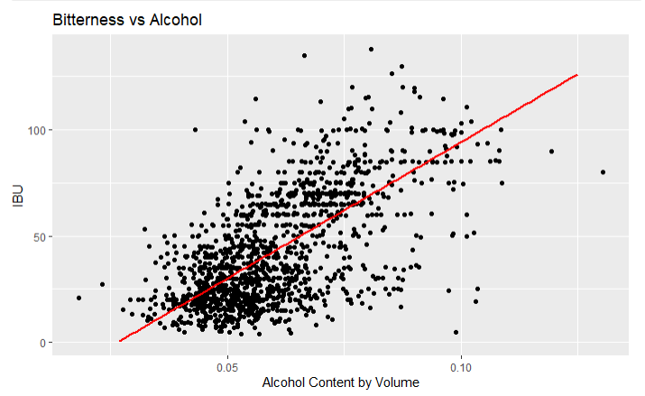
ABV and IBU
Given this graph we see strong evidence of a positive relationship between IBU and Alcohol Content.
In general, as the bitterness of a beer goes up so does the alcohol content.
Notes:
We believe this is largely due to the style of beer. the wildly popular beer category, IPA, is notorious for being bitter and is made in a way that demonstrates this relationship. Dog head fish in Delaware has a 60-minute IPA and a 90-Minute IPA. These boast a 60 IBU score and a 6% ABV and a 90 IBU score and a 9% ABV respectively. This shows how bitterness and alcohol content can increase overtime.

Slide 9
Questions?
Notes:
Do we have to present the final project again to the class? Or to just the power point?
Date to submit? Is it due on the 6th of march
Explain why the clustering is of their interest
Explain how abv impacts ibu

