Slide 1
Budweiser
Exploratory data analysis
Authors: Dylan Scott, Sadik Aman
2/23/2021

Slide 2
Agenda
Breweries by state
Missing data values
ABV and IBU breakdown
Highest ABV
Highest IBU
Notes:
Breweries by state
How missing values were delt with
Breakdowns in ABV and IBU including the highest beer in each category

Slide 3
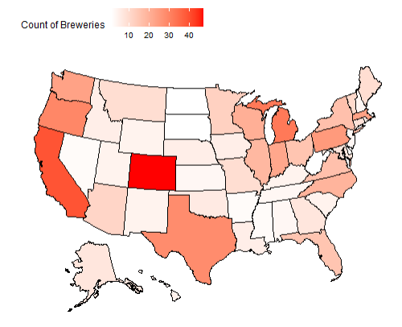
Brewery Count by State
Top 5 States:
Colorado
California
Michigan
Oregon
Texas

Slide 4
Data Cleaning
Started with 2410 beers.
We removed 1005 beers from the list due to missing values in:
ABV
IBU
Remaining observations of 1405 were complete enough to do our data analysis.
Notes:
This is a data loss in regards to beers of roughly 42%
Though that does seem substantial that does leave us with a good sample size of 1405 to do an initial analysis
We were comfortable moving forward with this amount

Slide 5
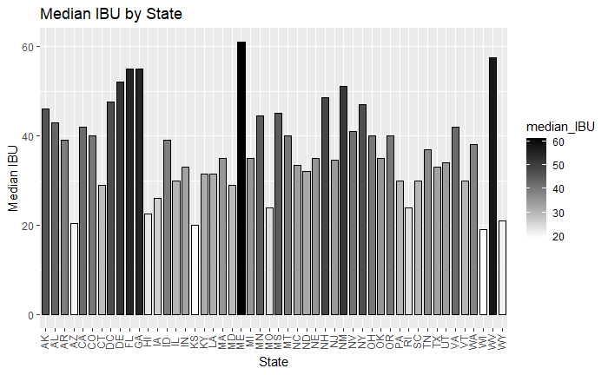
Median IBU by State
Location: Astoria, OR
Brewery: Astoria Brewing Company
Beer: Bitter Bitch Imperial IPA
IBU: 138
Style: American Double/ Imperial IPA
Notes:
Industry average of IBU: 35
This number was determined by the Median of the beer data
Highest also mane
West VA
Most popular IBU:

Slide 6
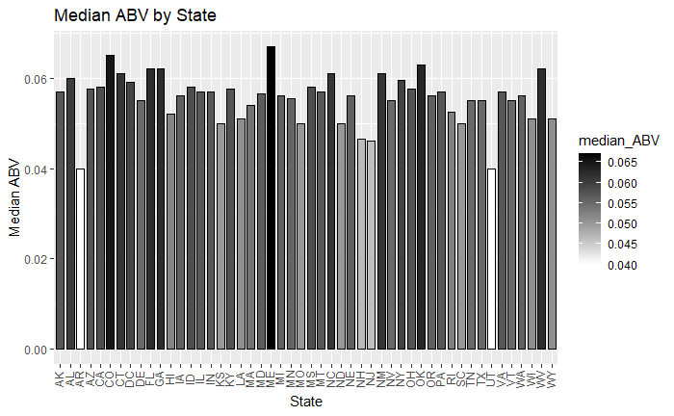
Median ABV by state
Location: Louisville, KY
Brewery: Against the Grain Brewery
Beer: London Balling
ABV: 12.5%
Style: English Barleywine
Notes:
Industry average of ABV: 5.7%
This number was determined by the Median of the beer data
Many states have heavy regulations on Beers sold above 12%
Many breweries have had to move states due to a change in state ABV regulations
Highest is meine
Lowest is Utah and Arkansas
Most popular ABV:

Slide 7
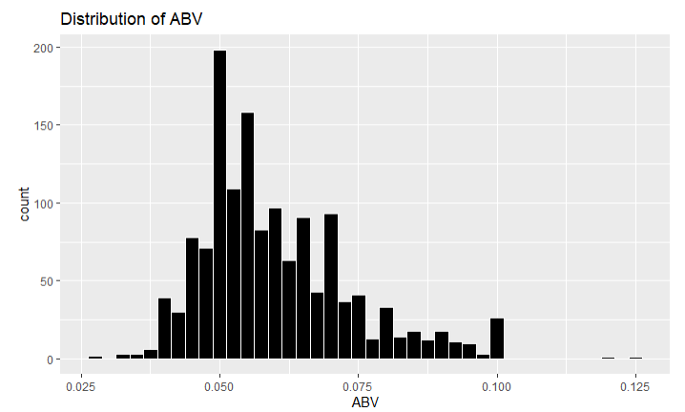
Breakdown of ABV
Mean: .060
Median: .057
Standard Deviation: .014
Max: .125
Min: .027
Notes:
The data looks slightly right skewed to us with a large spike at 5%
This skewness is largely due to states restrictions on ABV. States like Oklahoma (cold only) and Utah carry 4% ABV versions of your most popular beers relative to our industry “standard” 5% - these restrictions also apply to the local breweries meaning they can not produce or sell beer above those 4% ABV thresholds though this only applies to cold beers in Oklahoma’s case.
Iowa also has a 5% or less cap on beer further restricting our distribution

Slide 8
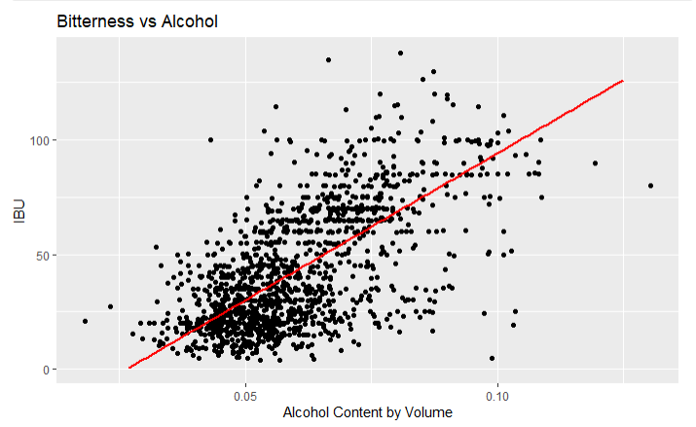
ABV and IBU
Given this graph we see strong evidence of a positive relationship between IBU and Alcohol Content.
In general, as the bitterness of a beer goes up so does the alcohol content.
Notes:
We believe this is largely due to the style of beer. the wildly popular beer category, IPA, is notorious for being bitter and is made in a way that demonstrates this relationship. Dog head fish in Delaware has a 60-minute IPA and a 90-Minute IPA. These boast a 60 IBU score and a 6% ABV and a 90 IBU score and a 9% ABV respectively. This shows how bitterness and alcohol content can increase overtime.

Slide 9
Questions?

