Slide 1
Data Version Control (DVC)
NFL TAC 2022

Slide 2
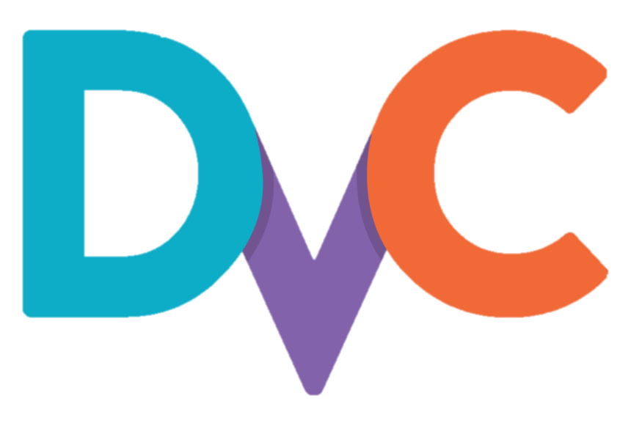
Overview
What is DVC?
Open-source version control system for machine learning projects
Basically – Git extension for data and models
How has DVC helped us?
Make models shareable and reproducible
Use Git branches to try different ideas
Track model performance metrics automatically
Deploy models/data to production
Other cool features:
Language/framework agnostic (R, Python, etc.)
Storage agnostic (Amazon S3, Azure, Google Drive, On Premise, etc.)
Pipeline caching (skip intermediate steps if code didn’t change)
Exceptional documentation

