Slide 1
Survival Prediction After Heart Failure
Machine Learning & Bayesian Methods
Li Shandross, Scott Hebert

Slide 2
Introduction
Cardiovascular diseases (CVDs), including heart failure, account for ~17 million deaths worldwide annually
CVDs part of non-communicable disease burden in industrialized countries
Current evaluation for disease progression lacking
Heart failure prediction essential in clinical practice yet has failed to achieve high accuracy
Reference paper authors' machine learning methods showed certain accuracy gains but still room for additional improvements

Slide 3
 | MCC | F₁ score | Accuracy | TP rate | TN rate | PR AUC | ROC AUC
Random Forests (EF, SC) | 0.418 | 0.754* | 0.585 | 0.541 | 0.855 | 0.541 | 0.698
Gradient boosting (EF, SC) | 0.414 | 0.750 | 0.585 | 0.550 | 0.845 | 0.673* | 0.792
SVM radial (EF, SC) | 0.348 | 0.720 | 0.543 | 0.519 | 0.816 | 0.494 | 0.667
Strat log. reg (EF, SR, & FU) | 0.616* | 0.719 | 0.838* | 0.785* | 0.860* | 0.617 | 0.822*
Strat log. Reg (all features) | 0.607 | 0.714 | 0.833 | 0.780 | 0.856 | 0.612 | 0.818

Slide 4
Can Bayesian logistic regression improve upon machine learning in terms of prediction accuracy?

Slide 5


Model Equations
Full model:
Intercept-only model:
Reduced model (based on reference paper):
Horseshoe prior model:
where:
a_{i} refers to patient age in years,
m_{i} refers to the presence of anaemia,
h_{i} refers to the presence of high blood pressure,
k_{i} refers to blood creatinine phosphokinase level in mcg/L,
d_{i} refers to the presence of diabetes,
e_{i} refers to ejection fraction (percentage of blood leaving the heart upon each contraction),
p_{i} refers to blood platelets in kiloplatelets/mL,
x_{i} refers to sex (M/F),
c_{i} refers to serum creatinine in mg/dL,
s_{i} refers to serum sodium in mEq/L,
g_{i} refers to whether the patient smokes

Slide 6
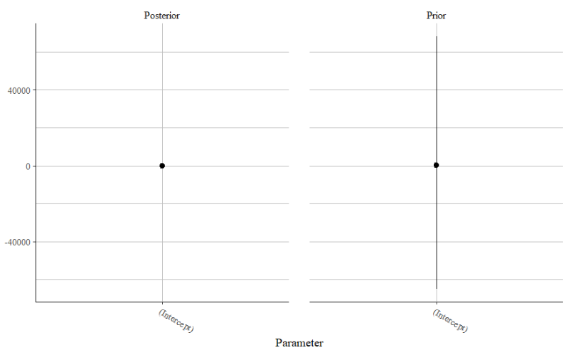
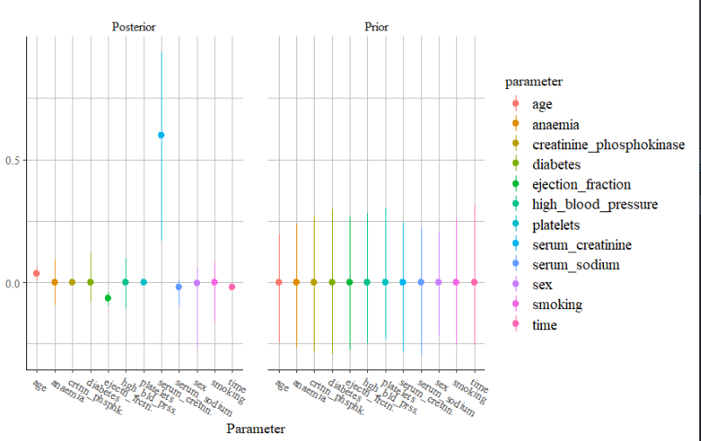
Horseshoe Prior Details
Useful for situations with more parameters than observations OR parameters highly correlated
Shrinks coefficients weakly supported by data towards zero
Identified most important predictors: 1) serum creatinine, 2) ejection fraction, 3) age
Same as paper's results, based on guess of 2 important predictors

Slide 7
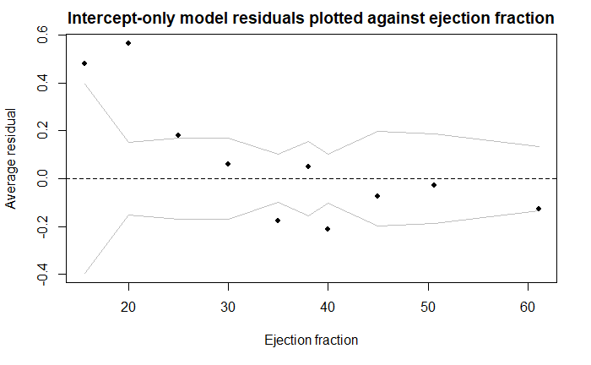
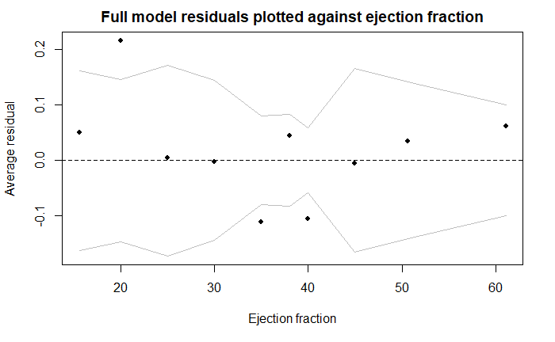
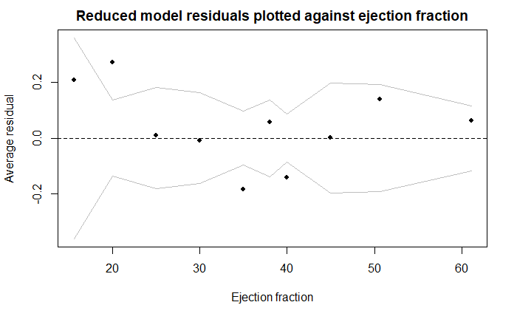
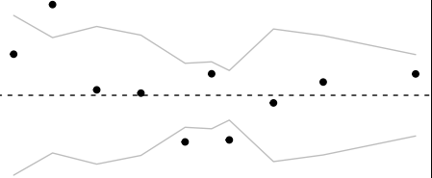
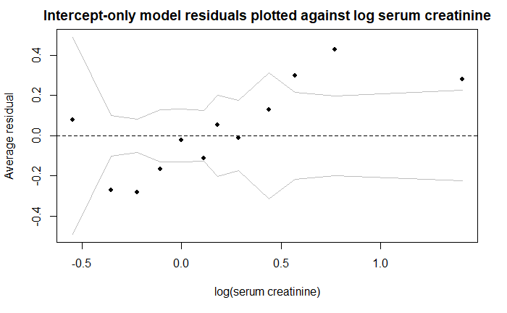
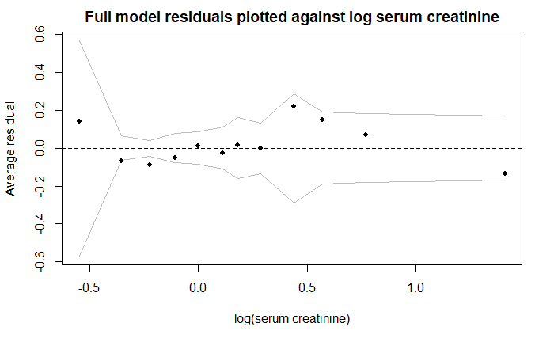
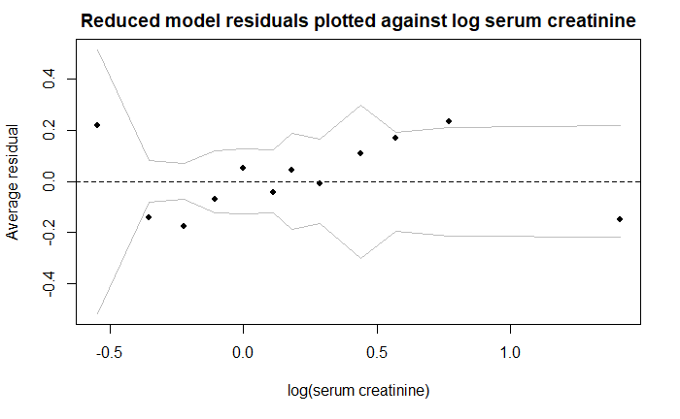
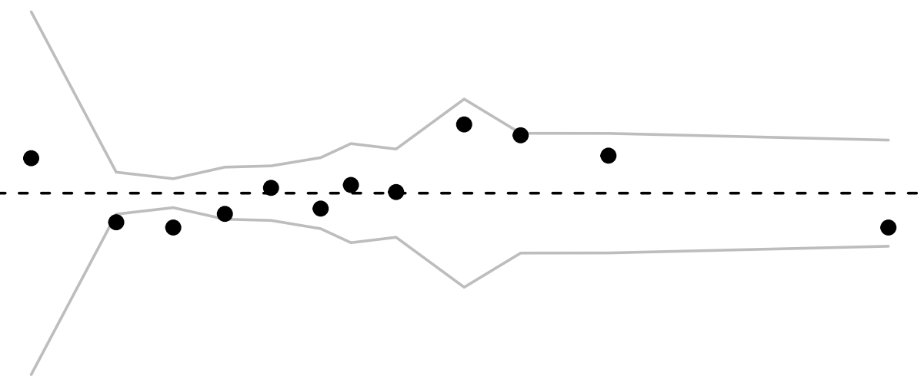
Results: In-Sample Checks
Residuals plotted against ejection fraction:
Residuals plotted against (log) serum creatinine:

Slide 8
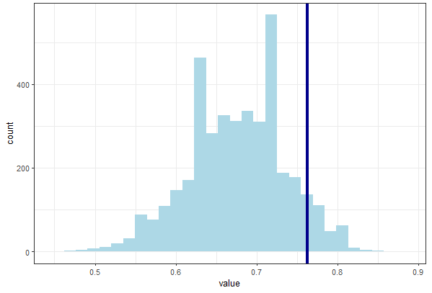
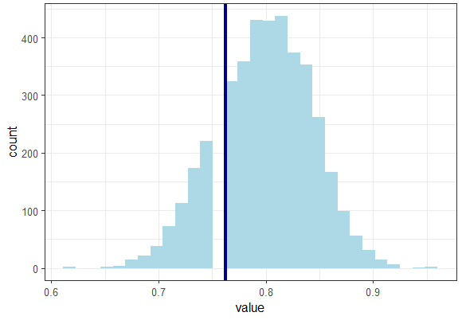
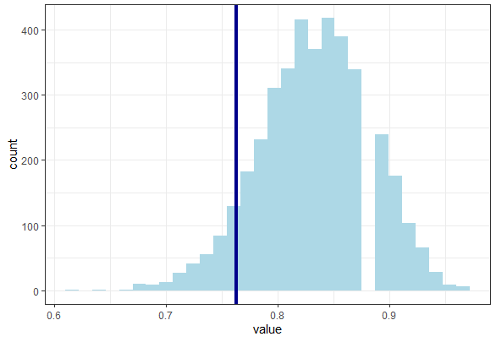
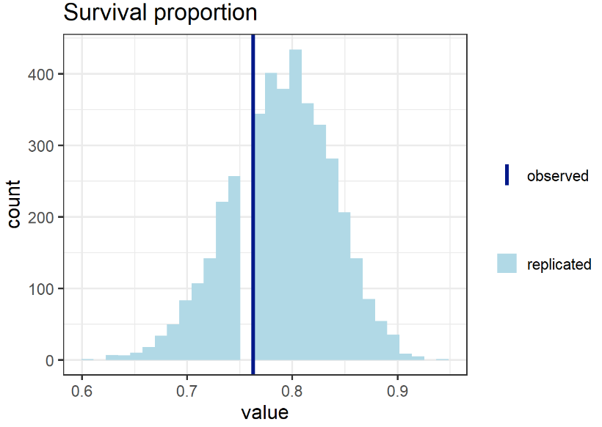
Results: In-Sample Checks
Binned residuals generally look okay, except for no predictor model
Plotted against three most important predictors: age, ejection fraction, serum creatinine
3 main test statistics:
Survival proportion: Excellent (ppv $\approx$ 0.5)
Survival proportion of normal ejection fraction: Okay/Poor/Bad (see below)
Survival proportion of normal serum creatinine levels: Poor/Bad (ppv < 0.25)
Intercept-only: 0.094
Full model: 0.836
Reduced model: 0.940
Horseshoe model: 0.766

Slide 9
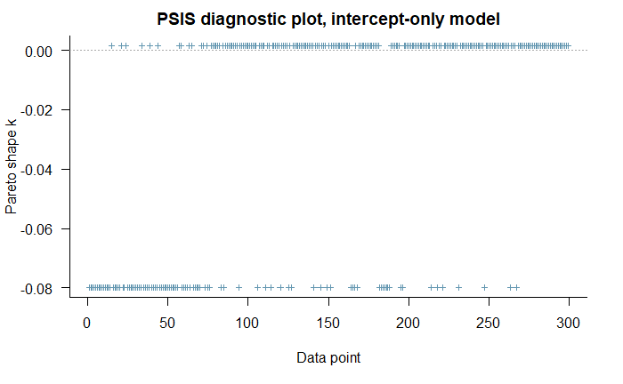
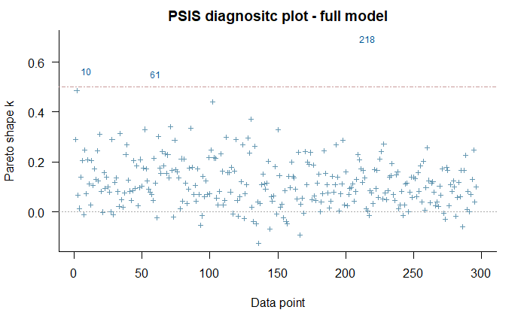
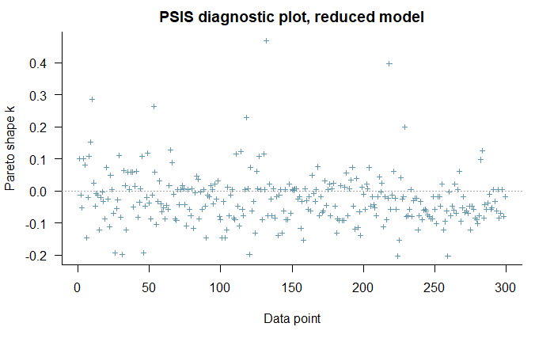
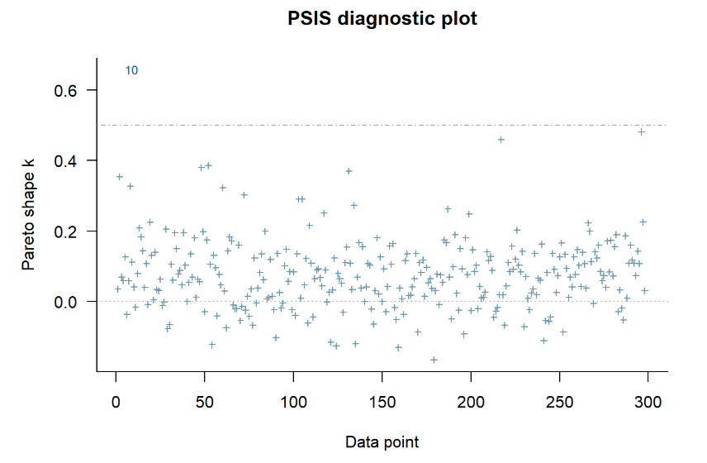
Results: Out-of-Sample Checks
No influential points for any models
The horseshoe prior model has best ELPD of all models, followed closely by the full model
Horseshoe = -122.1, Full model = -125.1,
Reduced model = -165.8, Intercept only model = -188.7
Best 2 models >2 sd's better than other models
We calculate confusion matrix values since this is logistic regression and to compare against machine learning methods of reference paper

Slide 10
Results: Model Comparisons
 | ELPD | MCC | TP rate | TN rate | Accuracy | ROC AUC
Horseshoe | -122.1 | 0.433 | 0.615 | 0.817 | 0.752 | 0.894
Full | -125.1 | 0.464 | 0.637 | 0.827 | 0.766 | 0.898
Reduced | -165.8 | 0.177 | 0.442 | 0.735 | 0.640 | 0.762
Int-only | -188.7 | -0.000 | 0.322 | 0.678 | 0.564 | 0.5
Random forests | - | 0.418 | 0.541 | 0.855 | 0.585 | 0.698
Stratified Reduced | - | 0.607 | 0.785 | 0.860 | 0.838 | 0.818
Notes:
Note: These are in-sample checks
For further research, we could compare the stratified reduced model from the reference paper to a hierarchical model

Slide 11
Conclusion/Discussion
Overall, full model performed best, but only marginally better than horseshoe prior model
Train-test split may have put horseshoe prior model on top
Horseshoe prior model is simpler, would be easier to implement and computationally more efficient
Horseshoe model has additional guard against overfitting vs full model
Full and horseshoe prior models performed better than Random Forests in all metrics except true negative rate
Horseshoe model and Random Forests model have comparable simplicity
Future research: Bayesian hierarchical model, Bayesian survival analysis
Utilizing follow-up time variable

