Slide 1
Untangle Your Front End Development with Visual Studio 2015
Scott heckel

Slide 2

Scott Heckel
Consultant
Web and Mobile Development
MSSE University of Minnesota
CMPE & CS University of Wisconsin
Questions? scott.heckel@gmail.com @scottheckel

Slide 3
Visual Studio 2015
What’s new?

Slide 4
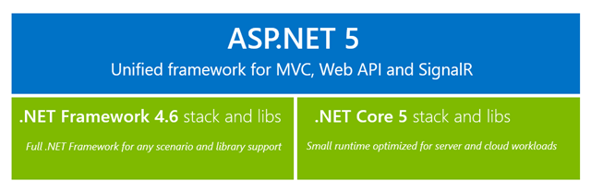
ASP.NET 5 and the Core-CLR

Slide 5
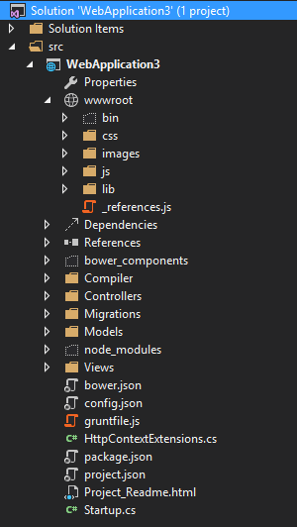
New Web Project Structure

Slide 6








Embracing Front End Tooling

Slide 7
The Package Managers
Install and upgrade your dependencies

Slide 8

For C# Dependencies
Reside in…
project.json
References

Slide 9
For Node.js Dependencies
Reside in…
package.json
Dependencies -> NPM

Slide 10
Bower
For Front-End Dependencies
Reside in…
bower.json
Dependencies -> Bower

Slide 11
The Build/Task Tools
Automate, Compile and transform

Slide 12
The Build/Task Tools
MSBuild
Grunt - Tasks
Gulp.js - Streams

Slide 14
Semantic Versioning
Major.Minor.Patch
0.1.0
1.0.5

Slide 15
Semantic Versioning
Initial Development Version?
0.x.x
Public
1.0.0

Slide 16
Semantic Versioning
Fix a bug & backwards compatible?
Patch Bump
Add functionality & backwards compatible?
Minor Bump
Backwards Incompatible?
Major Bump

Slide 17
Semantic Versioning
1.0.3
>=1.0.3
~1.0.3
1.0.x
1.x
*

Slide 19
NPM Packages
Grunt
Grunt-Bower-Task
Grunt-Contrib-Uglify
Grunt-Sass
Load-Grunt-Config

Slide 20
Bower Packages
Bootstrap
Bootstrap-sass
jQuery
jQuery-Validation
jQuery-Validation-Unobtrusive
Hammer.js
Bootstrap-Touch-Carousel
Underscore

Slide 21

Questions?
https://github.com/scottheckel/talks
@scottheckel
Scott.heckel@gmail.com

