Slide 1
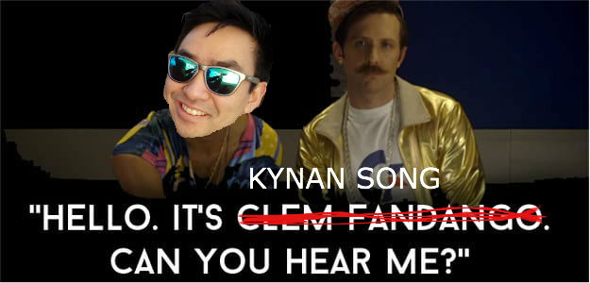
Drinkable
By:

Slide 2
What does it do?
Through the wonder of inner joins, you can access a drop down box containing a choice of ingredients.
This will then narrow down a list of cocktails that contain this ingredient.
From the list, you can select a cocktail and learn how to make it.

Slide 3
MVP
Just to display a list of cocktails based on ingredient choice.

Slide 4
Planning
Wire Frame designs helped a lot in terms of working out what functions would be needed where.
MoSCoW for working out MVP.
Table diagrams helped to get my head around the many to many concept.
Class Diagrams and File Structure plan to work out what goes where and how things interact.

Slide 5
Trials and Tribulations
Learning SQLite and more of the functionality of Android Studio was pretty tough.
There are a lot of tutorials out there, however some are out of date and others take quite complicated route.
EXAMPLE: One tutorial led me to creating a DataManager class which resulted in singleton methods and became rather confusing.

Slide 6
More Issues
SQLite syntax.
It is not case-sensitive, so led to a lot of ambiguous errors.
Commas are important.
Changing versions every time a change is made to the database.

Slide 7
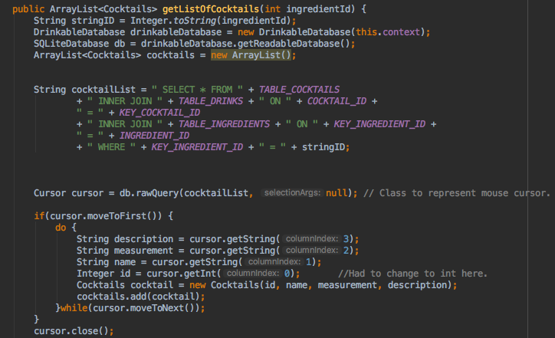
Using inner-joins in SQLite

Slide 8
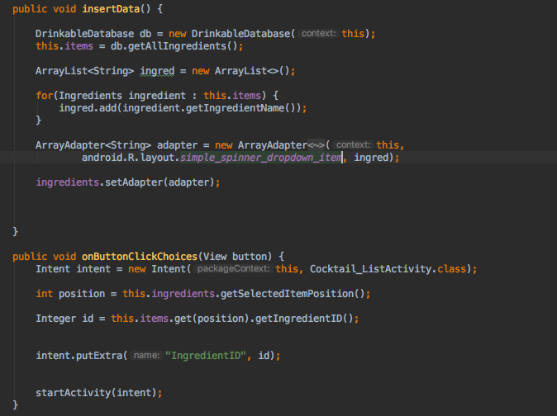
Using a spinner

Slide 9
Features to add
Recommended spirits.
Recommended bars.
More filter options.
More graphics.
Refactor code to make it DRY.
Refactor code so methods are in the right place.

Slide 10
Things to do better.
More planning.
Don’t read several tutorials at once.
Better naming conventions.

Slide 11

Questions?

