Slide 1
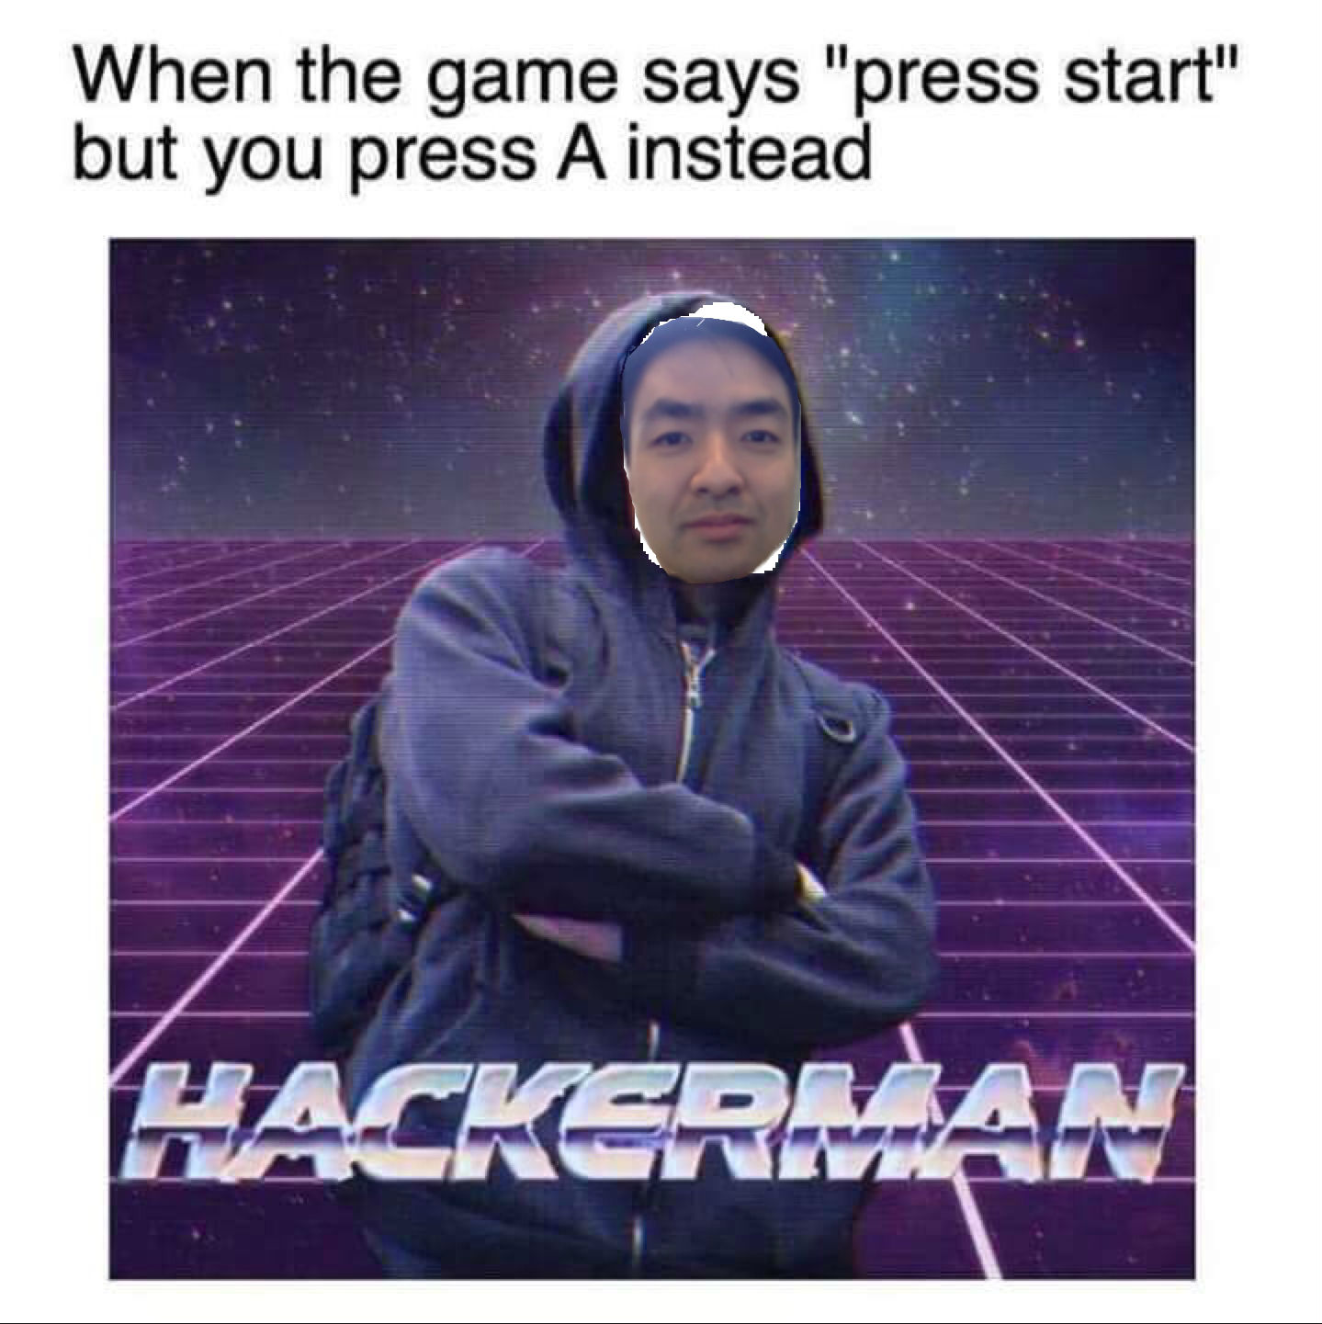
Money Saver Project
By Kynan Song

Slide 2
Planning
App functionality
Bits to add
Challenges
Experience

Slide 3
Initial planning
User Profiles
User Needs
Basic Class Diagram
Project file structure

Slide 4
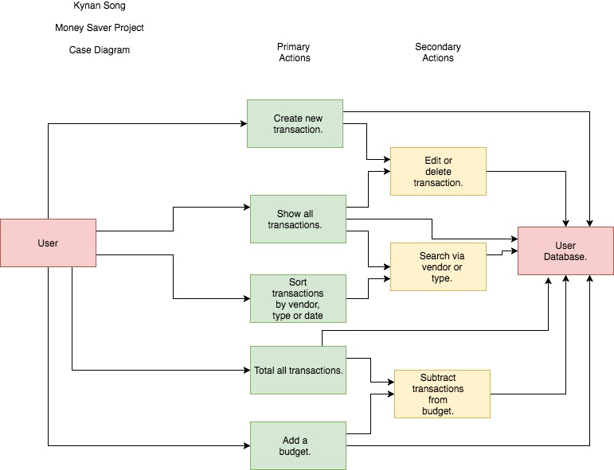
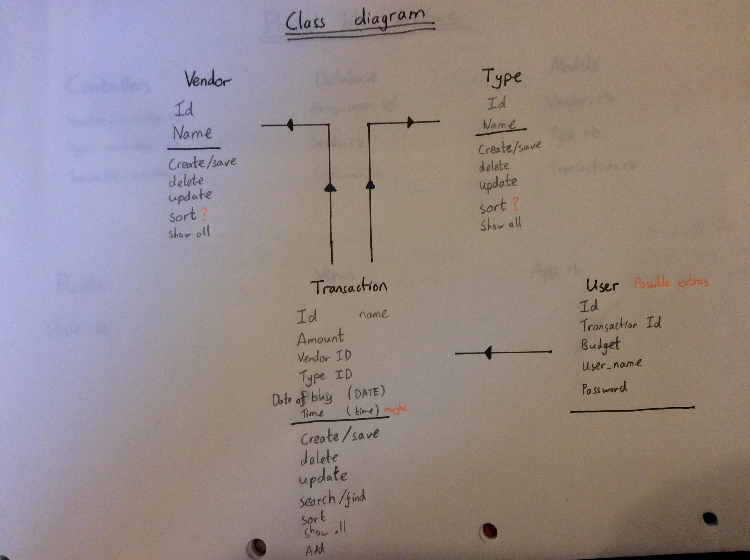
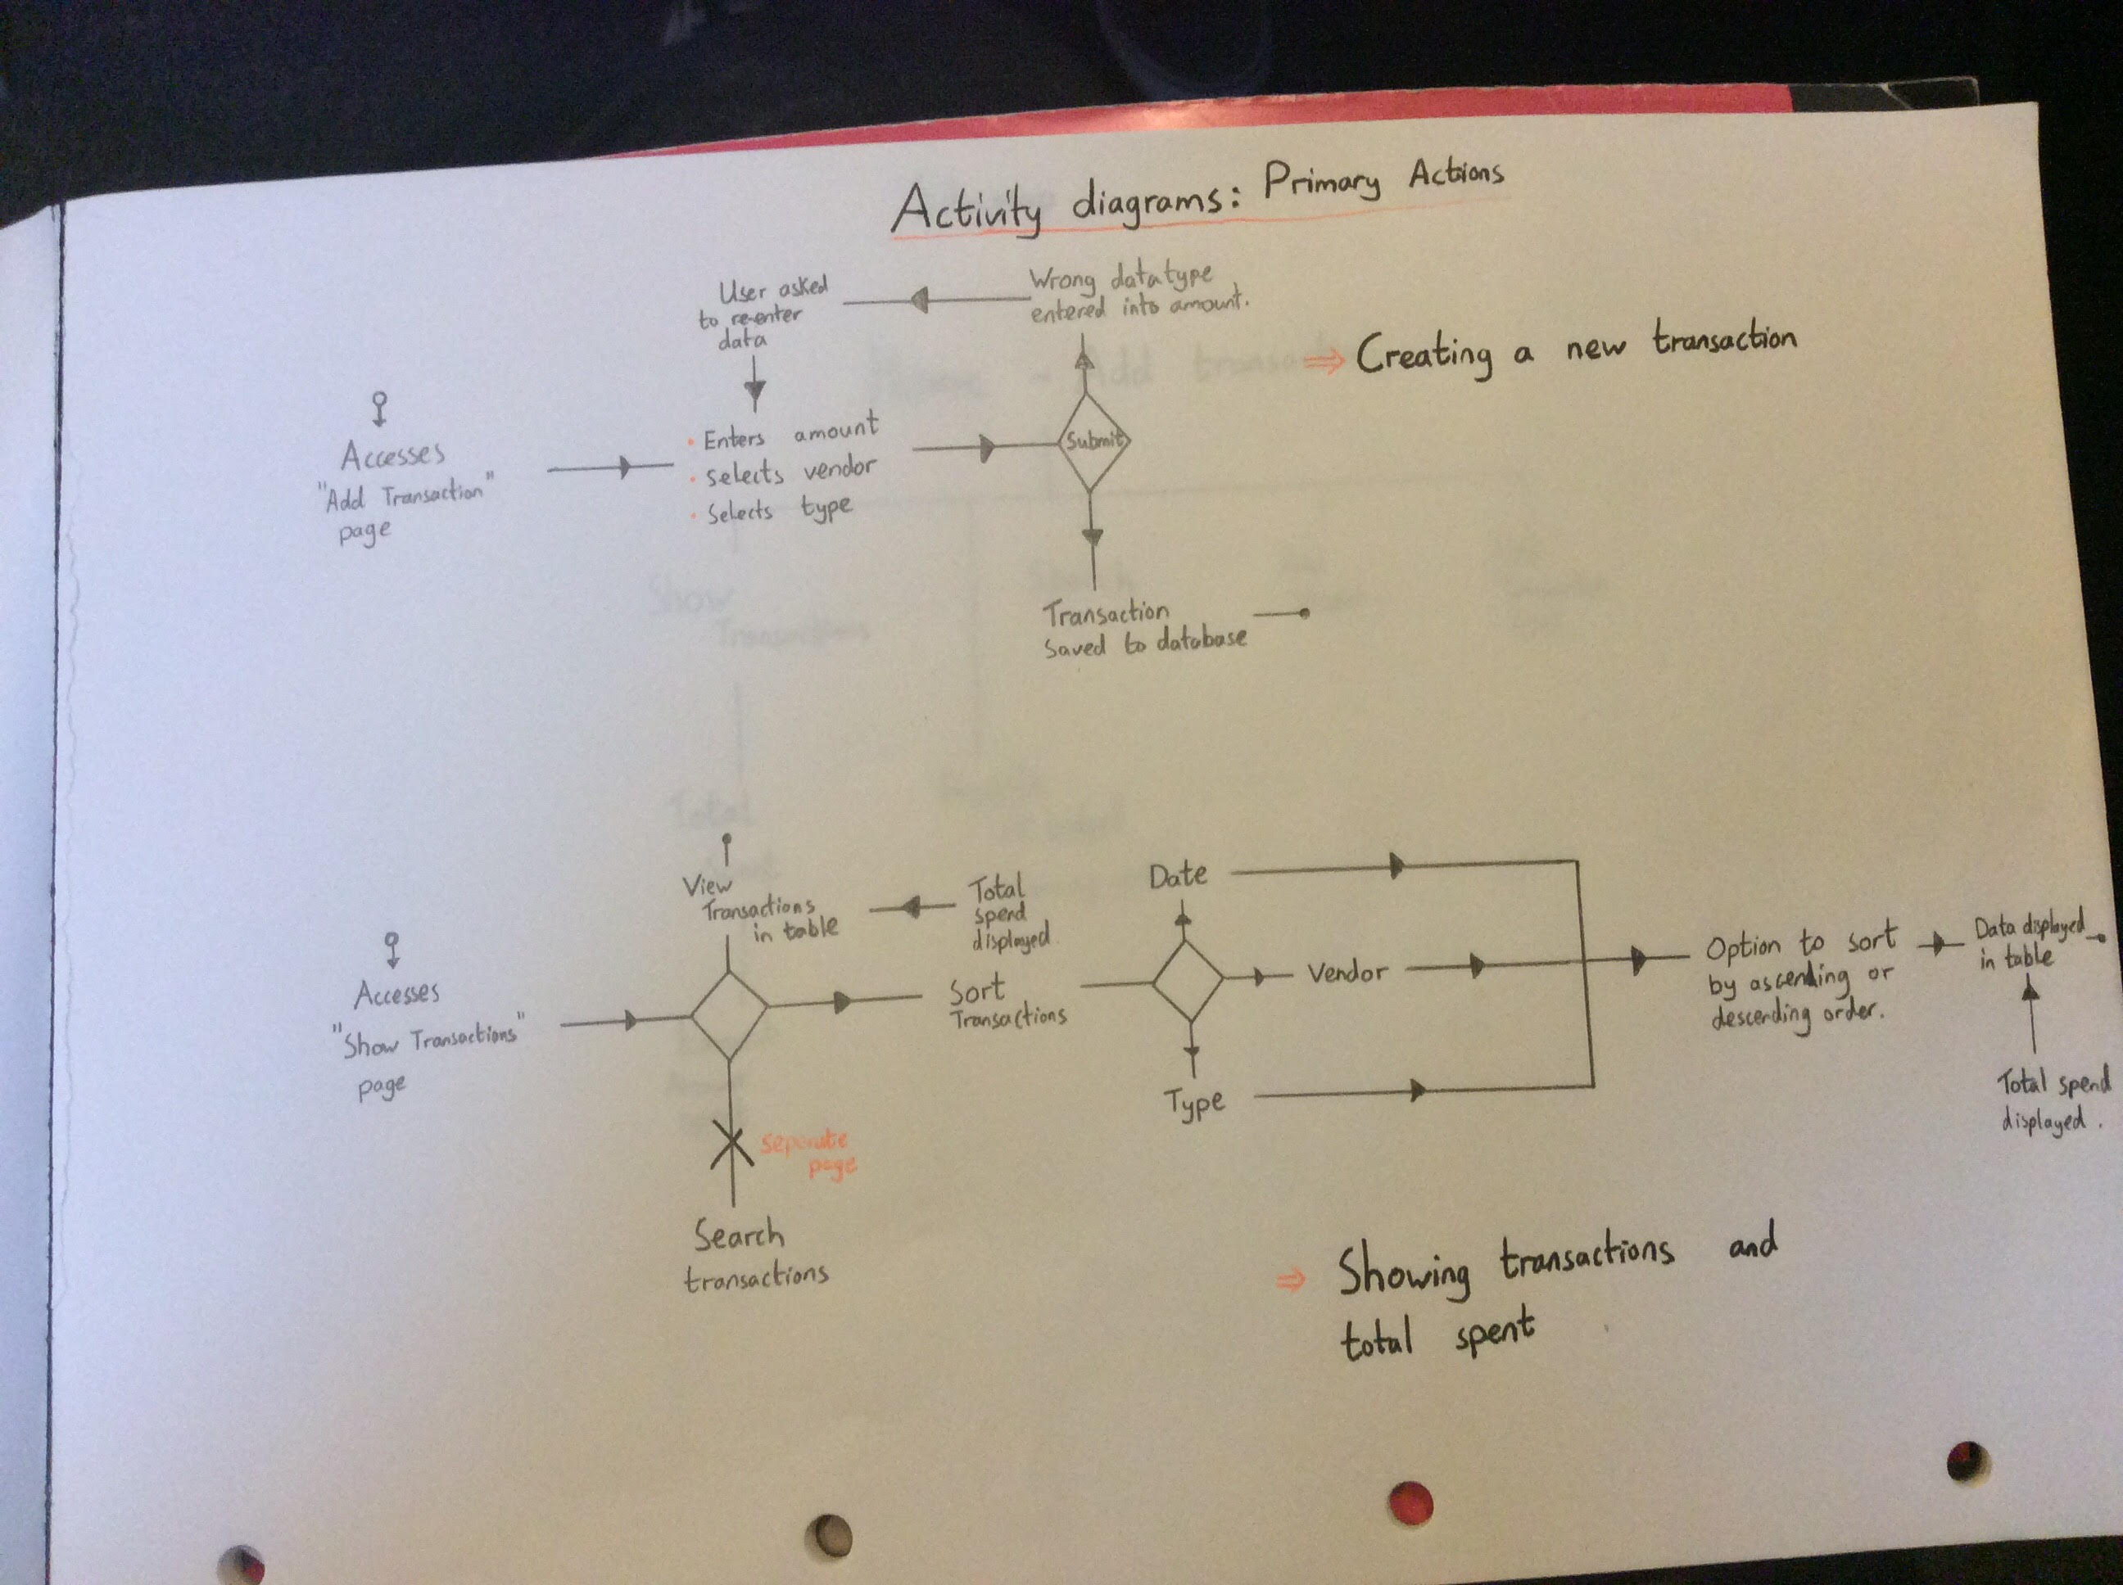
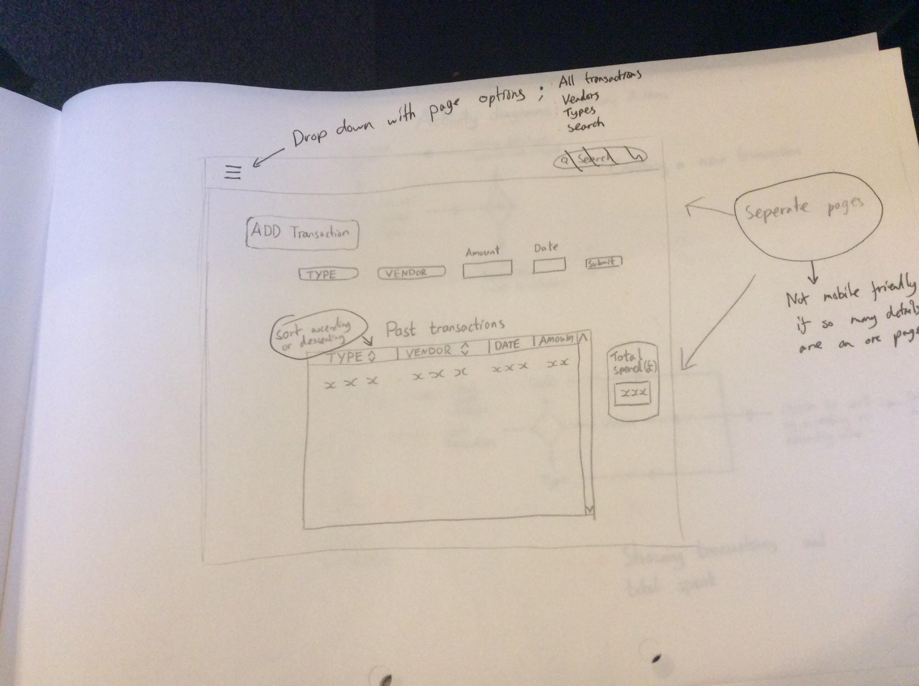
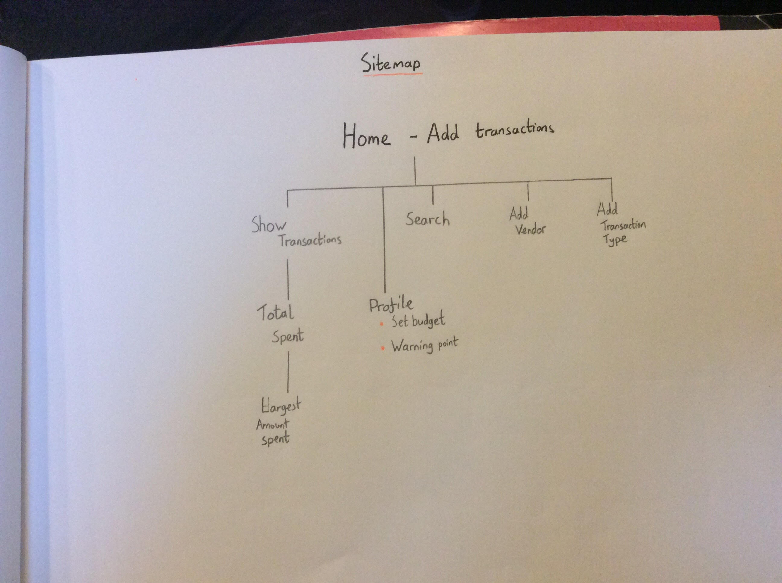
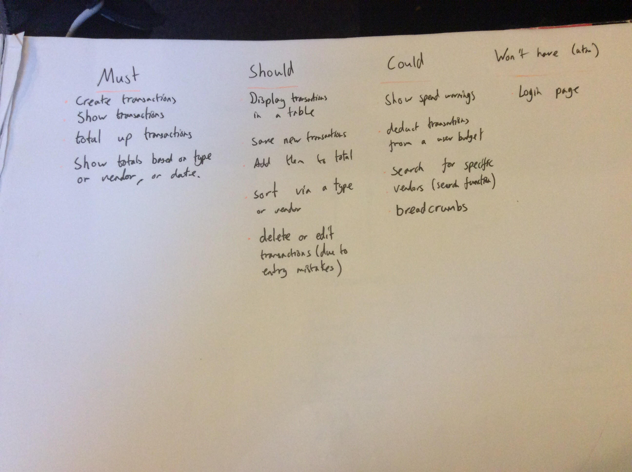
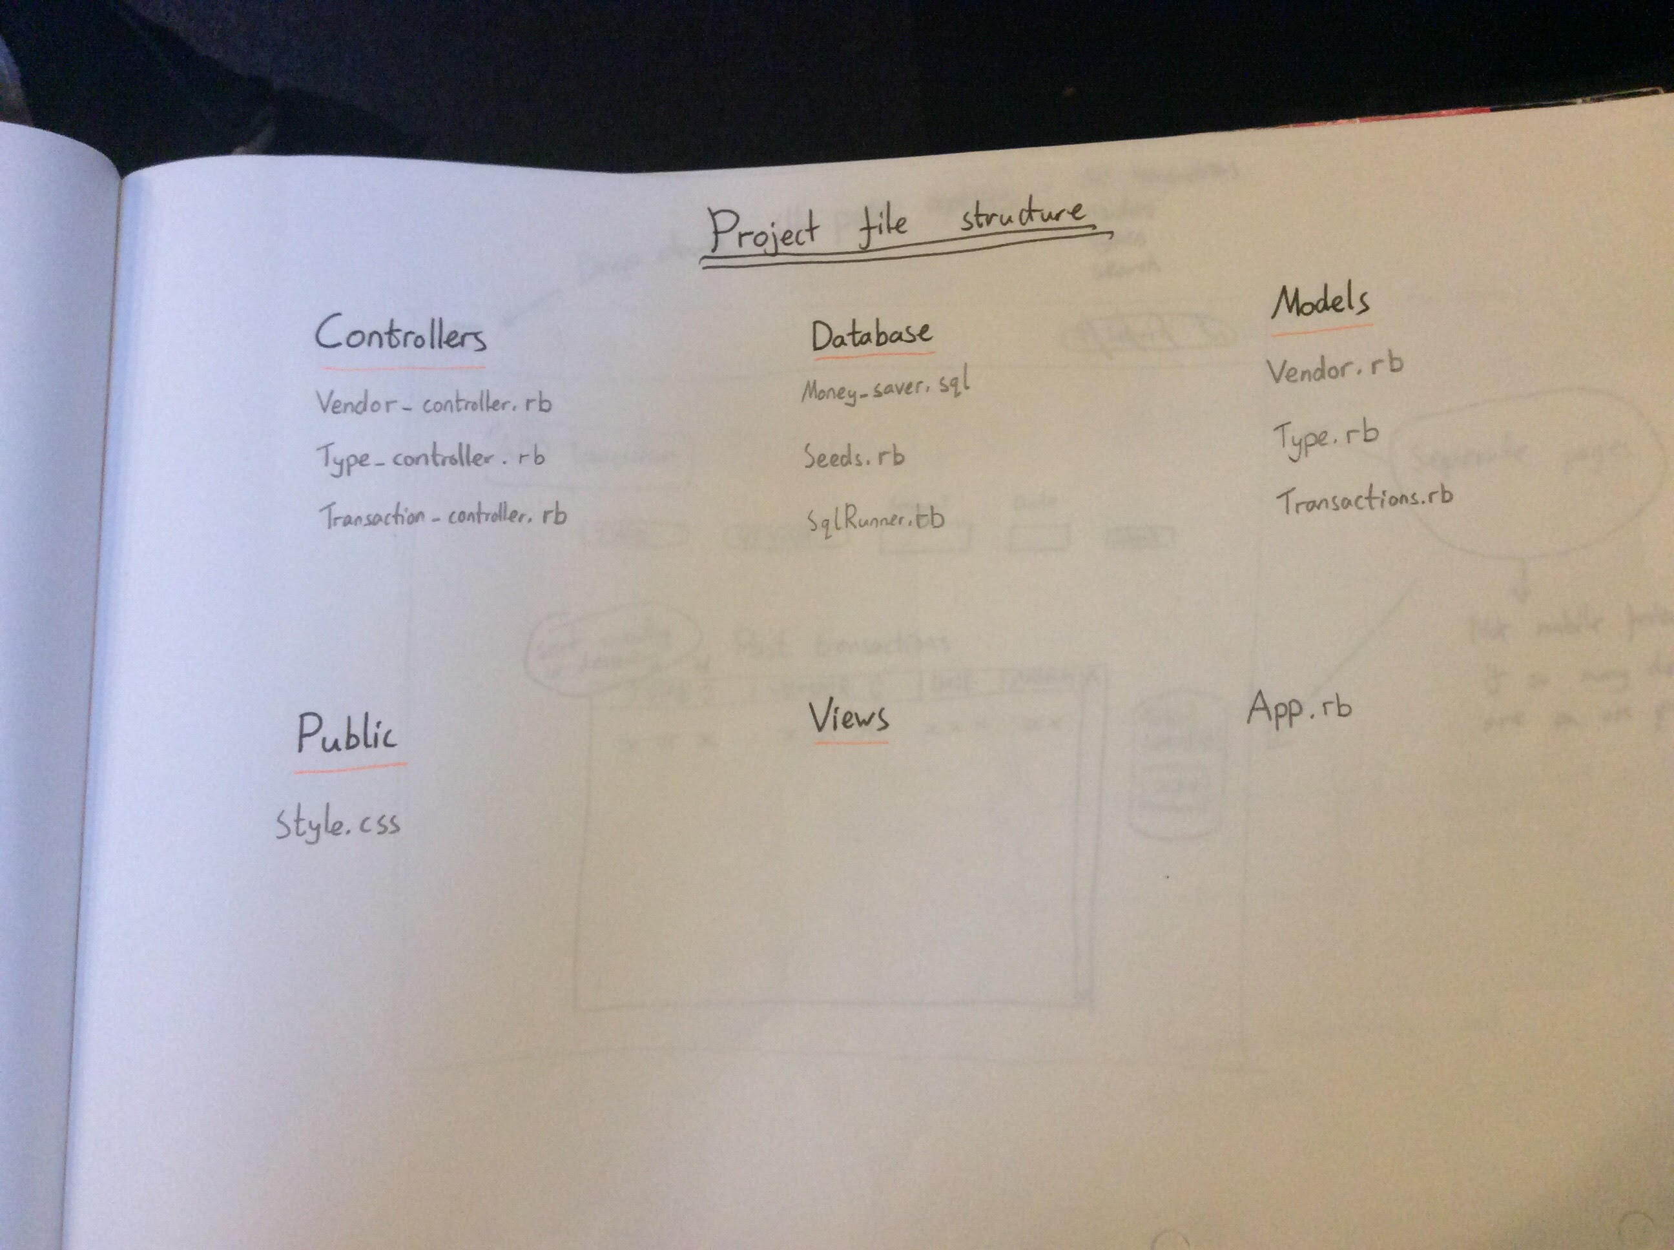
Subsequent Planning

Slide 5
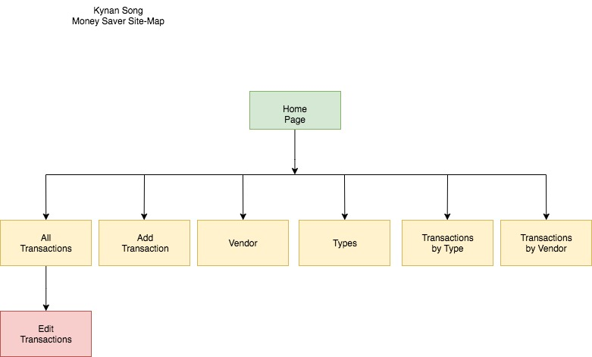
Final Site Map

Slide 6
App Functionality & Code
MVP
Create new transactions
Display a list of all transactions
Display total amount spent
Display total amount spent by tag

Slide 7
Bits to add
User can add their own budget
Currently a framework is set up.
Establish a budget by month.
Login screen and authentication
Sort by date

Slide 8
Challenges
HTML and CSS!
ERB – connecting functions and pages together.

Slide 9
My experience with this project.
Really enjoyed the initial planning, discussing ideas really helped.
Drawing up plans was really helpful as a reference to work off then writing the models scripts.
HTML and CSS were frustrating but it was very satisfying when it all came together.

Slide 10

Questions?

