Slide 1
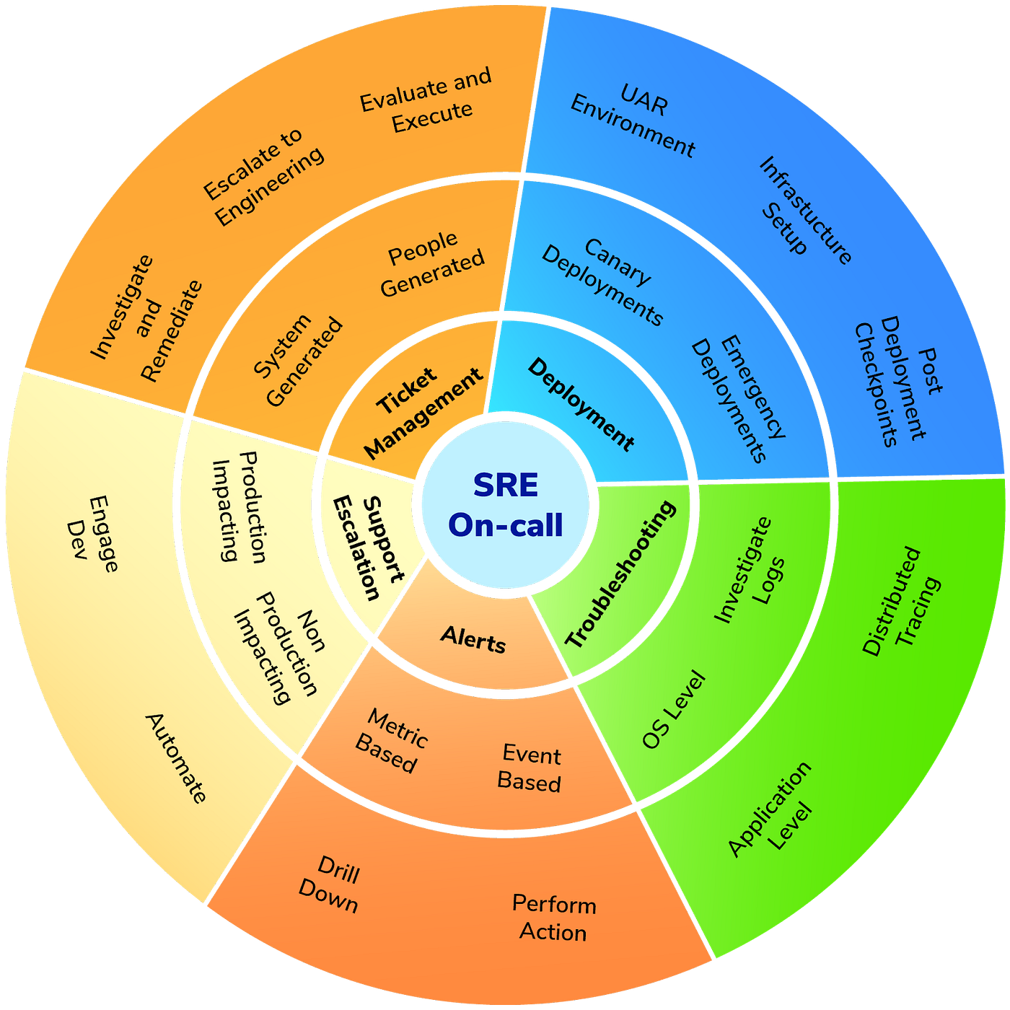
Pager Rotation Duties
Scott Macioce - Module 7 - CSD380

Slide 2
What Are Pager Rotation Duties?
Pager rotation is the shared schedule where engineers are on-call to respond to production incidents.
Alerts come from monitoring tools which consist of page, SMS, phone, or app notification.
In DevOps, developers, managers, and architects share on-call with Ops so everyone feels the impact of production issues.
The goal is to ensure fast response, reduce customer impact, and create feedback from production back into daily development work.

Slide 3

Why Pager Rotation Matters in DevOps
Many incidents still escape the deployment pipeline, so teams rely on production telemetry + on-call responders to restore service quickly.
Waking developers no matter the time of day for issues comes with a sense of urgency and ownership which results in defects get fixed faster and with more care.
On-call makes it clear that a feature is only completed when it runs reliably in production, not just when the code is merged.

Slide 4

Designing Effective Pager Rotations
Use primary + secondary on-call so there is always backup if the primary is overloaded or unreachable.
Define a rotation cadence that balances coverage, personal life, and accounts for time zones.
Track pager load and keep it sustainable so that a high pager load is a signal to fix underlying reliability issues and vise versa.
Publish a clear schedule so everyone knows who is on-call and how to escalate.

Slide 5

Expectations for On-Call
Be Present
Be reachable during the shift and able to respond quickly to pages.
Triage
Triage alerts using runbooks, logs, and dashboards. Resolve or escalate within defined SLAs.
Communicate
Communicate in shared channels so others can assist and learn.
Provide
Provide a handoff summary at the end of the rotation.

Slide 6
Best Practices
Devs, leads, and architects all participate in pager rotation.
Managers join the rotation often to see impact and prioritize reliability work appropriately.
Run blameless post-incident reviews to turn outages into learning opportunities.
Emphasize that on-call is about owning and improving the service, not just answering pages.

Slide 7
Tooling & Automation
Monitoring and alerting platforms route alerts to the correct rotation.
Use incident management tools with integrated chat and dashboards to coordinate response and capture history.
Maintain runbooks and auto-remediation scripts so common issues can be fixed quickly.

Slide 8
Reducing Fatigue and Burnout
Only actionable, customer-impacting incidents should page someone at night.
Keep rotations fair, limit consecutive nights or weekends, and provide recovery time after heavy incidents.
Encourage schedule swaps and backup coverage when people are sick or on vacation.
Use repeated noisy pages as a signal to fix root causes.

Slide 9
Pager Rotation Checklist
Shared Dev + Ops rotation with clear primary/secondary responders
Sustainable schedule and pager load, documented escalation paths
Strong tooling
Blameless post-incident reviews feeding reliability improvements
Leadership support: on-call time recognized, rewarded, and used to prioritize technical debt and resilience work

Slide 10

References
Kim, G., Humble, J., Debois, P., Willis, J., & Forsgren, N. (2021). The DevOps handbook: How to create world-class agility, reliability, & security in technology organizations (2nd ed.). IT Revolution.
PagerDuty, I. (2025). Being On-Call - PagerDuty Incident Response Documentation. PagerDuty Incident Response Documentation. https://response.pagerduty.com/oncall/being_oncall/
‌Spadaccini, A. (2015). Being On-Call. Sre.google; Google SRE. https://sre.google/sre-book/being-on-call/
‌On-Call Rotations and Schedules. (2025, March 27). PagerDuty. https://www.pagerduty.com/resources/incident-management-response/learn/call-rotations-schedules/
Squadcast. (2025, February 27). On-Call Rotation: A Complete Guide to Best Practices. Medium. https://medium.com/@squadcast/on-call-rotation-a-complete-guide-to-best-practices-997b0da54499

