Slide 1

Security Controls in Shared Source Code Repositories
CSD380 – DevOps Module 11.2 – Security Controls Scott Macioce

Slide 2
Why Security Controls Matter
Shared repositories are central to modern DevOps workflows
Multiple contributors increase risk of:
Unauthorized access
Accidental data exposure
Malicious code injection
Repositories often contain:
Intellectual property
Secrets or credentials
Infrastructure and pipeline definitions
Strong security controls protect both code integrity and supply chain security

Slide 3

Access Control & Authentication
Best Practices:
Enforce least privilege access
Use role-based access control (RBAC)
Require multi-factor authentication (MFA) for all contributors
Limit admin access to a small group
Why it matters:
Reduces risk of insider threats
Prevents unauthorized commits or deletions

Slide 4
Branch Protection & Code Reviews
Protect main/master branches
Require pull requests for all changes
Enforce:
Required reviewers
Status checks (CI must pass)
No direct pushes to main
Prevents unreviewed or malicious code from entering production
Encourages collaboration and shared accountability
Benefits:
Controls to implement:

Slide 5
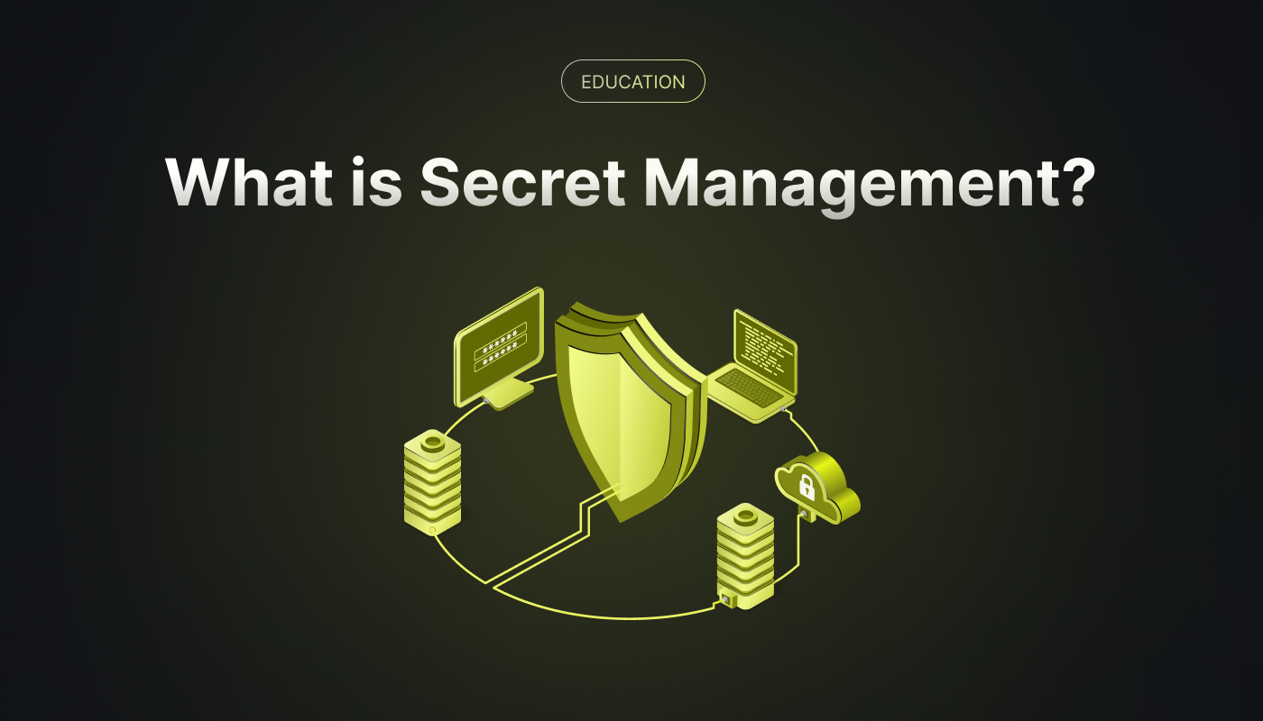

Secrets Management & Scanning
Common risks:
Hard-coded API keys
Passwords committed accidentally
Tokens exposed in configuration files
Best Practices:
Use secrets managers (Vault, AWS Secrets Manager)
Enable secret scanning
Block commits containing credentials
Tools:
GitHub Secret Scanning
TruffleHog
Gitleaks

Slide 6

Dependency & Supply Chain Security
Why this matters:
Most applications rely heavily on third-party libraries
Vulnerable dependencies can compromise the entire system
Controls:
Enable dependency scanning
Monitor for vulnerable or outdated packages
Use signed dependencies when possible
Tools:
GitHub Dependabot
Snyk
OWASP Dependency-Check

Slide 7

Auditing, Logging & Monitoring
Best Practices:
Enable repository audit logs
Monitor:
Access changes
Permission updates
Force pushes or branch deletions
Regularly review logs for anomalies
Benefits:
Supports incident response
Enables accountability and traceability
Helps meet compliance requirements

Slide 8

Automation & Policy Enforcement
DevOps-aligned controls:
Automate security checks in CI/CD pipelines
Enforce policies as code
Fail builds if security rules are violated
Examples:
Static analysis (SAST)
Dependency scanning
License compliance checks
Result:
Security becomes continuous and scalable
Reduces reliance on manual enforcement

Slide 9

Mistakes to Avoid
Overly permissive access
Relying only on manual reviews
Ignoring alerts due to alert fatigue
Treating security as a one-time setup instead of ongoing practice
Key takeaway: Security controls must evolve with the repository and team.

Slide 10

References
OWASP. (2025, July). OWASP Top Ten. Owasp.org; OWASP. https://owasp.org/www-project-top-ten/
‌Code security documentation. (n.d.). GitHub Docs. https://docs.github.com/en/code-security
‌NIST. (2019). NIST Computer Security Resource Center | CSRC. Nist.gov. https://csrc.nist.gov/
‌Singh, A. (2024, November 17). Securing Your GitHub Organization: Advanced Best Practices for Code Protection and Workflow…. Medium. https://medium.com/@anshumaansingh10jan/how-to-secure-and-configure-github-organizations-for-optimal-security-5fbc43bc4f1d
‌a-a-ron. (2025). Maintain a Secure Repository by Using GitHub Best Practices - Training. Microsoft.com. https://learn.microsoft.com/en-us/training/modules/maintain-secure-repository-github/

