Slide 1

Establishing a Just, Learning Culture
Scott Macioce CSD380-DevOps Module 9

Slide 2
What Is a Just, Learning Culture?
Encourages accountability without blame
Focuses on learning from failures rather than punishing individuals
Supports psychological safety, transparency, and continuous improvement
Critical to DevOps because teams must experiment, deploy quickly, and recover from failures

Slide 3

Why a Just Culture Matters
Reduces fear of reporting incidents or near-misses
Improves incident response and postmortems
Enhances team morale and trust
Strengthens system reliability through shared learning

Slide 4

Organizational Fear & Blame Culture
Employees avoid reporting issues due to fear of punishment
Blame is often placed on individuals instead of systems
Leadership behaviors may reinforce fear rather than learning
Reduces transparency and delays discovering critical failures

Slide 5
Lack of Psychological Safety
Teams do not feel safe to speak up, challenge decisions, or admit mistakes
High-pressure environments amplify silence and compliance
Psychological safety is essential for innovation and continuous learning

Slide 6
Poor Incident Review Practices
Postmortems focus on who failed rather than what failed
01
Root cause analysis becomes “root blame analysis”
02
Lessons are not shared or documented
03
Teams repeat the same mistakes across projects
04

Slide 7
Lack of Leadership Commitment
Leaders may claim to support learning but default to punitive responses
Without modeling transparency and curiosity, culture does not change
Learning culture requires leaders to actively reward honesty and reporting

Slide 8
Outdated Policies & Rigid Processes
Legacy HR, compliance, and legal frameworks may require punitive action
Strict operational rules discourage experimentation
DevOps principles clash with slow, control-heavy environments

Slide 9
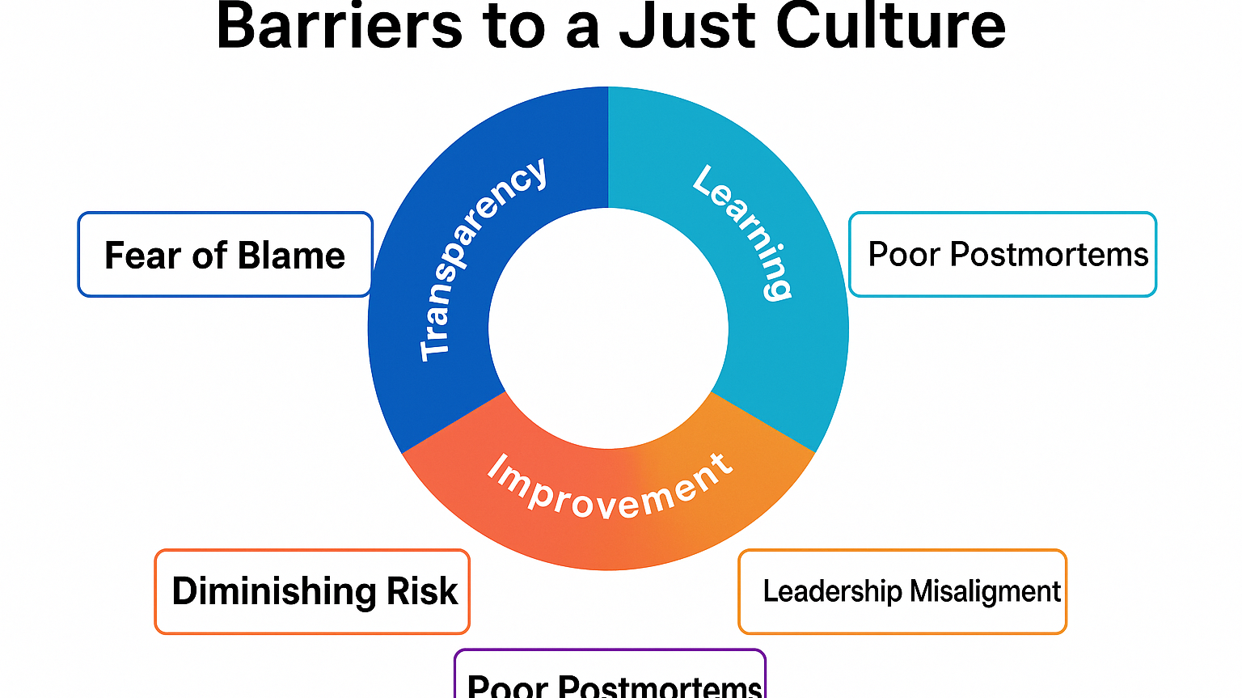

Slide 10

So, why a just learning culture?
A Just Culture enables safe experimentation, shared learning, and system resilience
Barriers are often cultural, not technical
Removing these barriers requires leadership modeling, supportive policies, and blameless postmortems
When implemented well, a Just Culture strengthens DevOps performance and collaboration

Slide 11

References:
Etsy Engineering | Blameless PostMortems and a Just Culture. (2020). Etsy. https://www.etsy.com/codeascraft/blameless-postmortems
‌Michalowski, M. (2025, June 9). Cultural Debt vs. Technical Debt in Infrastructure Automation - DevOps.com. DevOps.com. https://devops.com/cultural-debt-vs-technical-debt-in-infrastructure-automation/
‌Boysen, P. G. (2013). Just Culture: A Foundation for Balanced Accountability and Patient Safety. The Ochsner Journal, 13(3), 400–406. https://pmc.ncbi.nlm.nih.gov/articles/PMC3776518/
‌Mass General Brigham. (2023). What Is Just Culture? Changing the way we think about errors to improve patient safety and staff satisfaction. Www.brighamandwomensfaulkner.org. https://www.brighamandwomensfaulkner.org/about-bwfh/news/what-is-just-culture-changing-the-way-we-think-about-errors-to-improve-patient-safety-and-staff-satisfaction
‌

