Slide 1
Light Arcade
Scott James
floridaconsulting@gmail.com
Github.com/scottjames

Slide 2
Game Idea
Build a simple/fun 2-player game
Entry for Maker Faire Orlando
Short/Fast games, quick turn around
No player lines, easy to observe
No skill: Just hit buttons fast
Countdown clock to add pressure to players
10 seconds per game.

Slide 3
Approach – Hardware Build
Use new methods and materials
not PVC and plastic boxes
Used 4" ECT, MDF custom milled
Paint with "hammered" for industrial look.
High impact display - stand out in a crowd
not just another video game
Portable (able to take to Maker Faire)

Slide 4
Approach – Electronics Build
Simple, DIY electronics
No custom fabricated PCB
Use Vero Strip-Board
Easier for people to copy/hack their own.
High impact display - stand out in a crowd
Use LED lights, not classic “video” game.
Portable

Slide 5
Design
Use Arduino, much as possible
Raspberry Pi for multi-media display
Data feed to Pi is *receive only* (simpler)

Slide 6
Implementation
Platform: CPU board
Arduino pro mini (ATMega328, no USB)
Raspberry Pi, HDMI output to monitor
3-to-5 volt level shifter
Data flows from Arduino -> level shift -> Pi

Slide 7
Inputs
Inputs - buttons
Always did software debounce.
This time use hardware debouncing.
Research: 10 msec debounce period.
Utility buttons: start game, and ?
Multiple headers/pins to hook on and test inputs/outputs.

Slide 8
Display
NeoPixel display LED strips
Install LED inside buttons for feedback
VGA screen, Raspberry Pi

Slide 9
Arduino software
NeoPixel Library (adafruit.com)
Serial 115200 baud -> Pi data feed.
Serial text commands, easier debug/reading in terminal.
Event loop to drive game
State machine:
DEMO -> PLAY -> FINISH -> DEMO
Modular approach, Arduino-friendly, simple - Buttons - Game - Display - Serial
=

Slide 10
Arduino software
NeoPixel display LED strips
Install White LED inside buttons for feedback
VGA screen, Raspberry Pi

Slide 11
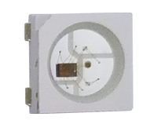
Neo Pixels
RGB LED (Worldsemi WS2812B chip)
Individually addressable
24-bit color, 255 levels of brightness.
Great for basic animation, color lighting.
Not great for POV, video playback (too slow),
newer WS2801/WS2822 can do 2-wire, 25MHz.
30 LED/Meter, 5 Meter roll: ~$30 (AliExpress)

Slide 12

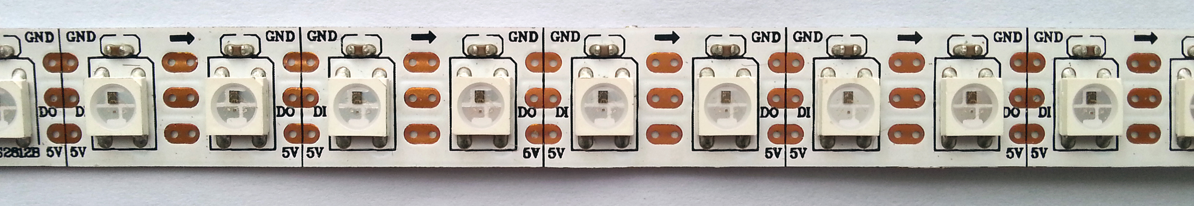
Neo Pixels
Serial Data, like a bucket brigade.

Slide 13
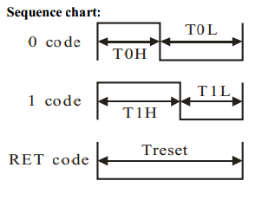
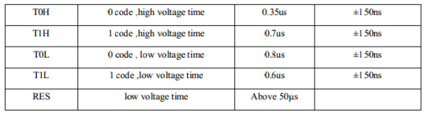
Neo Pixels
Not I2C,TWI or SPI – proprietary timing :(
Use bit-bang to program.
1-bit cycle is about 1.2 microsecond.
~50+ usec frame (10 is ok)

Slide 14
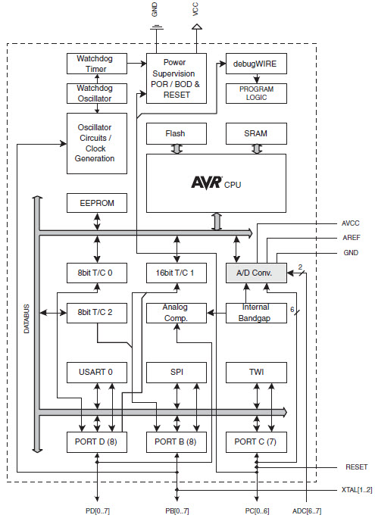
[ Heart of Arduino ]
Atmel ATMega328
Features...
AVR risc cpu
UART (Serial I/O)
Gen. Purp. I/O
Flash (non volatile 32k)
Ram (8k)
Timer (3 total)
Analog → Digital

Slide 15
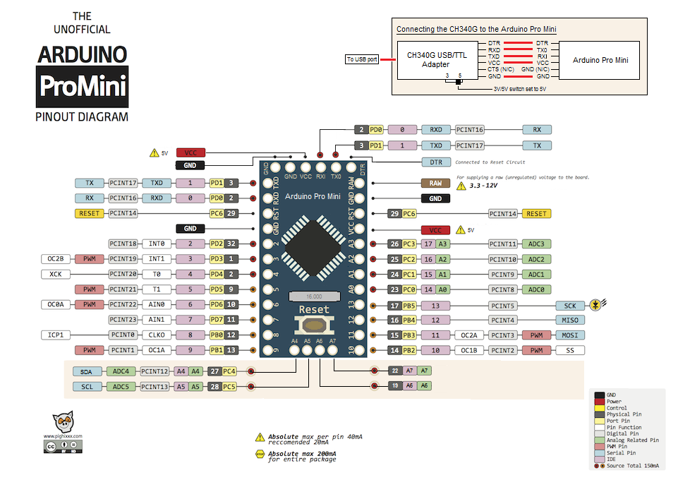
Arduino Pro Mini

Slide 16
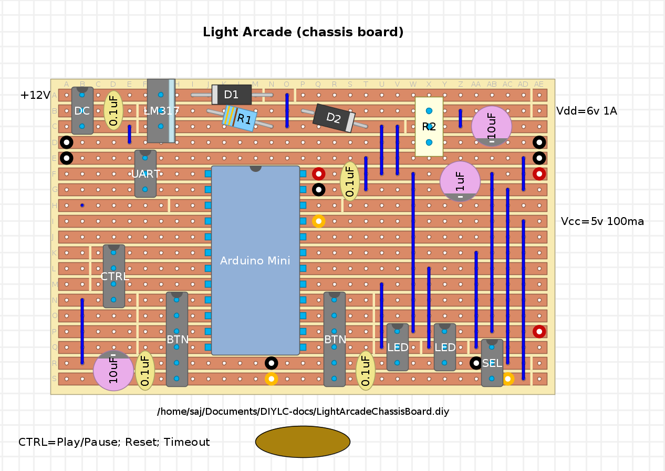
Main Board

Slide 17
Arduino: Pin Mapping
// === PIN CONFIGURATION ====================
#define PIN_P1B1 6 // btn 1
#define PIN_P1L1 7 // led 1
#define PIN_P1B2 8 // btn 2
#define PIN_P1L2 9 // led 2
#define PIN_P2B1 13 // btn 1
#define PIN_P2L1 12 // led 1
#define PIN_P2B2 11 // btn 2
#define PIN_P2L2 10 // led 2
#define PIN_NEWGAME 2 // util pin 2
#define PIN_PAUSE 3 // util pin 3
#define PIN_SELECT_POT A2 // voltage divider with Potentiometer to select game (someday)
#define PIN_STRIP0 A0 // strip0 / player 1
#define PIN_STRIP1 A1 // strip1 / player 2
// IMPORTANT: To reduce NeoPixel burnout risk, add 1000 uF capacitor across
// pixel power leads, add 300 - 500 Ohm resistor on first pixel's data input
// and minimize distance between Arduino and first pixel. Avoid connecting
// on a live circuit...if you must, connect GND first.

Slide 18
LightArcade Program
Modular Design:
LightArcadeSerial – main module
LAButton – button handler
LAGame – game “model”, “controller”
LAGraphics – LED display “view”
LASerial – Serial interface, text reports
Module common “methods”:
InitXXX()
updateXXX()

Slide 19
Arduino: Globals
// === MODULE GLOBALS ==============================
// store pin configuration in arrays for iteration later on
int pinLed[4] = {
PIN_P1L1, PIN_P1L2, // Player 0 (Left/Blue)
PIN_P2L1, PIN_P2L2 // Player 1 (Right/Red)
};
int pinButton[6] = {
PIN_P1B1, PIN_P1B2, PIN_P2B1, PIN_P2B2, // P0, P1
PIN_NEWGAME, PIN_PAUSE
};
int pinUtil[2] = { PIN_NEWGAME, PIN_PAUSE }; // utility inputs
// ~48" strip is 39 LEDs
#define NUM_STRIP_ELEMENTS 39
Adafruit_NeoPixel strip[2] = {
Adafruit_NeoPixel(NUM_STRIP_ELEMENTS, PIN_STRIP0, NEO_GRB + NEO_KHZ800),
Adafruit_NeoPixel(NUM_STRIP_ELEMENTS, PIN_STRIP1, NEO_GRB + NEO_KHZ800)
};
long now; // current millis, global clock
uint16_t x; // global loop counter for sequencing of lights, cycles 0 - 0xFFFF

Slide 20
Arduino: Setup()
void setup() {
delay(2000); // delay at startup to power up
// open fast serial port
Serial.begin(115200);
while (!Serial)
; // wait for serial port to connect. Needed for Leonardo only
initButtons();
// Some example procedures showing how to display to the pixels:
Serial.println("# BEGIN SETUP");
// setup strips and button LEDs; do lamp test.
initGraphics();
// setup new game
initGameModel();
x = 0;
Serial.println("# END SETUP");
}

Slide 21
Arduino: Loop()
/**
* Arduino loops with short period.
* Only a couple calls are blocking (and they fix the clock)
* Service Inputs, Game model, output to LED and Serial
*/
void loop() {
now = millis();
// service input buttons, debouncing and toggle delay values.
updateButtons(x);
// update game, calc button rate from toggle delay, calc player scores
updateGameModel(x);
// update display on led strips with current player scores
updateGraphics(x);
// send report to Raspberry Pi with: clockTick, button status, game state, etc.
updateSerial(x);
x++; // this global 16 bit unsigned integer will overflow (recycle) at 0xFFFF
// delay(5); // 5 msec sleep/tick interval
delay(1); // 1 msec sleep/tick interval
}

Slide 22
Read Button
Buttons are active low (gnd == 0 == pressed)
// read 6 buttons, debounce, load into bitmask
// 76543210 = mask
// 1100 = player 0/1
// 1010 = button 0/1
// 32 = util aka Pi gpio 2,3
int readButtonsDebounce() {
buttonCurrMask = 0;
for (int b = 0; b < 6; b++) {
buttonCurrMask |= ( (digitalRead(pinButton[b]) ? 0 : 1) << b ); // invert, LOW=1
}
}

Slide 23
Button Logic (Toggle)
Bit mask to read each button
Detect on/off state comparing each loop
Enforce toggle in bitmask
unsigned char toggleMask = 0x05;
// toggle bit mask for both pairs of buttons !MUST INIT 0x0101
// states for player0 (toggle with player0 ANDMASK = 0011 = 0x03)
// if btn0 on and toggleMask 0001, then toggleMask = 0010
// if btn1 on and toggleMask 0010, then toggleMask = 0001
// states for player1 (toggle with player1 ANDMASK = 1100 = 0x0c)
// if btn2 on and toggleMask 0100, then toggleMask = 1000
// if btn3 on and toggleMask 1000, then toggleMask = 0100
// XOR with toggleBit of 0x03 (btn0,1) or 0x06 (btn2,3)
int tryToggleButton(int btn, uint16_t x) {
if ( (toggleMask & (0x01 << btn)) ) {
// toggle the mask and wait for the other button
// NOTE: btn & 0x02 is 0 for btn0,1 and is 1 for btn 2,3
uint16_t player = (btn & 0x02) >> 1;
uint16_t toggleBit = ( player ? 0x0c : 0x03 ); // player 1 ANDMASK=0x0c (0b1100), player 0 ANDMASK=0x03 (0b0011)
toggleMask ^= toggleBit; // toggle both bits in mask with XOR
toggleDelay[player] = (now - toggleTime[player]);
// scale down delay, limit to MAX_DELAY
toggleDelay[player] = ( toggleDelay[player] > MAX_DELAY) ? MAX_DELAY : toggleDelay[player];
toggleTime[player] = now;
//sendToggleReport(x); // DEBUG: send toggle report for testing...
return true;
}
else {
return false;
}
}

Slide 24
Arduino Tour...
LightArcadeSerial

Slide 25
Pi Software
Need multi-media audio/video display
Easy to program/modify
Options?
Node.js
JohnnyFive robot api.
Python,
Pygame - perfect.

Slide 26
Pygame (needs)
Slide Show – show pictures of build
Read serial data from Arduino
Event loop
Handle “reports” (no ACK required)
Demo: slides
Play: scores, countdown
Winner: show winner team

Slide 27
Pygame State Machine
Demo: show slides
Play: scores, countdown clock
Winner: show winner team

Slide 28
Pygame Programming
LASerial – read text 'report' data stream
Photo – display: Slides, Clock/Score, Winner
Sound – play 'start' and 'winner' sound
Tour pygame code...

Slide 29
Python Tour...
LightArcade.py

Slide 30
IRL: Button problems
Button debounce too slow
tempo was important
Worked ok...some kids 'ran the table' as a result of learning tempo.
Met game programmer at Maker Faire Orlando
"10 msec is glacial"

Slide 31
IRL: Data timing problems
To fix “score lag” last minute change...
Push toggleReport() on each button press.
toggleReport() overloaded python Serial buffer.
“finish” and sound had delay lag (out of sync).
Had to turn off Screen/Pi in Orlando :-(

Slide 32
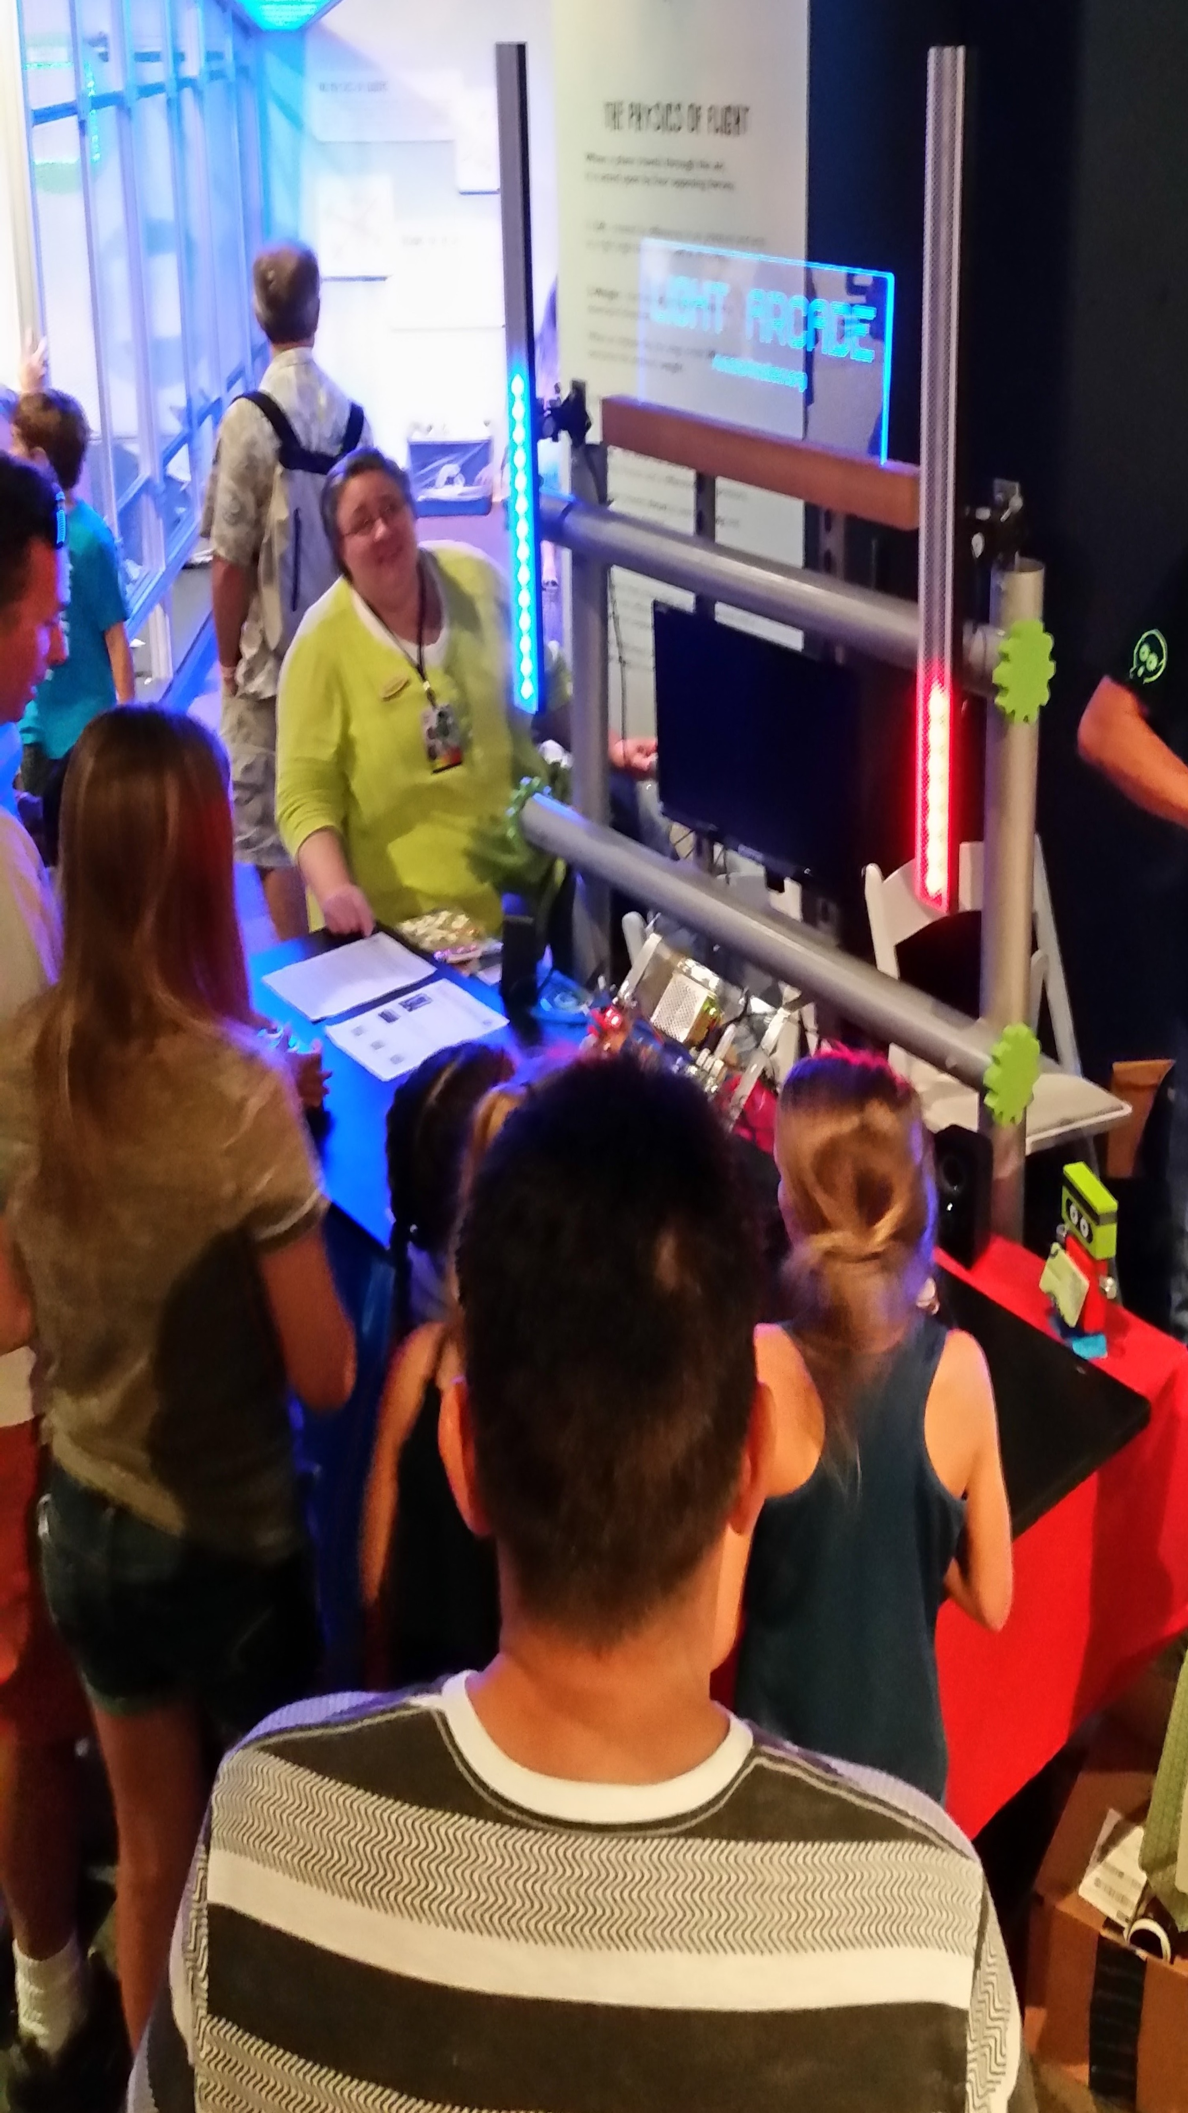
It worked: fun time
Saturday: 10k people
Sunday: 4k people
Monday: lost voice

Slide 33
IRL: Connector problems
Pin Connector with RTV was flexible
acted as strain relief.
Added Sugru (looks great!)
Stiff connector had no strain relief, acted as fulcrum, pulled wire.
Solder joint broke (left blue LED strip)

Slide 34
LA++: next generation
Evolve the Game

Slide 35
LA++: design ideas
offload LED strip display to dedicated Arduino
New buttons, better LEDs for feedback
Offload sound/clock (remove Pi dependency)
Web cam with Pi / Open CV to capture player image at win/loss, like “Photo-Finish”
Wi-Fi Portal / NoCatNet / Access Point

Slide 36
LA++: implementation ideas
- I2C instead of Serial text; bus pirate
- Serial used to flash Arduino, pain to disconnect.
- I2C MP3 for sound? no Pi required.
- I2C large 7-segment countdown.
I2C easy: using Wire.h in Arduino.
Arduino Tour... I2C...

Slide 37
Join us!
SuncoastMakers.org
Hack Light Arcade, or make your own
Other Ideas coming soon...
Video Projection Mapping
Computer Vision (OpenCV)
Cicada POV (Stationary Fast LED Strips)

