Slide 1
Software Development Project
Leader: Chan Keen Keet
Member: Ng Wen Yang
Lee Kang Wei

Slide 2
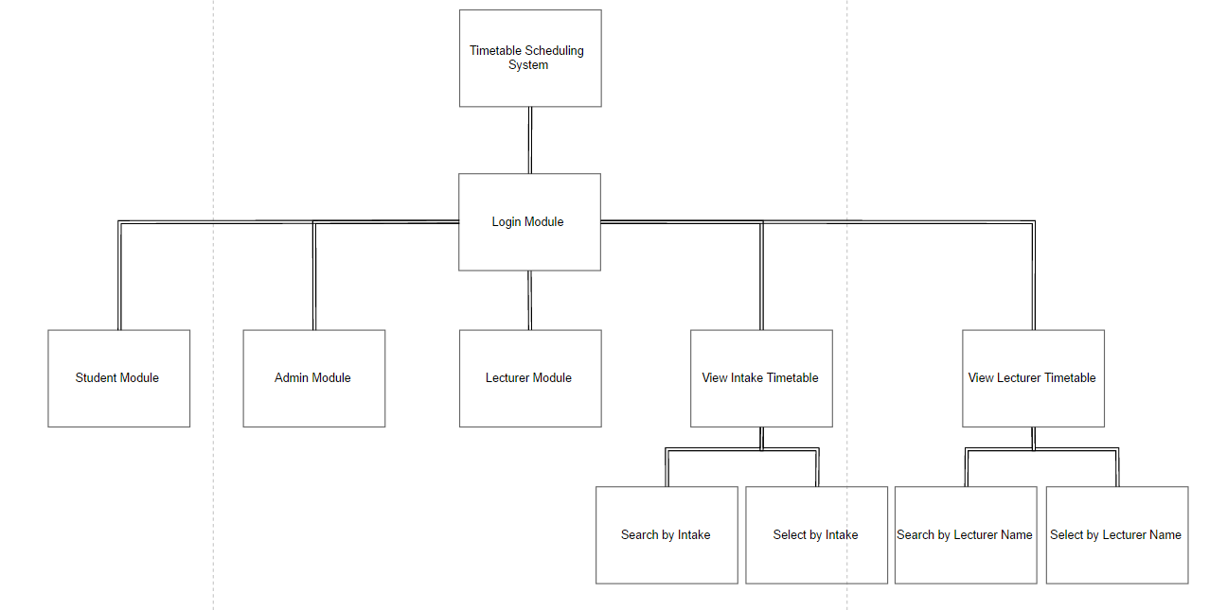
System Hierarchy Chart
Login Module

Slide 3
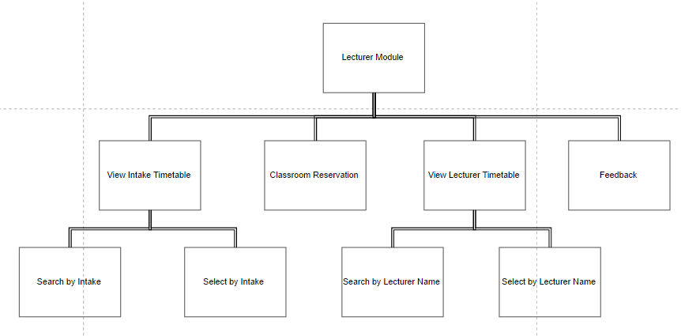
System Hierarchy Chart
Lecturer Module

Slide 4
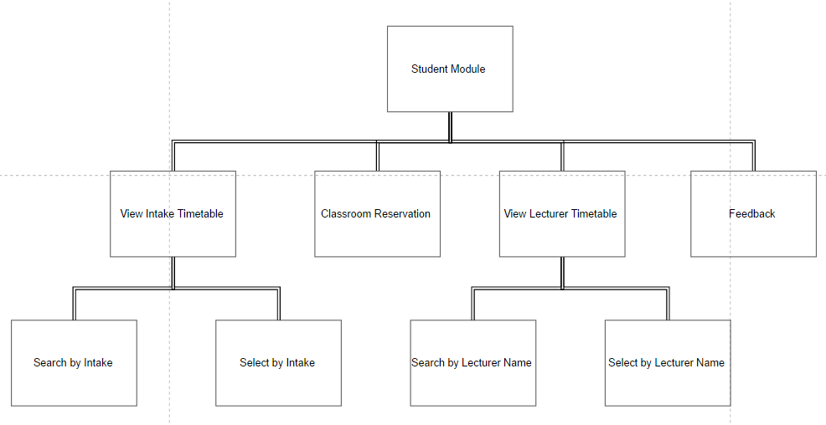
System Hierarchy Chart
Student Module

Slide 5
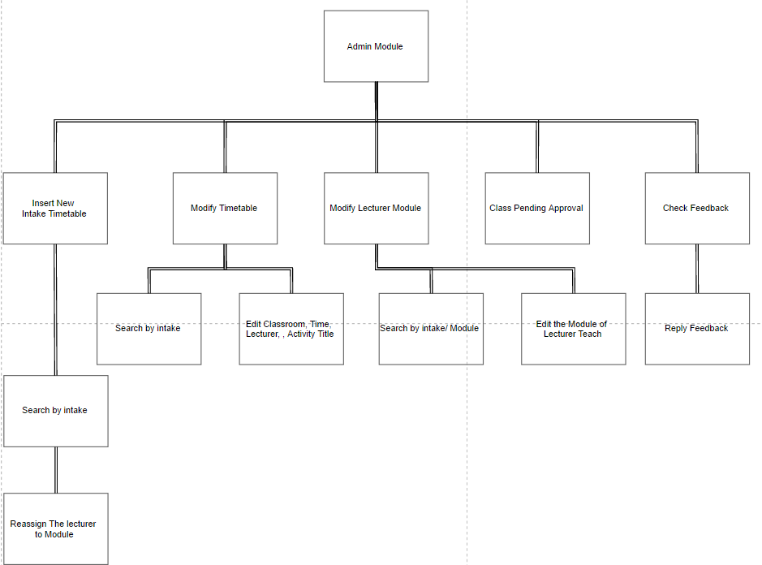
System Hierarchy Chart
Admin Module

Slide 6
Preliminary Screen Design

Slide 7
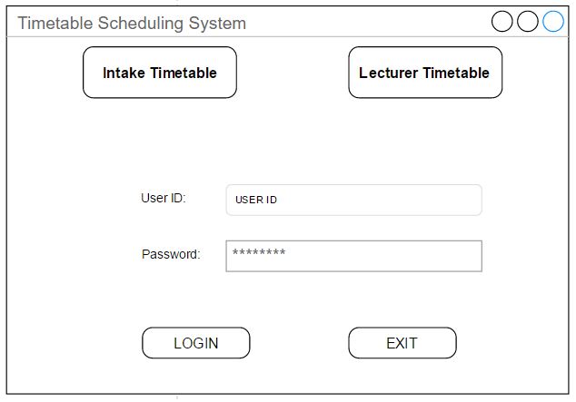
Login page

Slide 8
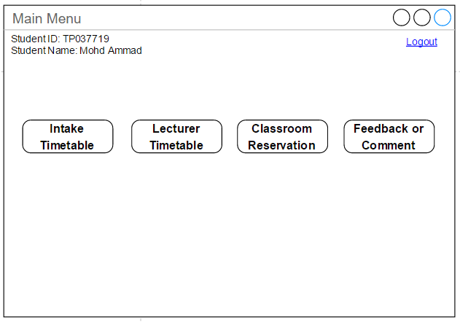
Student Main Menu

Slide 9
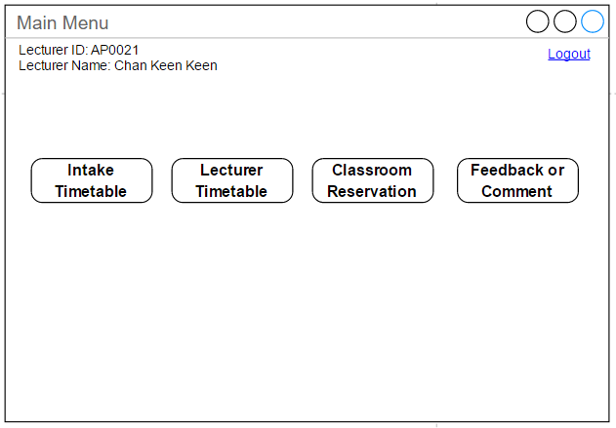
Lecturer Main Menu

Slide 10
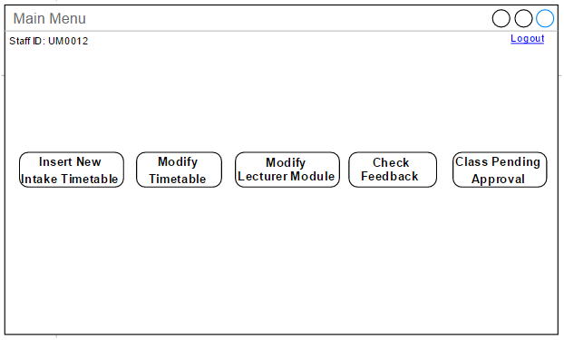
Admin Main Menu

Slide 11
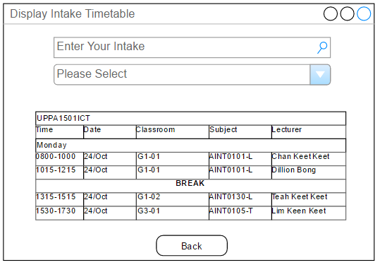
Display Intake Timetable

Slide 12
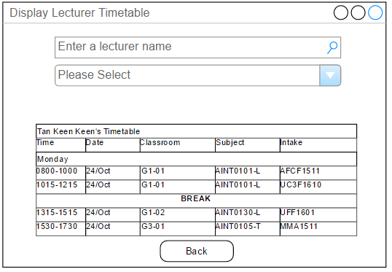
Display Lecturer Timetable

Slide 13
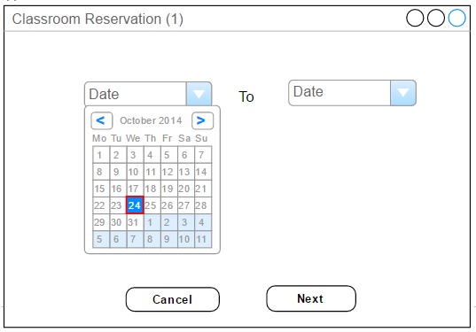
Classroom Reservation (1)

Slide 14
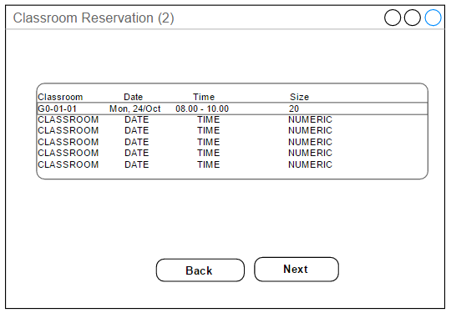
Classroom Reservation (2)

Slide 15
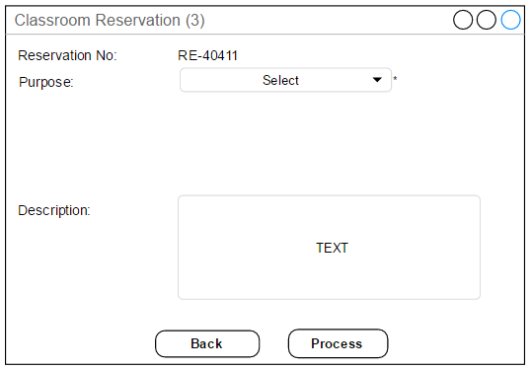
Classroom Reservation (3)

Slide 16
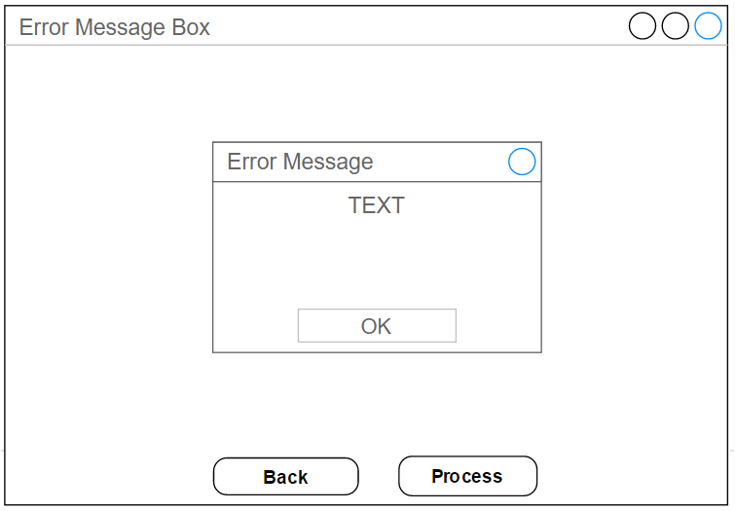
Error Message

Slide 17
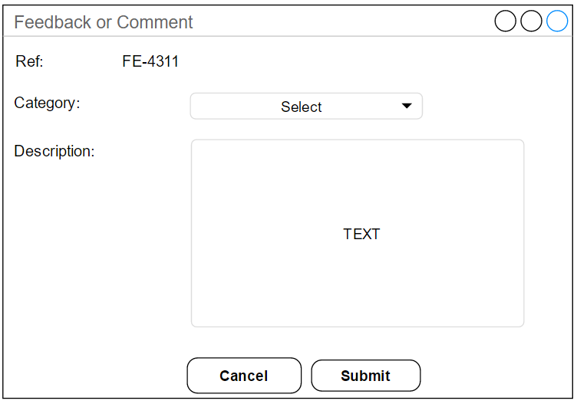
Feedback or Comment

Slide 18
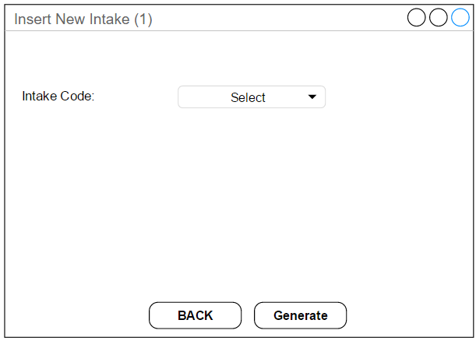
Insert New Intake (1)

Slide 19
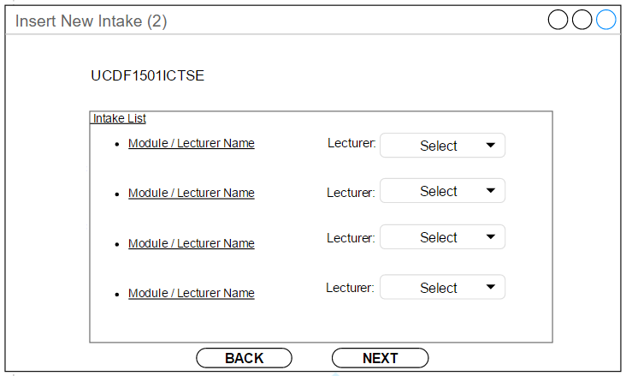
Insert New Intake (2)

Slide 20
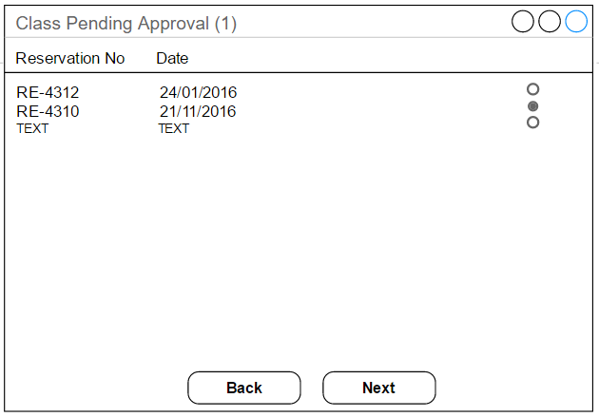
Class Pending Approval (1)

Slide 21
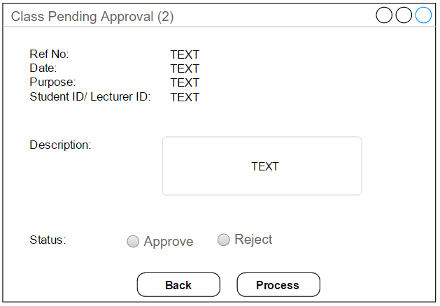
Class Pending Approval (2)

Slide 22
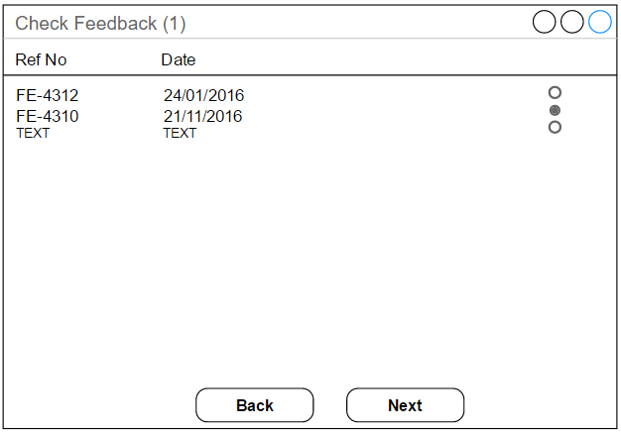
Check Feedback (1)

Slide 23
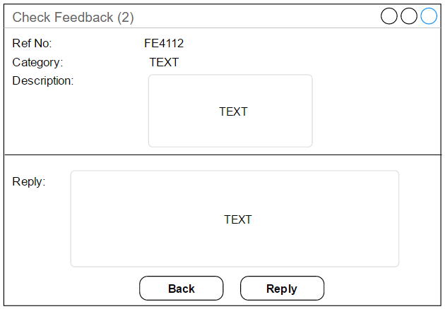
Check Feedback (2)

Slide 24
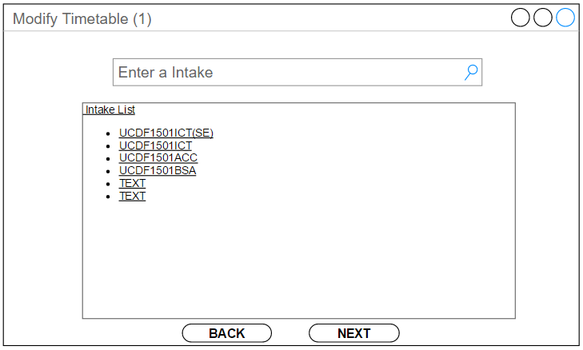
Modify Timetable (1)

Slide 25
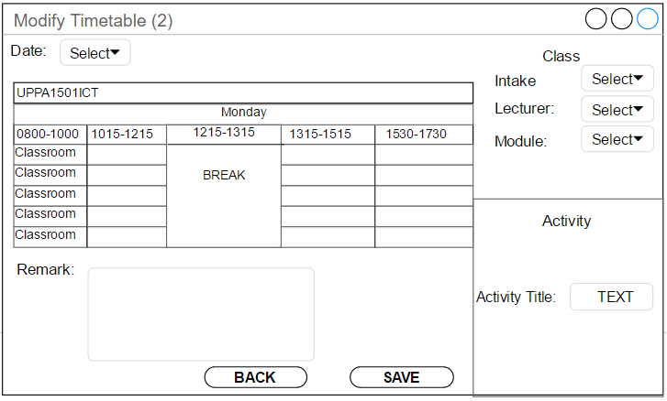
Modify Timetable (2)

Slide 26
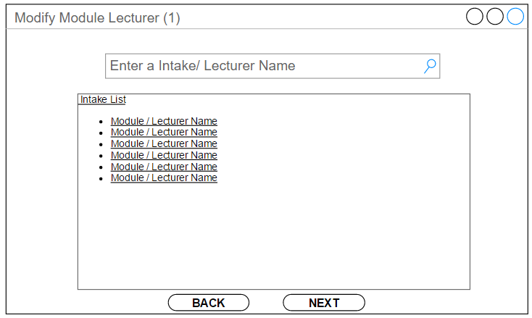
Modify Module Lecturer (1)

Slide 27
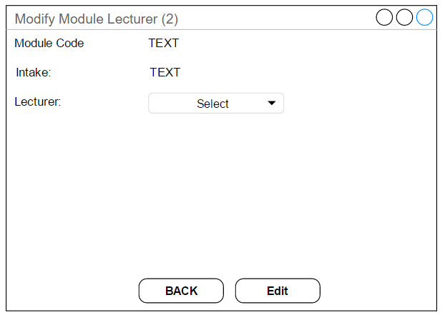
Modify Module Lecturer (2)

Slide 28
Preliminary Report Design

Slide 29
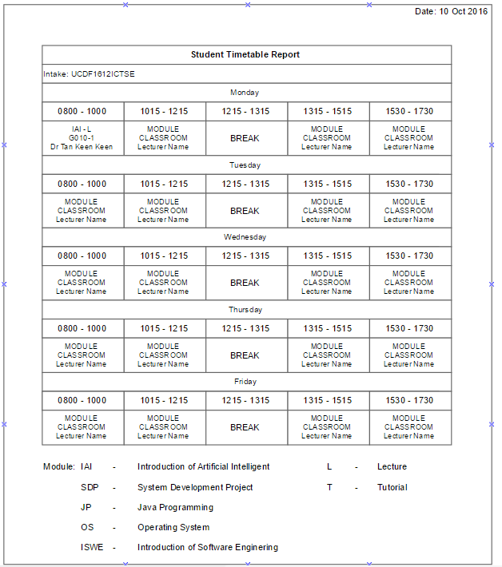
Student Timetable Report

Slide 30
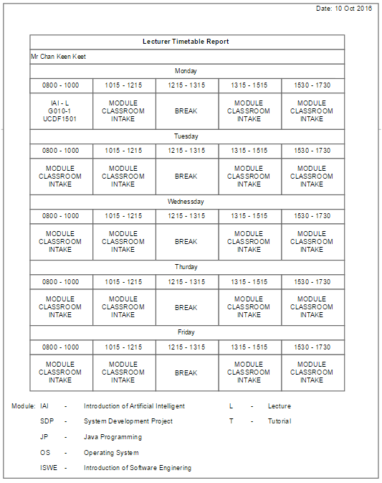
Lecturer Timetable Report

Slide 31
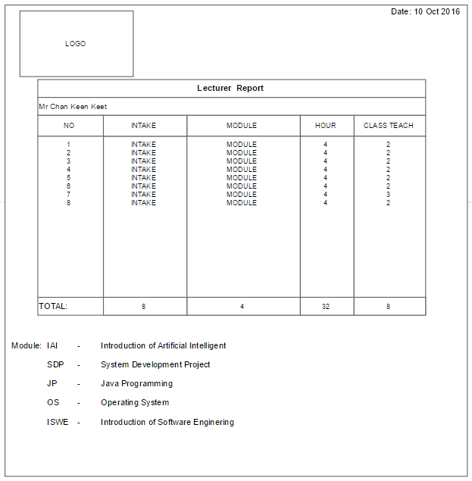
Lecturer Report

Slide 32
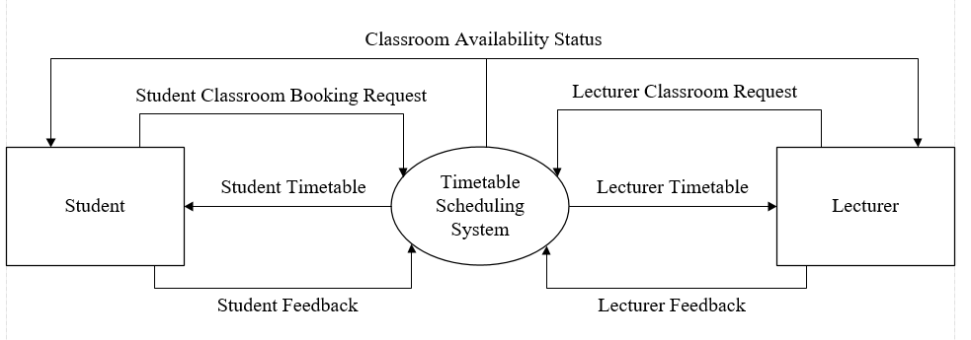
Context Diagram

Slide 33
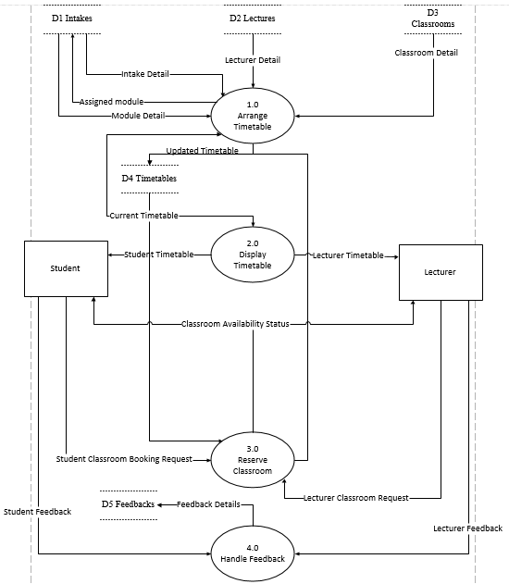
Data Flow Diagram Level 0

Slide 34
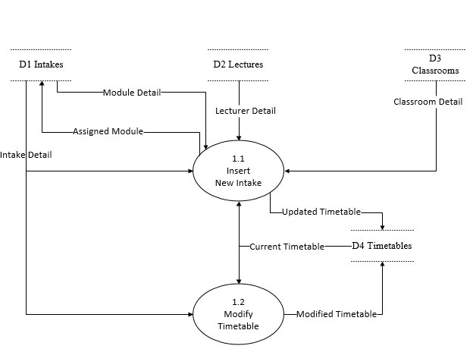
Data Flow Diagram Level 1

Slide 35
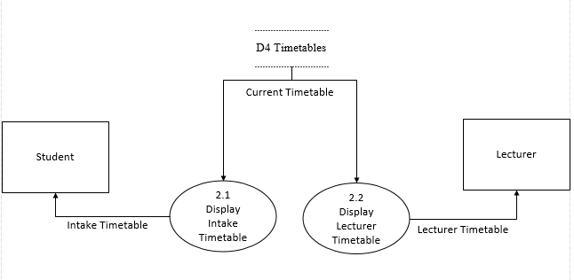
Data Flow Diagram Level 1

Slide 36
Data Dictionary

Slide 37
Data Dictionary External Entity
Name | Student
Description | Student of the university who uses the timetable scheduling system to view timetables and reserve classroom.
Input data flows | Student Timetable, Classroom Availability Status, Intake Timetable
Output data flows | Student Classroom Booking Request, Student Feedback

Slide 38
Data Dictionary External Entity
Name | Lecturer
Description | Lecturer of the university who uses the timetable scheduling system to view timetables and reserve classroom.
Input data flows | Lecturer Timetable, Classroom Availability Status
Output data flows | Lecturer Classroom Request, Lecturer Feedback

Slide 39
Data Dictionary Process
Name | 1.1 Insert New Intake
Description | This process is to assign lecturer to the modules of the new intake and then generate classes based on the starting and ending of the new intake
Input data flows | Module Detail, Intake Detail, Lecturer Detail, Classroom Detail, Current Timetable
Output data flows | Assigned Module, Updated Timetable
Process description | Refer to the Pseudo code InsertNewIntake

Slide 40
Data Dictionary Process
Name | 1.2 Modify Timetable
Description | This process is to modify the timetable where lecturer, date and time can be change when it is needed
Input data flows | Intake Detail, Current Timetable
Output data flows | Modified Timetable
Process description | Refer to the Pseudo code ModifyTimetable

Slide 41
Data Dictionary Process
Name | 2.1 Display Intake Timetable
Description | This process is to display timetable of the selected intake from the current timetable
Input data flows | Current Timetable
Output data flows | Intake Timetable
Process description | Refer to Pseudo code of DisplayIntakeTimetable

Slide 42
Data Dictionary Process
Name | 2.2 Display Lecturer Timetable
Description | This process is to display timetable of the selected lecturer from the current timetable
Input data flows | Current Timetable
Output data flows | Lecturer Timetable
Process description | Refer to Pseudo code of DisplayLecturerTimetable

Slide 43
Data Dictionary Process
Name | 3.0 Reserve Classroom
Description | This process is for student and lecturer to reserve the classroom that is available by sending classroom request to the admin and pending for approval.
Input data flows | Current Timetable, Student Classroom Booking Request, Lecturer Classroom Request
Output data flows | Classroom Availability Status, Updated Timetable
Process description | Refer to Pseudo code of ReserveClassroom(user) section

Slide 44
Data Dictionary Data Flow
Name | Intake Detail
Description | The intake details that are obtained from the intake data store which is a shared database
Origin/Source | D1 Intakes
Destination | 1.1 Insert New Intake
Data Structure | Lecturer ID, Lecturer Name, Module, Date, Intake Code, Level, Time, Module Code, Classroom ID

Slide 45
Data Dictionary Data Flow
Name | Module Detail
Description | Module details of the intake that are obtained from the intakes data store which is a shared database
Origin/Source | D1 Intakes
Destination | 1.1 Insert New Intake
Data Structure | Module Name, Module ID, Intake Code, Classroom ID

Slide 46
Data Dictionary Data Flow
Name | Lecturer Detail
Description | Lecturer details are obtained from the lectures data store which is a shared database
Origin/Source | D2 Lectures
Destination | 1.1 Insert New Intake
Data Structure | Lecturer ID, Lecturer Name, Intake, Module, Classroom ID

Slide 47
Data Dictionary Data Flow
Name | Classroom detail
Description | Classroom details that are obtained from classroom data store and it is a shared database
Origin/Source | D3 Classrooms
Destination | 1.1 Insert New Intake
Data Structure | Classroom ID, Intake Code, Facility

Slide 48
Data Dictionary Data Flow
Name | Updated Timetable
Description | Timetable will be updated when new intake is inserted into the timetable
Origin/Source | Insert New Intake
Destination | D4 Timetables
Data Structure | Module ID, Module Name, Time Slot, Intake Code, Date, Classroom ID, Lecturer Name

Slide 49
Data Dictionary Data Flow
Name | Current Timetable
Description | The current timetable are ready to be modified and insert as a new intake. If no modification is made, the current timetable will be the latest timetable and is ready to be display for student and lecturer.
Origin/Source | D4 Timetables
Destination | 1.1 Insert New Intake, 1.2 Modify Timetable, 2.1 Display Intake Timetable, 2.2 Display Lecturer Timetable
Data Structure | Module ID, Module Name, Time Slot, Intake Code, Date, Classroom ID, Lecturer Name

Slide 50
Data Dictionary Data Store
Name | D1 Intakes
Description | Store all intake and module details and it is a shared database
Input data flows | Assigned Module
Output data flows | Intake Detail, Module Detail
Data Structure | Date, Time Slot, Module Name, Module ID, Intake Code, Classroom

Slide 51
Data Dictionary Data Store
Name | D2 Lectures
Description | Store all lecturer details that is needed to arrange the timetable and it is a shared database
Input data flows | -
Output data flows | Lecturer Detail
Data Structure | Lecturer Name, Lecturer ID, Module ID, Module Name, Intake Code

Slide 52
Data Dictionary Data Store
Name | D3 Classrooms
Description | Store all types of classrooms details like labs and auditoriums. It is also a shared database
Input data flows | -
Output data flows | Classroom Detail
Data Structure | Classroom ID, Facility, Classroom Size, Status,

Slide 53
Data Dictionary Data Store
Name | D4 Timetables
Description | Store all latest timetables details
Input data flows | Updated Timetable, Modified Timetable
Output data flows | Current Timetable
Data Structure | Date, Classroom ID, Time Slot, Module, Lecturer Name, Intake Code, Module ID

Slide 54
Data Dictionary Data Store
Name | D5 Feedbacks
Description | Store all feedbacks details from lecturer and students. It is a shared database
Input data flows | Feedback Details
Output data flows | -
Data Structure | Description, Student ID, Lecturer ID, Reference ID, Categories

Slide 55
Entity Relationship Data

Slide 57
Pseudocode

Slide 58
Login Page
START
WHILE user does not terminate the program
GET userOption from user
CASE userOption OF
lecturerTimetable : CALL DisplayLecturerTimetable
intakeTimetable : CALL DisplayIntakeTimetable
Login :
GET loginID from user
GET loginPassword from user
GET userList from database
FOR each user in userList
IF loginID EQUALS TO User.ID THEN
IF loginPassword EQUALS TO user.Password THEN

Slide 59
CASE user.type OF
student : CALL MainMenu with (user)
lecturer : CALL MainMenu with (user)
admin : CALL AdminMainMenu (user)
END CASE
BREAK
ELSE
DISPLAY errorMessage
BREAK
END IF
END IF
IF User is last user THEN
DISPLAY errorMessage
END IF
END FOR
END CASE
END WHILE
END

Slide 60
Main Menu(user)
START
WHILE the user is not logged out
GET selection from user
CASE selection OF
courseTimetable : CALL DisplayCourseTimetable
lecturerTimetable : CALL DisplayLecturerTimetable
classroomReservation : CALL ReserveClassroom with (user)
feedback : CALL SumbitFeedback with (user)
logout : END
END CASE
END WHILE

Slide 61
Admin Main Menu(user)
START
GET selection from user
CASE selection OF
insertNewIntakeTimetable : CALL InsertNewIntake
modifyTimetable : CALL ModifyTimetable
modifyModuleLecturer : CALL ModifyModuleLecturer
classPendingApproval : CALL ApproveClassPending
checkFeedback : CALL CheckFeedback
logout : END
END CASE

Slide 62
Display Lecturer Timetable
START
GET timetableList from database
GET lecturer from user
GET currentTime from system
DISPLAY timetable filter by lecturer and currentTime from timetableList
END

Slide 63
Display Intake Timetable
START
GET timetableList from database
GET intakeCode from user
GET currentTime from system
DISPLAY timetable filter by intakeCode and currentTime from timetableList
END

Slide 64
Reserve Classroom (user)
START
GET userType from user.type
CASE userType OF
lecturer : fill purposeOption with (extra class, class replacement)
student : fill purposeOption with (student activity)
END CASE
GET date from user
validate whether date input is empty input
GET timetableList form database
SET availableClassroomList as timetableList filter by time and empty timeslot

Slide 65
DISPLAY availableClassroomList
GET timeslotSelection from user
validate whether timeslotSelection input is empty input
GET purposeOption from user
validate whether purposeOption input is empty input
GET descriptionText from user
GET confirmation from user
SAVE classroomReservationRequest to database with (timeslotSelection, purposeOption, user)
END

Slide 66
Submit Feedback (user)
START
GET category from user
GET feedbackText from user
GET confirmation from user
GET referenceNumber from database
INCERMENT referenceNumber in database
SAVE feedback to database including user.ID, user.name, user.type, datetime
END

Slide 67
Insert New Intake
START
GET intakeList form database
GET intakeSelection from user
validate whether intakeSelection input is empty input
GET intakeStartingDate from database
GET intakeEndingDate from database
GET lecturerList from database
GET ModuleList from database
FOR each module in the ModuleList
FOR each lecturer in lecturerList
IF lecturer can teach the module THEN

Slide 68
CALL lecturerList.sortByWorkload
CALL module.assignLecturer with (lecturer)
BREAK
END IF
END FOR
END FOR
DISPLAY module with lecturer
GET moduleLecturerChange from user
GET confirmation from user
SAVE assignedModule to database
GET timetableList from database
GET maxDayTeachingHour
GET maxDayLearningHour
FOR all module in moduleList
FOR all timeslot in timetableList

Slide 69
IF timeslot.lecturer.dayTeachingHour with (timeslot) < maxDayTeachingHour AND timeslot.intakeDayLearningHour with (timeslot) < maxDayLearningHour AND timeslot.lecturer.isAvailable with (timeslot) AND timeslot.noDuplicatedIntakeModule with (timeslot) AND timeslot.NoLargeGapBetweenClass with (timeslot) THEN
CALL module.assignTimeslot with (timeslot)
BREAK
END IF
IF reached last timeslot THEN
Append module to exceptionList
DISPLAY warningMessage
END IF
END FOR
END FOR
DISPLAY exceptionList
GET classroomList from database
CALL classroomList.sortBySize
CALL timetableList.sortByStudentSize

Slide 70
FOR every timeslot in timetableList
FOR every classroom in classroomList
IF timeslot.studentSize < classroom.size AND THEN
CALL timeslot.assignClassroom with (classroom)
BREAK
END IF
IF reached last timeslot THEN
Append timeslot to exceptionList
DISPLAY warningMessage
END IF
END FOR
END FOR
DISPLAY exceptionList
SAVE timetable to database

Slide 71
Modify Timetable
START
GET timetableList from database
DISPLAY full timetable in gridview
GET intakeSelection from user
GET timeslotSelection from user
GET date from user
validate whether date input is empty input
DISPLAY timetable filter by date
GET newClassType from user

Slide 72
CASE newClass OF
class : GET newIntakecode from user
validate whether newIntakecode input is empty input
GET newLecturer from user
CALL newLecturer.validateOverlapping
GET newModule from user
validate whether newModule input is empty input
CALL newModule.validateOverlapping
activity : GET newActivityTitle from user
END CASE
GET newRemark from user
SAVE newTimeslot to database
END

Slide 73
Modify Module Lecturer
START
GET intakeList form database
GET intakeSelection from user
GET lecturerList from database
GET ModuleList from database
DISPLAY module with lecturer
GET selection from user
validate whether selection input is empty input

Slide 74
GET newModuleLecturer from user
GET confirmation from user
SAVE assignedIntakeModule to database
END

Slide 75
Approve Class Pending
START
GET pendingList from database
GET selection from user
validate whether selection input is empty input
DISPLAY classReservationDetails from selection
GET approveConfirmation from user
validate whether approveConfirmation input is empty input
SAVE timeslot to database
END

Slide 76
Check Feedback
START
GET feedbackList from database
DISPLAY feedbackList
GET selection from user
validate whether selection input is empty input
DISPLAY selected feedback
END

