Slide 1
Sample Presentation
  This is a subtitle
  Scott Kirkwood
Notes:
bold or not?

Slide 2
Introduction
mm2odp creates a simple presentation from a FreeMind mind map
Each slide page has line items
  That can
    be nested
      to any
        depth

Slide 3
Slide with Unicode
São Paulo
Hergé

Slide 4
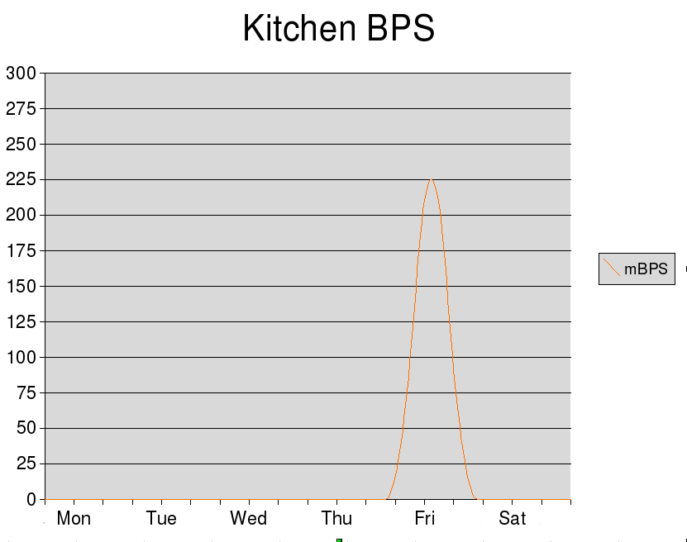
Image with picture

Slide 5
No list
Put a green check on the slide
And the items below won't
appears as a list
  But sub-sub items
  still will

Slide 6
Stop Light
The stoplight icon
Will make your
Slide build one
row at a
time

Slide 7
Skip a slide
You can skip a slide like the previous one, which you didn't see.

Slide 8
Pros
Advantages of mm2s5
  Very quick and easy
  FreeMind has a great GUI and is very intuitive to use
  FreeMind and S5 are actively supported
  FreeMinds, S5 and mm2s5 are all cross platform
  FreeMind is useful for more than just presentations :-)
  You can create nice presentations templates in CSS

Slide 9
Cons
Problems with mm2s5
  Need to edit/compile/test your presentations
  You need to remember to save in FreeMind

Slide 10
Conclusions
If you stick to a simple presentations you can create something very quickly and easily
OpenOffice Impress is cross platform and you can show it anywhere
For longer presentations, you may find the edit/compile/test process tedious

Slide 11
Links
http://freemind.sourceforge.net/wiki/index.php/Main_Page
http://code.google.com/p/mm2odp/

