Slide 1
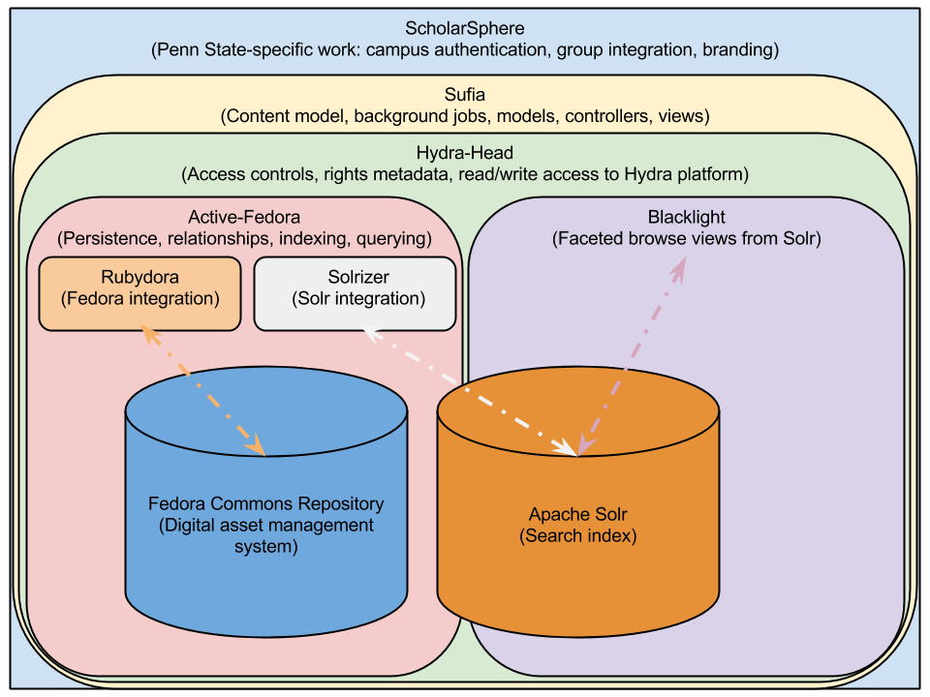
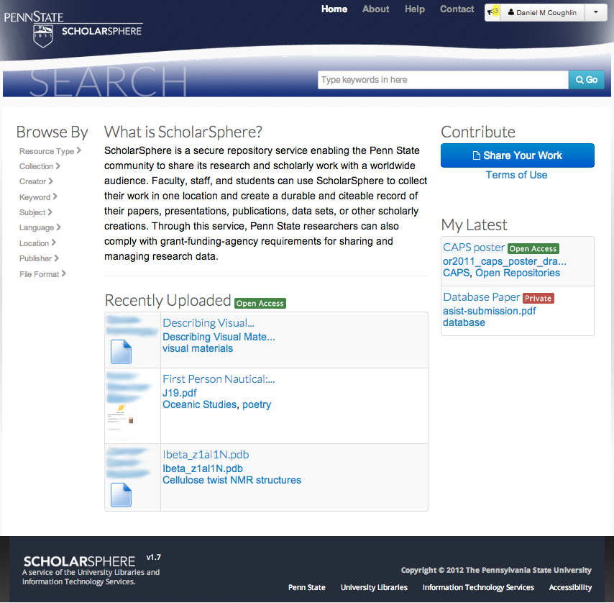
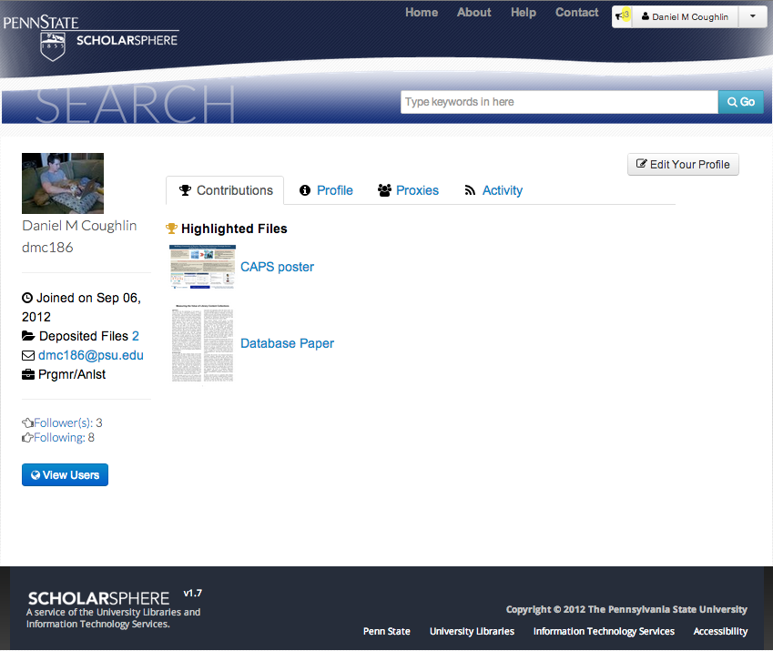
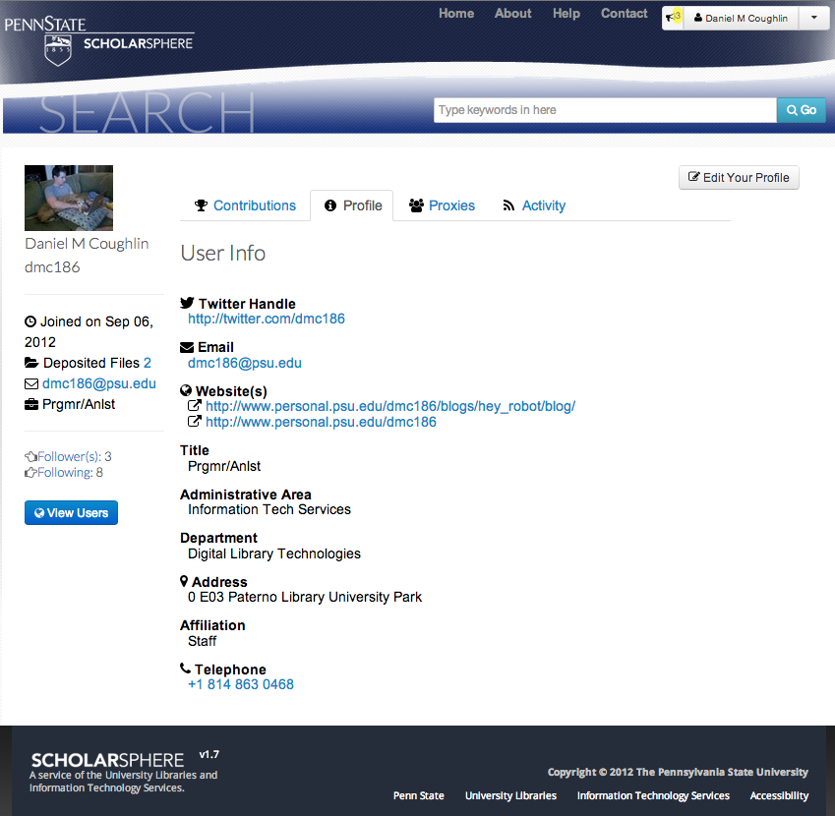
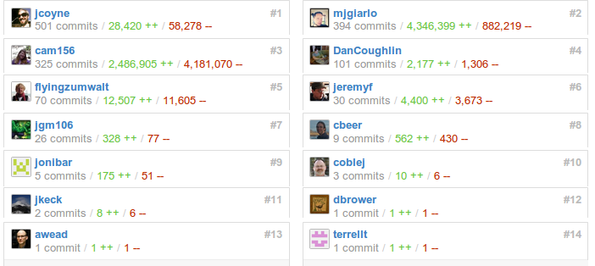



Spheres of Community Building: ScholarSphere and Sufia
By: Daniel Coughlin, Michael Giarlo, and Patricia Hswe
In fall 2012 Penn State released ScholarSphere, a repository service leveraging the Hydra/Fedora technology stack. ScholarSphere supports self-deposit of research materials, for preservation and access.
Shortly after ScholarSphere went into production, we launched work on Sufia with other Hydra community members. Sufia, the engine that powers ScholarSphere and provides its baseline functionality, facilitates sharing of the code base.
Our focus is on community-based collaborations to propel iterative design and development and to enhance usability. These include the creation of Sufia, as well as early engagement of stakeholders, such as faculty and students, through use case discussions and usability testing.
Hydra/Fedora-based architecture supporting ScholarSphere
About ScholarSphere and Sufia
ScholarSphere UI after logging in
TASK - Viewing and revising your ScholarSphere Profile
ScholarSphere allows you to choose files to highlight in your user profile. Try highlighting a file.
Were you able to highlight a file? How easy was the process to complete?
View your ScholarSphere profile page.
Does the highlighted file appear on your profile?
On your profile page, can you find a list of all of the files you have uploaded? What are your reactions to the location and appearance of this list?
Edit your ScholarSphere profile.
Are there any profile features you would like that currently are not available?
Contributors to Sufia
Above: Sample tasks from usability test given to stakeholders
At right: Profile page in ScholarSphere

