Slide 1



right click
click
click

Slide 2

repeat
10
click
click

Slide 3

when
seen
click
stop script

Slide 4
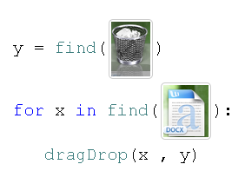


set
y
to
repeat until
not
exist
drag
drop
y

Slide 5
Model Scratch’s syntax and design as closely as possible
Scratch has 450,000 registered users
Hopefully they can all use Sikuli

Slide 6
ToDo
Spatial operators?
Sub region matching?
Event-based programming?
Iterator?
Block programming?
E.g., array.each do |x| ….. end

