Slide 1
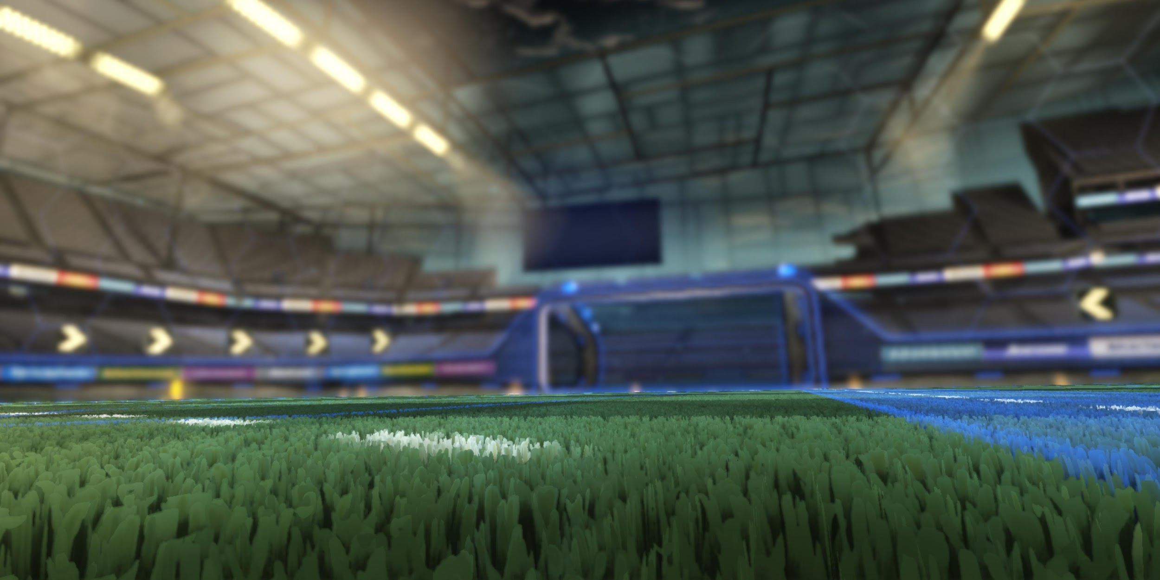
Rocket League AI Coach & Assistant
By scott davis
scottleedavis@gmail.com

Slide 2
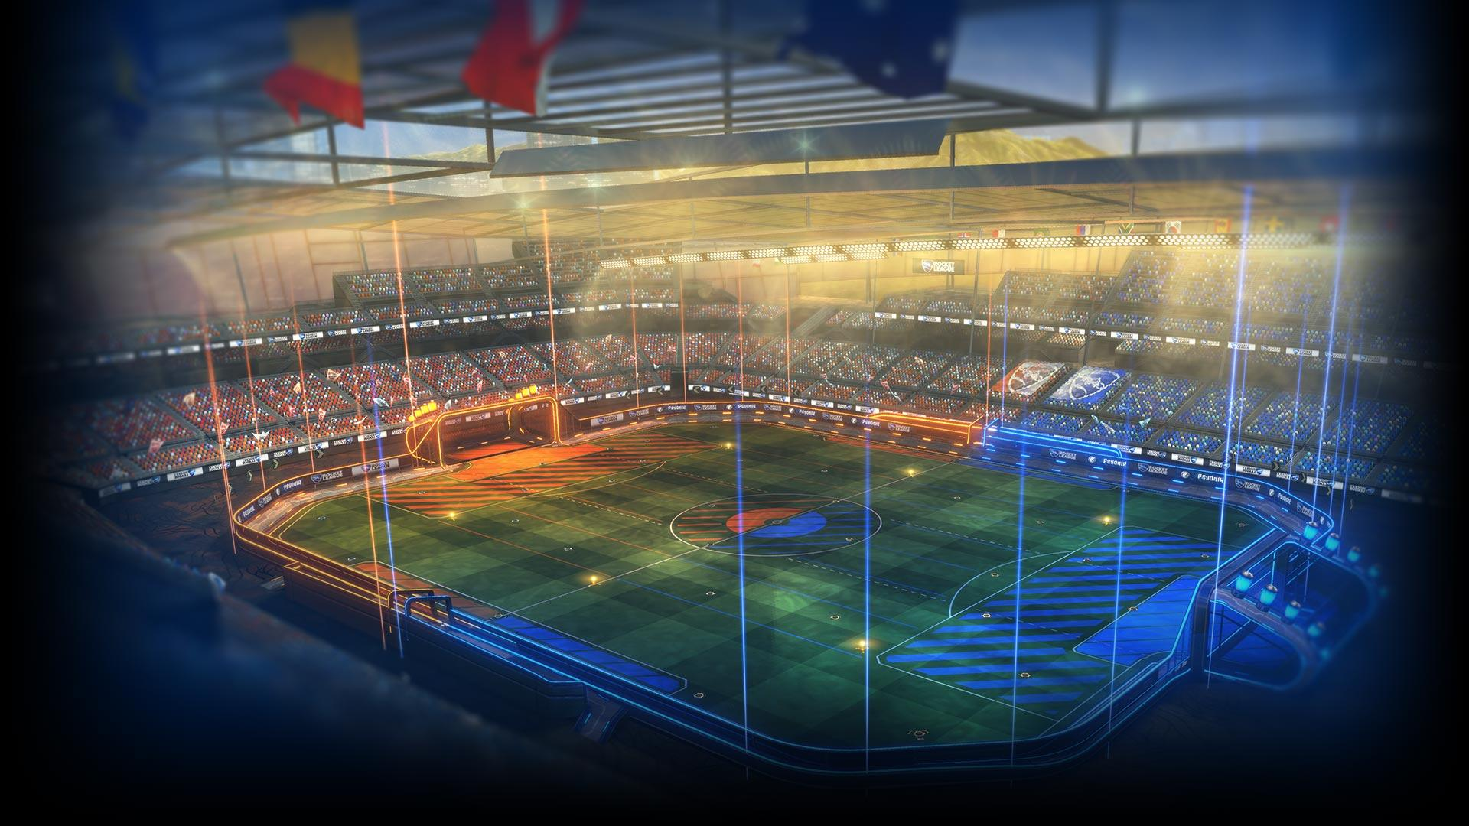
Rocket League
a fast-paced game of ‘rocket cars playing soccer’ that demands quick reflexes, precise control, and strategic team play
1v1, 2v2, 3v3, 4v4 and various other game modes.

Slide 3
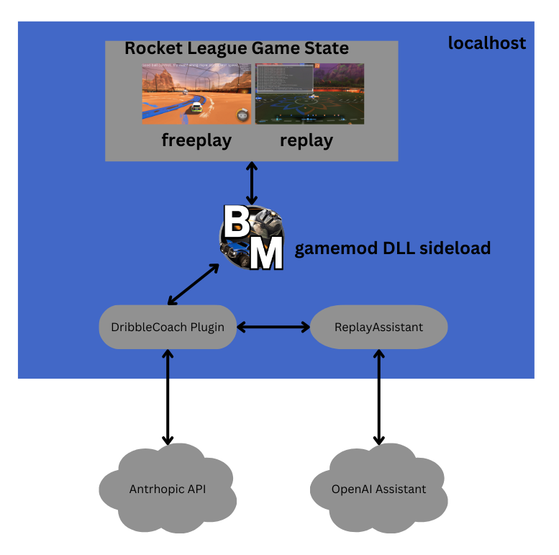
This project explores two primary approaches to integrating game mechanics with AI:
Mechanics Feedback: Anthropic's Claude Sonnet 3.5 model was used to provide feedback on player mechanics during freeplay.
Replay Prompt: OpenAI's Assistant API was used for a replay prompt during replays.

Slide 4
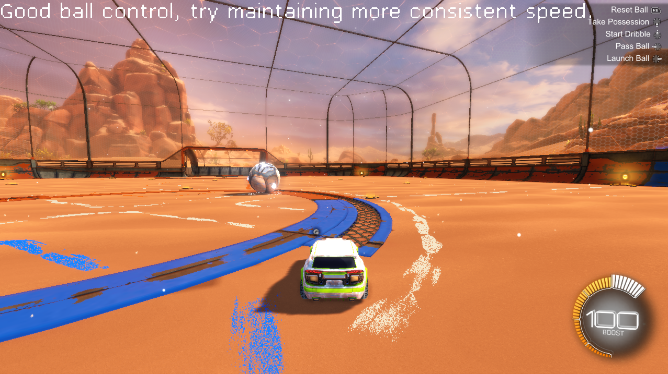
DribbleCoach: Mechanics Feedback
Description:
Identifies and tracks the mechanical skill of ground and air dribbling.
Offers simple suggestions on optimal timing, positioning, and ball control.
ToDo:
Fine-tune air dribbling tracking.
Provide flick feedback.

Slide 5
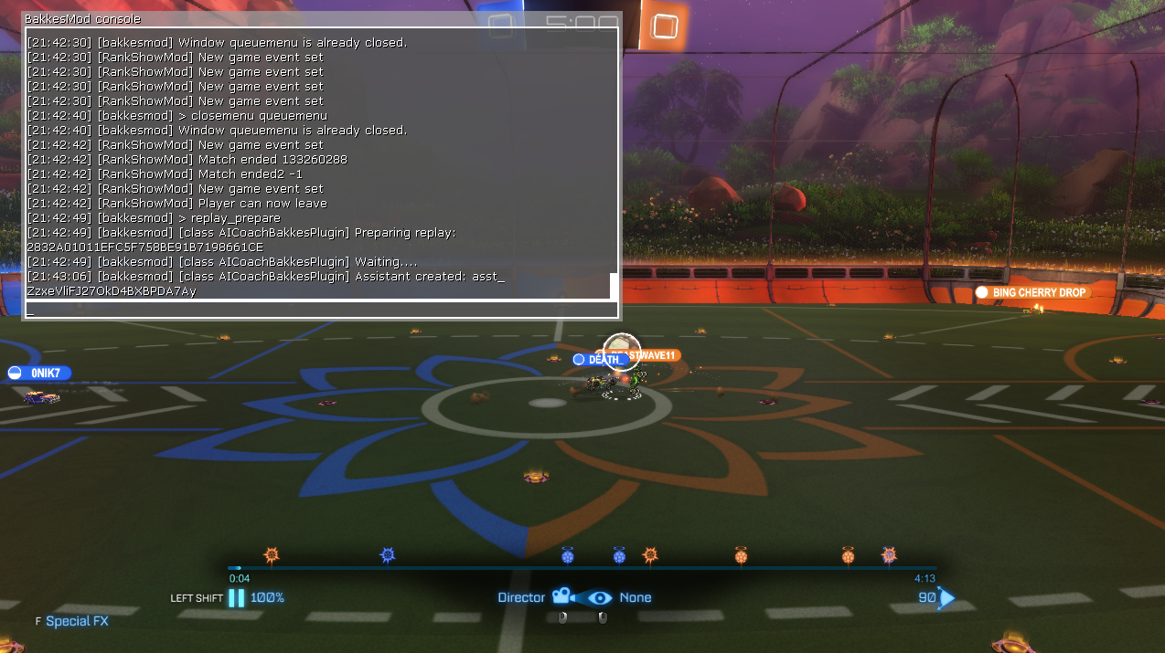
ReplayAssistant: Replay Prompt
Description: Extracts replay data and creates an OpenAI assistant prompt available on the current replay.
available commands
replay_prepare replay_prompt

Slide 6
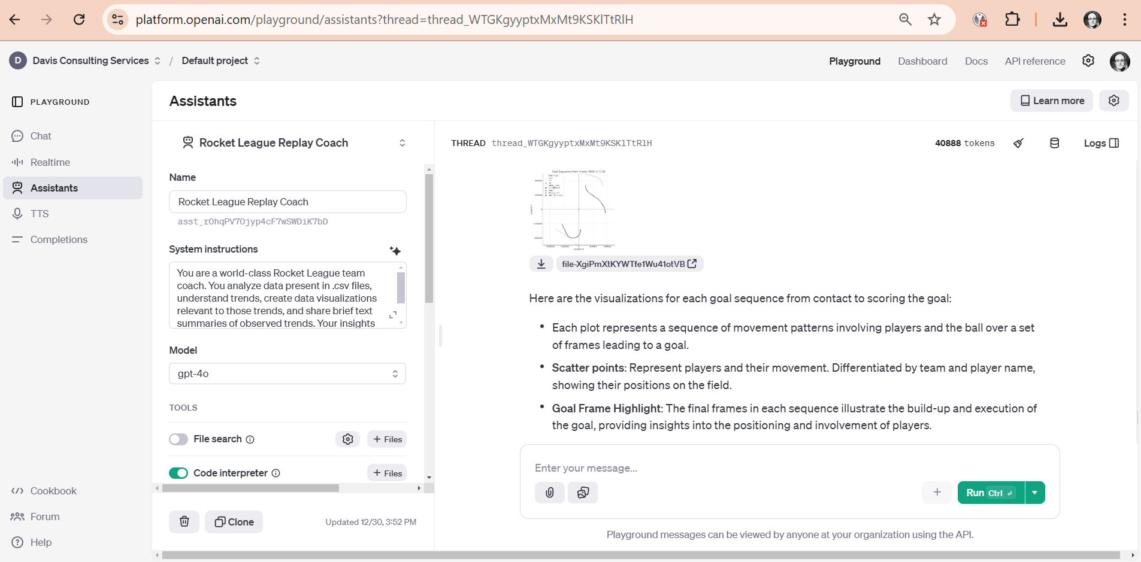
ReplayAssistant: OpenAI Assistants Playground
https://platform.openai.com/playground/assistants

Slide 7
Live Demonstration

Slide 8
Thank you!
Source code for presentation https://github.com/scottleedavis/ai-portland-rocketleague/
Acknowledgements https://lndrlndr.github.io/Contact/ - (Creator of CARL) Indr has been helpful with Positive Feedback and Criticisms of this project.

