Slide 1
Using Machine Learning to Determine Who Should Get a Stimulus Check

Slide 2
Business Problem
Assumption*: citizens within/under defined income threshold will most benefit from stimulus check
Want a way to, in the absence a person’s immediate income, identify those citizens above* → [develop PERSON PROFILE based on weighted characteristics]
Machine learning algorithm can help us weight the most important characteristics associated with a person’s income for use under the following example circumstances:
Don’t have access to recent tax return
Citizen’s immediate job/financial circumstances have changed
Specific industries/communities have been affected by pandemic/natural disaster

Slide 3
Questions
What factors contribute most to telling us who makes above 50k, least at risk without a stimulus check? What types of people need the most support based on?
What is the highest precision we can get to minimize the false positives, where we assume a family can make it without a check but can’t?
How do we minimize the overall cost / impact of the pandemic?
Is there an industry focus we should have? What industries should we focus on?

Slide 4
Consequences of Getting this Wrong
False Negative → If we’re wrong about who makes under 50k
Send check [less resources to allocate to others and support future programs]
Citizens may use that check frivolously, but contribute back to the economy
False Positive → If we’re wrong about who makes over over 50k [we’re wrong]
No check → puts citizens at risk of homeless (cost more), lost job
We have more resources to reallocate, but the time lost doesn’t help you pay your bills
Enact policies to alleviate people who we’ve missed

Slide 5
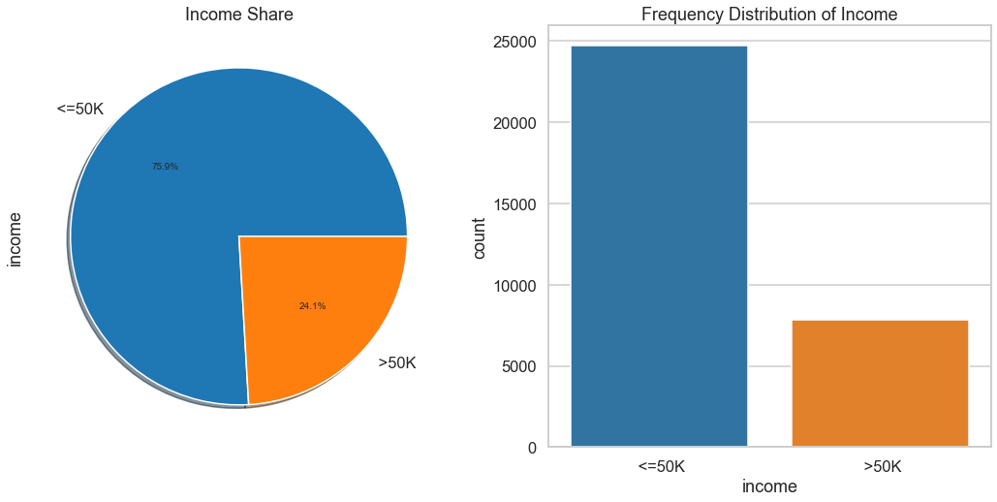
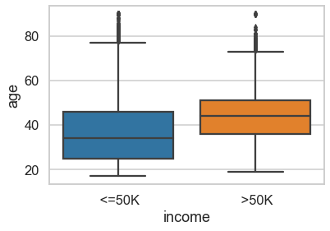
The percentage of the population in dire need of the check coincides with age

Slide 6
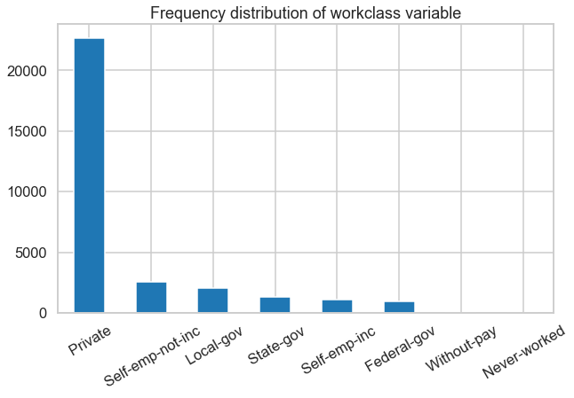
A focus on private industry gives the highest opportunity to address the 75% of the population that makes less than 50K

Slide 7
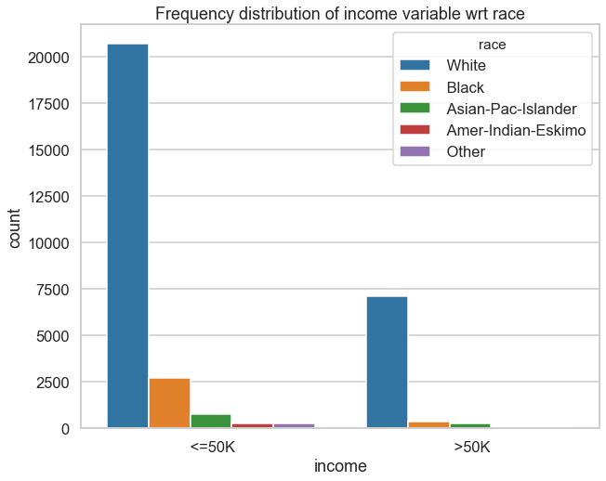
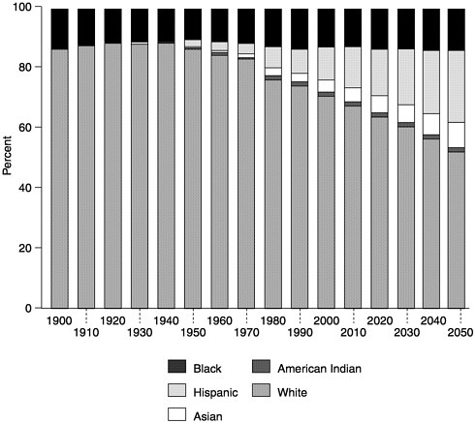
UCI Data Set this is based may not accurately represent our population today, but some of the characteristics it takes into account might still be relevant

Slide 8
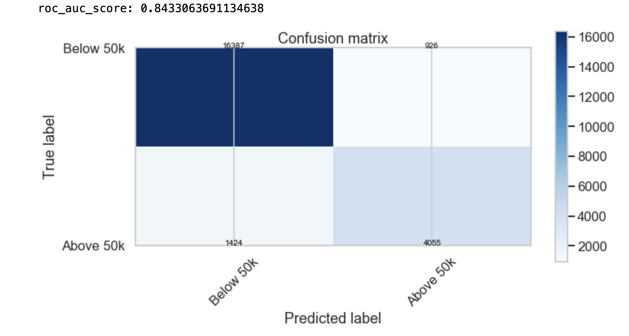
Model Performance
Model | Precision | Accuracy | F1 Score
Random Forest (0.73) | 0.99 | 0.98 | 0.97
KNN (0.85) | 0.92 | 0.90 | 0.92
Decision Tree (0.63) | 1.0 | 1.0 | 1.0
All Models listed can have variable cross-Validation rates x→ evaluator of overfit/underfitting of mode
Can be improved with better feature engineering
Wouldn’t trust score < 0.7
Notes:
Cross val 0.85, we can measure with 92% precision that the person in our model needs to money

Slide 9
Conclusions
Industry or workplace was not a pivotal characteristic in predicting >50k according to model
Top 3 factors are AGE, MARRIED, EDUCATION
Highest precision of our models thus far is 0.9
Minimize overall cost by lowering the initial amount deployed, but iterating over multiple rounds to make sure people are taken care of

Slide 10
Future Recommendations
Feed next rounds of data into model to train, collect information relevant to industries of relevant today → clearer
Bin wage classes differently to assign different stimulus amounts based on wage classes
Alternate analysis can also be done with respect to wage class → different factors might distinguish those in the 150k and up class vs 75k-90k → zipcode could segment the data → identify risk of being able to weather pandemic (vaccine selection)
Though not done in this study might be interesting to explore wage disparities by community / culture → if funds dispense at a state level, could prioritize support based on tiered approach [zipcode]

Slide 11
Thank you, what outstanding Questions do you have?

Slide 12
Takeaways: …confidence in people who receive it not needing it will feed the economy engine, in addition to those needing the support not becoming homeless which is inherently more expensive than the initial stimulus hit, and longer to recover from
Not going to use race

