Slide 1
The first 50 nodes: The DevOps-ish journey at a Windows Enterprise

Slide 2

Change advice from an 6 year old
“Get messy and make mistakes” – Lucca Nasello

Slide 3
About us
99.5% VMware, 99.9% Microsoft Server (3000+ Servers)
Largely 3 tier COTS business applications

Slide 4
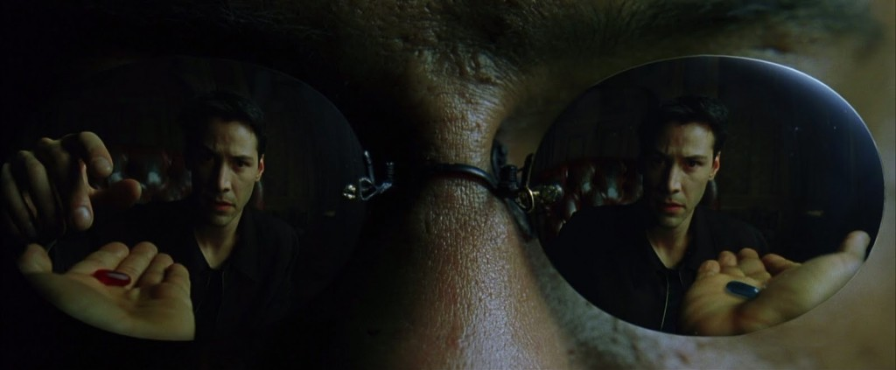
Enter Gene Kim
Phoenix Project !
*Gene Kim: Why You Need DevOps Now: A Fourteen Year Study...

Slide 5
Top 5 Predictors of IT Performance*
Peer-reviewed change approval process
Version control for all production artifacts
Proactive monitoring
High-trust organization culture
Win-win relationship between dev and ops
*Puppet Labs State of the DevOps

Slide 6

Click, Click, Next jobs are obsolete*
*Jeffrey Snover – Arrested DevOps Episode 30 - DevOps in a Microsoft World

Slide 7
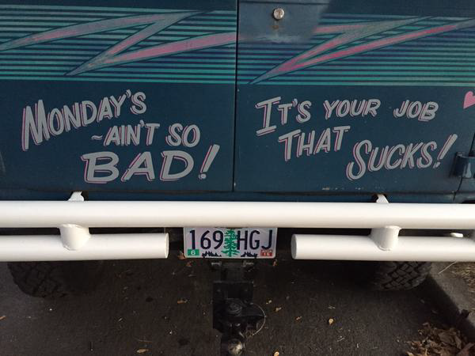
Click, Click, Next jobs are obsolete*
+
*Jeffrey Snover – Arrested DevOps Episode 30 - DevOps in a Microsoft World

Slide 8

Click, Click, Next jobs are obsolete*
+
=
*Jeffrey Snover – Arrested DevOps Episode 30 - DevOps in a Microsoft World

Slide 9

Yeah but…
“We are not like Flickr | Amazon | Netflix | Etsy”
“Why would we even want to deploy _____ servers in a day?”
“Wait, what? They have a SSH/RDP tip jar?”
“We don’t need______I can already do all that with Windows…”
“We don’t have time to make things better… “

Slide 10
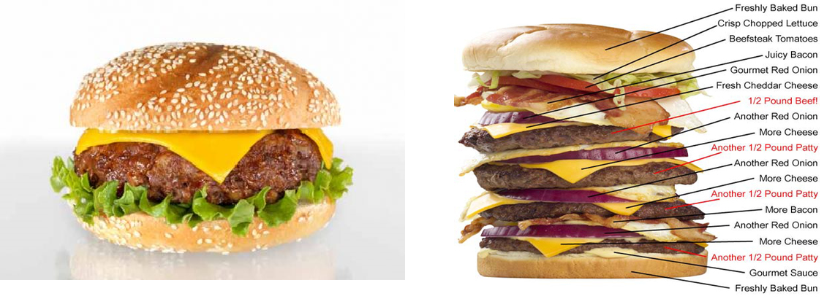
Minimum Viable Process (MVP) *
Tweak practices just before the team becomes comfortable
*Lean Enterprise Humble, Molesky, O’Reilly

Slide 11



DevOps may not be our destination: Becoming less fragile is central to our journey

Slide 12

Early Adopters

Slide 13

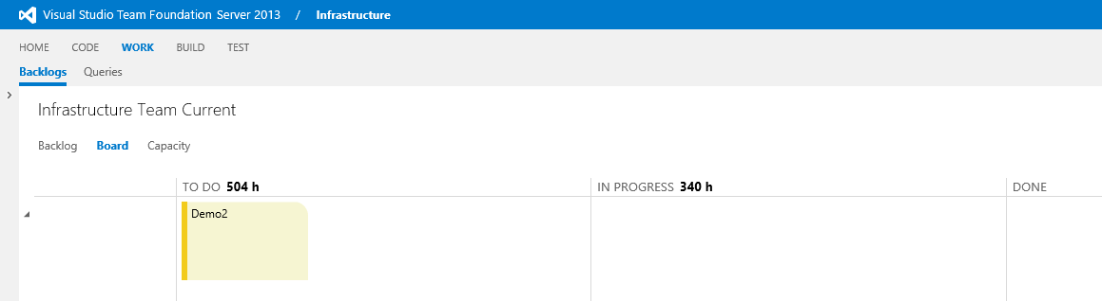
Making the work visible – Kanban*
How have you made it as easy as possible to participate?
* Dominica Degrandis - Kanban Flow meets DevOps

Slide 14
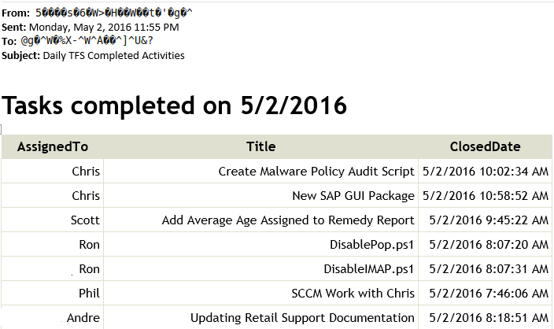
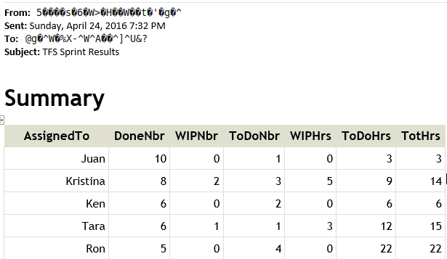
Metrics to reinforce flow

Slide 15
Version Control and Scripting and Kanban…Oh My!

Slide 16
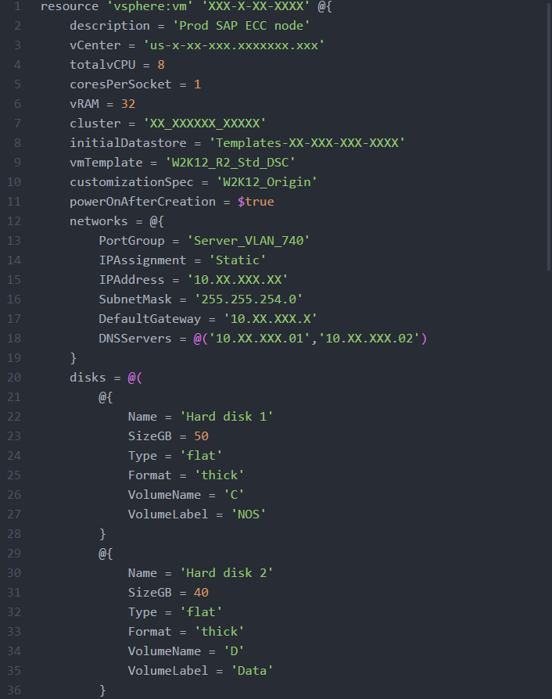
Server script - simple

Slide 17
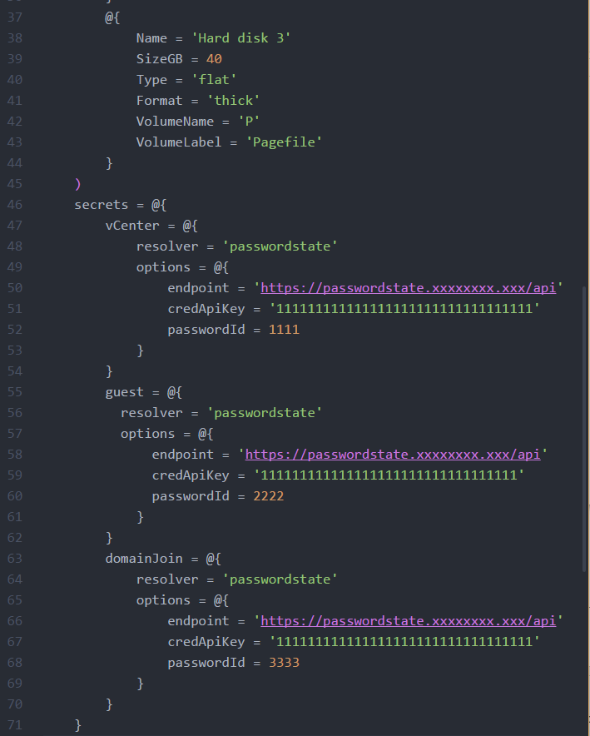
A little harder now…

Slide 18
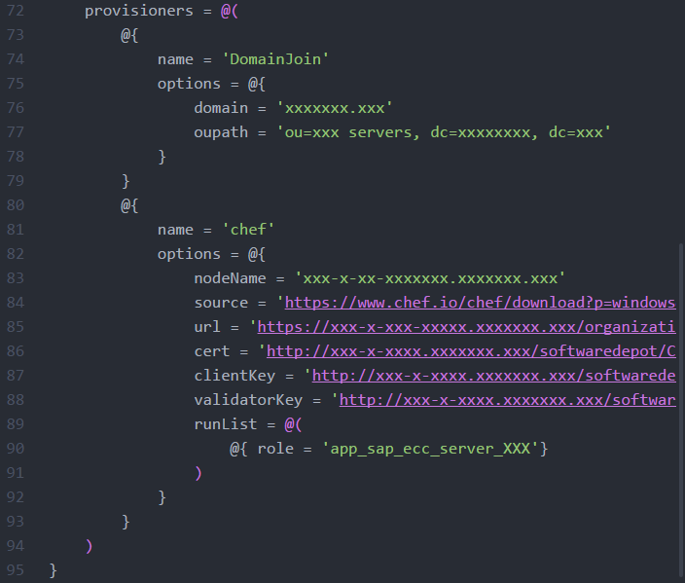
Bootstrapping CHEF on each new server

Slide 19
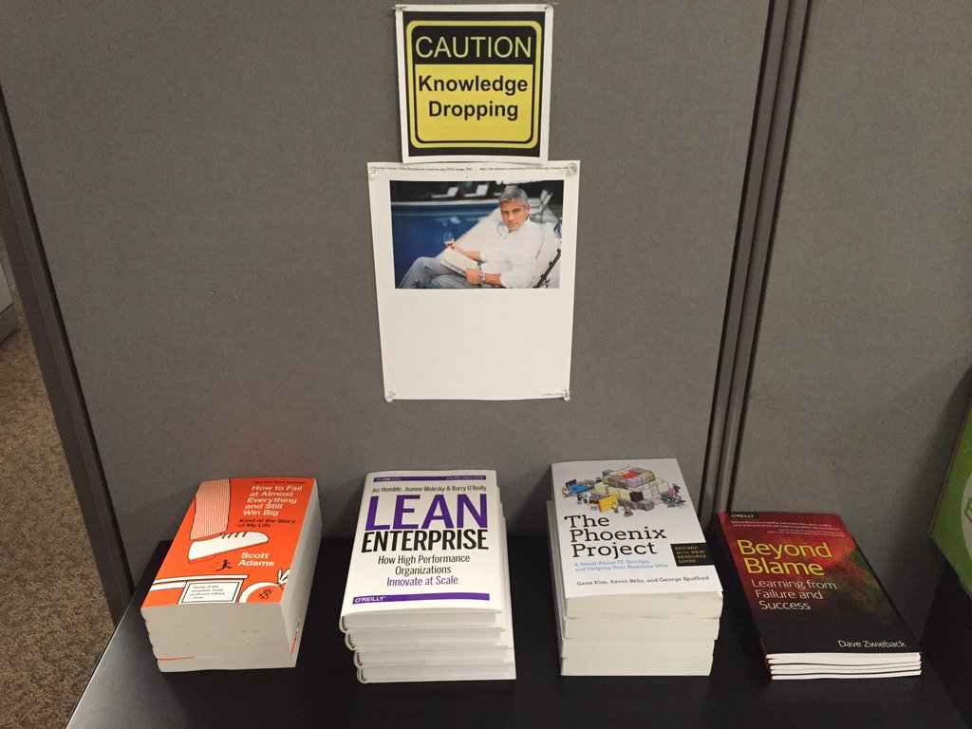
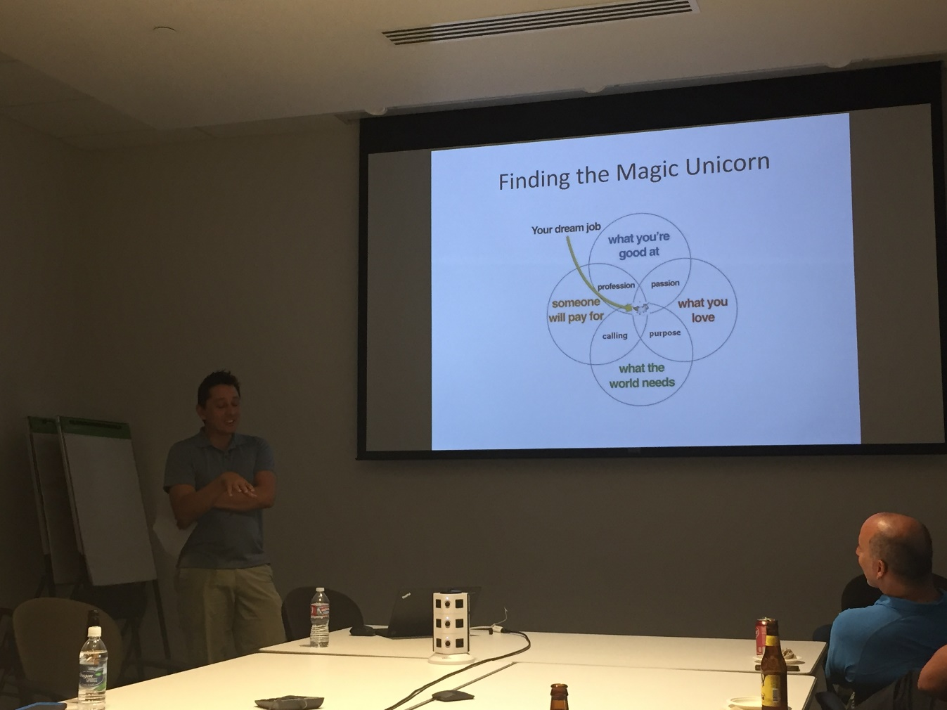
Building curious people

Slide 20
Thank You
Minimum Viable Process (apply PDCA!)
Find the win-win: good for the enterprise & good for team
Make it easy for new adopters to join
Scott Nasello @scottnasello | snasello@columbia.com

