Slide 1
“Regulation” Does Not Exist: Disassembling the Wharton Index
Scott Markley Research Director National Zoning Atlas 30 April 2026

Slide 2
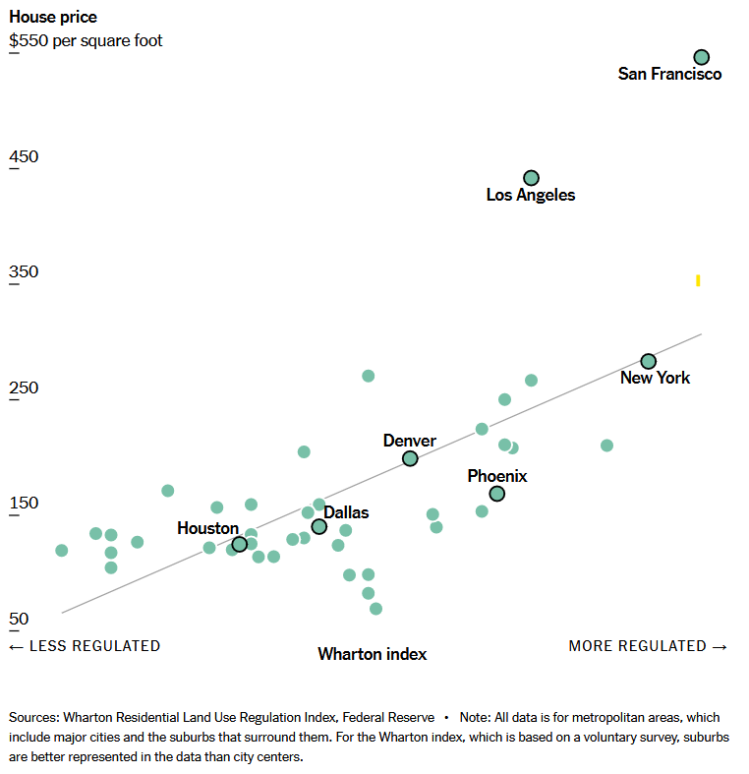
Higher Level of Land Use Regulation = Higher Housing Prices
Ascendant Theory of Housing Unaffordability:
New York Times (2024)

Slide 3
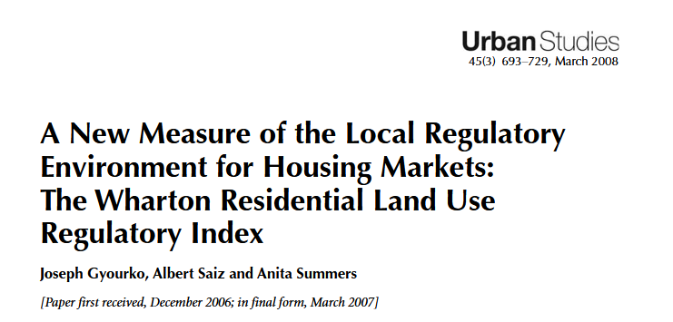
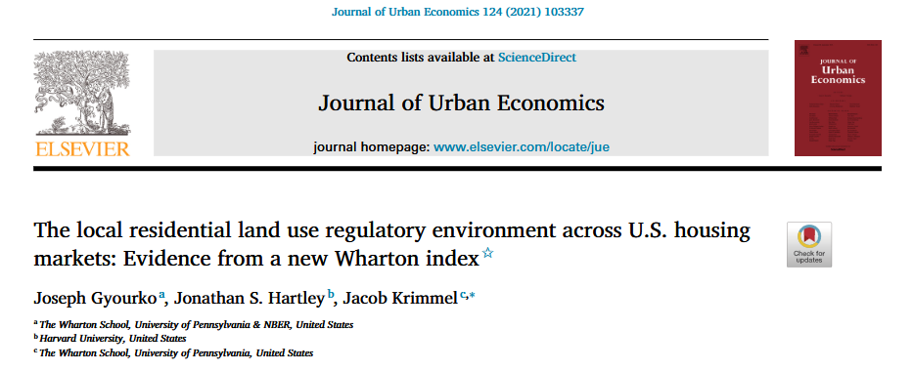
Undifferentiated Regulation
Wharton Residential Land Use Regulation Index (WRLURI)
Survey of >2,500 local governments on regulatory restrictiveness
Number ranging from -2.6 to 4.9
Cited ~1,500 times
Gyourko et al., 2008
Gyourko et al., 2021

Slide 4
Objectives
Disassemble the Wharton Index to understand its components.
Compare the Wharton Index against actual land use regulations.

Slide 5
Disassembling the Wharton Index

Slide 6
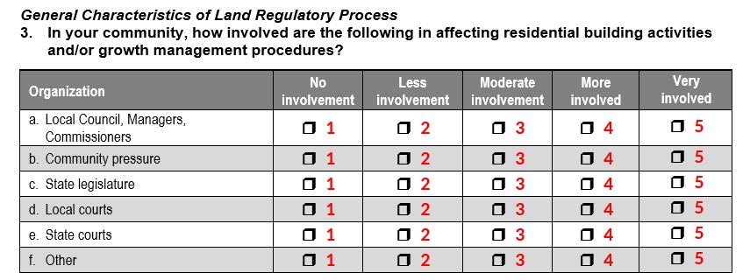







Subindices 1-3: Perceived Political Pressure + Involvement
1
1
2
3
3
1

Slide 7
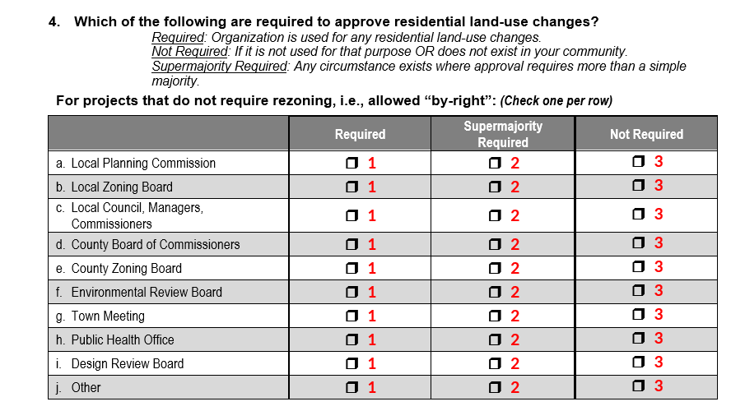






















Subindices 4-6: Governing Bodies Believed to be Involved in “By Right” and Not By Right Zoning Changes
/
4,5
4,5
4,5
4,5
4,5
4,5
6
4,5
4,5
4,5

Slide 8
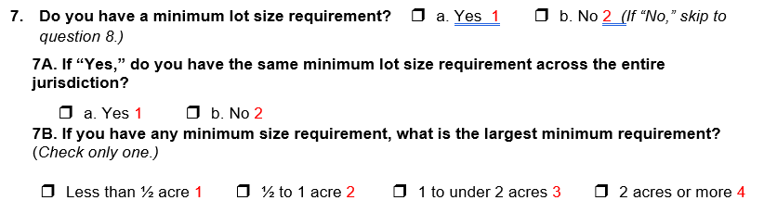
Subindex 7: Existence of a Minimum Lot Size of Some Size Somewhere

Slide 9
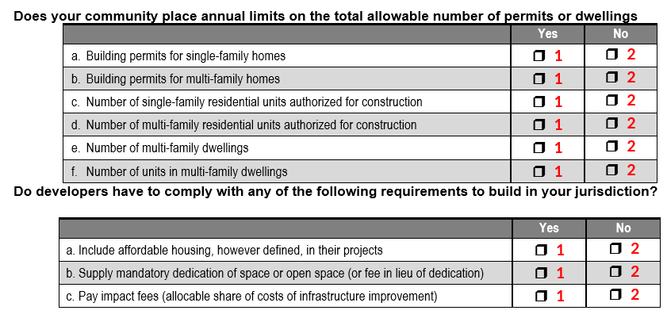

Subindex 8 – 11: Building Limits, Affordable Housing, Open Space, Impact Fees
8
8
8
8
8
8
9
10
11
Notes:
Ignore 8
Problem with 9: it includes any affordable housing yes/no doesn’t make sense. Nowhere requires all new units to have affordable housing, so again, there’s an issue with the extent of the rule and what the affordability provisions are
Problem with 10: Same issue
Problem with 11: Same issue: no indication of how if certain projects require impact fees or every project. And Impact fees are low in places that don’t have a lot of development and higher in hot markets so, with all this, there is

Slide 10
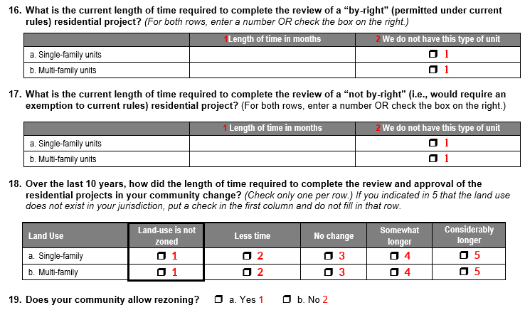
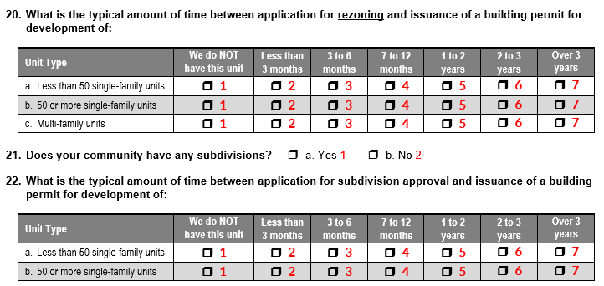
Subindex 12: Length of Time It Takes for Various Approvals
Notes:
Problem: I think this is interesting but not exactly the same thing as regulatory restrictiveness

Slide 11
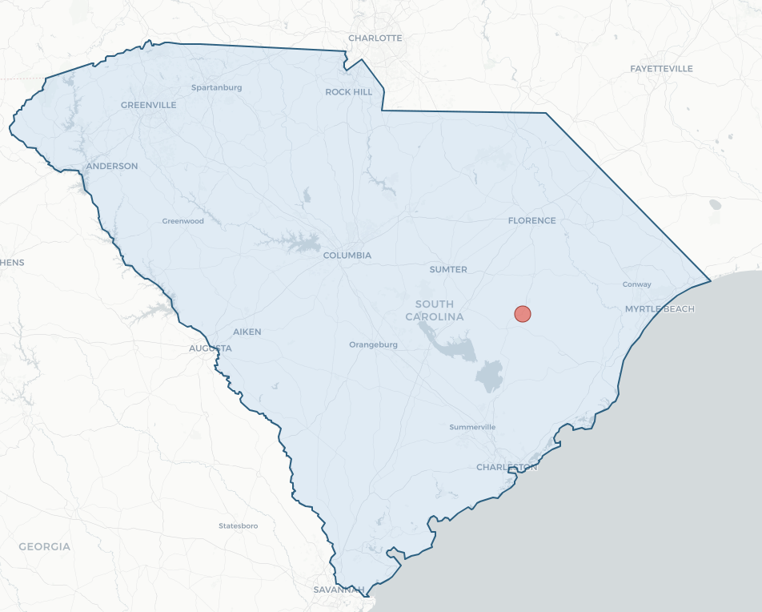

Kingstree, SC
Population: 3,055
Source: Municipal Association of South Carolina

Slide 12
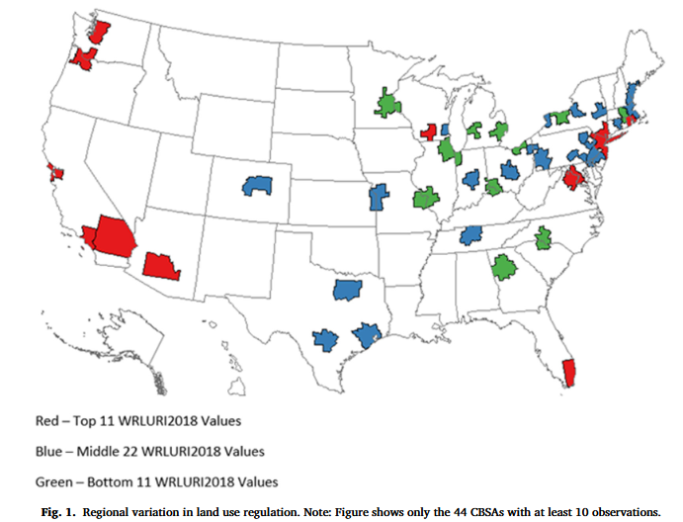
The Result
Gyourko et al., 2021
New York Times (2024)

Slide 13
How does the Wharton Index compare to actual land use regulations?

Slide 14
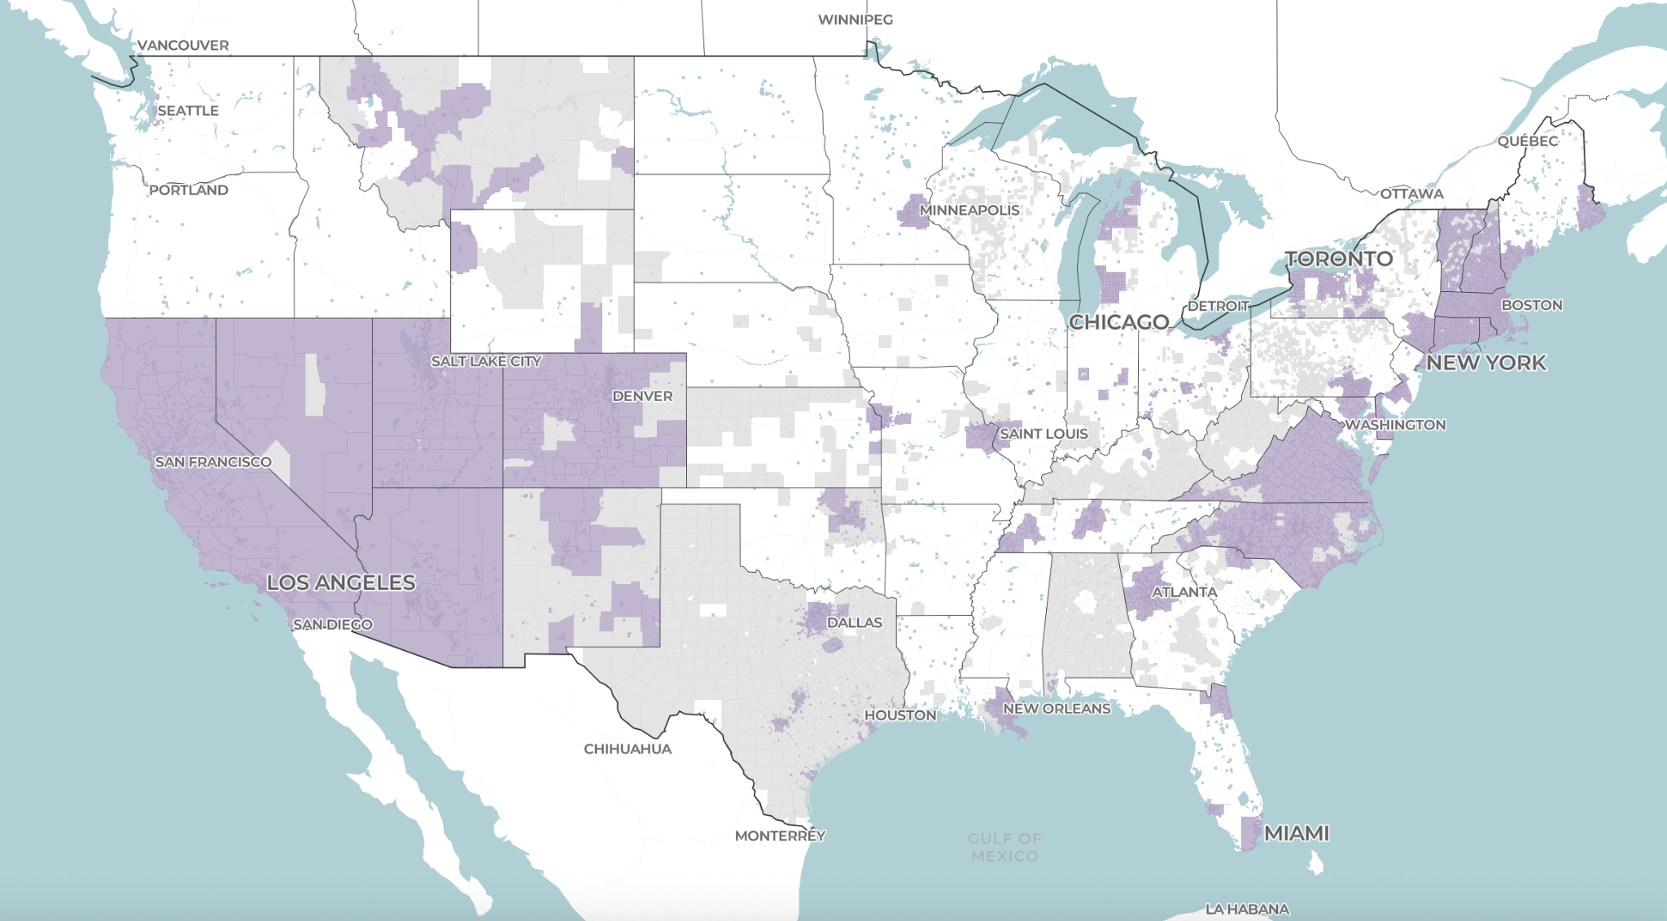
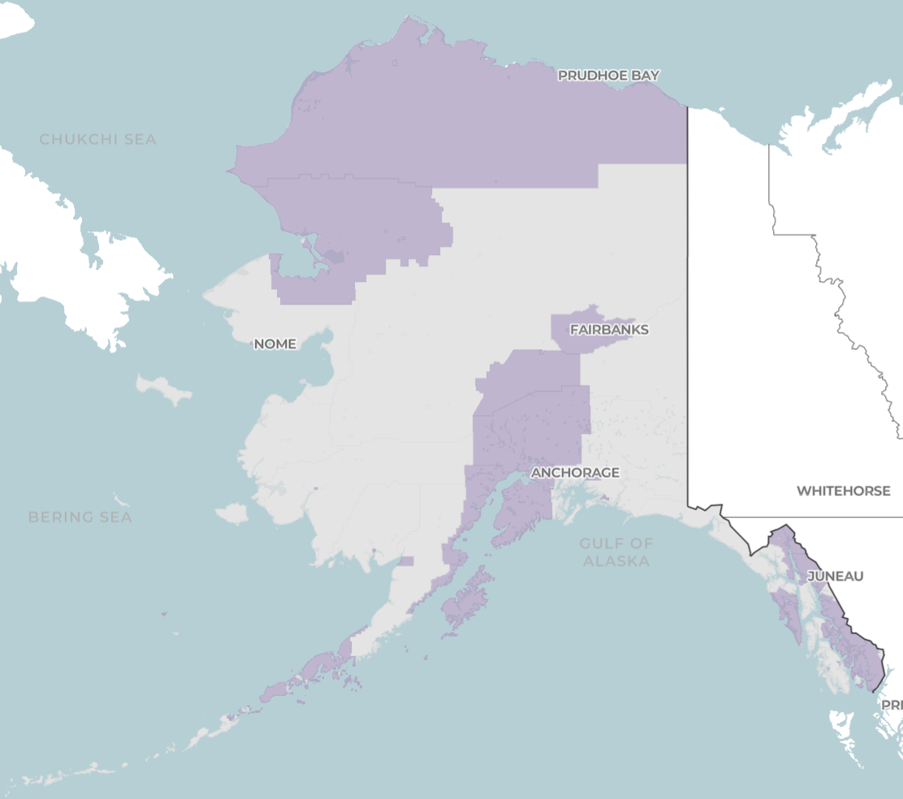


zoningatlas.org/atlas
VT
NH
MA
NV
UT
CO
RI
CT
CA
VA
DC
DE
NC
AZ
NM
AK
HI

Slide 15
Analysis
Compare WRLURI against three well-known metrics of zoning restrictiveness:
% of residential land prohibiting apartments
% of single-family land where minimum lot sizes exceed 1 acre
% of single-family land where accessory dwelling units (ADUs) are prohibited
1,033 (out of 2,473) jurisdictions in both WRLURI + NZA

Slide 16
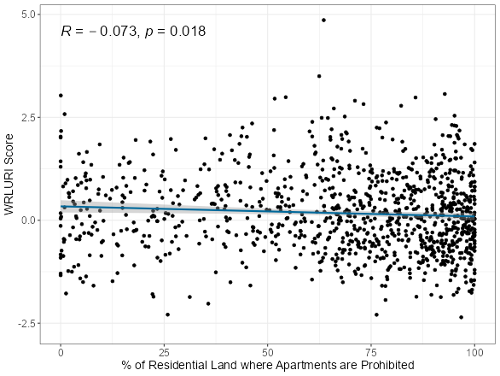
WLRURI vs. % of Residential Land where Apartments are Prohibited

Slide 17
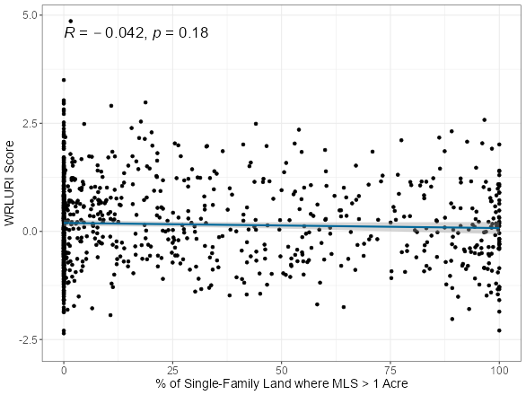
WRLURI vs. % of Single-Family Land where Minimum Lot Sizes Exceed 1 Acre

Slide 18
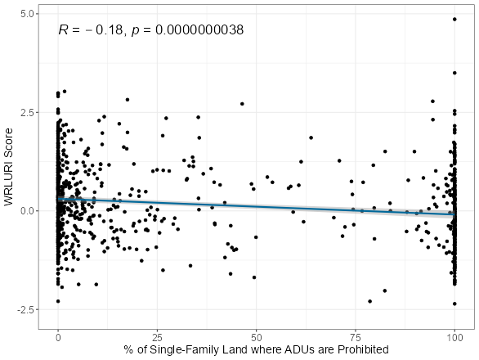
WRLURI vs. % of Single-Family Land where ADUs are Prohibited

Slide 19
Concluding Thoughts

Slide 20
Concluding Thoughts
What does the wide acceptance of the Wharton Index tell us about the state of urban theory?
My contention: tearing down restrictive concepts like “undifferentiated regulation” can be important part of building up urban theory

Slide 21
Contact
Scott Markley
scott@landuselabs.com

