Slide 1
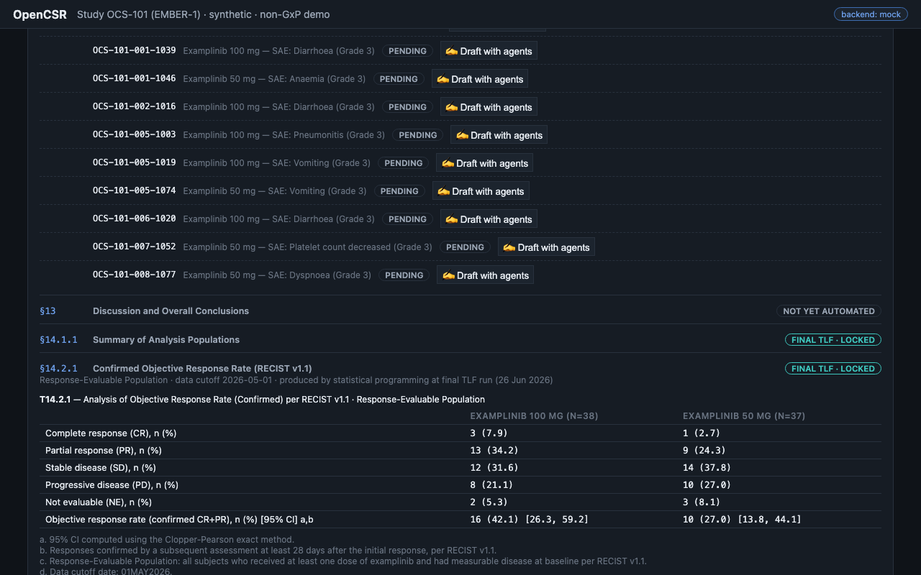
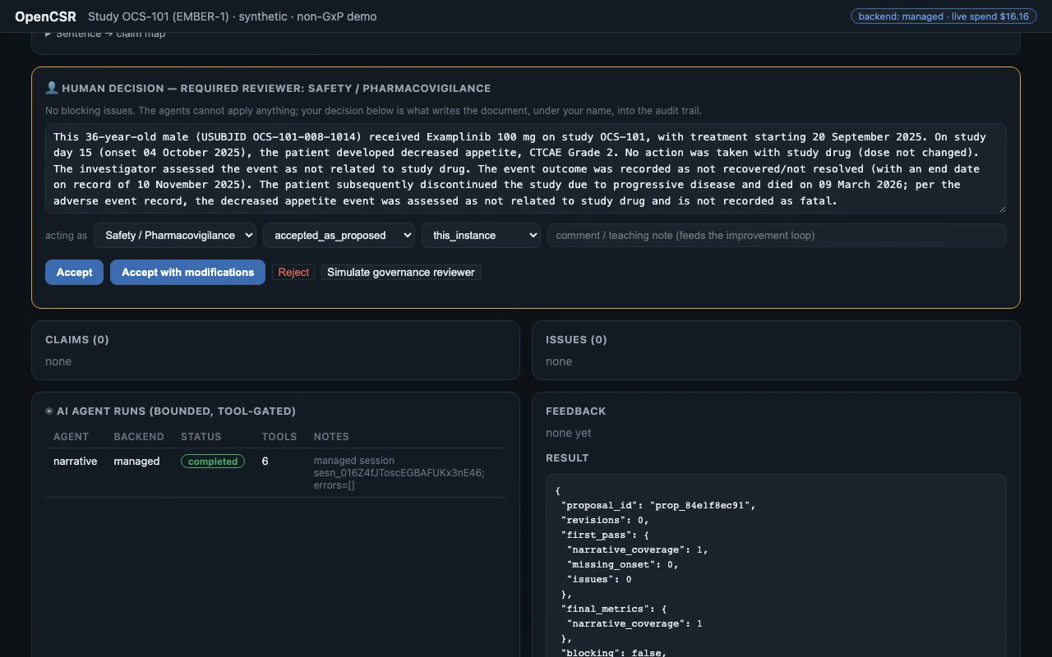
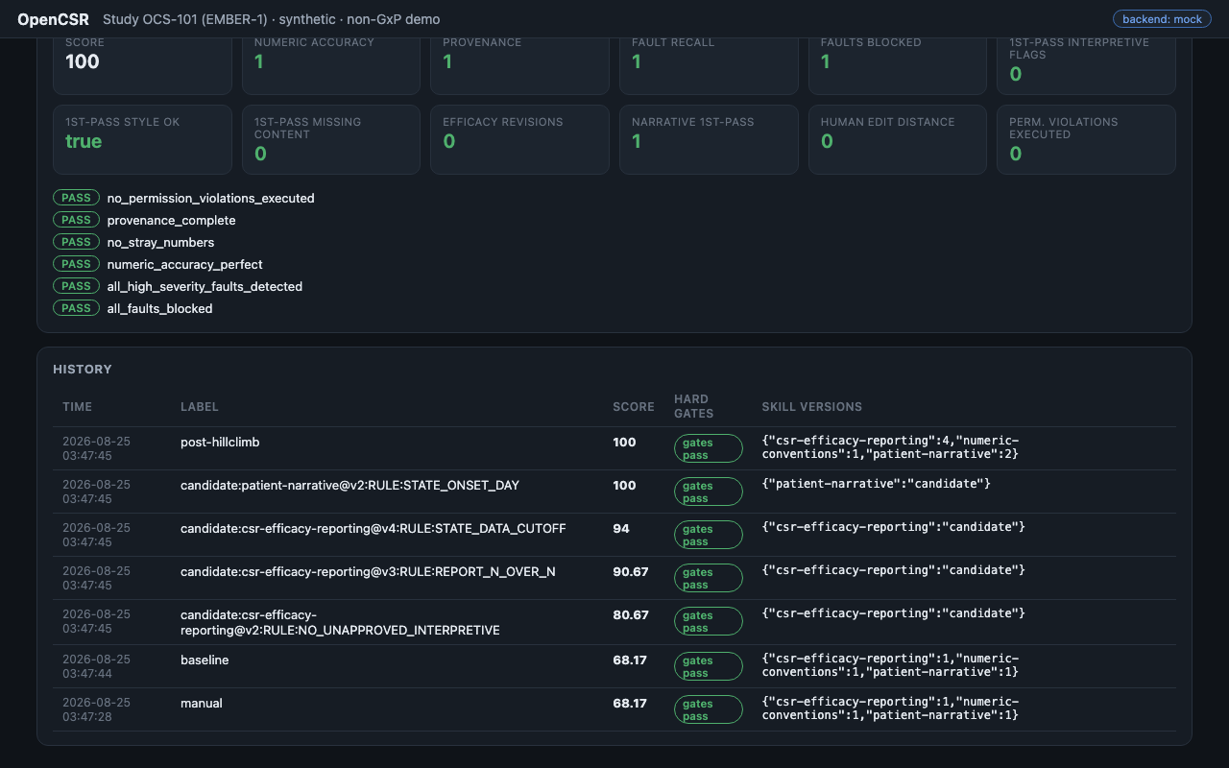
How we test the framework
OpenCSR · synthetic study OCS-101 · non-GxP demo
input data → generated clinical content → validated against a reference medical-writing corpus
1
INPUT · locked study data
2
GENERATE · drafted by agents, signed by a human
3
VALIDATE · against a reference corpus
→
→
TLFs with exact cells and footnotes, ADaM datasets (ADSL · ADRS · ADAE), protocol & SAP documents — frozen and hash-stamped per task. Swap in your own study under data/.
A patient narrative (ICH E3 §12.3.2), drafted by live agents from that subject's records only — then reviewed and approved by Safety/PV, role-stamped into the audit trail.
Element-by-element ICH E3 checks, exact recomputation from the datasets, and scoring vs the gold reference corpus (CSRBench) — hard pass/fail gates, not vibes.
Hard gates on every run: provenance 1.0 · numeric accuracy 1.0 · ICH element coverage · 0 capability escapes. The same corpus runs free, offline, in CI — and gates every skill, prompt, and model change.
github.com/scottogden10/opencsr · scottogden10.github.io/opencsr/csrbench.html

