Slide 1
ACT &SAT
How to Increase Participation

Slide 2
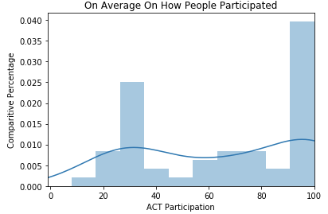
What does the national ACT participation look like?

Slide 3
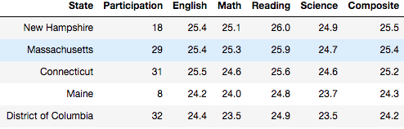
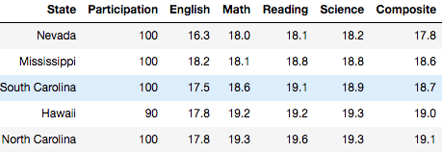
How does that affect average test scores?

Slide 4
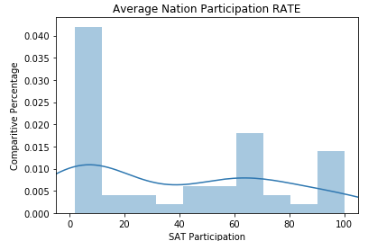
What does the national SAT participation look like?

Slide 5
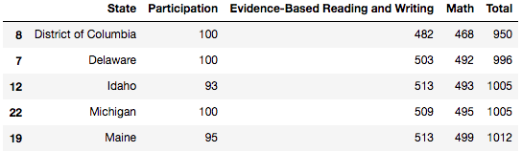
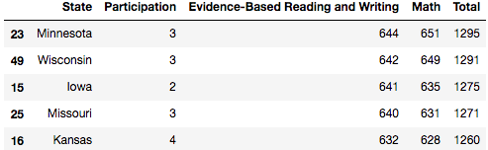
Again, how does that affect average test scores?

Slide 6
Why would these results occur?
For those states with low participation and high test results it is likely due to the following:
Selection/Population Bias
Those states having low participation but high scores likely include a more competitive or wealthier students who wanted to go out of their way to take this test.

Slide 7
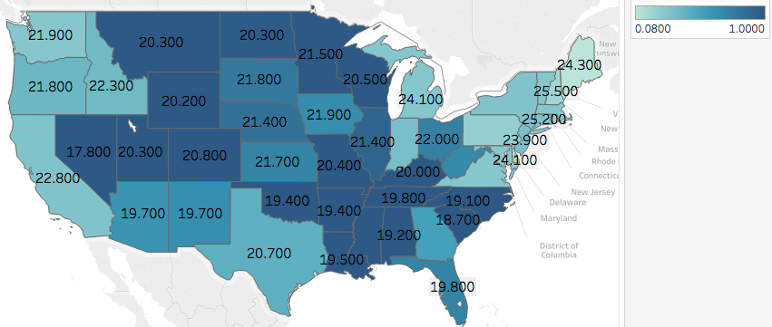
Where to market for ACT? The states with high scores but lower participation rates.
The dark blue states have a higher participation population and as the color shade lightens so does the participation. One can also see the lighter shades having a higher composite score

Slide 8
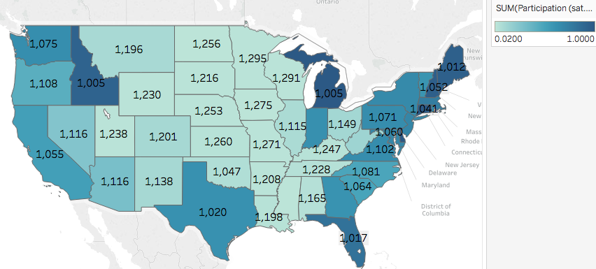
Where to market for SAT? States with high scores but lower participation!
The dark blue states have a higher participation population and as the color shade lightens so does the participation. One can also see the lighter shades having a higher total SAT score.

Slide 9
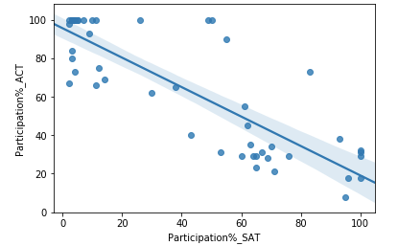
A Possible Issue of Increasing Participation of One Test
Trying to increase one test over the other could end up having a detriment on the other. There appears to be a negative correlation between the increase in participation of one test and the decrease in participation of the other. So you would want to grab customer loyalty quickly.

Slide 10
To Conclude
ACT/SAT comapnies would want to target states where participation is currently low and market the idea of how students in those areas are out defeating their competitors
Change the business strategy to win market share and gain customer loyalty as there is a negative relationship between the popularity of one over the other
The statistics were based off of a sample size which may note have been independent and should be taken cautiously depending on ones level of risk.

