Slide 1
JS Functional Testing
An overview of NodeJS, PhantomJS, CasperJS and PhantomCSS

Slide 2
Outline
Case Study – HTML5 App
NodeJS
PhantomJS
CasperJS
PhantomCSS
Demo

Slide 3
Case Study
Pure JavaScript Application
HTML5 / Canvas
JavaScript MVC
Drawing Application, needed to know more than CSS

Slide 4
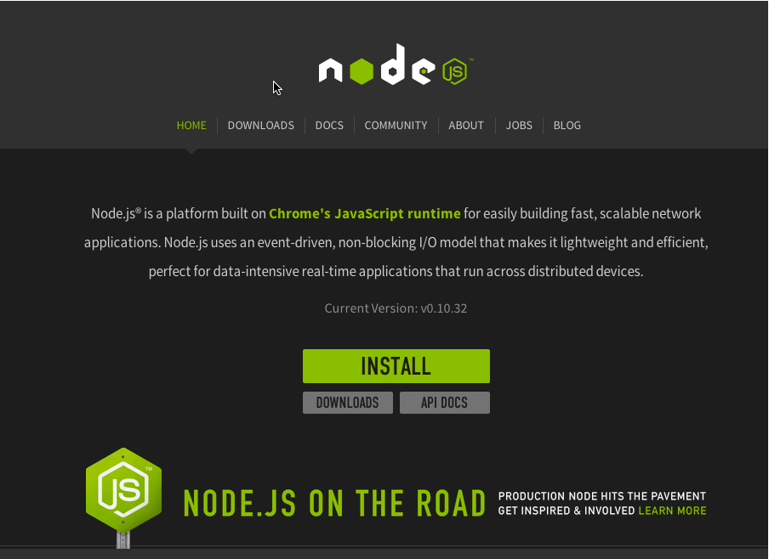
NodeJS & NPM

Slide 5
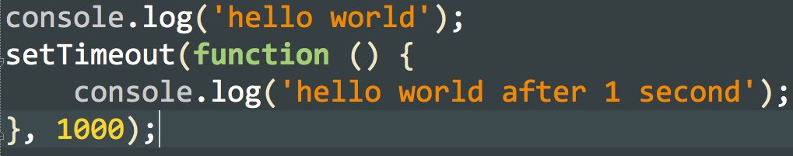
NodeJS - Sample Code

Slide 6
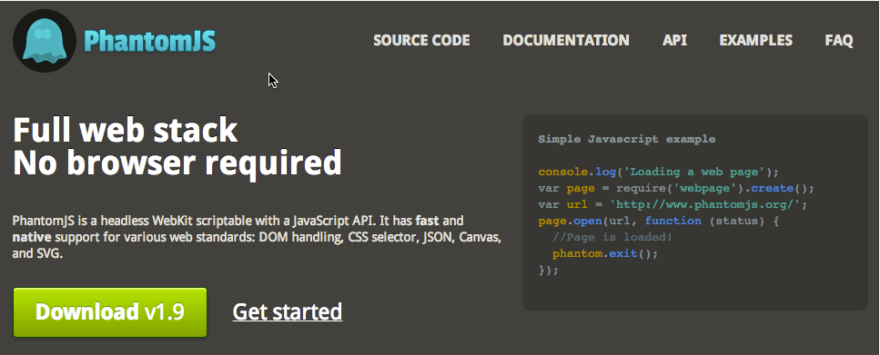
PhantomJS

Slide 7
PhantomJS
Headless Web-Kit
Browser that runs via command line and executes JavaScript
Can be driven from Selenium WebDriver
Stand-Alone Binary (No NodeJS Required)

Slide 8
PhantomJS Installation
http://phantomjs.org/download.html
Run Installer
Add to PATH

Slide 9
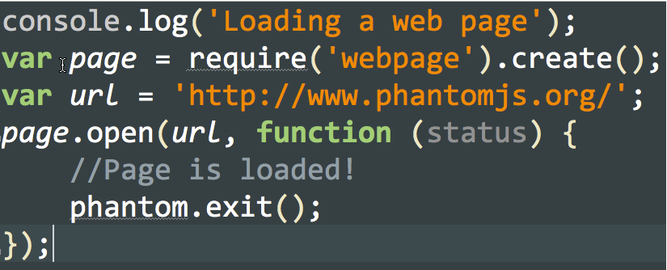
PhantomJS - QuickStart

Slide 10
JavaScript Notes
JS Syntax & Asynchronous Code
Phantom Object – Child of window
Web Page Module – Core Object you will work with when scripting.

Slide 11
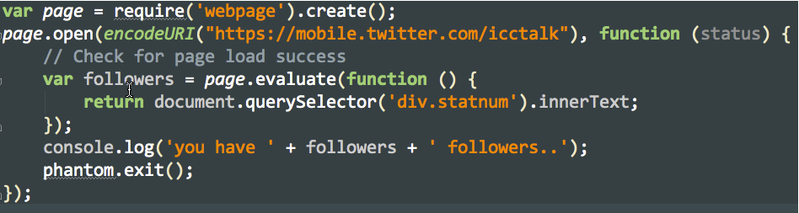
PhantomJS - Scraping

Slide 12
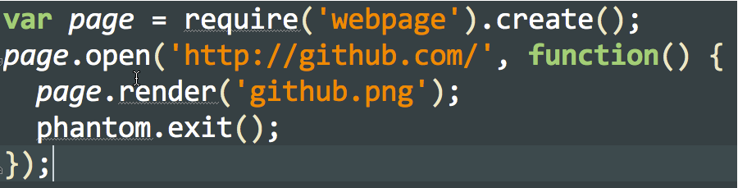
PhantomJS – Screen Capture

Slide 13
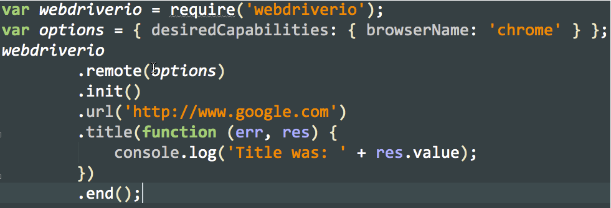
Drive PhantomJS with Selenium & WebDriver

Slide 14
Some Difficulties With PhantomJS
Multiple Page Sequences – Callbacks within Callbacks (AngularJS/Ajax)
WaitFor – Waiting for certain things to happen before going to “Next Thing”
Async Loading JS – Very Complicated Scripts

Slide 15
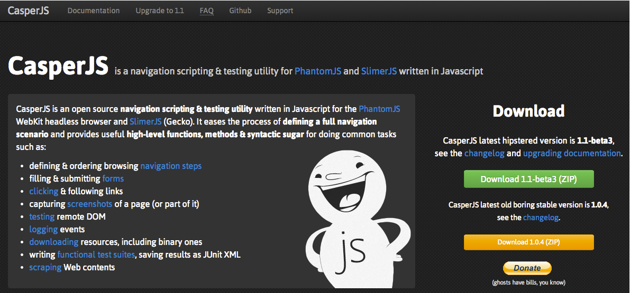
Casper JS

Slide 16
CasperJS - Installation
Install NodeJS
Install PhantomJS and Python 2.6
npm install -g casperjs

Slide 17
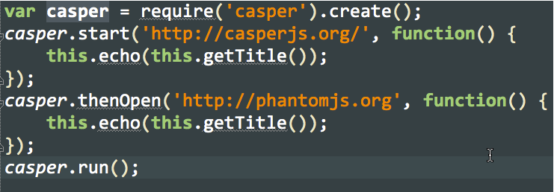
CasperJS - Quickstart

Slide 18
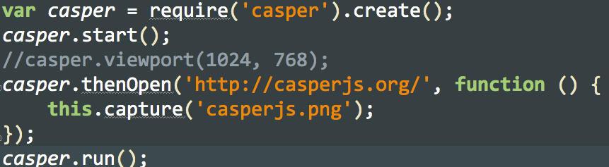
CasperJS - Capture

Slide 19
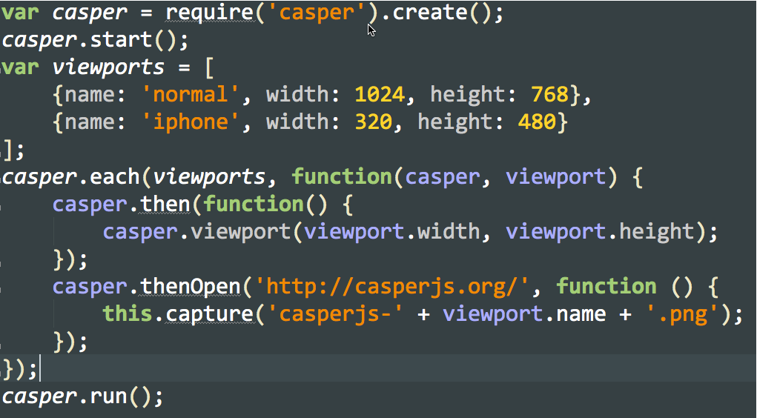
CasperJS Example 2

Slide 20
PhantomCSS - Instllation
Install Node
Install PhantomJS
Install CasperJS
npm install phantomcss

Slide 21
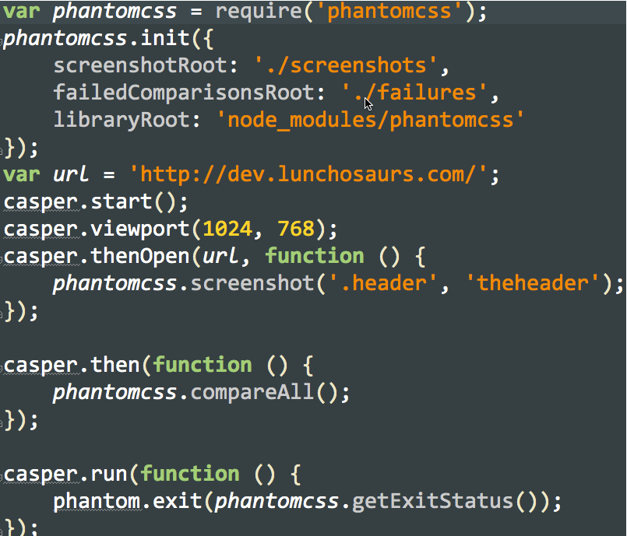
Phantom CSS - Quickstart

Slide 22
Demo & Code

Slide 23
Thanks!
spreston@icct.com
@scottpreston

