Slide 1
Corona/Lua Tutorial
By Scott Harrison

Slide 2
What is Lua?
Lua is a programing language
It works on most platforms that support c (Window, MacOS, android, iOS, etc)
It is fast and very light weight
Easy to learn
It is not class based
More info at lua.org/about.html

Slide 3

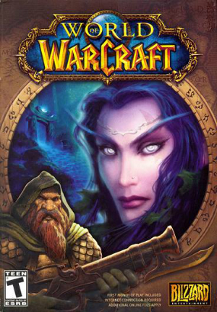
Lua is used in:

Slide 4

What is Corona?
It is a App/2d Game Engine
Uses lua as programing language
It is free to use
The Corona Simulator allows you to see you changes in realtime
Powered by Open Gl (graphics)
Apps that use Corona

Slide 5
Balloon Pop
Demo

Slide 6
Challenge
High Score system
Leaderboards
Make the speed of balloons increase
Different types and color or balloons

