Slide 1

You’re Doing Agile Right But agile wrong
scottsauber
Slides at scottsauber.com

Slide 2
Audience
TODO

Slide 3
Agenda
TODO

Slide 4
Goals
TODO

Slide 5





Who am I?
Director of Engineering at Lean TECHniques
Microsoft MVP
Dometrain Author
Redgate Community Ambassador
Co-organizer of Iowa .NET User Group

Slide 6
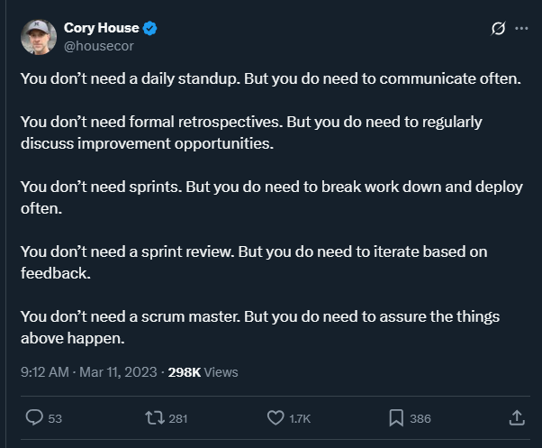
Account Organization

Slide 7
Ideas
Account Organization
Show the Agile Manifesto
You need to be Fluid, Nimble, Lean – Agile is dead
We aren’t measuring what matters. On Time. Within Budget. Within Scope. We aren’t measuring value
Apple iPhone
SAFe image – where’s the customer?

Slide 8

Takeaways
TODO
scottsauber

Slide 9
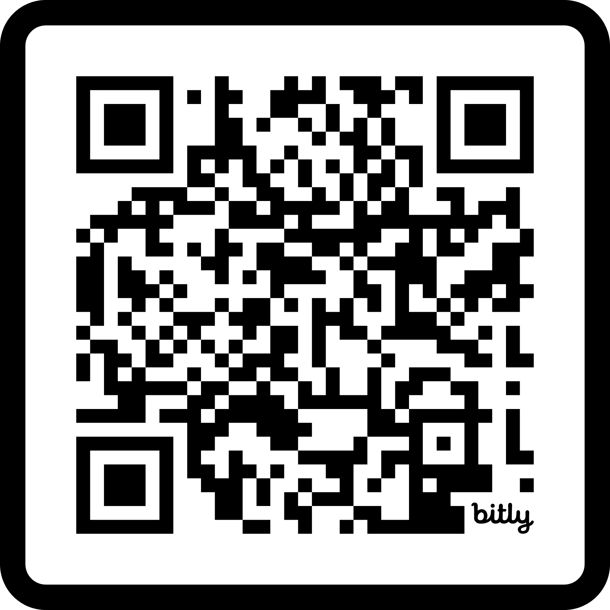
Questions? ssauber@leantechniques.com @scottsauber.com on Bluesky @scottsauber on Twitter
Schedule time with me to ask questions:
Slides at scottsauber.com
scottsauber

Slide 10
Thanks!
Slides at scottsauber.com
scottsauber

